Slide 1
16.317: Microprocessor System Design I
Instructor: Dr. Michael Geiger
Spring 2012
Lecture 27: Exam 2 Review
Notes:
Chapter 2

Slide 2
Lecture outline
Announcements/reminders
  Lab 3 report due 4/11
  HW 4, Lab 4 to be posted ASAP
Today: Exam 2 Review
  Exam stats
  Regrades—as with Exam 1, can submit requests within 1 week (4/13)
  Figuring out where you stand
  Exam solution
Microprocessors I: Exam 2 Review

Slide 3
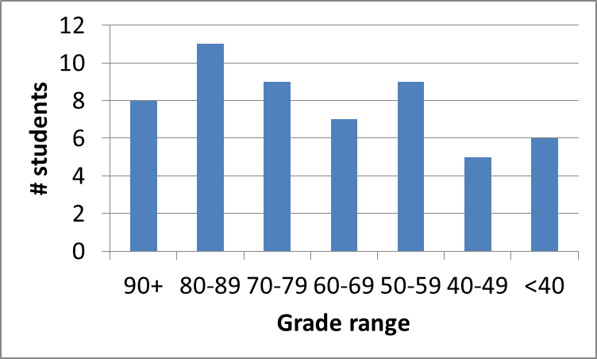
Exam stats & grade distribution
Average: 67.1
Median: 72
Std. deviation: 21.7
Max: 99
Question-by-question averages:
  Q1: 12.1 / 20 (60%)
  Q2: 23.8 / 40 (59%)
  Q3: 31.2 / 40 (78%)
Microprocessors I: Exam 2 Review

Slide 4
Figuring out where you stand
Homework: 10% (3/5 done)
Labs: 35% (2/5 done; 1/5 graded)
Exams: 55% (15% + 20% + 20%)
45% of your grade still to be determined
Estimating your grade
  Homework avg (HWA) =
  (total homework points) / 3
  Lab avg (LA) = score from Lab 1
  Exam avg (EA) =
  ((Exam1) + (Exam2 * 1.33)) / 2.33
  Overall avg = HWA * 0.1 + LA * 0.35 + EA * 0.55
Microprocessors I: Exam 2 Review

Slide 5
Figuring out where you stand
Estimated avg.
= HWA * 0.1 + LA * 0.35 + EA * 0.55
Current course average: ~75%, SD = 12
  “Curve” would add at most ~7 points, possibly less, to those below mean
  Therefore, right now:
    Min grade for C-: 63
    Min grade for D: 53
    THESE NUMBERS WILL ALMOST CERTAINLY CHANGE BEFORE SEMESTER’S END—THESE FIGURES ARE JUST ROUGH ESTIMATES!!!!!
Microprocessors I: Exam 2 Review

Slide 6
Next time
More on interfacing, memory organization
Microprocessors I: Exam 2 Review

