Slide 1
16.317: Microprocessor System Design I
Instructor: Dr. Michael Geiger
Spring 2012
Lecture 30: PIC data memory
Notes:
Chapter 2

Slide 2
Lecture outline
Announcements/reminders
  Lab 4 posted, due 4/25
    Limited # of PICkits → strongly suggest you work in a group for the last two assignments
    PICkits can be checked out from the lab
  HW 4 to be posted early next week
  No class Monday (Patriots’ Day)
  Exam regrade requests due today
Lecture outline
  Review
    Microcontroller basics
    PIC introduction
  Continue with PIC
Microprocessors I: Lecture 30

Slide 3
Review
Microcontrollers: CPU integrated with storage, I/O devices
  Examples
    Timers/event counters
    Parallel & serial ports
    Clock generator
    Analog to digital converter
  Benefits: low cost/low power, easy to program
  Limitations: storage, computational power
Introduced PIC 16F684 microcontroller
  14 pins—12 multiplexed I/O + power/ground
  All computations using 2 values use accumulator
  Harvard memory architecture
  Memory divided into SFR / GPR
  Dedicated 8-entry system stack for return addresses (subroutines/interrupts)
Microprocessors I: Lecture 30

Slide 4
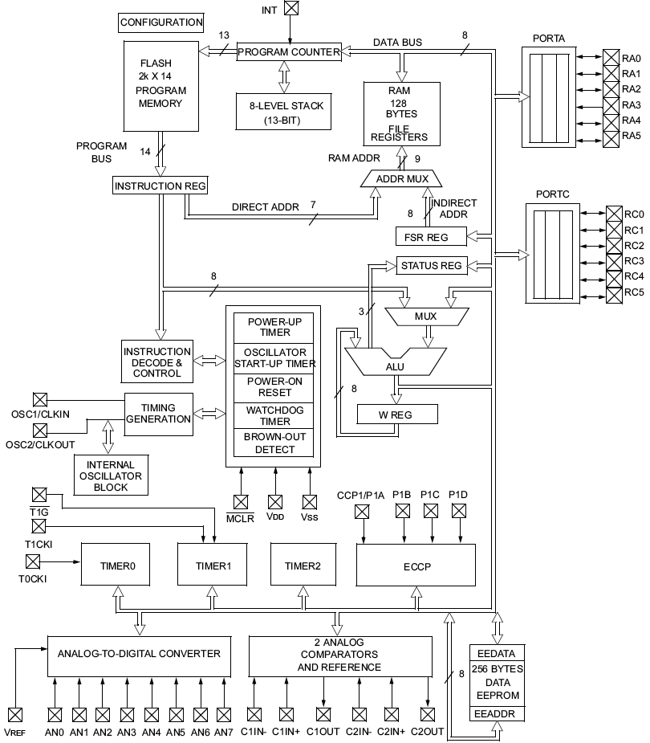
PIC16F684 Block Diagram
Microprocessors I: Lecture 30
Notes:
Chapter 9

Slide 5
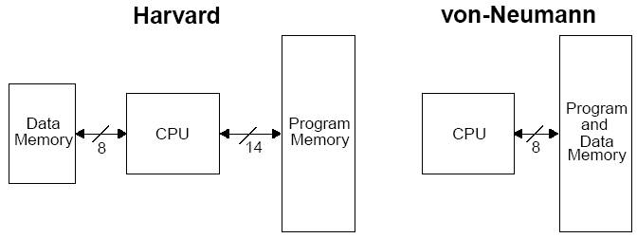
Harvard vs Von Neumann
Organization of program and data memory
Microprocessors I: Lecture 30
Notes:
Chapter 9

Slide 6
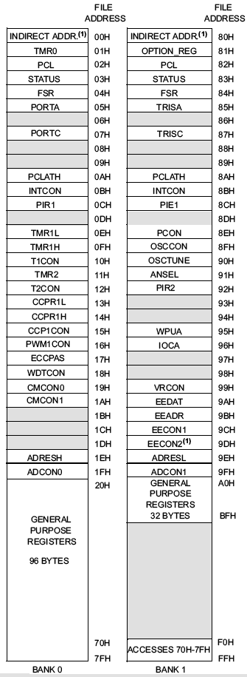
Data Memory Map
Data memory consists of
  Special Function Registers (SFR) area
  General Purpose Registers (GPR) area
SFRs control the operation of the device
GPRs are area for data storage and scratch pad operations
GPRs are at higher address than SFRs in a bank
Different PIC microcontrollers may have different number of GPRs
Microprocessors I: Lecture 30
Notes:
Chapter 9

Slide 7
Banking
Data memory is partitioned into banks
In this PIC family, each bank holds 128 bytes (max offset = 7Fh)
  Processors w/4 banks : 4*128 bytes = 512 bytes
  Processors w/2 banks : 2*128 bytes = 256 bytes
Lower locations of each bank are reserved for SFRs. Above the SFRs are GPRs.
Implemented as Static RAM
Some “high use” SFRs from bank0 are mirrored in the other banks (e.g., INDF, PCL, STATUS, FSR, PCLATH, INTCON)
RP0 and RP1 bits in the STATUS register selects the bank when using direct addressing mode.
Microprocessors I: Lecture 30
Notes:
Chapter 9

Slide 8
Banking (cont.)
14-bit instructions use 7 bits to address a location
Memory space is organized in 128Byte banks.
PIC 16F684 has two banks - Bank 0 and Bank 1.
Bank 1 controls operation of the PIC
  Example: TRISA determines which bits of Port A are inputs/outputs
Bank 0 is used to manipulate the data
  Example: PORTA holds actual state of I/O port A
Microprocessors I: Lecture 30
Notes:
Chapter 9

Slide 9
Special Function Registers (1)
W, the working register
  To move values from one register to another register, the value must pass through the W register.
FSR (04h,84h,104h,184h), File Select Register
  Indirect data memory addressing pointer
INDF (00h,80h,100h,180h)
  accessing INDF accesses the location pointed by IRP+FSR
PC, the Program Counter, PCL (02h, 82h, 102h, 182h) and PCLATH (0Ah, 8Ah, 10Ah, 18Ah)
Microprocessors I: Lecture 30
Notes:
Chapter 9

Slide 10

Special Function Registers (2)
STATUS (03h, 83h, 103h, 183h)
  IRP: Register bank select bit (indirect addressing)
  RP1:RP0 – Register bank select bits (direct addressing)
  NOT_TO: Time Out bit, reset status bit
  NOT_PD: Power-Down bit, reset status bit
  Z: Zero bit ~ ZF in x86
  DC: Digital Carry bit ~ AF in x86
  C: Carry bit ~ CF in x86 (note: for subtraction, borrow is opposite)
Microprocessors I: Lecture 30
Notes:
Chapter 9

Slide 11
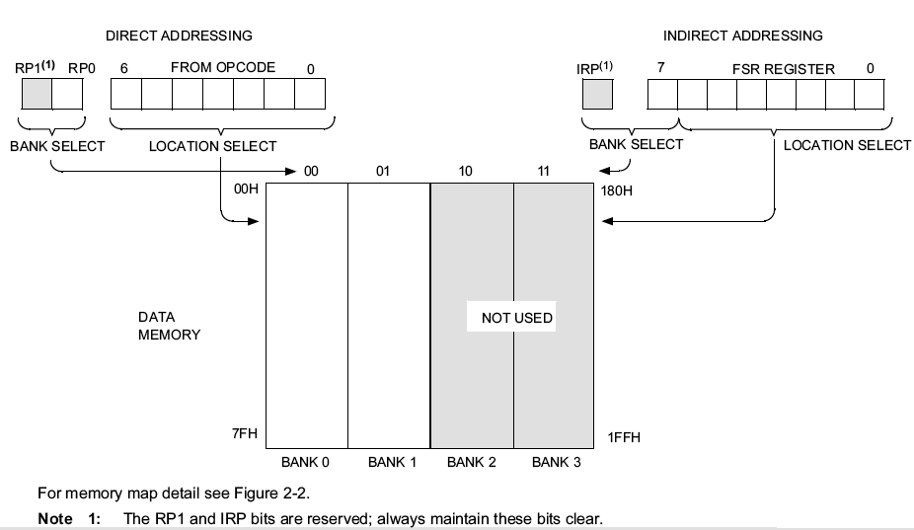
Direct/Indirect Addressing
Microprocessors I: Lecture 30
Notes:
Chapter 9

Slide 12
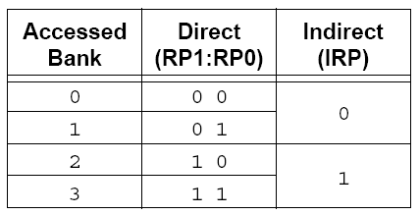
Direct Addressing
Lowest 7 bits of instruction identify a register file address
The other two bits of register address come from RP0 and RP1 bits in the STATUS register
Example: Bank switching (Note: case of 4 banks)
  CLRF STATUS ; Clear STATUS register (Bank0)
  : ;
  BSF STATUS, RP0 ; Bank1
  : ;
  BCF STATUS, RP0 ; Bank0
  : ;
  MOVLW 0x60 ; Set RP0 and RP1 in STATUS register, other
  XORWF STATUS, F ; bits unchanged (Bank3)
  : ;
  BCF STATUS, RP0 ; Bank2
  : ;
  BCF STATUS, RP1 ; Bank0
Microprocessors I: Lecture 30
Notes:
Chapter 9

Slide 13
Direct addressing examples
Assume you are using the PIC 16F684, which has two memory banks
What address is being accessed if:
  STATUS = 60h, instruction = 031Fh?
  STATUS = 40h, instruction = 1F02h?
  STATUS = 13h, instruction = 0793h?
  STATUS = EEh, instruction = 03F1h?
Microprocessors I: Lecture 30

Slide 14
Example solution
Recall that, in direct addressing
  Address is 8 bits
  Lowest 7 bits = lowest 7 bits of instruction
  8th bit = RP0 bit of STATUS = STATUS bit 5
STATUS = 60h, instruction = 031Fh?
  STATUS = 0110 0000₂
  Instruction = 0000 0011 0001 1111₂
  Address = 1001 1111₂ = 0x9F
STATUS = 40h, instruction = 1F02h?
  STATUS = 0100 0000₂
  Instruction = 0001 1111 0000 0010₂
  Address = 0000 0010₂ = 0x02
Microprocessors I: Lecture 30

Slide 15
Example solution (cont.)
Recall that, in direct addressing
  Address is 8 bits
  Lowest 7 bits = lowest 7 bits of instruction
  8th bit = RP0 bit of STATUS = STATUS bit 5
STATUS = 13h, instruction = 0793h?
  STATUS = 0001 0011₂
  Instruction = 0000 0111 1001 0011₂
  Address = 0001 0011₂ = 0x13
STATUS = EEh, instruction = 03F1h?
  STATUS = 1110 1110₂
  Instruction = 0000 0011 1111 0001₂
  Address = 1111 0001₂ = 0xF1
Microprocessors I: Lecture 30

Slide 16
Indirect Addressing
The INDF register is not a physical register. Addressing the INDF register will cause indirect addressing.
Any instruction using the INDF register actually accesses the register pointed to by the File Select Register (FSR).
The effective 9-bit address is obtained by concatenating the 8-bit FSR register and the IRP bit in STATUS register.
Example
    MOVLW 0x20 ;initialize pointer
    MOVWF FSR ;to RAM
    NEXT: CLRF INDF ;clear INDF register
    INCF FSR,F ;inc pointer
    BTFSS FSR,4 ;all done? (to 0x2F)
    GOTO NEXT ;no clear next
    CONTINUE
    : ;yes continue
Microprocessors I: Lecture 30
Notes:
Chapter 9

Slide 17
I/O Ports
General I/O pins are the simplest of peripherals used to monitor and control other devices.
For most ports, the I/O pin’s direction (input or output) is controlled by the data direction register TRISx (x=A,B,C,D,E): a ‘1’ in the TRIS bit corresponds to that pin being an input, while a ‘0’ corresponds to that pin being an output
The PORTx register is the latch for the data to be output. Reading PORTx register read the status of the pins, whereas writing to it will write to the port latch.
Example: Initializing PORTA (PORTA is an 8-bit port. Each pin is individually configurable as an input or output).
bcf STATUS, RP0 ; bank0
bcf STATUS, RP1
clrf PORTA ; initializing PORTA by clearing output data latches
bsf STATUS, RP0 ; select bank1
movlw 0xCF ; value used to initialize data direction
movwf TRISA ; WHAT BITS OF PORT A ARE INPUTS? (0-3, 6, 7)
; WHAT BITS ARE OUTPUTS? (4, 5)
Microprocessors I: Lecture 30
Notes:
Chapter 9

Slide 18
Next time
Continue with discussion of PIC
Microprocessors I: Lecture 30

