Slide 1
16.317
Microprocessor Systems Design I
Instructor: Dr. Michael Geiger
Spring 2013
Lecture 13:
Jump and loop instructions

Slide 2
Lecture outline
Announcements/reminders
  Lab 1 posted; due 3/6
  Exam 1 regrades due 3/1
Today’s lecture
  Byte set on condition instruction
  Jump instructions
  Loop instructions
  Early feedback forms
Microprocessors I: Lecture 13

Slide 3
Review
Flag control instructions
  Initialize carry flag to 0 (CLC), 1 (STC), or ~CF (CMC)
  Set (STI) or clear (CLI) interrupt flag
  Transfer flags to (LAHF) or from (SAHF) register AH
CMP D, S
  Flags show result of (D) – (S)
    Assumes signed computation
  ZF = 1 → D == S
  ZF = 0, (SF XOR OF) = 1 → D < S
  ZF = 0, (SF XOR OF) = 0 → D > S
Condition codes: mnemonics implying certain flag conditions
Microprocessors I: Lecture 13

Slide 4
Byte Set on Condition Instruction
Byte set on condition instruction
  Used to set byte based on condition code
  Can be used for boolean results—complex conditions
  General format:
    SETcc D
    cc = one of the supported conditional relationships
Microprocessors I: Lecture 13
Notes:
Chapter 6 part 1

Slide 5
Byte Set on Condition Instruction
Operation: Flags tested for conditions defined by “cc” and the destination in a register or memory updated as follows
If cc test True:
  11111111₂ = FFH → D
  If cc test False:
  00000000₂ = 00H → D
Examples of conditional tests:
SETE = set byte if equal → ZF = 1
SETC = set byte if carry → CF =1
SETBE = set byte if below or equal → CF = 1 +(or) ZF = 1
Example: SETA AL = set byte if above
  if CF = 0 • (and) ZF = 0
  (AL) = FFH
  Otherwise,
  (AL) =00H
Microprocessors I: Lecture 13
Notes:
Chapter 6 part 1

Slide 6
Example
Show the results of the following instructions, assuming that
  “A” = DS:100H = 0001H
  “B” = DS:102H = 0003H
  “C” = DS:104H = 1011H
  “D” = DS:106H = 1011H
  “E” = DS:108H = ABCDH
  “F” = DS:10AH = DCBAH
What complex condition does this sequence test?
MOV AX, [100H]
CMP AX, [102H]
SETLE BL
MOV AX, [104H]
CMP AX, [106H]
SETE BH
AND BL, BH
MOV AX, [108H]
CMP AX, [10AH]
SETNE BH
OR BL, BH
Microprocessors I: Lecture 13

Slide 7
Example solution
Condition being tested:
  To simplify, treat each word as a variable named “A” through “F”
  ((A <= B) && (C == D)) || (E != F)
Source: http://www.arl.wustl.edu/~lockwood/class/cs306/books/artofasm/Chapter_6/CH06-4.html
Microprocessors I: Lecture 13

Slide 8
Jump instructions
Used to change flow of program
  Next instruction specified by operand
Two general types
  Unconditional: JMP <target>
    Always goes to address indicated by <target>
  Conditional: Jcc <target>
    Jump only occurs if condition true
    cc replaced by valid condition code
      Most codes discussed in previous lecture
      Additional codes: CXZ/ECXZ
      → CX/ECX register is zero
Microprocessors I: Lecture 13

Slide 9
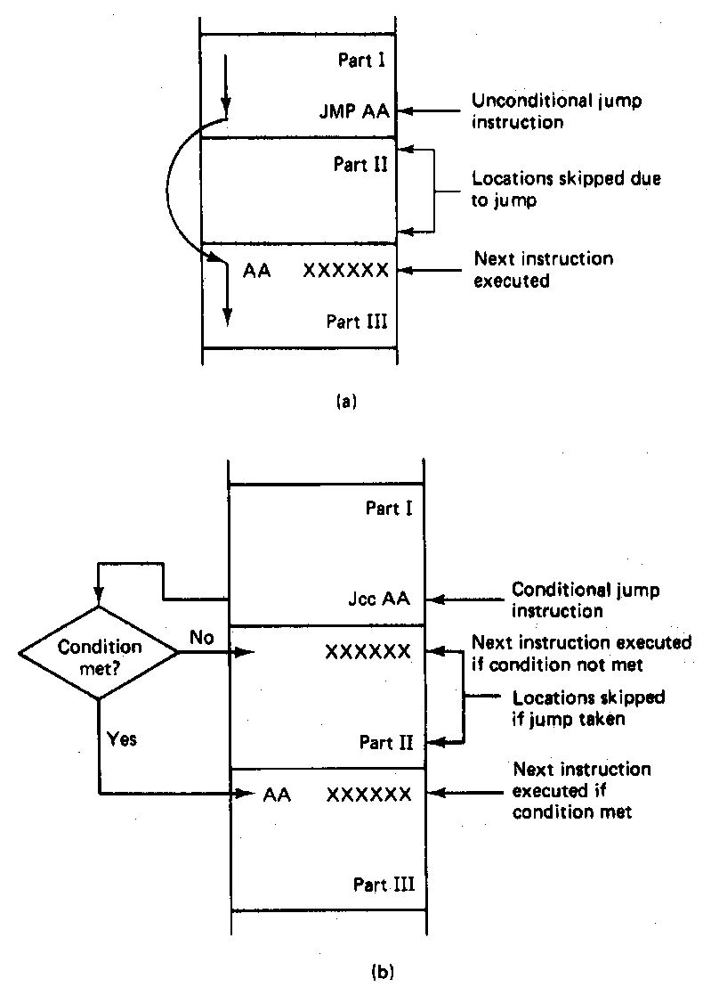
Jump Instructions
Microprocessors I: Lecture 13
Notes:
Chapter 6 part 1

Slide 10
Jump targets
Depends on distance from jump instruction
  Recall: CS:IP is logical addr. of current inst.
Intrasegment: target in same segment
  8-bit (short-label)/16-bit (near-label) immediate
    Signed offset added to current IP
    Usually specified by code writer simply as label
      E.g., JMP LABEL1
  16-bit register or memory location
    IP overwritten by contents of memory or register
    Register example: JE BX
    Memory example: JE WORD PTR [BX]
Microprocessors I: Lecture 13

Slide 11
Jump targets (cont.)
Depends on distance from jump instruction
  Recall: CS:IP is logical addr. of current inst.
Intersegment: target in different segment
  32-bit (far-label) immediate
  32-bit register
  32-bit memory location (DWORD PTR)
  In all cases, CS = upper 16 bits; IP = lower 16 bits
Microprocessors I: Lecture 13

Slide 12
Example: jump targets
NOTE: We did not take the time to go through these examples in detail during the lecture
Given CS = 1200H, IP = 0100H, and EBX = 14000020H, what are the target addresses of the following jump instructions?
  JMP 08H
  JPE FFF0H
  JE BX
  JNZ EBX
Microprocessors I: Lecture 13

Slide 13
Example solution
JMP 08H
  Short-label jump → add constant value to IP
  IP = 0100 + 08 = 0108H
  Target = CS:IP = 12000+0108 = 12108H
JPE FFF0H
  Near-label jump → add constant value to IP
  IP = 0100 + FFF0 = 00F0H
  Target = CS:IP = 12000+00F0 = 120F0H
Microprocessors I: Lecture 13

Slide 14
Example solution (cont.)
JE BX
  Register jump → overwrite IP with 16-bit register value
  IP = BX = 0020H
  Target = CS:IP = 12000 + 0020 = 12020H
JNZ EBX
  Register jump → overwrite CS, IP with 32-bit register value
  CS = upper word of EBX = 1400H
  IP = BX = 0020H
  Target = CS:IP = 14000 + 0020 = 14020H
Microprocessors I: Lecture 13

Slide 15
Example: program structure 1
Given the instructions below, what are the resulting register values if:
  AX = 0010H, BX = 0010H
  AX = 1234H, BX = 4321H
What type of high-level program structure does this sequence demonstrate?
Instructions
  CMP AX, BX
  JE L1
  ADD AX, 1
  JMP L2
  L1: SUB AX, 1
  L2: MOV [100H], AX
Microprocessors I: Lecture 13

Slide 16
Example solution
First case: AX = BX = 0010H
  CMP AX, BX → Shows AX == BX
  JE L1 → Cond. true—jump to L1
  ADD AX, 1
  JMP L2
  L1: SUB AX, 1 → AX = AX – 1 = 000F
  L2: MOV [100H], AX → Store 000F at DS:100H
Microprocessors I: Lecture 13

Slide 17
Example solution (cont.)
Second case: AX = 1234H, BX = 4321H
  CMP AX, BX → Shows AX < BX
  JE L1 → Cond. false—no jump
  ADD AX, 1 → AX = AX + 1 = 1235H
  JMP L2
  L1: SUB AX, 1 → AX = AX – 1 = 000F
  L2: MOV [100H], AX → Store 000F at DS:100H
Microprocessors I: Lecture 13

Slide 18
Example solution (cont.)
High-level program structure: if/else statement
  If part: compare + jump (if (AX == BX))
  Else part: what follows if condition false
  Unconditional jump used to skip “if” part
  Both parts have same exit (L2)
Microprocessors I: Lecture 13

Slide 19
Example: program structure 2
Given the instructions below, what are the resulting register values if, initially, AX = 0001H?
What type of high-level program structure does this sequence demonstrate?
Instructions
  MOV CL, 5
  L: SHL AX, 1
  DEC CL
  JNZ L
Microprocessors I: Lecture 13

Slide 20
Example: program structure 3
Given the instructions below, what are the resulting register values if, initially, AX = 0001H?
What type of high-level program structure does this sequence demonstrate?
Instructions
  MOV CL, 5
  L: JCXZ END
  ADD AX, AX
  DEC CL
  JMP L
  END: MOV [10H], AX
Microprocessors I: Lecture 13

Slide 21
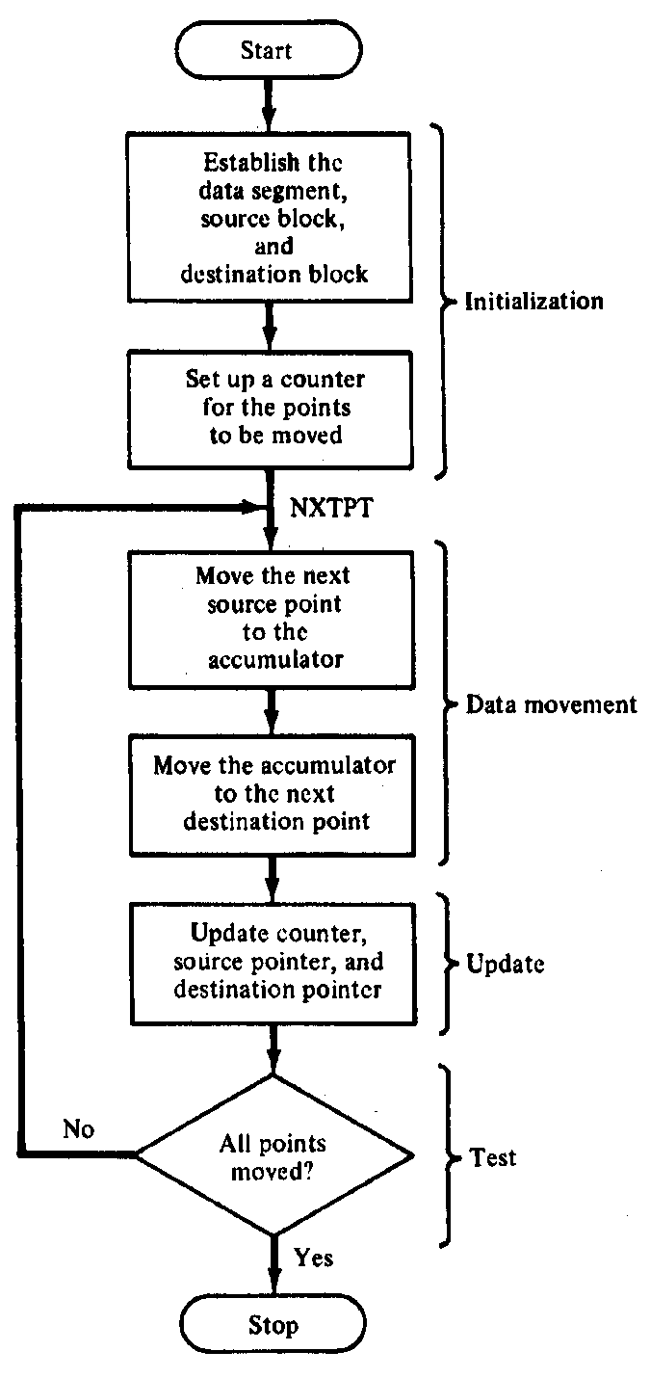
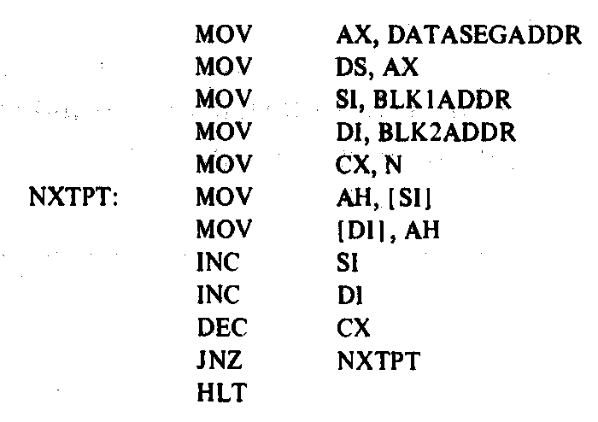
Block Move Program
Microprocessors I: Lecture 13
Notes:
Chapter 6 part 1

Slide 22
Loop instructions
Common operations in basic loops
  Compare
  Conditional jump
  Decrement loop counter (CX)
Loop instructions combine all into one op
  All decrement CX by 1, then check if CX == 0
  <target> must be short-label (8-bit immediate)
  LOOP <target>: Return to <target> if CX != 0
  LOOPE/LOOPZ <target>: Return to <target> if (CX != 0) && (ZF == 1)
  LOOPNE/LOOPNZ <target>: Return to <target> if (CX != 0) && (ZF != 1)
Microprocessors I: Lecture 13

Slide 23
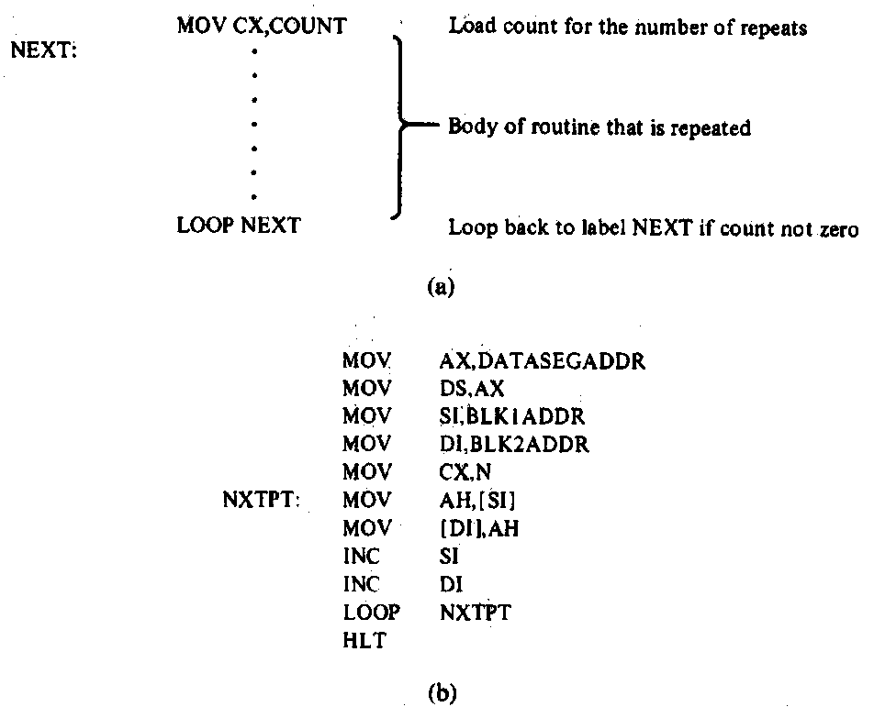
Loop Program Structure
Structure of a loop
  CX = initial count
  Loop body: code to be repeated
  Loop instruction– determines if loop is complete or if the body is to repeat
Example: block move
Microprocessors I: Lecture 13
Notes:
Chapter 6 part 2

Slide 24
Loop example 1
Rewrite the post-tested loop seen earlier using a loop instruction:
  MOV CL, 5
  L: SHL AX, 1
  DEC CL
  JNZ L
Solution:
  MOV CL, 5
  L: SHL AX, 1
  LOOP L
Microprocessors I: Lecture 13

Slide 25
Loop example 2
Describe the operation of the following program (Example 6.15-6.16).
What is the final value of SI if the 15 bytes between 0A001 and 0A00F have the following values?
  00 01 02 03 04 05 06 07 08 09 0A 0B 0C 0D 0E
MOV DL, 05
MOV AX, 0A00
MOV DS, AX
MOV SI, 0000
MOV CX, 000F
AGAIN: INC SI
CMP [SI], DL
LOOPNE AGAIN
Microprocessors I: Lecture 13

Slide 26
Final notes
Next time: Continue with instructions
Reminders:
  Lab 1 due 3/6
  Exam 1 regrades due 3/1
Microprocessors I: Lecture 13

