Slide 1
16.317
Microprocessor Systems Design I
Instructor: Dr. Michael Geiger
Spring 2013
Lecture 2: General Microprocessor Overview

Slide 2
Lecture outline
Announcements/reminders
  Sign up for the discussion group on piazza.com
Today’s lecture: General microprocessor overview (cont.)
  Microprocessor architecture
  Instruction set architecture
  Operations
  Data
Microprocessors I: Lecture 2

Slide 3
Computer components
What are the key components of a computer?
  Microprocessor (MPU/CPU) performs computation
  Input to read data from external devices
    Examples: Keyboard, mouse, ports (Ethernet, USB, etc.)
  Output to transmit data to external devices
    Examples: screen, speaker, VGA interface, ports (Ethernet, USB, etc.)
  Storage to hold program code and data
    RAM, hard disk, possibly other media (CD/DVD, external drive)
Will see that microprocessor contains smaller-scale versions of these components
  Computation engine
  I/O interface
  Internal storage
Microprocessors I: Lecture 2
Notes:
Chapter 1

Slide 4

Abstraction of program control
Easiest for humans to understand high-level languages
Processor interprets machine language
Assembly language: abstraction with intermediate level of detail
  Breaks machine code into instructions
  Gives some insight into how each instruction behaves
  More readable than bit patterns!
Microprocessors I: Lecture 2

Slide 5
Processor architecture
“Architecture” can refer to
  High-level description of hardware; could be
    Overall system
    Microprocessor
    Subsystem within processor
  Operations available to programmer
    Instruction set architecture
  Other applications to computing (e.g., “software architecture”) we won’t discuss
Commonly used to discuss functional units and how they work together
Microprocessors I: Lecture 2

Slide 6
Role of the ISA
User writes high-level language (HLL) program
Compiler converts HLL program into assembly for the particular instruction set architecture (ISA)
Assembler converts assembly into machine language (bits) for that ISA
Resulting machine language program is loaded into memory and run
Microprocessors I: Lecture 2

Slide 7
ISA design
Think about a HLL statement like
X[i] = i * 2;
ISA defines how such statements are translated to machine code
  What information is needed?
Microprocessors I: Lecture 2

Slide 8
ISA design (cont.)
Think about a HLL statement like
X[i] = i * 2;
Questions answered in every ISA (or “software model”)
  How will the processor implement this statement?
    What operations are available?
    How many operands does each instruction use?
  Where are X[i] and i?
    How do we reference the operands?
  What type(s) of data are X[i] and i?
    What types of operands are supported?
    How big are those operands?
  Instruction format issues
    How many bits per instruction?
    What does each bit or set of bits represent?
    Are all instructions the same length?
Microprocessors I: Lecture 2

Slide 9
Operation types
Operations: what should processor be able to do?
  Data transfer
    Move data between storage locations
  Arithmetic operations
    Typical: add, subtract, maybe multiply/divide, negation
  Logical operations
    Typical: AND, OR, NOT, XOR
    Often includes bit manipulation: shifts, rotates, test/set/clear single bit
  Program control
    “Jump” to another part of program
    May be based on condition
    Used to implement loops, conditionals, function call/return
  Typically some processor-specific special purpose ops
Microprocessors I: Lecture 2

Slide 10
Operands
Two major questions when dealing with data
  “How” do we store them? → what do the bits represent?
  Where do we store them?
    … and how do we access those locations)?
First question deals with data types
Second question deals with data storage and addressing
Microprocessors I: Lecture 2

Slide 11
Data types
Also seen in high-level languages
  Think about C types: int, double, char, etc.
  What does a data type specify?
    How big is each piece of data?
    How do we interpret the bits representing those data?
Data sizes
  Smallest addressable unit: byte (8 bits)
  Can also deal with multi-byte data: 16, 32, 64 bits
  Often deal with words of data
    Word size processor-dependent (16 bits on x86, 32 bits on MIPS)
    Can have double words, quad words, half words …
Interpreting bits
  Numbers: Integers, floating-point; signed vs. unsigned
  May treat as characters, other special formats
Microprocessors I: Lecture 2

Slide 12
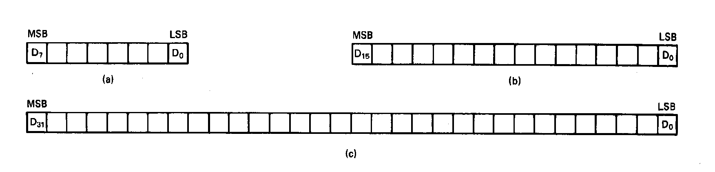
Unsigned Integers
All numbers are binary in memory
All bits represent data
Types:
Sizes Range
8-bit 0H → 255₁₀
16-bit 0H → 65,535₁₀
32-bit 0H → 4,294,967,295₁₀
Microprocessors I: Lecture 2
Notes:
Chapter 2

Slide 13
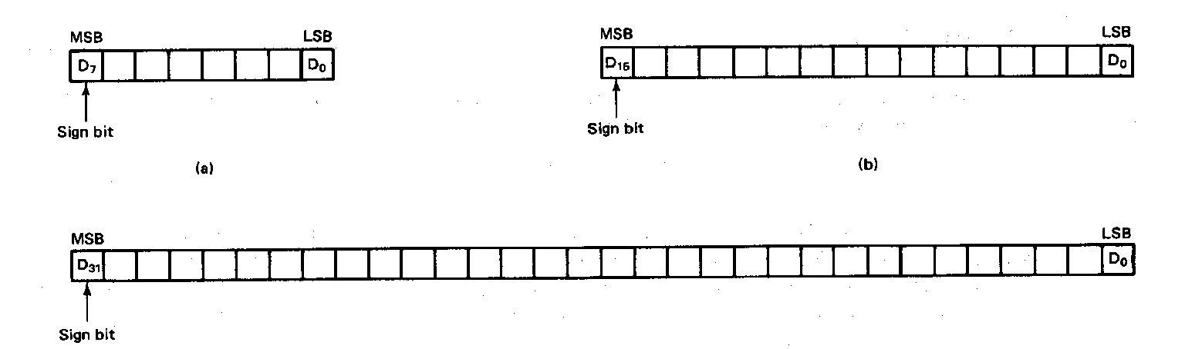
Signed Integers
MSB is sign bit ( 0/1 -> +/-)
Remaining bits represent value
Negative numbers expressed in 2’s complement notation
Types:
Sizes Range
8-bit -128 → +127
16-bit -32,768 → +32,767
32-bit -2,147,483,648 → +2,147,483,647
Microprocessors I: Lecture 2
Notes:
Chapter 2

Slide 14
Integer Examples
Given the 8-bit value: 1001 1111₂
Calculate the decimal value of this integer as
  An unsigned integer
  A signed integer
Microprocessors I: Lecture 2
Notes:
Chapter 2

Slide 15
Integer example solution
Given the 8-bit value: 1001 1111₂
Calculate the decimal value of this integer as
  An unsigned integer
  Solution:
    (1 x 2⁷) + (1 x 2⁴) + (1 x 2³) + (1 x 2²) + (1 x 2¹) + (1 x 2⁰)
    = 128 + 16 + 8 + 4 + 2 + 1 = 159
  A signed integer
  Solution:
    MSB = 1 → negative value
    To get magnitude, take 2’s complement:
    0110 0001₂ = (1 x 2⁶) + (1 x 2⁵) + (1 x 2⁰)
    = 64 + 32 + 1 = 97
    → Result = -97
Microprocessors I: Lecture 2

Slide 16
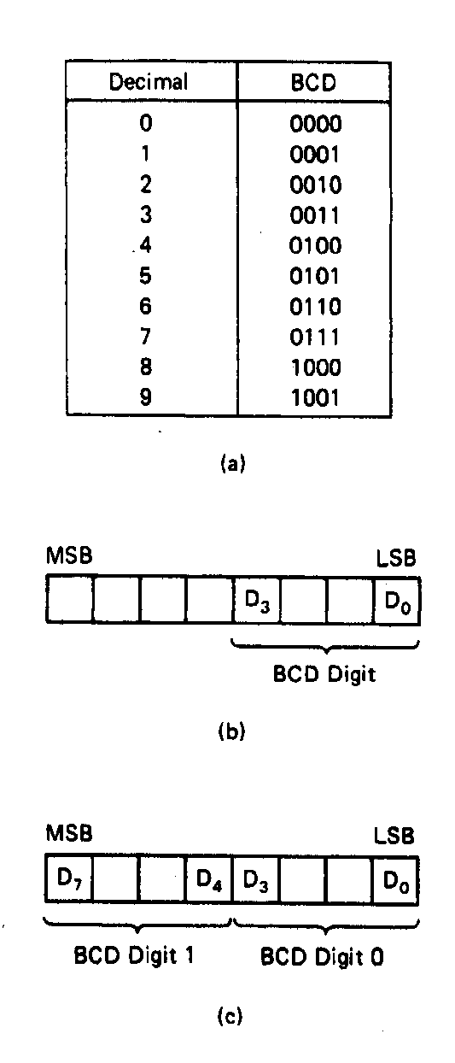
BCD Numbers
Direct coding of numbers as binary coded decimal (BCD) numbers supported
Unpacked BCD [Fig.2.10(b)]
  Lower four bits contain a digit of a BCD number
  Upper four bits filled with zeros (zero filled)
Packed BCD [Fig. 2.10(c)]
  Lower significant BCD digit held in lower 4 bits of byte
  More significant BCD digit held in upper 4 bits of byte
Example: Packed BCD byte at address 01000H is 10010001₂, what is the decimal number?
Organizing as BCD digits gives,
1001_{BCD} 0001_{BCD} = 91₁₀
Microprocessors I: Lecture 2
Notes:
Chapter 2

Slide 17
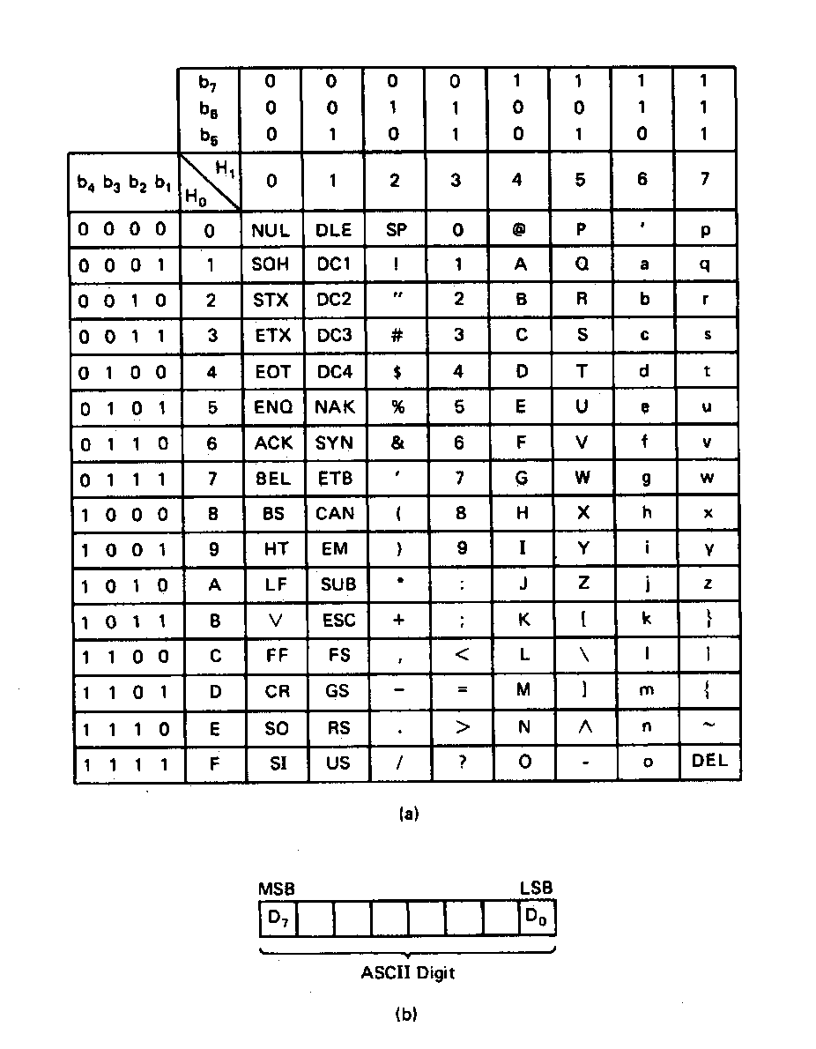
ASCII Data
American Code for Information Interchange (ASCII) code
ASCII information storage in memory
  Coded one character per byte
  7 LS-bits = b₇b₆b₅b₄b₃b₂b₁
  MS-bit filled with 0
Example: Addresses 01100H-01104H contain ASCII coded data 01000001, 01010011, 01000011, 01001001, and 01001001, respectively. What does the data stand for?
0 100 0001_{ASCII} = A
0 101 0011_{ASCI} = S
0 100 0011_{ASCII} = C
0 100 1001_{ASCII} = I
0 100 1001_{ASCII} = I
Microprocessors I: Lecture 2
Notes:
Chapter 2

Slide 18
Data storage
What characteristics do we want storage media to have?
Two primary answers
  Speed
  Capacity
  Very difficult to get both in single storage unit
Processors use two different types of storage
  Registers
  Memory
Microprocessors I: Lecture 2

Slide 19
Final notes
Next time
  Continue general processor overview
    Conclude discussion of data storage
  80386DX introduction
Reminders:
  Check the course web page
  Join the course discussion group on piazza.com
Microprocessors I: Lecture 2

