Slide 1
16.317
Microprocessor Systems Design I
Instructor: Dr. Michael Geiger
Spring 2014
Lecture 32:
PIC example programs:
Analog to digital conversion

Slide 2
Lecture outline
Announcements/reminders
  HW 6 due Friday, 5/2
    Group assignment with PICkits—groups of 2 or 3
  HW 7 to be posted; also due Friday, 5/2
    Extra-credit problem set
    Can replace lowest grade for HW 1-5 only
      Everyone must complete HW 6
  Exam 3: Tuesday, 5/6, 11:30-2:30
    Must complete course evaluation—will post on website
Review: PIC interrupts
Today’s lecture
  Analog-to-digital conversion
Microprocessors I: Lecture 32

Slide 3
Review: Interrupts
PIC controllers allow internal and external interrupts
Single interrupt service routine
  Must determine interrupt cause, then handle
  Code addresses handled slightly differently
    Processor goes to address 0 on reset, 4 on interrupt
    Reset “vector”: jump to start of main program
    Interrupt “vector”: jump to start of ISR
Interrupt setup
  Enable device-specific interrupts first
  Enable global interrupts (GIE bit on PIC16F1829)
Interrupt handling
  Determine which device caused interrupt
  Clear device-specific interrupt flag
  Execute code to actually process interrupt, then retfie
Microprocessors I: Lecture 32

Slide 4
Analog to digital converter
10 bits of resolution
  ADC value = (V / V_{REF}) * 1023
11 analog input channels
  Split across ports A, B, and C
Can be referenced to V_{DD} or external reference
Key registers
  ANSELx: Determines if pin(s) on port x are configured as analog or digital
  ADCON0/ADCON1: Configuration registers
  ADRESH/ADRESL: High/low bits of ADC result
ADC can generate interrupt when done
  Set PEIE (peripheral interrupt enable) in INTCON
  Set ADIE (analog to digital interrupt enable) in PIE1
  When interrupt occurs, ADIF = 1 in PIR1 (must be cleared)
Microprocessors I: Lecture 32

Slide 5
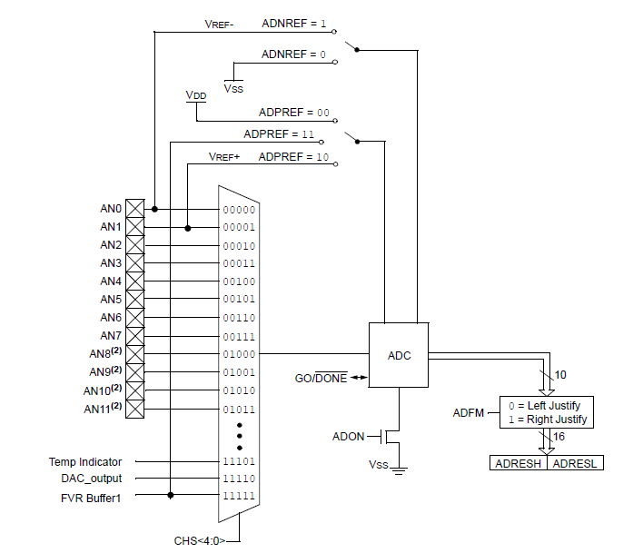
ADC block diagram
Microprocessors I: Lecture 32

Slide 6
ADCON0
CHS <4:0>: channel select
GO/DONE’: start/end conversion
  Explicitly set to 1 to start conversion
  ADC will clear when conversion is done
ADON: Turns ADC on/off
Microprocessors I: Lecture 32

Slide 7
ADCON1
ADFM: Result format
  ADFM = 0 → right justified (ADRESL holds low 8 bits of result; upper 6 bits of ADRESH = 0)
  ADFM = 1 → left justified (ADRESH holds upper 8 bits of result; lower 6 bits of ADRESL = 0)
ADCS<2:0>: Conversion clock select
  Divide system clock by factor between 2 and 64
  Or, select dedicated RC oscillator
ADNREF: Negative reference voltage
  V_{SS} or negative reference input
ADPREF: Positive reference voltage
  V_{DD}, positive reference input, or internal fixed voltage reference
Microprocessors I: Lecture 32

Slide 8
ADC setup
In assembly (a2d.asm)
;already in bank1
bsf TRISA, 4 ;Pot.connected to RA4
movlw b'00001101‘ ;select RA4 as ADC source
movwf ADCON0 ; & enable (actually AN3)
movlw b'00010000‘ ;left justified, Fosc/8
movwf ADCON1 ; speed, vref is Vdd
banksel ANSELA ;bank3
bsf ANSELA, 4 ;analog for ADC
In C (a2d.c)
TRISAbits.TRISA4 = 1; //Pot. connected to RA4
ANSELAbits.ANSA4 = 1; //analog
ADCON0 = 0b00001101; //select RA4 as source of ADC
// and enable module (AN3)
ADCON1 = 0b00010000; //left justified, FOSC/8
// ref is Vdd
Microprocessors I: Lecture 32

Slide 9
ADC access in assembly (a2d.asm)
Read ADC; put upper 4 bits on LEDs
;Start the ADC
nop ;required ADC delay
banksel ADCON0
bsf ADCON0, GO ;start the ADC
btfsc ADCON0, GO ;this bit will be cleared when
; the conversion is complete
goto $-1 ;keep checking until GO clear
;Grab Results and write to the LEDs
swapf ADRESH, w ;Get top 4 MSbs
banksel LATC
movwf LATC ;move into the LEDs
Microprocessors I: Lecture 32

Slide 10
ADC access in C (a2d.c)
while (1) {
__delay_us(5); //wait for ADC
// charging cap to
// settle
GO = 1;
//wait for conversion to finish
while (GO) continue;
//grab the top 4 MSbs
LATC = (ADRESH >> 4);
}
Microprocessors I: Lecture 32

Slide 11
Using ADC to determine delay (asm) (1/4)
MainLoop:
call A2d ;get the ADC result
;top 8 MSbs are now in the working register
movwf Delay2 ;move result to outer delay loop
;if ADC result is zero, load in a value of '1' or
; else delay loop will decrement starting at 255
call CheckIfZero
call DelayLoop ;delay next LED turning ON
call Rotate ;rotate the LEDs
bra MainLoop ;do this forever
Microprocessors I: Lecture 32

Slide 12
Using ADC to determine delay (asm) (2/4)
CheckIfZero:
movlw d'0‘ ;load wreg with '0'
xorwf Delay2, w ;XOR wreg with the ADC
; result and save in wreg
btfss STATUS, Z ;if ADC result is NOT '0', ; simply return to MainLoop
return ;return to MainLoop
;ADC result IS '0'. Load delay routine with '1'
; to avoid decrementing a rollover value of 255
movlw d'1'
movwf Delay2 ;move into delay location
return ;return to MainLoop
Microprocessors I: Lecture 32

Slide 13
Using ADC to determine delay (asm) (3/4)
A2d:
;Start the ADC
nop ;required ADC delay
banksel ADCON0
bsf ADCON0, GO ;start the ADC
btfsc ADCON0, GO ;this bit cleared when
; conversion complete
goto $-1 ; check until GO clear
movf ADRESH, w ;Get the top 8 MSbs
return
Microprocessors I: Lecture 32

Slide 14
Using ADC to determine delay (asm) (4/4)
DelayLoop:
;Delay amount determined by ADC
decfsz Delay1,f ;will always be
; decrementing 255
goto DelayLoop
decfsz Delay2,f ;Delay2 = 8 MSBs
; from ADC
goto DelayLoop
return
Microprocessors I: Lecture 32

Slide 15
Using ADC to determine delay (C)
while (1) {
delay = adc(); //grab the top 8 MSbs
__delay_ms(5); //delay for AT LEAST 5ms
//decrement the 8 MSbs of the ADC and delay 2ms
// for each
while (delay-- != 0)
__delay_ms(2);
//shift to the right to light up the next LED
LATC >> = 1;
//when the last LED is lit, restart the pattern
if(STATUSbits.C)
LATCbits.LATC3 = 1;
}
Microprocessors I: Lecture 32

Slide 16
Final notes
Next week
  Office hours during class time on M/W
  Friday: Exam 3 Preview lecture
Reminders:
  HW 6 due Friday, 5/2
    Group assignment with PICkits—groups of 2 or 3
  HW 7 to be posted; also due Friday, 5/2
    Extra-credit problem set
    Can replace lowest grade for HW 1-5 only
      Everyone must complete HW 6
  Exam 3: Tuesday, 5/6, 11:30-2:30
    Must complete course evaluation—will post on website
Microprocessors I: Lecture 32

