Slide 1
16.317
Microprocessor Systems Design I
Instructor: Dr. Michael Geiger
Spring 2014
Lecture 5:
Memory operand examples
Assembly basics

Slide 2
Lecture outline
Announcements/reminders
  HW 1 due 2/5
    Involves use of Visual Studio
Review
  x86 memory addressing
Today’s lecture
  x86 memory operand examples
  Assembly programming basics
Microprocessors I: Lecture 5

Slide 3
Review: x86 memory
Six segment registers: CS (code), SS (stack), DS, ES, FS, GS (data)
Each segment 64 KB, starts on 16B boundary
  Lowest hex digit of 20-bit address = 0
Logical address → SBA:EA
  Examples: DS:SI, SS:SP, CS:IP, DS:1000H
Physical address: actual memory address
  Shift 16-bit segment register to left by 4 bits = SBA
  Add 16-bit EA to SBA
Calculating EA
  Direct addressing: EA = const
  Register indirect: EA = reg
    Only BP/SP use SS; others use DS by default
  Based-indexed: EA = base reg. + index reg.
  Register relative: EA = reg. + const
  Base-relative-plus-index: EA = base reg. + index reg. + const.
  Scaled-index: EA = register + (scaling factor * second register)
Microprocessors I: Lecture 5

Slide 4
Example
Compute the physical address for the specified operand in each of the following instructions. The register contents and variables are as follows:
  (CS) = 0A00₁₆
  (DS) = 0B00₁₆
  (ESI) = 00000100₁₆
  (EDI) = 00000200₁₆
  (EBX) = 00000300₁₆
Destination operand in: MOV [DI], AX
Source operand in: MOV DI, [SI]
Destination operand in: MOV [BX+0400H], CX
Destination operand in: MOV [DI+0400H], AH
Destination operand in MOV [BX+DI+0400H], AL
Microprocessors I: Lecture 5

Slide 5
Example solutions
Note: all memory operands in problem use data segment
  DS = 0B00H → segment base address (SBA) = 0B000H
  Linear address (LA) = SBA + effective address (EA)
Destination operand in: MOV [DI], AX
  EA = value in DI = 0200H
  LA = 0B000H + 0200H = 0B200H
Source operand in: MOV DI, [SI]
  EA = value in SI = 0100H
  LA = 0B000H + 0100H = 0B100H
Microprocessors I: Lecture 5

Slide 6
Example solutions (cont.)
Destination operand in: MOV [BX+0400H], CX
  EA = value in BX + 0400H = 0300H + 0400H = 0700H
  LA = 0B000H + 0700H = 0B700H
Destination operand in: MOV [DI+0400H], AH
  EA = value in DI + 0400H = 0200H + 0400H = 0600H
  LA = 0B000H + 0600H = 0B600H
Destination operand in MOV [BX+DI+0400H], AL
  EA = BX + DI + 0400H
  = 0300H + 0200H + 0400H = 0900H
  LA = 0B000H + 0900H = 0B900H
Microprocessors I: Lecture 5

Slide 7
Instruction Assembly Notation
Each instruction is represented by a mnemonic that describes its operation—called its operation code (opcode)
  MOV = move (data transfer)
  ADD = add (arithmetic)
  AND = logical AND (logic)
  JMP = unconditional jump (control transfer)
Operands are the other parts of an assembly language instructions
    Identify whether the elements of data to be processed are in registers or memory
      Source operand– location of one operand to be process
      Destination operand—location of the other operand to be processed and the location of the result
Microprocessors I: Lecture 6

Slide 8
Assembly Language Statements
General structure of an assembly language statement
LABEL: INSTRUCTION ;COMMENT
  Label—address identifier for the statement
  Instruction—the operation to be performed
  Comment—documents the purpose of the statement
  Example:
START: MOV AX, BX ; Copy BX into AX
Other examples:
  INC SI ;Update pointer
ADD AX, BX
  Few instructions have a label—usually marks a jump to point
  Not all instructions need a comment
Microprocessors I: Lecture 6
Notes:
Chapter 3

Slide 9
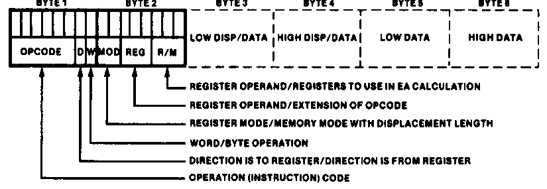
Instruction Encoding
80x86’s instruction set is variable length
  Multiple instruction sizes
    1 to 6 bytes in length for 8088/8086
    Up to 17 bytes for 80386,80486, and Pentium
  Variable length advantages (trait of CISC)
    Allows for many addressing modes
    Allows full size (32-bit) immediate data and addresses
    Instructions can use as many bytes as necessary
  Disadvantage of variable length
    Requires more complicated decoding hardware—speed of decoding is critical in modern uP
    Most uP use fixed length (trait of RISC)
Microprocessors I: Lecture 6
Notes:
Chapter 4

Slide 10
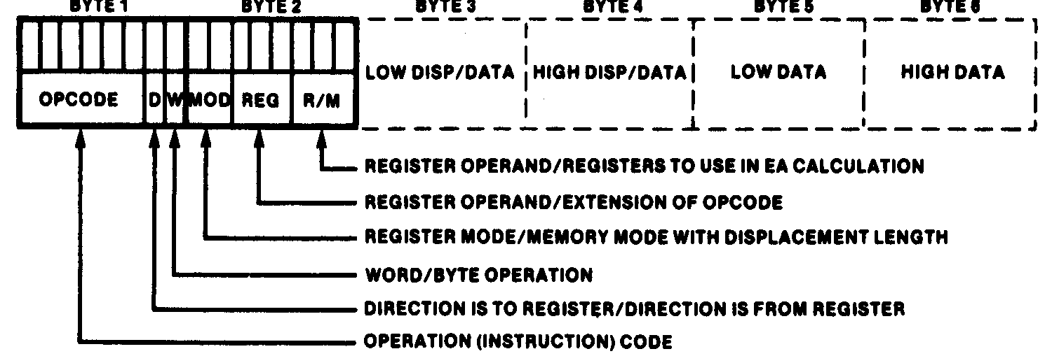
Instruction Encoding
Information encoded in an instruction
  What operation ?
  What operands ?
  Byte, word or double-word ?
  Operands in register or memory ?
  How the address is to be generated, if mem?
Microprocessors I: Lecture 6

Slide 11
x86 data types (“review”)
Refresher on x86 registers
  Gen. purpose registers: 16 or 32 bits
  Data registers can hold 8 bit data as well
  Determining size: register name
  Example: “accumulator” register
    8 bit data: AL = lowest byte; AH = next lowest byte
    16 bit data: AX = lowest 16 bits (AH/AL together as word)
    32 bit data: EAX = entire 32 bits
Say EAX = 1A2B3C4DH
  What are AL, AH, and AX?
  AL = 4DH, AH = 3CH, AX = 3C4DH
Microprocessors I: Lecture 6

Slide 12
x86 memory accesses
# bytes from memory usually = # bytes in register
Example: MOV AX, [100H]
  AX is 16-bit register → move word from DS:100H to AX
Sometimes necessary to specify size
  Use “<size> PTR”: BYTE PTR, WORD PTR, DWORD PTR
  Example: MOVZX EAX, BYTE PTR [100H]
    Take byte from memory
    Zero-extend data to 32 bits and store in EAX
Remember, x86 uses little-endian data
Microprocessors I: Lecture 6

Slide 13
Final notes
Next time:
  Data transfer instructions
Reminders:
  HW 1 due 2/5
    Involves use of Visual Studio
Microprocessors I: Lecture 5

