Slide 1
16.317
Microprocessor Systems Design I
Instructor: Dr. Michael Geiger
Summer 2012
Lecture 5
Instructions: bit test/scan, compare, jump, loop

Slide 2
Lecture outline
Announcements/reminders
  Lab 2 report due today
  HW 2 posted; due Monday, 7/30
  Lab 3 report due Monday, 7/30
Today’s lecture
  More 80386DX instructions
    Bit test/scan, flag control
    Compare
    Jumps
    Loops
  Exam 1 Review
    Solution, stats
Microprocessors I: Lecture 5

Slide 3
Bit Test Instructions
BT → Bit test
BTR → Bit test and reset
BTS → Bit test and set
BTC → Bit test and complement
Format of bit test instruction: BT(x) D,S
  (S) → index that selects the position of the bit tested
  (D) → Holds value tested
Operation:
  Enables programmer to test bit in a value in register or memory
  All → Save the value of the selected bit in the CF
  BT → Leaves selected bit unchanged
  BTR → Clears the bit (bit = 0)
  BTS → Sets the bit (bit = 1)
  BTC → Complements the bit (bit = ~bit)
Microprocessors I: Lecture 5
Notes:
Chapter 5 part 2

Slide 4
Bit Test Instructions
Example:
  BTC BX,7
Before execution
  (BX) = 03F0H = 0000 0011 1111 0000₂
After Execution
  (CF) = bit 7 of BX = 1
  (BX) = 0370H = 0000 0011 0111 0000₂
Microprocessors I: Lecture 5
Notes:
Chapter 5 part 2

Slide 5
Bit Scan Instructions
BSF → Bit scan forward
BSR → Bit scan reverse
Format of bit scan instructions: BS(x) D,S
  (S) → Holds value for which bits are tested to be 0
  (D) → Index of first bit that tests as non-zero
Operation:
  Enable programmer to test value to determine if all bits are 0
  BSF → Scans bits starting from bit 0
    Set ZF = 0 if all bits are found to be zero
    Sets ZF = 1 when first 1 bit detected and places index of that bit into destination
  BSR → Scans bits starting from MSB
    Set ZF = 0 if all bits are found to be zero
    Sets ZF = 1 when first 1 bit detected and places index of that bit into destination
Example:
  BSF ESI,EDX → 32-bits of EDX scanned starting from B₀
  If EDX = 00000000 → ZF = 0 (all bits zero)
  If EDX = 00000001 → ESI = 00000000, ZF = 1 (bit 0 is 1)
  If EDX = 00003000 → ESI = 0000000C, ZF = 1 (bit 12 is first bit set to 1)
Microprocessors I: Lecture 5
Notes:
Chapter 5 part 2

Slide 6
Example
Given initial state shown in handout
List all changed registers/memory locations and their values, as well as CF
Instructions
  BT WORD PTR [02H], 4
  BTC WORD PTR [10H], 1
  BTS WORD PTR [04H], 1
  BSF CX, WORD PTR [0EH]
  BSR DX, WORD PTR [09H]
Microprocessors I: Lecture 5

Slide 7
Example solution
BT WORD PTR [02H], 4
  Address = DS:02H = 21102H
  Word at 21102 = 1010H = 0001 0000 0001 0000
  CF = bit 4 = 1
BTC WORD PTR [10H], 1
  Address = DS:10H = 21110H
  Word at 21110 = 001EH = 0000 0000 0001 1110
  CF = bit 1 = 1
  Complement bit 1
    Word at 21110 = 0000 0000 0001 1100 = 001CH
Microprocessors I: Lecture 5

Slide 8
Example solution (cont.)
BTS WORD PTR [04H], 1
  Address = DS:04H = 21104H
  Word at 21104 = 0189H = 0000 0001 1000 1001
  CF = bit 1 = 0
  Set bit 1
    Word at 21110 = 0000 0001 1000 1011 = 018BH
BSF CX, WORD PTR [0EH]
  Address = DS:0EH = 2110EH
  Word at 2110E = 00FFH = 0000 0000 1111 1111
  Word is not zero → ZF = 1
  First non-zero bit (starting from bit 0) is bit 0 → CX = 0000H
BSR DX, WORD PTR [09H]
  Address = DS:09H = 21109H
  Word at 2110E = 0000H = 0000 0000 0000 0000
  Word is zero → ZF = 0
  DX unchanged
Microprocessors I: Lecture 5

Slide 9
Flag Control Instructions
Modifying the carry flag
  Used to initialize the carry flag
  Clear carry flag (CLC): CF = 0
  Set carry flag (STC): CF = 1
  Complement carry flag (CMC): CF = ~CF
Modifying the interrupt flag
  Used to turn off/on external hardware interrupts
  Clear interrupt flag (CLI): IF = 0
  Set interrupt flag (STI): IF = 1
Microprocessors I: Lecture 5
Notes:
Chapter 6 part 1

Slide 10
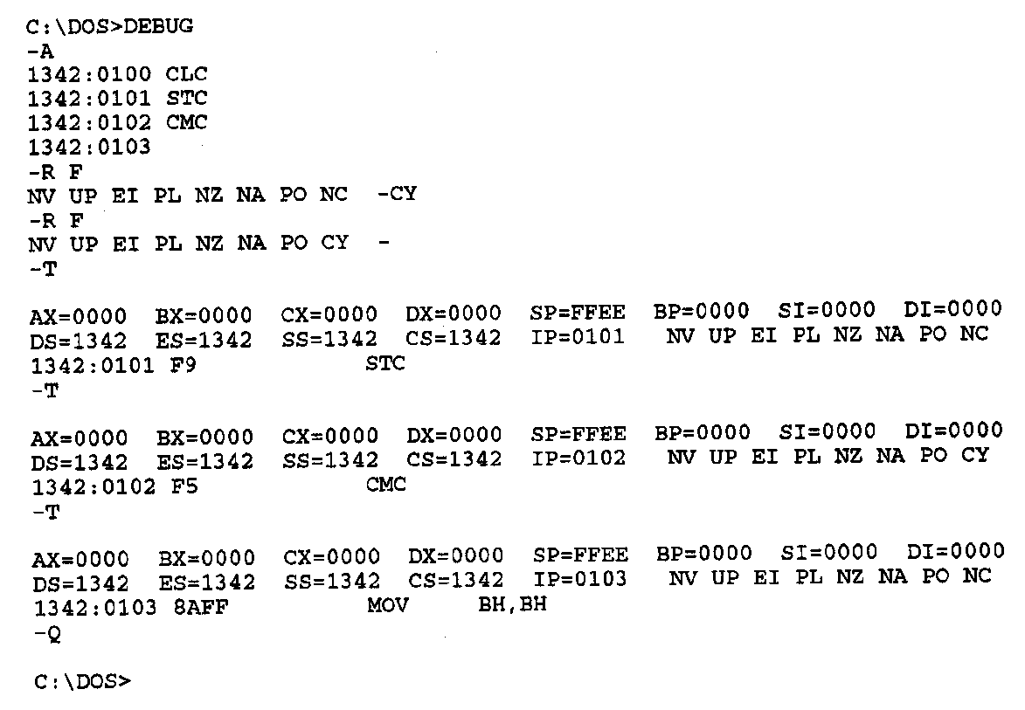
Flag Control Instructions- Example
Debug flag notation
  CF → CY = 1, NC = 0
Example—Execution of carry flag modification instructions
  CY=1
  CLC ;Clear carry flag
    STC ;Set carry flag
    CMC ;Complement carry flag
Microprocessors I: Lecture 5
Notes:
Chapter 6 part 1

Slide 11
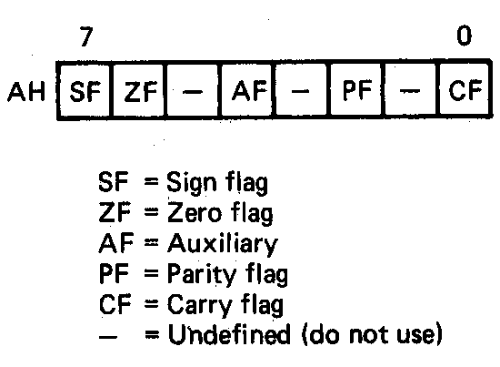
Loading and Saving the Flag Register
All loads and stores of flags take place through the AH register
  Format of the flags in the AH register
    B₀ = CF
    B₂ = PF
    B₄ = AF
    B₆ = ZF
    B₇ = SF
Load AH with content of flags registers (LAHF)
  AH = (Flags)
  Flags unchanged
Store content of AH in flags register (SAHF)
  (Flags) = AH
  SF,ZF,AF,PF,CF → updated
Microprocessors I: Lecture 5
Notes:
Chapter 6 part 1

Slide 12
Loading and Saving the Flag Register
Application—saving a copy of the flags and initializing with new values
LAHF ;Load of flags into AH
MOV [MEM1],AH ;Save old flags at address MEM1
MOV AH,[MEM2] ;Read new flags from MEM2 into AH
SAHF ;Store new flags in flags register
Microprocessors I: Lecture 5
Notes:
Chapter 6 part 1

Slide 13
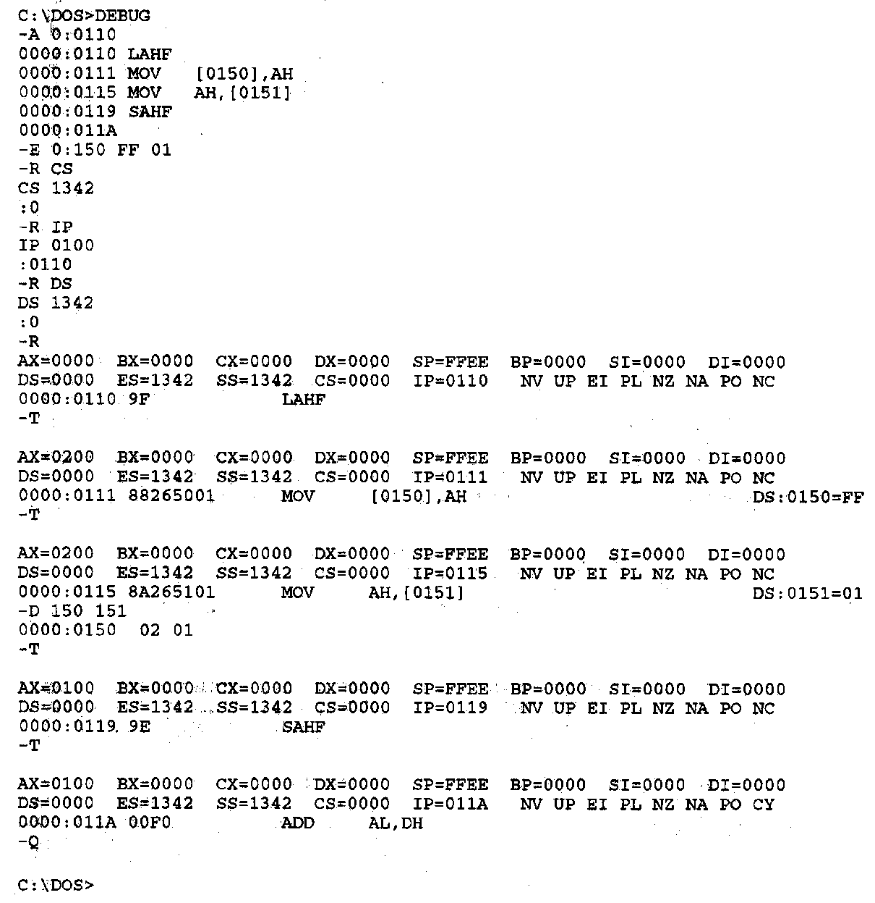
Flag Control Instructions- Example
Example—Execution of the flags save and initialization sequence
Other flag notation:
  Flag = 1/0
  SF = NG/PL
  ZF = ZR/NZ
  AF = AC/NA
  PF = PE/PO
Microprocessors I: Lecture 5
Notes:
Chapter 6 part 1

Slide 14
Example
Given initial state shown in handout
List all changed registers/memory locations and their values, as well as CF
Instructions
  LAHF
  MOV [20H], AH
  MOV AH, [30H]
  SAHF
  MOV AX, [26H]
  CMC
  RCL AX, CL
Microprocessors I: Lecture 5

Slide 15
Example solution
LAHF
  AH = Flags register = 00H
MOV [20H], AH
  Address = DS:20H = 10110H
  Byte at 10110H = 00H
MOV AH, [30H]
  Address = DS:30H = 10120H
  AH = byte at 10120 = 1EH
SAHF
  Flags register = AH = 1EH
  SF = Bit 7 = 0
  ZF = Bit 6 = 0
  AF = Bit 4 = 1
  PF = Bit 2 = 1
  CF = Bit 0 = 0
Microprocessors I: Lecture 5

Slide 16
Example solution (cont.)
MOV AX, [26H]
  Address = DS:26H = 10116H
  AX = word at 10116 = 4020H
CMC
  Complement CF
  CF = ~CF = ~0 = 1
RCL AX, CL
  Rotate AX left through carry by CL places
  (CF,AX) = 1 0100 0000 0010 0000₂ rotated left by 5
  AX = 0000 0100 0001 0100₂ = 0414H, CF = 0
Microprocessors I: Lecture 5

Slide 17
Compare Instructions
Compare 2 values; store result in ZF/SF
General format: CMP D,S
  Works by performing subtraction (D) – (S)
    D, S unchanged
  ZF/SF/OF indicate result (signed values)
    ZF = 1 → D == S
    ZF = 0, (SF XOR OF) = 1 → D < S
    ZF = 0, (SF XOR OF) = 0 → D > S
Microprocessors I: Lecture 5
Notes:
Chapter 6 part 1
(D) (S) result CF SF AF
AX BX
2345>1234 0 0 0
1234<2345 1 1 1
1234>ABCD 1 0 1
ABCD<1234 0 1 0
ABCD>A000 0 0 0
A000<ABCD 1 1 1
7FFF 8000 overflow

Slide 18
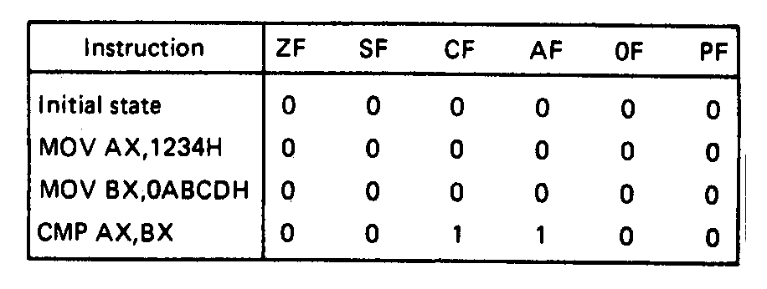
Compare Instructions- Example
Example—Initialization of internal registers with immediate data and compare. Example:
    MOV AX,1234H ;Initialize AX
    MOV BX,ABCDH ;Initialize BX
    CMP AX,BX ;Compare AX-BX
  Data registers AX and BX initialized from immediate data
  IMM16 → (AX) = 1234H → + integer
  IMM16 → (BX) = ABCDH → - integer
  Compare computation performed as:
  (AX) = 0001001000110100₂ (BX) = 1010101111001101₂
(AX) – (BX) = 0001001000110100₂ - 1010101111001101₂
  ZF = 0 = NZ
  SF = 0 = PL ;treats as signed numbers
  CF = 1 = CY
  AF = 1 = AC
  OF = 0 = NV
  PF = 0 = PO
Microprocessors I: Lecture 5
Notes:
Chapter 6 part 1

Slide 19
Condition codes
Conditional execution: result depends on value of flag bit(s)
Intel instructions specify condition codes
  Condition code implies certain flag values
  Opcodes written with cc as part of name
  cc can be replaced by any valid code
  Examples: SETcc, Jcc
    Specific examples: SETL, SETZ, JNE JG
Microprocessors I: Lecture 5

Slide 20
Condition codes (cont.)
Testing overflow alone
  O (OF = 1), NO (OF =0)
Testing carry flag alone
  “Below” or “above” describes carry flag
  Used with unsigned comparisons
  B, NAE, or C (CF = 1)
  NB, AE, or NC (CF = 0)
Testing sign flag alone
  S (SF = 1), NS (SF = 0)
Testing parity flag alone
  P or PE (PF = 1)
  NP or PO (PF = 0)
Microprocessors I: Lecture 5

Slide 21
Condition codes (cont.)
Testing equality/zero result
  E or Z (ZF = 1)
  NE or NZ (ZF = 0)
Codes that combine multiple flags
  Testing “above”/”below” and equality
    BE or NA (CF OR ZF = 1)
    NBE or A (CF OR ZF = 0)
  Testing less than/greater than
    L or NGE (SF XOR OF = 1)
    NL or GE (SF XOR OF = 0)
    LE or NG ((SF XOR OF) OR ZF = 1)
    NLE or G ((SF XOR OF) OR ZF = 0)
Microprocessors I: Lecture 5

Slide 22
Byte Set on Condition Instruction
Byte set on condition instruction
  Used to set byte based on condition code
  Can be used for boolean results—complex conditions
  General format:
    SETcc D
    cc = one of the supported conditional relationships
Microprocessors I: Lecture 5
Notes:
Chapter 6 part 1

Slide 23
Byte Set on Condition Instruction
Operation: Flags tested for conditions defined by “cc” and the destination in a register or memory updated as follows
If cc test True:
  11111111₂ = FFH → D
  If cc test False:
  00000000₂ = 00H → D
Examples of conditional tests:
SETE = set byte if equal → ZF = 1
SETC = set byte if carry → CF =1
SETBE = set byte if below or equal → CF = 1 +(or) ZF = 1
Example: SETA AL = set byte if above
  if CF = 0 • (and) ZF = 0
  (AL) = FFH
  Otherwise,
  (AL) =00H
Microprocessors I: Lecture 5
Notes:
Chapter 6 part 1

Slide 24
Example
Show the results of the following instructions, assuming that
  “A” = DS:100H = 0001H
  “B” = DS:102H = 0003H
  “C” = DS:104H = 1011H
  “D” = DS:106H = 1011H
  “E” = DS:108H = ABCDH
  “F” = DS:10AH = DCBAH
What complex condition does this sequence test?
MOV AX, [100H]
CMP AX, [102H]
SETLE BL
MOV AX, [104H]
CMP AX, [106H]
SETE BH
AND BL, BH
MOV AX, [108H]
CMP AX, [10AH]
SETNE BH
OR BL, BH
Microprocessors I: Lecture 5

Slide 25
Example solution
Condition being tested:
  To simplify, treat each word as a variable named “A” through “F”
  ((A <= B) && (C == D)) || (E != F)
Source: http://www.arl.wustl.edu/~lockwood/class/cs306/books/artofasm/Chapter_6/CH06-4.html
Microprocessors I: Lecture 5

Slide 26
Jump instructions
Used to change flow of program
  Next instruction specified by operand
Two general types
  Unconditional: JMP <target>
    Always goes to address indicated by <target>
  Conditional: Jcc <target>
    Jump only occurs if condition true
    cc replaced by valid condition code
      Most codes discussed in previous lecture
      Additional codes: CXZ/ECXZ
      → CX/ECX register is zero
Microprocessors I: Lecture 5

Slide 27
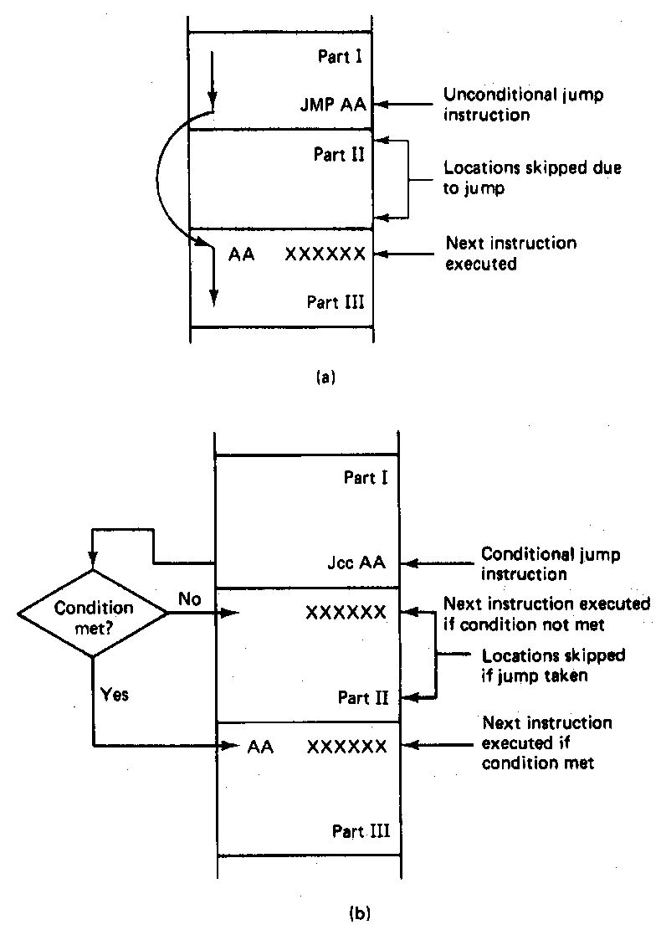
Jump Instructions
Microprocessors I: Lecture 5
Notes:
Chapter 6 part 1

Slide 28
Jump targets
Depends on distance from jump instruction
  Recall: CS:IP is logical addr. of current inst.
Intrasegment: target in same segment
  8-bit (short-label)/16-bit (near-label) immediate
    Signed offset added to current IP
    Usually specified by code writer simply as label
      E.g., JMP LABEL1
  16-bit register or memory location
    IP overwritten by contents of memory or register
    Register example: JE BX
    Memory example: JE WORD PTR [BX]
Microprocessors I: Lecture 5

Slide 29
Jump targets (cont.)
Depends on distance from jump instruction
  Recall: CS:IP is logical addr. of current inst.
Intersegment: target in different segment
  32-bit (far-label) immediate
  32-bit register
  32-bit memory location (DWORD PTR)
  In all cases, CS = upper 16 bits; IP = lower 16 bits
Microprocessors I: Lecture 5

Slide 30
Example: jump targets
Given CS = 1200H, IP = 0100H, and EBX = 14000020H, what are the target addresses of the following jump instructions?
  JMP 08H
  JPE FFF0H
  JE BX
  JNZ EBX
Microprocessors I: Lecture 5

Slide 31
Example solution
JMP 08H
  Short-label jump → add constant value to IP
  IP = 0100 + 08 = 0108H
  Target = CS:IP = 12000+0108 = 12108H
JPE FFF0H
  Near-label jump → add constant value to IP
  IP = 0100 + FFF0 = 00F0H
  Target = CS:IP = 12000+00F0 = 120F0H
Microprocessors I: Lecture 5

Slide 32
Example solution (cont.)
JE BX
  Register jump → overwrite IP with 16-bit register value
  IP = BX = 0020H
  Target = CS:IP = 12000 + 0020 = 12020H
JNZ EBX
  Register jump → overwrite CS, IP with 32-bit register value
  CS = upper word of EBX = 1400H
  IP = BX = 0020H
  Target = CS:IP = 14000 + 0020 = 14020H
Microprocessors I: Lecture 5

Slide 33
Example: program structure 1
Given the instructions below, what are the resulting register values if:
  AX = 0010H, BX = 0010H
  AX = 1234H, BX = 4321H
What type of high-level program structure does this sequence demonstrate?
Instructions
  CMP AX, BX
  JE L1
  ADD AX, 1
  JMP L2
  L1: SUB AX, 1
  L2: MOV [100H], AX
Microprocessors I: Lecture 5

Slide 34
Example solution
First case: AX = BX = 0010H
  CMP AX, BX → Shows AX == BX
  JE L1 → Cond. true—jump to L1
  ADD AX, 1
  JMP L2
  L1: SUB AX, 1 → AX = AX – 1 = 000F
  L2: MOV [100H], AX → Store 000F at DS:100H
Microprocessors I: Lecture 5

Slide 35
Example solution (cont.)
Second case: AX = 1234H, BX = 4321H
  CMP AX, BX → Shows AX < BX
  JE L1 → Cond. false—no jump
  ADD AX, 1 → AX = AX + 1 = 1235H
  JMP L2
  L1: SUB AX, 1 → AX = AX – 1 = 000F
  L2: MOV [100H], AX → Store 000F at DS:100H
Microprocessors I: Lecture 5

Slide 36
Example solution (cont.)
High-level program structure: if/else statement
  If part: compare + jump (if (AX == BX))
  Else part: what follows if condition false
  Unconditional jump used to skip “if” part
  Both parts have same exit (L2)
Microprocessors I: Lecture 5

Slide 37
Example: program structure 2
Given the instructions below, what are the resulting register values if, initially, AX = 0001H?
What type of high-level program structure does this sequence demonstrate?
Instructions
  MOV CL, 5
  L: SHL AX, 1
  DEC CL
  JNZ L
Microprocessors I: Lecture 5

Slide 38
Example: program structure 3
Given the instructions below, what are the resulting register values if, initially, AX = 0001H?
What type of high-level program structure does this sequence demonstrate?
Instructions
  MOV CL, 5
  L: JCXZ END
  ADD AX, AX
  DEC CL
  JMP L
  END: MOV [10H], AX
Microprocessors I: Lecture 5

Slide 39
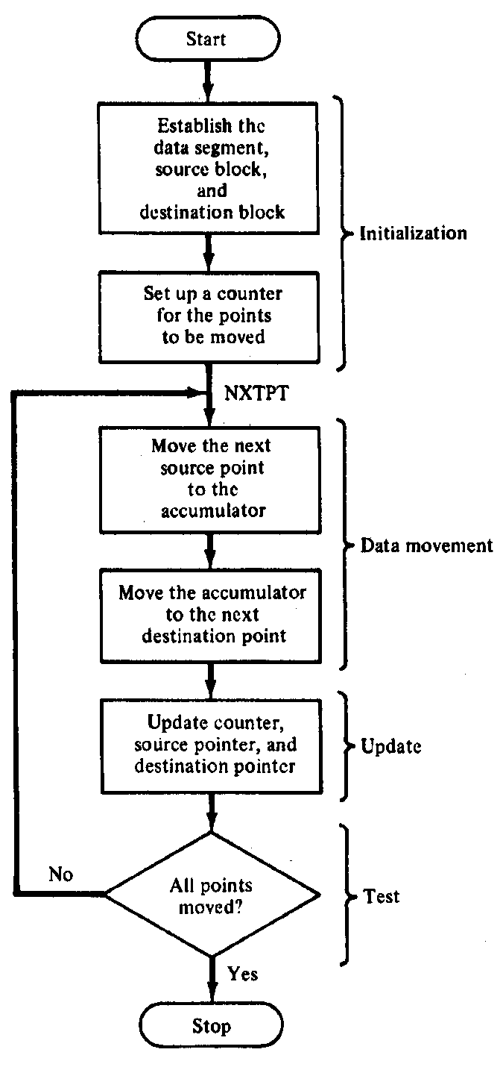
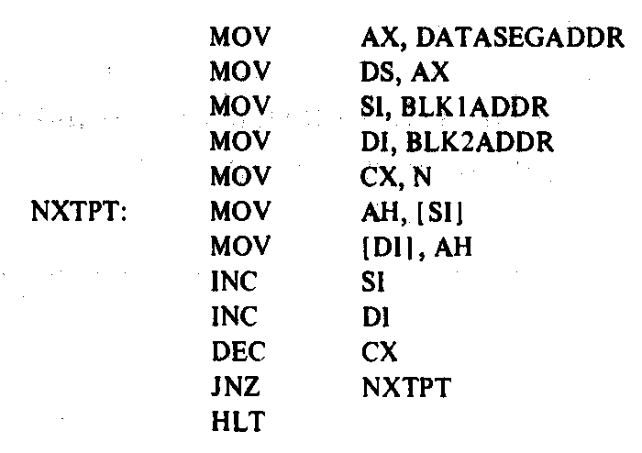
Block Move Program
Microprocessors I: Lecture 5
Notes:
Chapter 6 part 1

Slide 40
Loop instructions
Common operations in basic loops
  Compare
  Conditional jump
  Decrement loop counter (CX)
Loop instructions combine all into one op
  All decrement CX by 1, then check if CX == 0
  <target> must be short-label (8-bit immediate)
  LOOP <target>: Return to <target> if CX != 0
  LOOPE/LOOPZ <target>: Return to <target> if (CX != 0) && (ZF == 1)
  LOOPNE/LOOPNZ <target>: Return to <target> if (CX != 0) && (ZF != 1)
Microprocessors I: Lecture 5

Slide 41
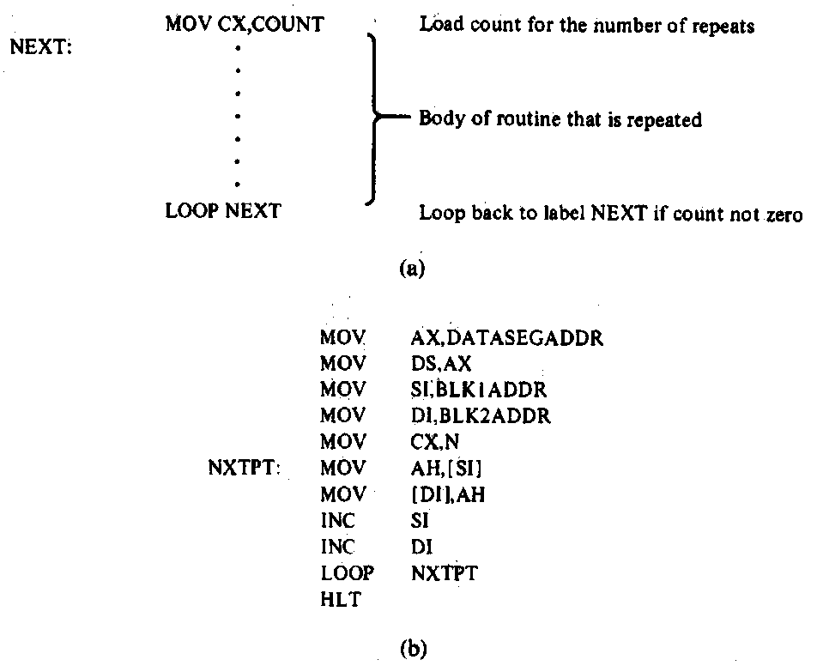
Loop Program Structure
Structure of a loop
  CX = initial count
  Loop body: code to be repeated
  Loop instruction– determines if loop is complete or if the body is to repeat
Example: block move
Microprocessors I: Lecture 5
Notes:
Chapter 6 part 2

Slide 42
Loop example 1
Rewrite the post-tested loop seen earlier using a loop instruction:
  MOV CL, 5
  L: SHL AX, 1
  DEC CL
  JNZ L
Solution:
  MOV CL, 5
  L: SHL AX, 1
  LOOP L
Microprocessors I: Lecture 5

Slide 43
Loop example 2
Describe the operation of the following program (Example 6.15-6.16).
What is the final value of SI if the 15 bytes between 0A001 and 0A00F have the following values?
  00 01 02 03 04 05 06 07 08 09 0A 0B 0C 0D 0E
MOV DL, 05
MOV AX, 0A00
MOV DS, AX
MOV SI, 0000
MOV CX, 000F
AGAIN: INC SI
CMP [SI], DL
LOOPNE AGAIN
Microprocessors I: Lecture 5

Slide 44
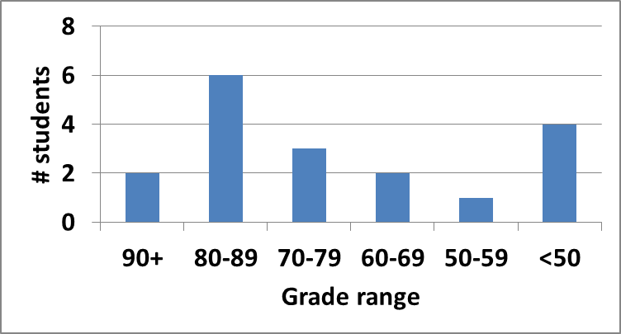
Exam stats
Question-by-question averages:
  Q1: 11.1 / 20 (56%)
  Q2: 34.1 / 40 (85%)
  Q3: 25.3 / 40 (63%)
Average: 70.6
Median: 71.5
Std. deviation: 18
Max: 93
Microprocessors I: Lecture 5

Slide 45
Regrade requests
Due Monday, 7/30
Must be written (preferably on a separate sheet)
You must also return your exam
  Do not write on your exam if you plan on submitting a regrade request
Must demonstrate understanding of problem
  Bad: “I deserve more points on Problem 3a.”
  Good: “I deserve more points on Problem 3a because I calculated a wrong result for one instruction based on a wrong result from a previous instruction. I used the right operation; I just plugged in the wrong value.”
Microprocessors I: Lecture 5

Slide 46
Final notes
Next time
  Subroutine instructions
  80386DX protected mode
Reminders
  HW 2, Lab 3 both due Monday, 7/30
  Exam 2 one week from Wednesday (8/2)
Microprocessors I: Lecture 5

