Slide 1
16.317
Microprocessor Systems Design I
Instructor: Dr. Michael Geiger
Summer 2013
Lecture 2:
x86 introduction
General microprocessor introduction
Data: types, storage, and addressing modes

Slide 2
Lecture outline
Announcements/reminders
  Sign up for the discussion group on Piazza
  HW 1 due Friday, 7/12
  HW 2 to be posted
Review
  Instruction set architecture
  Data types
  Data storage
  Addressing modes
Today’s lecture: x86 introduction
  Registers
  Memory organization and addressing
  Assembly introduction
  Data transfer instructions
Microprocessors I: Lecture 2

Slide 3
Review: processor basics; ISA
Processor components
  Microprocessor for computation
  Input/output to communicate with outside world
  Storage to hold code/data
Instruction set architecture
  Defines how programmer interfaces with hardware
  Operations generally fall into one of four groups
    Data transfer: move data across storage locations
    Arithmetic: add, subtract, etc.
    Logical: AND, OR, shifts, etc.
    Program control: jumps/branches/calls
Microprocessors I: Lecture 2

Slide 4
Review: ISA, storage
Instruction set architecture (cont.)
  Operands: the data being operated on
    How are the bits interpreted? (int, FP, signed/unsigned)
    What size are they? (byte, word, etc.)
    How do we reference operands?
  Instruction formats: how instructions are encoded
Data storage
  Registers
    Small, fast set of on-chip storage (primarily for speed)
    Referenced by name
  Memory
    Larger, slower set of storage (primarily for capacity)
    Organized as hierarchy …
    … but programmer references single range of addresses
    Memory issues
      Aligned data: address divisible by number of bytes
      Endianness: 80x86 data is little endian
Microprocessors I: Lecture 2

Slide 5
Review: Addressing modes
Addressing modes
  Register addressing → data in register
  Immediate addressing → data in instruction
  Memory addressing → data in memory
    Need effective address
    EA calculation
      Direct addressing → EA = constant
      Register indirect → EA = register value
      Base + displacement addressing → EA = constant + reg(s)
Microprocessors I: Lecture 2

Slide 6
x86 intro
“x86” → family of Intel ISAs
  Starts with 8086 processor (1978)
  Used (w/extensions) in current processors
General purpose processor
Supports use of 8, 16, 32, or 64 bit data
Allows both register and memory operands
Segmented memory architecture
Real and protected mode operation
  Protected mode supports virtual memory
Microprocessors I: Lecture 2

Slide 7
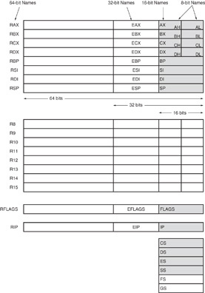
Register Set
Nine 32-bit registers
  (4) Data registers- EAX, EBX, ECX, EDX, can be used as 32, 16 or 8bit
  (2) Pointer registers- EBP, ESP
  (2) Index registers- ESI, EDI
  (1) Instruction pointer- EIP
Six 16-bit registers
  (6) Segment registers- CS, DS, SS, ES, FS, GS
Flags (status) register-EFLAGS
Microprocessors I: Lecture 2
Notes:
Chapter 2

Slide 8
Register Set
64-bit extensions
  Added with Pentium 4
  Data/pointer/index/IP/ flag register extended to 64 bits
  8 additional data registers (R8-R15)
Microprocessors I: Lecture 2
Notes:
Chapter 2

Slide 9
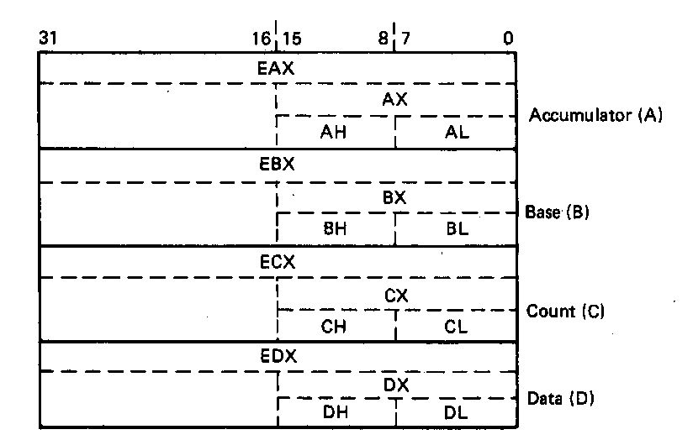
General Purpose Data Registers
Four general purpose data registers
  Accumulator (A) register
  Base (B) register
  Count (C) register
  Data (D) register
Can hold 8-bit, 16-bit, or 32-bit data
  AH/AL = high and low byte value
  AX = word value
  EAX = double word value
General uses:
  Hold data such as source or destination operands for most operations—ADD, AND, SHL
  Hold address pointers for accessing memory
Some also have dedicated special uses
  C—count for loop,
  B—table look-up translations, base address
  D—indirect I/O and string I/O
Microprocessors I: Lecture 2
Notes:
Chapter 2

Slide 10
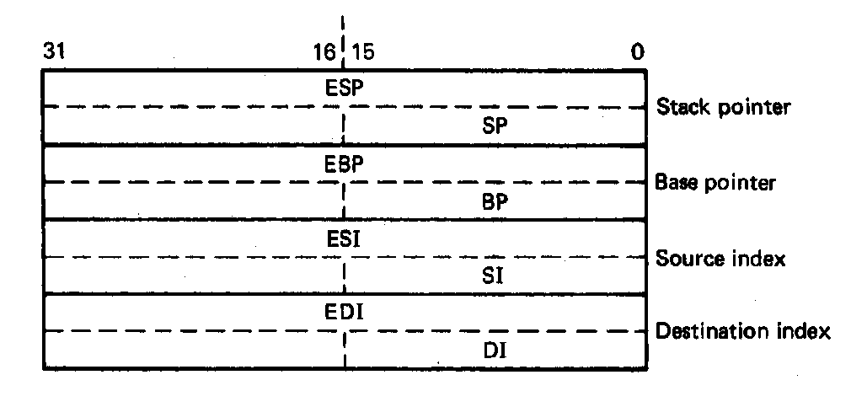
Pointer Registers
Two pointer registers
  Stack pointer register
    ESP = 32-bit extended stack pointer
    SP = 16-bit stack pointer
  Base pointer register
    EBP = 32-bit extended base pointer
    BP = 16-bit base pointer
Use to access information in stack segment of memory
  SP/BP offsets from the current value of the stack segment base address
  Select a specific storage location in the current 64K-byte stack segment
    SS:SP—points to top of stack (TOS)
    SS:BP—points to data in stack
Microprocessors I: Lecture 2
Notes:
Chapter 2

Slide 11
Index Registers
Two index registers
  Source index register
    ESI = 32-bit source index register
    SI = 16-bit source index register
  Destination index registers
    EDI = 32-bit destination index register
    DI = 16-bit destination index register
  Used to access source and destination operands in data segment of memory
    DS:SI—points to source operand in data segment
    DS:DI—points to destination operand in data segment
    Also used to access information in the extra segment (ES)
Microprocessors I: Lecture 2
Notes:
Chapter 2

Slide 12
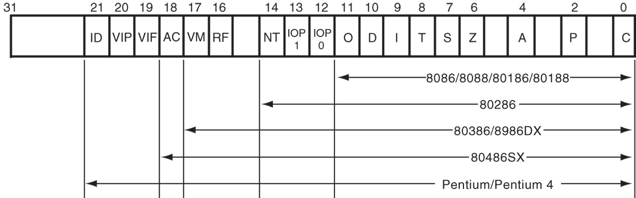
Flags Register
32-bit register holding single bit status and control information
9 active flags in real mode
Two categories
  Status flags: conditions resulting from instruction
    Most instructions update status
    Used as test conditions
  Control flags: control processor functions
    Used by software to turn on/off operating capabilities
Microprocessors I: Lecture 2
Notes:
Chapter 2

Slide 13
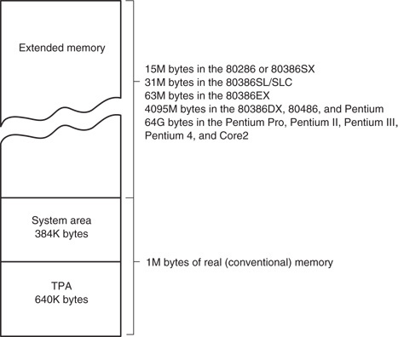
x86 memory spaces
x86 architecture implements independent memory and input/output (not shown) address spaces
Memory address space
  1 MB “real” memory
    System + transient program area (TPA)
  Extended memory size dependent on processor
Input/output address space- 65,536 bytes long (64KB)
Microprocessors I: Lecture 2
Notes:
Chapter 2

Slide 14
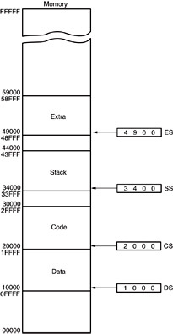
Memory segmentation
Only subset of address space is active (accessible)
Memory split into segments
  Active sections of memory
  Segments may overlap
  Segment size can be fixed (as in x86 real mode) or variable (as in protected mode)
Architecture requires register(s) to store start of active segment(s)
Microprocessors I: Lecture 2
Notes:
Chapter 2

Slide 15
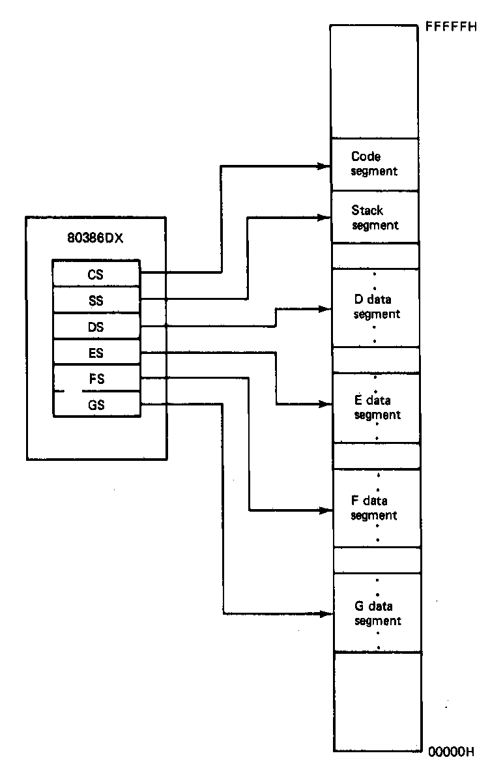
Segmentation in x86
Each real mode segment 64KB
Six programmer-controlled segment registers indicate start of each segment
Each segment must start on 16-byte boundary
  Valid starting addresses: 00000H, 00010H, 00020H, etc.
Total active memory: 384 KB
  64 KB code segment (CS)
  64 KB stack segment (SS)
  256 KB over 4 data segments (DS, ES, FS, GS)
Microprocessors I: Lecture 2
Notes:
Chapter 2

Slide 16
x86 memory addressing
Two pieces to address in segmented memory
  Starting address of segment
  Offset within segment
x86 real mode specifics
  All addresses are 20 bits
  Segment registers hold upper 16 bits of segment base address
    Where are the lower 4 bits of the base address?
      Always 0, since starting address must be divisible by 16
  Calculated effective address used as 16-bit offset
    Why is offset 16 bits?
      64KB = 2¹⁶ → 16 bit address needed to choose location within segment
Microprocessors I: Lecture 2

Slide 17
x86 memory addressing
Within instruction, address is combination of segment register/effective address
  Address of form SBA:EA
    SBA = segment base address
    EA = effective address
  EA based on addressing mode
  Address examples
    CS:IP → address of current instruction
    SS:SP → address of top of stack
    DS:0100H → address within current data segment with offset 0100H
Use this information to find linear address
  Program-generated location in memory space
Microprocessors I: Lecture 2

Slide 18
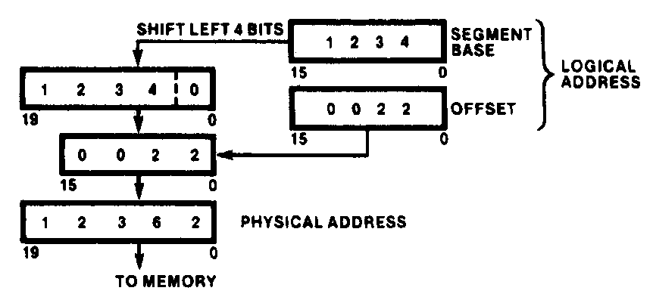
Generating Real-Mode Memory Address
  Segment base address = 1234H
  Offset = 0022H
  1234H = 0001001000110100₂
  0022H = 0000000000100010₂
  Shifting base address,
  00010010001101000000₂ = 12340H
  Adding binary segment address and offset
00010010001101000000₂ + 0000000000100010₂
= 00010010001101100010₂
    = 12362H
  In hex:
  12340H + 0022H = 12362H
Microprocessors I: Lecture 2
Notes:
Chapter 2

Slide 19
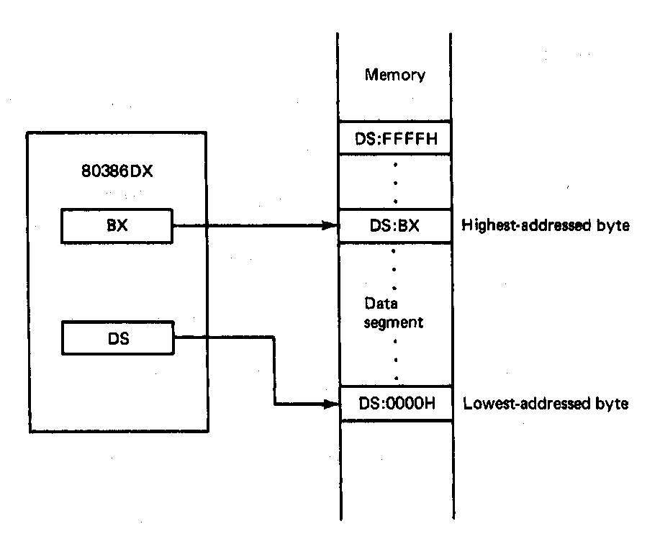
Boundaries of a Segment
Six active segments: CS, DS, ES. GS, FS, SS
  Each 64K-bytes in size → maximum of 384K-bytes of active memory
    64K-bytes for code
    64K-bytes for stack
    256K-bytes for data
Starting address of a data segment
DS:0H → lowest addressed byte
Ending address of a data segment
DS:FFFFH → highest addressed byte
Address of an element of data in a data segment
  DS:BX → address of a byte, word, or
  double word element of data in the
  data segment
Microprocessors I: Lecture 2
Notes:
Chapter 2

Slide 20
Address generation examples
Given the following register values:
  CS = 0x1000
  SS = 0x2000
  DS = 0x3000
  ES = 0x4000
  EIP = 0x00000100
  ESP = 0x0002FF00
  EBP = 0x0000F000
  ESI = 0x0001000E
  EBX = 0xABCD1234
What linear addresses correspond to the following logical addresses?
  CS:IP
  SS:SP
  SS:BP
  DS:SI
  ES:BX
Microprocessors I: Lecture 2

Slide 21
Example solutions
CS:IP
  CS << 4 = 0x10000
  Address = 0x10000 + 0x0100 = 0x10100
SS:SP
  SS << 4 = 0x20000
  SP = lower 16 bits of ESP = 0xFF00
  Address = 0x20000 + 0xFF00 = 0x2FF00
SS:BP
  SS << 4 = 0x20000
  BP = lower 16 bits of EBP = 0xF000
  Address = 0x20000 + 0xF000 = 0x2F000
Microprocessors I: Lecture 2

Slide 22
Example solutions (cont.)
DS:SI
  DS << 4 = 0x30000
  SI = lower 16 bits of ESI = 0x000E
  Address = 0x30000 + 0x000E = 0x3000E
ES:BX
  ES << 4 = 0x40000
  BX = lower 16 bits of EBX = 0x1234
  Address = 0x40000 + 0x1234 = 0x41234
Microprocessors I: Lecture 2

Slide 23
80386DX memory operands
Addresses in 80386DX instructions enclosed by brackets
Most instructions don’t explicitly specify segment register
  DS is usually default
  Some instructions use SS, CS as default
Examples (using basic MOV instruction)
  MOV AX, [0100H] → move data from DS:100H to AX
  MOV AX, DS:[0100H] → same as above
  MOV AX, ES:[0100H] → move data from ES:100H to AX
In all examples above
  0100H is effective address
  Segment register is either DS or ES
Microprocessors I: Lecture 2

Slide 24
x86 addressing modes
All examples of general addressing modes discussed earlier
Direct addressing
  EA = constant value
  Example: MOV AX, [0100H]
Register indirect addressing
  EA = value stored in register
  Valid registers: SI, DI, BX, BP
    SS default segment if BP used; DS otherwise
  Example: MOV [DI], AX
Base-plus-index addressing
  EA = base register (BX/BP) + index register (SI/DI)
  Example: MOV AX, [BX+SI]
Microprocessors I: Lecture 2

Slide 25
x86 addressing modes (cont.)
Register relative addressing
  EA = register + constant
  Examples:
    MOV CL, [BX+4]
    MOV AX, ARRAY[BX] ARRAY is constant memory location
Base relative-plus-index addressing
  EA = base register + index register + constant
  Example: MOV AX, 10H[SI][BX] -or-
  MOV AX, [10H+SI+BX]
Scaled-index addressing
  EA = register + (scaling factor * second register)
  Often useful for array accesses
    Scaling factor = element size (2, 4, 8 bytes)
  Example: MOV EDX, [EAX + 4*EBX]
Microprocessors I: Lecture 2

Slide 26
Example
Compute the physical address for the specified operand in each of the following instructions. The register contents and variables are as follows:
  (CS) = 0A00₁₆
  (DS) = 0B00₁₆
  (ESI) = 00000100₁₆
  (EDI) = 00000200₁₆
  (EBX) = 00000300₁₆
Destination operand in: MOV [DI], AX
Source operand in: MOV DI, [SI]
Destination operand in: MOV [BX+0400H], CX
Destination operand in: MOV [DI+0400H], AH
Destination operand in MOV [BX+DI+0400H], AL
Microprocessors I: Lecture 2

Slide 27
Example solutions
Note: all memory operands in problem use data segment
  DS = 0B00H → segment base address (SBA) = 0B000H
  Linear address (LA) = SBA + effective address (EA)
Destination operand in: MOV [DI], AX
  EA = value in DI = 0200H
  LA = 0B000H + 0200H = 0B200H
Source operand in: MOV DI, [SI]
  EA = value in SI = 0100H
  LA = 0B000H + 0100H = 0B100H
Microprocessors I: Lecture 2

Slide 28
Example solutions (cont.)
Destination operand in: MOV [BX+0400H], CX
  EA = value in BX + 0400H = 0300H + 0400H = 0700H
  LA = 0B000H + 0700H = 0B700H
Destination operand in: MOV [DI+0400H], AH
  EA = value in DI + 0400H = 0200H + 0400H = 0600H
  LA = 0B000H + 0600H = 0B600H
Destination operand in MOV [BX+DI+0400H], AL
  EA = BX + DI + 0400H
  = 0300H + 0200H + 0400H = 0900H
  LA = 0B000H + 0900H = 0B900H
Microprocessors I: Lecture 2

Slide 29
Instruction Assembly Notation
Each instruction is represented by a mnemonic that describes its operation—called its operation code (opcode)
  MOV = move (data transfer)
  ADD = add (arithmetic)
  AND = logical AND (logic)
  JMP = unconditional jump (control transfer)
Operands are the other parts of an assembly language instructions
    Identify whether the elements of data to be processed are in registers or memory
      Source operand– location of one operand to be process
      Destination operand—location of the other operand to be processed and the location of the result
Microprocessors I: Lecture 2

Slide 30
Assembly Language Statements
General structure of an assembly language statement
LABEL: INSTRUCTION ;COMMENT
  Label—address identifier for the statement
  Instruction—the operation to be performed
  Comment—documents the purpose of the statement
  Example:
START: MOV AX, BX ; Copy BX into AX
Other examples:
  INC SI ;Update pointer
ADD AX, BX
  Few instructions have a label—usually marks a jump to point
  Not all instructions need a comment
Microprocessors I: Lecture 2
Notes:
Chapter 3

Slide 31
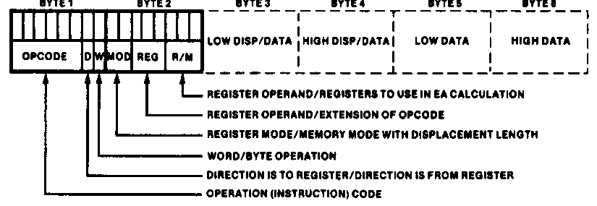
Instruction Encoding
80x86’s instruction set is variable length
  Multiple instruction sizes
    1 to 6 bytes in length for 8088/8086
    Up to 17 bytes for 80386,80486, and Pentium
  Variable length advantages (trait of CISC)
    Allows for many addressing modes
    Allows full size (32-bit) immediate data and addresses
    Instructions can use as many bytes as necessary
  Disadvantage of variable length
    Requires more complicated decoding hardware—speed of decoding is critical in modern uP
    Most uP use fixed length (trait of RISC)
Microprocessors I: Lecture 2
Notes:
Chapter 4

Slide 32
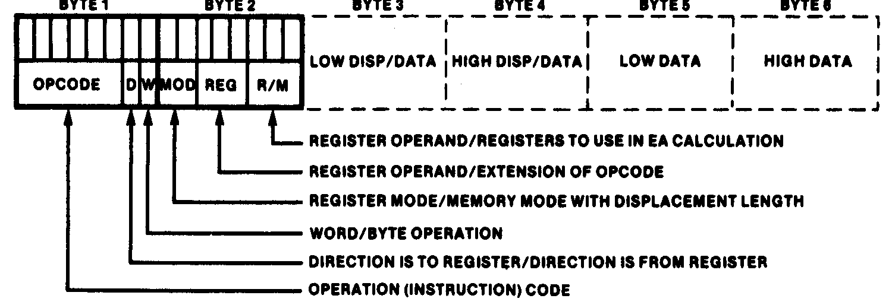
Instruction Encoding
Information encoded in an instruction
  What operation ?
  What operands ?
  Byte, word or double-word ?
  Operands in register or memory ?
  How the address is to be generated, if mem?
Microprocessors I: Lecture 2

Slide 33
x86 data types (“review”)
Refresher on x86 registers
  Gen. purpose registers: 16 or 32 bits
  Data registers can hold 8 bit data as well
  Determining size: register name
  Example: “accumulator” register
    8 bit data: AL = lowest byte; AH = next lowest byte
    16 bit data: AX = lowest 16 bits (AH/AL together as word)
    32 bit data: EAX = entire 32 bits
Say EAX = 1A2B3C4DH
  What are AL, AH, and AX?
  AL = 4DH, AH = 3CH, AX = 3C4DH
Microprocessors I: Lecture 2

Slide 34
x86 memory accesses
# bytes from memory usually = # bytes in register
Example: MOV AX, [100H]
  AX is 16-bit register → move word from DS:100H to AX
Sometimes necessary to specify size
  Use “<size> PTR”: BYTE PTR, WORD PTR, DWORD PTR
  Example: MOVZX EAX, BYTE PTR [100H]
    Take byte from memory
    Zero-extend data to 32 bits and store in EAX
Remember, x86 uses little-endian data
Microprocessors I: Lecture 2

Slide 35
Instruction types
Recall the four general types of instructions used by most microprocessors
  Data transfer
  Arithmetic
  Logical (including shifts, bitwise, etc.)
  Program control
x86 has some additional types (which we may not cover)
  Processor control
  String instructions
  Input/output instructions
Microprocessors I: Lecture 2

Slide 36
Data transfer instructions
MOV
MOVSX
MOVZX
XCHG
LEA
Load full pointer
Additional data transfer instructions (covered later, if at all)
  PUSH/POP (stack transfers)
  INS/OUTS (I/O)
  MOVS/LODS/STOS (string instructions)
  BSWAP (switch from little endian to big endian)
  XLAT (table lookup)
  CMOV (conditional move)
Microprocessors I: Lecture 2

Slide 37
MOV
Used to copy data between
  Registers
  Registers/memory
  Immediate value (source only) to register/memory
Format: MOV D, S
Operation: (D) = (S)
Restrictions
  Immediate value can only be used as source
  If segment register is destination, source must be memory or register (no immediate)
Microprocessors I: Lecture 2

Slide 38
MOV examples
Assume: AX = 0100H, CS = 3000H, (DS:100H) = 00H, (DS:101H) = FFH
MOV BL, AL
  BL = AL = 00H
MOV DX, CS
  DX = CS = 3000H
MOV CX, [100H]
  CX = word starting at DS:100H = FF00H
Microprocessors I: Lecture 2

Slide 39
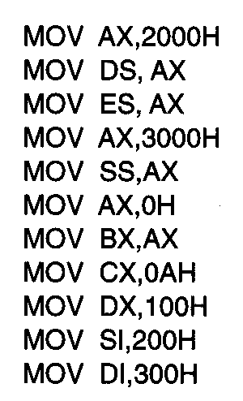
Usage of Move Instruction
Example—Initialization of internal registers with immediate data and address information
  What is the final state of all affected registers?
  Why is AX used to initialize segment registers?
Microprocessors I: Lecture 2
Notes:
Chapter 5 (I)

Slide 40
Usage of Move Instruction (soln)
MOV AX, 2000H → AX = 2000H
MOV DS, AX → DS = AX = 2000H
MOV ES, AX → ES = AX = 2000H
MOV AX, 3000H → AX = 3000H
MOV SS, AX → SS = 3000H
MOV AX, 0H → AX = 0000H
MOV BX, AX → BX = AX = 0000H
MOV CX, 0AH → CX = 000AH
MOV DX, 100H → DX = 0100H
MOV SI, 200H → SI = 0200H
MOV DI, 300H → DI = 0300H
Microprocessors I: Lecture 2
Notes:
Chapter 5 (I)

Slide 41
MOVSX/MOVZX
Move and extend data (fill upper bits with 0/1)
  ZX → zero extend
  SX → sign extend → copy MSB of source
Format: MOVZX D, S
MOVSX D, S
Operation: lower bits of D = S
upper bits of D = 0 (MOVZX) or
upper bits of D = MSB of S (MOVSX)
Restrictions
  Only register/memory operands (no immediates)
  Source must contain fewer bits than destination
  If memory operand used, size must be specified
Microprocessors I: Lecture 2

Slide 42
MOVSX/MOVZX examples
Assume: AX = 0100H, DX = 8100H, (DS:100H) = 00H, (DS:101H) = FFH
What are the results of the following instructions?
MOVSX EBX, AX
MOVSX EBX, DX
MOVZX EBX, DX
MOVSX EBX, BYTE PTR [100H]
MOVSX EBX, WORD PTR [100H]
Microprocessors I: Lecture 2

Slide 43
MOVSX/MOVZX examples (soln)
Assume: AX = 0100H, DX = 8100H, (DS:100H) = 00H, (DS:101H) = FFH
What are the results of the following instructions?
MOVSX EBX, AX
  EBX = AX sign-extended = 00000100H (orig. value underlined)
MOVSX EBX, DX
  EBX = DX sign-extended = FFFF8100H
MOVZX EBX, DX
  EBX = DX zero-extended = 00008100H
MOVSX EBX, BYTE PTR [100H]
  EBX = byte at DS:100 sign-extended = 00000000H
MOVSX EBX, WORD PTR [100H]
  EBX = word at DS:100 sign-extended = FFFFFF00H
Microprocessors I: Lecture 2

Slide 44
XCHG
Swap contents of source and destination
Format: XCHG D, S
Operation: (D) = (S)
(S) = (D)
Restrictions:
  Memory operand can only be used as destination
Microprocessors I: Lecture 2

Slide 45
LEA
Perform effective address computation and store result in register
Format: LEA D, EA
Operation: D = EA
Example: LEA SI, [10H + DI]
Microprocessors I: Lecture 2

Slide 46
Load full pointer
Load contents of memory into both register and segment register
Format: Lxx D, addr
  xx = DS, ES, FS, GS, SS
Operation:
  (D) = contents of addr
  Segment register xx = contents of:
    addr + 2 if D is 16-bit register
    addr + 4 if D is 32-bit register
Microprocessors I: Lecture 2

Slide 47
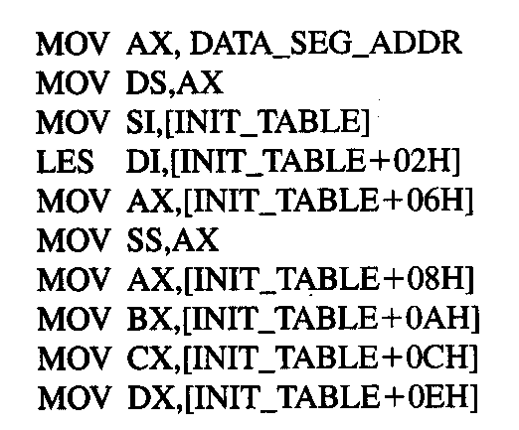
Example
DATA_SEG_ADDR:0000
DATA_SEG_ADDR:INIT_TABLE | 11 | 22
 | 33 | 44
 | 55 | 66
 | 77 | 88
 | 99 | AA
 | BB | CC
 | DD | EE
 | FF | 16
 | 03 | 17
Show the results of running the following program if DATA_SEG_ADDR = 1200H:
Microprocessors I: Lecture 2

Slide 48
Example solution
DATA_SEG_ADDR:0000
DATA_SEG_ADDR:INIT_TABLE | 11 | 22
 | 33 | 44
 | 55 | 66
 | 77 | 88
 | 99 | AA
 | BB | CC
 | DD | EE
 | FF | 16
 | 03 | 17
MOV AX,DATA_SEG_ADDR
  AX = DATA_SEG_ADDR
  = 1200H
MOV DS, AX
  DS = AX = 1200H
MOV SI, [INIT_TABLE]
  SI = memory @ DS:INIT_TABLE
  = 2211H
LES DI,[INIT_TABLE+02H]
  DI = memory @ DS:INIT_TABLE+02H
  = 4433H
  ES = memory @ DS:INIT_TABLE+04H
  = 6655H
Microprocessors I: Lecture 2

Slide 49
Example solution (cont.)
DATA_SEG_ADDR:0000
DATA_SEG_ADDR:INIT_TABLE | 11 | 22
 | 33 | 44
 | 55 | 66
 | 77 | 88
 | 99 | AA
 | BB | CC
 | DD | EE
 | FF | 16
 | 03 | 17
MOV AX,[INIT_TABLE+06H]
  AX = memory @ DS:INIT_TABLE+06H
  = 8877H
MOV SS, AX
  SS = AX = 8877H
MOV AX,[INIT_TABLE+08H]
  AX = memory @ DS:INIT_TABLE+08H
  = AA99H
MOV BX,[INIT_TABLE+0AH]
  BX = memory @ DS:INIT_TABLE+0AH
  = CCBBH
Microprocessors I: Lecture 2

Slide 50
Example solution (cont.)
DATA_SEG_ADDR:0000
DATA_SEG_ADDR:INIT_TABLE | 11 | 22
 | 33 | 44
 | 55 | 66
 | 77 | 88
 | 99 | AA
 | BB | CC
 | DD | EE
 | FF | 16
 | 03 | 17
MOV CX,[INIT_TABLE+0CH]
  CX = memory @ DS:INIT_TABLE+0CH
  = EEDDH
MOV DX,[INIT_TABLE+0EH]
  DX = memory @ DS:INIT_TABLE+0EH
  = 16FFH
Microprocessors I: Lecture 2

Slide 51
Final notes
Next time: Continue with x86 instruction set
Reminders:
  Sign up for the discussion group on Piazza
  HW 1 due Friday, 7/12
  HW 2 to be posted; due date TBD
Microprocessors I: Lecture 2

