Slide 1
16.317
Microprocessor Systems Design I
Instructor: Dr. Michael Geiger
Summer 2013
Lecture 3:
Arithmetic instructions
Logical, shift, and rotate instructions
Bit test/scan instructions

Slide 2
Lecture outline
Announcements/reminders
  Sign up for the discussion group on Piazza
  HW 2 due today
  HW 3 to be posted; due Friday, 7/19
  Exam 1: Tuesday, 7/23
Review: x86 intro
  Registers
  Memory organization and addressing
  Assembly introduction
  Data transfer instructions
Today’s lecture: more of the x86 ISA
  Arithmetic instructions
  Logical, shift, and rotate instructions
  Bit test/scan instructions
Microprocessors I: Lecture 3

Slide 3
Review: x86 memory
Six segment registers: CS (code), SS (stack), DS, ES, FS, GS (data)
Each segment 64 KB, starts on 16B boundary
  Lowest hex digit of 20-bit address = 0
Logical address → SBA:EA
  Examples: DS:SI, SS:SP, CS:IP, DS:1000H
Physical address: actual memory address
  Shift 16-bit segment register to left by 4 bits = SBA
  Add 16-bit EA to SBA
Calculating EA
  Direct addressing: EA = const
  Register indirect: EA = reg
    Only BP/SP use SS; others use DS by default
  Based-indexed: EA = base reg. + index reg.
  Register relative: EA = reg. + const
  Base-relative-plus-index: EA = base reg. + index reg. + const.
  Scaled-index: EA = register + (scaling factor * second register)
Microprocessors I: Lecture 3

Slide 4
Review: data & data transfer instructions
x86 data accesses
  Registers: access as 8-bit (e.g. AL, AH), 16-bit (AX), 32-bit (EAX)
  Memory
    Data size usually matches register
    If not, explicitly specify (BYTE PTR, WORD PTR, DWORD PTR)
MOV: basic data transfer
  Can use registers, memory, immediates
  If segment reg. is destination, source must be register
MOVSX/MOVZX
  Sign-extend or zero-extend register/memory value
XCHG
  Exchange contents of source, dest
Microprocessors I: Lecture 3

Slide 5
Review: data transfer (continued)
LEA: load effective address
  Calculate EA/store in register
Load full pointer (LDS/LES/LFS/LGS/LSS)
  Load dest & segment register from memory
Microprocessors I: Lecture 3

Slide 6
Arithmetic instructions
Addition
  ADD
  ADC
  INC
Subtraction
  SUB
  SBB
  DEC
  NEG
Multiplication/division
  MUL
  IMUL
  DIV
  IDIV
Microprocessors I: Lecture 3

Slide 7
Flags
All arithmetic instructions set flags
  CF = carry flag (carry output from MSB of add/sub)
  OF = overflow flag
  ZF = zero flag (result is zero)
  SF = sign flag (1 if negative, 0 if positive)
  PF = parity flag (even parity in LSB)
  AF = auxiliary carry (carry between nibbles)
Stored in FLAGS register
Referenced in conditional instructions
Microprocessors I: Lecture 3

Slide 8
Addition instructions
ADD D, S
  Operation: (D) = (D) + (S)
ADC D, S
  Operation: (D) = (D) + (S) + (CF)
INC D
  Operation: (D) = (D) + 1
Microprocessors I: Lecture 3

Slide 9
Subtraction instructions
SUB D, S
  Operation: (D) = (D) – (S)
SBB D, S
  Operation: (D) = (D) – (S) – (CF)
DEC D
  Operation: (D) = (D) – 1
NEG D
  Operation: (D) = -(D)
  Two’s complement negation
Microprocessors I: Lecture 3

Slide 10
Addition/subtraction examples
Given the following initial state:
  AX = 1234H
  BL = ABH
  Memory location SUM = 00CDH
Show the results of each step of the following instruction sequences:
  ADD AX, [SUM]
  ADC BL, 05H
  NEG BL
  SUB AX, 12H
  INC WORD PTR [SUM]
Microprocessors I: Lecture 3

Slide 11
Example solution
ADD AX, [SUM]
  (AX) = (DS:SUM) + (AX)
  00CDH + 1234H = 1301H
  (AX) = 1301H, (CF) = 0
ADC BL,05H
  (BL) = (BL) + IMM8 +(CF)
  ABH + 05H + 0 = B0H
  (BL) = B0H, (CF) = 0
NEG BL
  (BL) = –(BL)
  –B0H = –(1011 0000)₂ = 0101 0000₂ = 50H
Microprocessors I: Lecture 3
Notes:
Chapter 5 (I)

Slide 12
Example solution (cont.)
SUB AX, 12H
  (AX) = (AX) – 0012H
  1301H – 0012H = 12EFH
  (AX) = 12EFH, (CF) = 0
INC WORD PTR [SUM]
  (DS:SUM) = (DS:SUM) + 1
  00CDH + 1 = 00CEH
  (SUM) = 00CEH, (CF) = 0
Microprocessors I: Lecture 3

Slide 13
Multiplication/division
Both signed and unsigned integer versions
Register A is always one of the sources
Destination always same; size-dependent
  Exception: signed multiplication does allow for slightly different operation
Easiest way to evaluate instructions: figure out decimal values of operands, do operation in decimal, then figure out binary/hex values of results
Microprocessors I: Lecture 3

Slide 14
MUL/IMUL
MUL S → unsigned multiplication
IMUL S → signed multiplication
Byte: (AX) = (AL) * (S)
Word: (DX,AX) = (AX) * (S)
Double-word: (EDX,EAX) = (EAX) * (S)
Only CF, OF updated
Microprocessors I: Lecture 3

Slide 15
DIV/IDIV
DIV S → unsigned division
IDIV S → signed division
Result split into quotient, remainder
Byte: (AL) = (AX) / (S)
(AH) = (AX) % (S)
Word: (AX) = (DX,AX) / (S)
(DX) = (DX,AX) % (S)
Dword: (EAX) = (EDX,EAX) / (S)
(EDX) = (EDX,EAX) % (S)
Special “convert” instructions used to sign-extend value in register A before division
Microprocessors I: Lecture 3

Slide 16
Logical instructions (+ shift, rotate)
AND
OR
XOR
NOT
SAL/SHL
SHR
SAR
SHLD
SHRD
ROL
ROR
RCL
RCR
Microprocessors I: Lecture 3

Slide 17
AND / OR / XOR / NOT
All logical operations use form: <op> D, S → (D) = (D) <op> (S)
  May have one memory operand
  Source may be immediate
Flags updated: CF, OF, SF, ZF, PF
AND → Logical AND
OR → Logical inclusive-OR
XOR → Logical exclusive-OR
NOT → Logical NOT
Microprocessors I: Lecture 3
Notes:
Chapter 5 part 2

Slide 18
Logical instructions: example
Show the state of AL after each instruction in the following sequence:
  MOV AL, 55H
  AND AL, 1FH
  OR AL, C0H
  XOR AL, 0FH
  NOT AL
Microprocessors I: Lecture 3

Slide 19
Logical instructions: solution
Show the state of AL after each instruction
  MOV AL, 55H
    AL = 55H
  AND AL, 1FH
    AL = 55H AND 1FH = 01010101 AND 00011111
    = 00010101 = 15H
  OR AL, C0H
    AL = 15H OR C0H = 00010101 OR 11000000
    = 11010101 = D5H
  XOR AL, 0FH
    AL = D5H XOR 0FH = 11010101 XOR 00001111
    = 11011010 = DAH
  NOT AL
    AL = NOT DAH = NOT(11011010) = 00100101 = 25H
Microprocessors I: Lecture 3

Slide 20
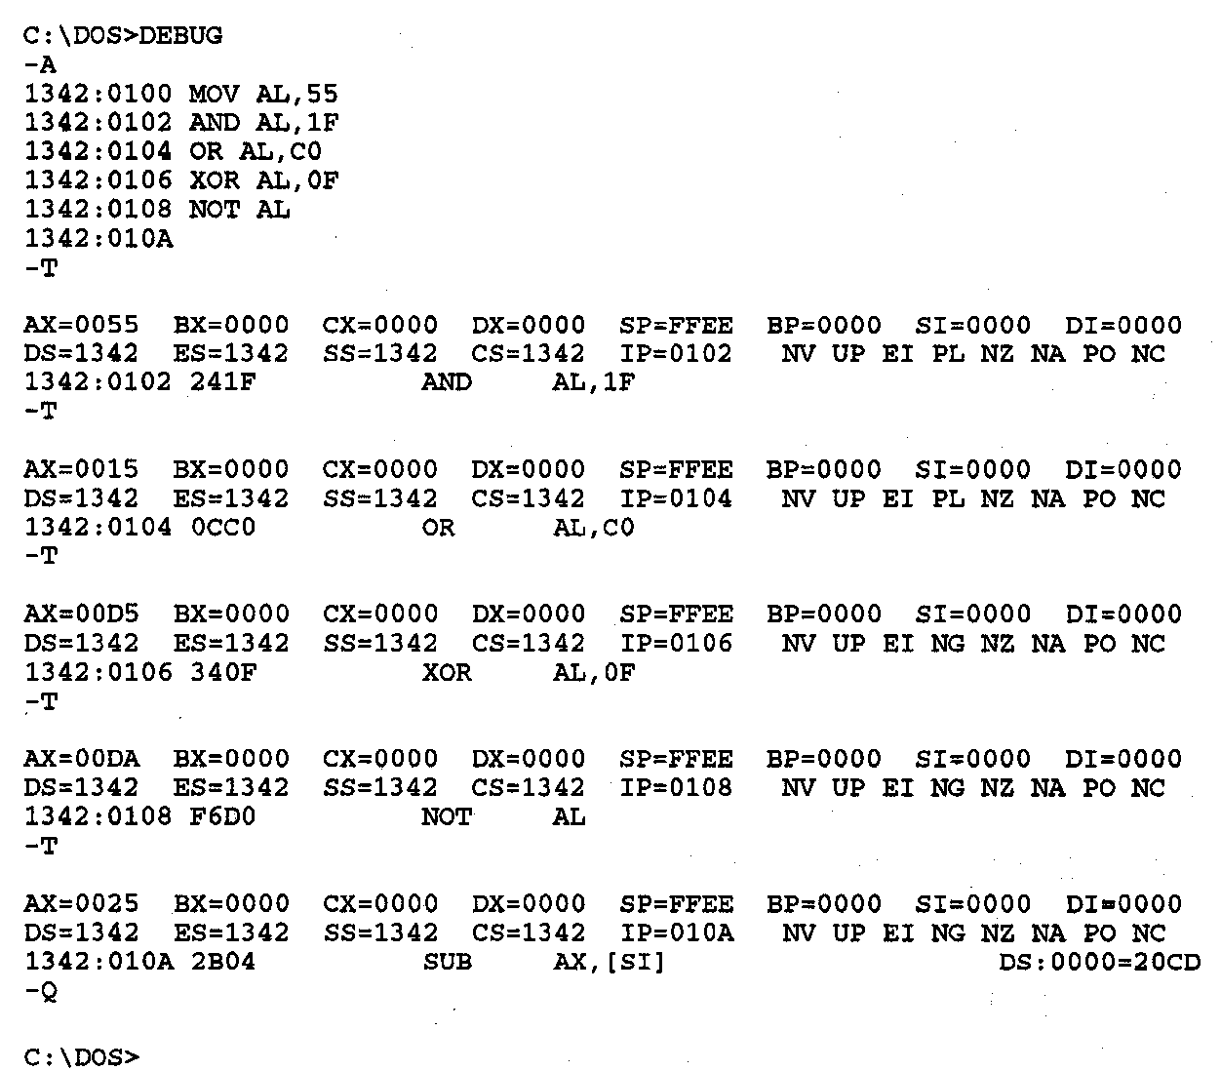
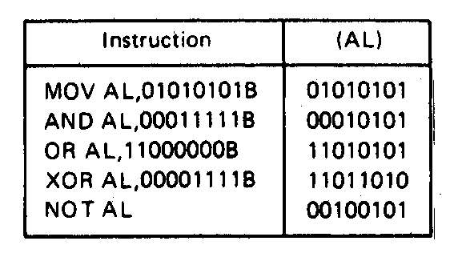
Logic Instructions- Example
Figure on right shows DEBUG program running this code
Each “T” executes one instruction; shows state of all registers/flags
Microprocessors I: Lecture 3
Notes:
Chapter 5 part 2

Slide 21
SHL / SAL / SHR / SAR
Shift instruction format: <op> D, <shamt>
  Destination may be register/memory
  <shamt>: shift amount
    May be immediate or register CL
All shift instructions store last bit shifted out in carry flag (CF)
SHL: logical shift left (double-precision version SHLD)
SAL: arithmetic shift left
  Shift to left by <shamt> bits; shift 0s into LS bits
SHR: logical shift right (double-precision version SHRD)
  Shift to right by <shamt> bits; shift 0s into MS bits
SAR: arithmetic shift right
  Shift to right by <shamt> bits; copy original MSB to fill MS bits (keep sign of value intact)
Microprocessors I: Lecture 3

Slide 22
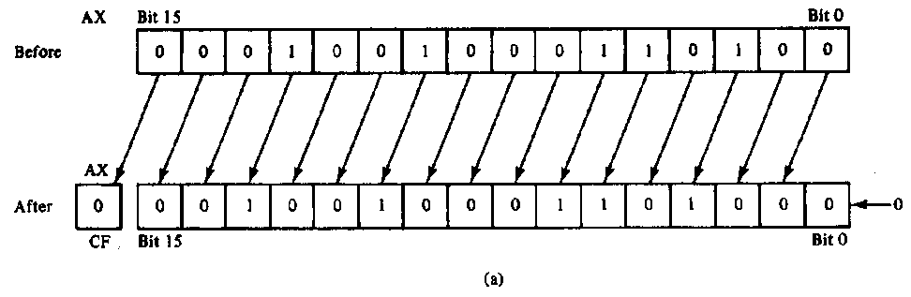
SAL/SHL example
SHL AX,1
Before execution
  Dest = (AX) = 1234H = 0001 0010 0011 0100₂ ,
  Count = 1, CF = X
Operation
  The value in all bits of AX are shifted left one bit position
  Emptied LSB is filled with 0
  Value shifted out of MSB goes to carry flag
After execution
  Dest = (AX) = 2468H = 0010 0100 0110 1000₂ , CF = 0
Notes
  MSB isolated in CF; can be used by conditional instruction
  Result has been multiplied by 2
Microprocessors I: Lecture 3

Slide 23
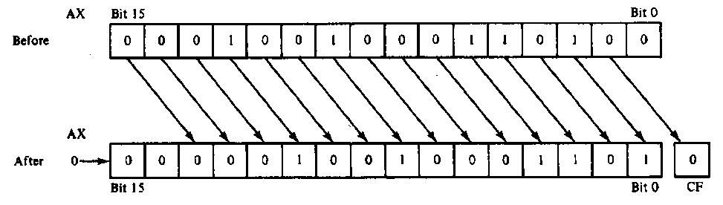
SHR example
SHR AX,CL
Before execution
  Dest = (AX) = 1234H = 466010 = 0001 00100011 0100₂
  Count = (CL) = 02H , CF = X
Operation
  The value in all bits of AX are shifted right two bit positions
  Emptied MSBs are filled with 0s
  Values shifted out of LSBs go to carry flag
After execution
  Dest = (AX) = 048DH = 116510 = 0000 0100 1000 1101₂ ,CF = 0
Notes:
  Bit 1 isolated in CF
  Result has been divided by 4
    4 X 1165 = 4660
Microprocessors I: Lecture 3

Slide 24
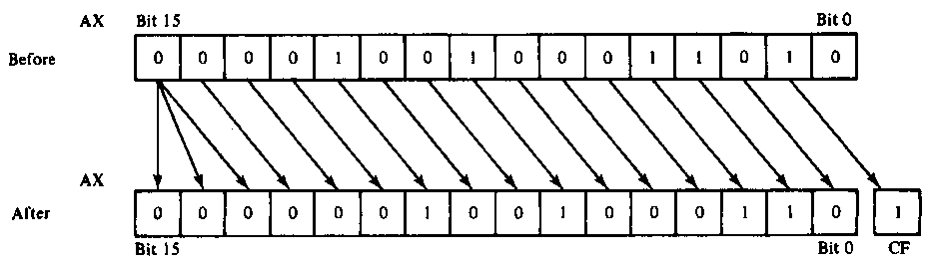
SAR example
SAR AX,CL
Before execution
  Dest = (AX) = 091AH = 0000100100011010₂ = +2330, Count = 02H , CF = X
Operation
  The value in all bits of AX are shifted right two bit positions
  Emptied MSB is filled with the value of the sign bit—sign maintained
  Values shifted out of LSBs go to carry flag
After execution
  Dest = (AX) = 0246H = 0000001001000110₂ = +582 , CF = 1
Conclusion
  Bit 1 isolated in CF
  Result has been sign extended
  Result value has been divided by 4 and rounded to integer
    4 X +582 = +2328
Microprocessors I: Lecture 3

Slide 25
Shift Instructions- Application
Application–Isolating a bit from a byte of data in memory in the carry flag
Example:
  Instruction sequence
    MOV AL,[CONTROL_FLAGS]
    MOV CL, 04H
    SHR AL,CL
  Before execution
    (CONTROL_FLAGS) = B₇B₆B₅B₄B₃B₂B₁B₀
  After executing 1st instruction
    (AL) =B₇B₆B₅B₄B₃B₂B₁B₀
  After executing 2nd instruction
    (CL) = 04H
  After executing 3rd instruction
    (AL) = 0000B₇B₆B₅B₄
    (CF) = B₃
Microprocessors I: Lecture 3
Notes:
Chapter 5 part 2

Slide 26
Shift example
Example: Given AL = 15H, CL = 03H, and CF = 0 show the state of AL and CF after each instruction in the sequence below:
  SHL AL, 1
  SHR AL, CL
  SAL AL, 5
  SAR AL, 2
Microprocessors I: Lecture 3

Slide 27
Solution
Initially, AL = 15H = 00010101₂
SHL AL, 1
  AL = (00010101 << 1) = 00101010₂ = 2AH
  CF = last bit shifted out = 0
SHR AL, CL
  AL = (00101010 >> 3) = 00000101₂ = 05H
  CF = last bit shifted out = 0
SAL AL, 5
  “Arithmetic” left shift same as SHL
  AL = (00000101 << 5) = 10100000₂ = A0H
  CF = last bit shifted out = 0
SAR AL, 2
  Arithmetic right shift keeps sign intact—copy MSB to fill leftmost positions
  AL = (10100000 >> 2) = 11101000₂ = E8H
  CF = last bit shifted out = 0
Microprocessors I: Lecture 3

Slide 28
Rotate instructions
Difference between rotates and shifts
  Shifts discard bits that are shifted out
  Rotates take bits that are shifted out and use them to fill vacated bits
Rotate instruction format: <op> D, <shamt>
  Destination may be register/memory
  <shamt>: shift amount
    May be immediate or register CL
All rotate instructions store last bit shifted out in carry flag (CF)
Microprocessors I: Lecture 3

Slide 29
ROR / ROL / RCR / RCL
ROR: rotate right
  Shift (D) to right by <shamt> bits
  <shamt> LS bits are moved to MS bits
ROL: rotate left
  Shift (D) to left by <shamt> bits
  <shamt> MS bits are moved to LS bits
RCR: rotate right through carry
  Treat (CF) as extra LS bit
  Shift (D,CF) to right by <shamt> bits
  <shamt> LS bits (from (D,CF)) are moved to MS bits
RCL: rotate left through carry
  Treat (CF) as extra MS bit
  Shift (CF,D) to left by <shamt> bits
  <shamt> MS bits (from (CF,D)) are moved to LS bits
Microprocessors I: Lecture 3

Slide 30
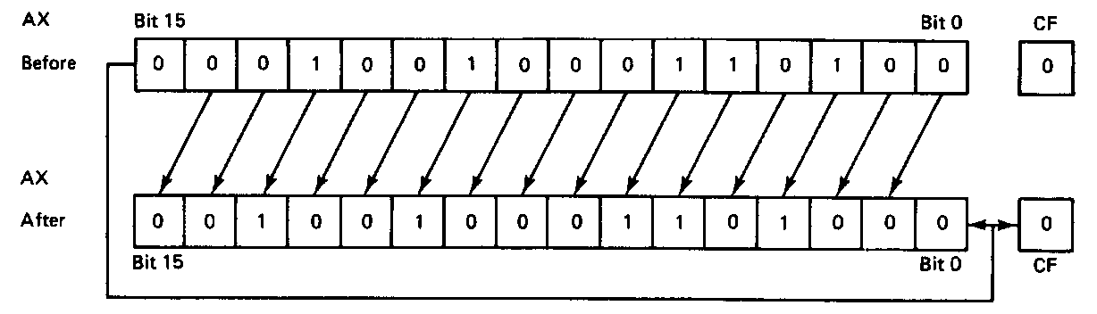
ROL example
ROL AX,1
Before execution
  Dest = (AX) = 1234H = 0001 0010 0011 0100₂
  Count = 1, CF = 0
Operation
  The value in all bits of AX are rotated left one bit position
  Value rotated out of the MSB is reloaded at LSB
  Value rotated out of MSB copied to carry flag
After execution
  Dest = (AX) = 2468H = 0010010001101000₂
  CF = 0
Microprocessors I: Lecture 3

Slide 31
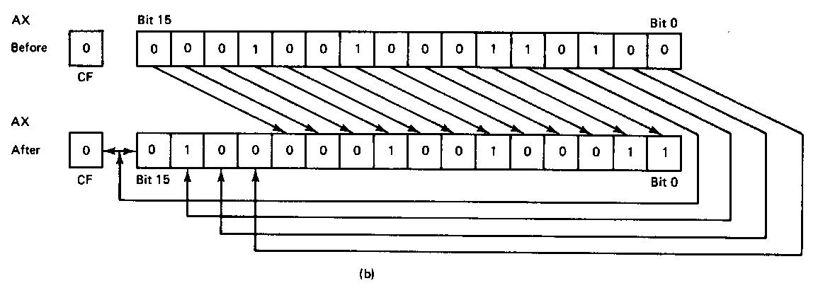
ROR example
ROR AX,CL
Before execution
  Dest = (AX) = 1234H = 0001 0010 0011 0100₂
  Count = 04H, CF = 0
Operation
  The value in all bits of AX are rotated right four bit positions
  Values rotated out of the LSB are reloaded at MSB
  Values rotated out of MSB copied to carry flag
After execution
  Dest = (AX) = 4123H = 01000001001000112
  CF = 0
Note position of hex characters in AX have been rearranged
Microprocessors I: Lecture 3

Slide 32
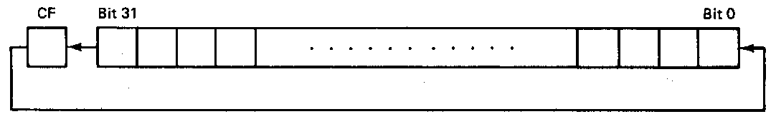
RCL example
RCL BX,CL
Before execution
  Dest = (BX) = 1234H = 0001 0010 0011 0100₂
  Count = 04H, CF = 0
Operation
  The value in all bits of AX are shifted left four bit positions
  Emptied MSBs are rotated through the carry bit back into the LSB
  Last value rotated out of MSB retained in carry flag
  First rotate loads prior value of CF at the LSB
After execution
  Dest = (BX) = 2340H = 0010 0011 0100 0000₂
  CF = 1
Microprocessors I: Lecture 3

Slide 33
Final notes
Next time:
  Rotate examples
  Bit test/bit scan instructions
  Conditional execution
  Exam 1 preview
Reminders:
  Sign up for the discussion group on Piazza
  HW 2 due today
  HW 3 to be posted; due Friday, 7/19
  Exam 1: Tuesday, 7/23
Microprocessors I: Lecture 3

