Slide 1
16.317
Microprocessor Systems Design I
Instructor: Dr. Michael Geiger
Summer 2013
Lecture 5:
Control flow instructions

Slide 2
Lecture outline
Announcements/reminders
  Lecture tomorrow (Friday, 7/26)
  HW 4 to be posted; due Tuesday, 7/30
  Exam 2: Thursday, August 1
Today’s lecture
  Jump instructions
  Loop instructions
  Subroutines & stack details
Microprocessors I: Lecture 5

Slide 3
Jump instructions
Used to change flow of program
  Next instruction specified by operand
Two general types
  Unconditional: JMP <target>
    Always goes to address indicated by <target>
  Conditional: Jcc <target>
    Jump only occurs if condition true
    cc replaced by valid condition code
      Most codes discussed in previous lecture
      Additional codes: CXZ/ECXZ
      → CX/ECX register is zero
Microprocessors I: Lecture 5

Slide 4
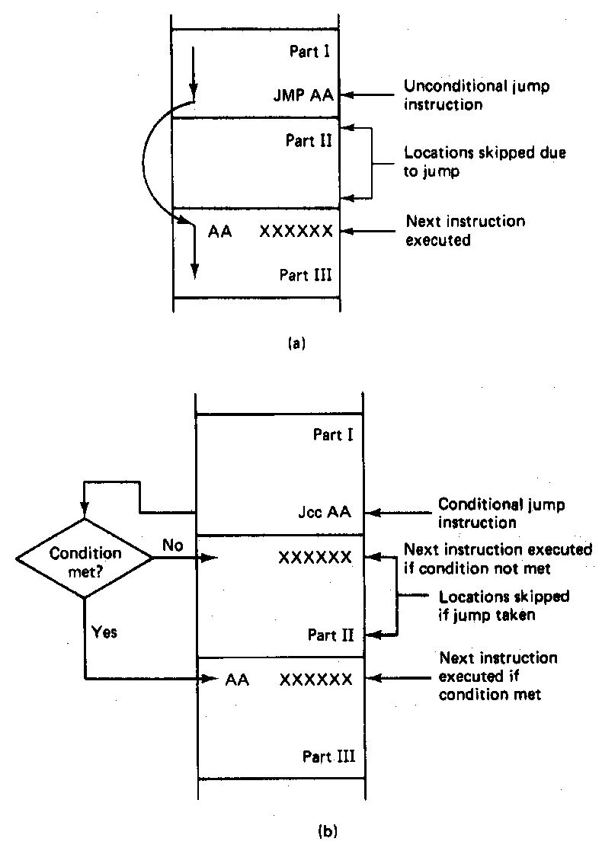
Jump Instructions
Microprocessors I: Lecture 5
Notes:
Chapter 6 part 1

Slide 5
Jump targets
Depends on distance from jump instruction
  Recall: CS:IP is logical addr. of current inst.
Intrasegment: target in same segment
  8-bit (short-label)/16-bit (near-label) immediate
    Signed offset added to current IP
    Usually specified by code writer simply as label
      E.g., JMP LABEL1
  16-bit register or memory location
    IP overwritten by contents of memory or register
    Register example: JE BX
    Memory example: JE WORD PTR [BX]
Microprocessors I: Lecture 5

Slide 6
Jump targets (cont.)
Depends on distance from jump instruction
  Recall: CS:IP is logical addr. of current inst.
Intersegment: target in different segment
  32-bit (far-label) immediate
  32-bit register
  32-bit memory location (DWORD PTR)
  In all cases, CS = upper 16 bits; IP = lower 16 bits
Microprocessors I: Lecture 5

Slide 7
Example: program structure 1
Given the instructions below, what are the resulting register values if:
  AX = 0010H, BX = 0010H
  AX = 1234H, BX = 4321H
What type of high-level program structure does this sequence demonstrate?
Instructions
  CMP AX, BX
  JE L1
  ADD AX, 1
  JMP L2
  L1: SUB AX, 1
  L2: MOV [100H], AX
Microprocessors I: Lecture 5

Slide 8
Example solution
First case: AX = BX = 0010H
  CMP AX, BX → Shows AX == BX
  JE L1 → Cond. true—jump to L1
  ADD AX, 1
  JMP L2
  L1: SUB AX, 1 → AX = AX – 1 = 000F
  L2: MOV [100H], AX → Store 000F at DS:100H
Microprocessors I: Lecture 5

Slide 9
Example solution (cont.)
Second case: AX = 1234H, BX = 4321H
  CMP AX, BX → Shows AX < BX
  JE L1 → Cond. false—no jump
  ADD AX, 1 → AX = AX + 1 = 1235H
  JMP L2
  L1: SUB AX, 1 → AX = AX – 1 = 000F
  L2: MOV [100H], AX → Store 000F at DS:100H
Microprocessors I: Lecture 5

Slide 10
Example solution (cont.)
High-level program structure: if/else statement
  If part: compare + jump (if (AX == BX))
  Else part: what follows if condition false
  Unconditional jump used to skip “if” part
  Both parts have same exit (L2)
Microprocessors I: Lecture 5

Slide 11
Example: program structure 2
Given the instructions below, what are the resulting register values if, initially, AX = 0001H?
What type of high-level program structure does this sequence demonstrate?
Instructions
  MOV CL, 5
  L: SHL AX, 1
  DEC CL
  JNZ L
Microprocessors I: Lecture 5

Slide 12
Example: program structure 3
Given the instructions below, what are the resulting register values if, initially, AX = 0001H?
What type of high-level program structure does this sequence demonstrate?
Instructions
  MOV CL, 5
  L: JCXZ END
  ADD AX, AX
  DEC CL
  JMP L
  END: MOV [10H], AX
Microprocessors I: Lecture 5

Slide 13
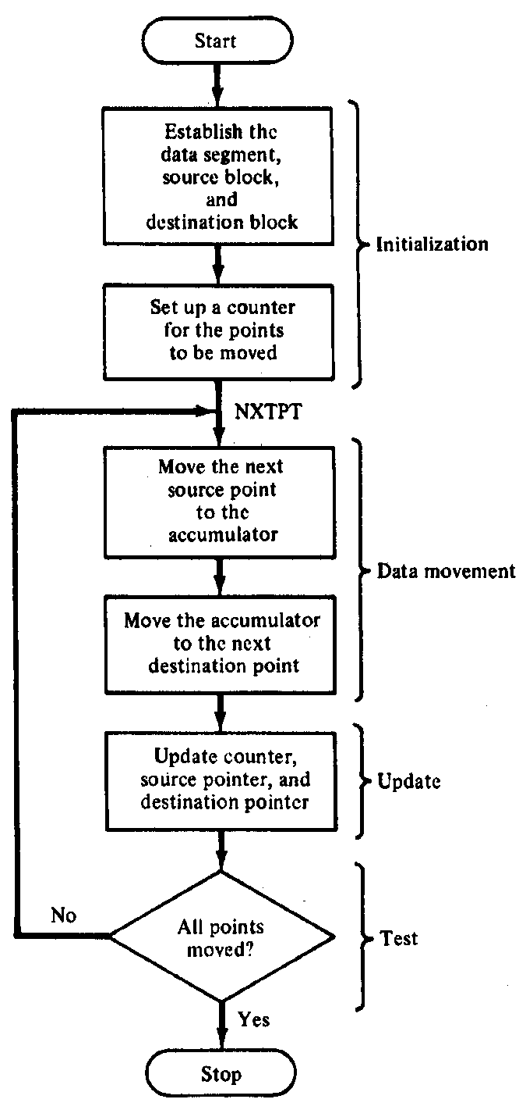
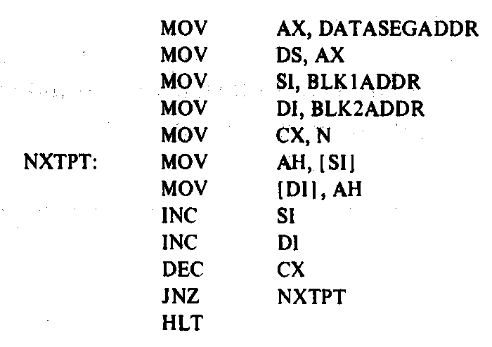
Block Move Program
Microprocessors I: Lecture 5
Notes:
Chapter 6 part 1

Slide 14
Loop instructions
Common operations in basic loops
  Compare
  Conditional jump
  Decrement loop counter (CX)
Loop instructions combine all into one op
  All decrement CX by 1, then check if CX == 0
  <target> must be short-label (8-bit immediate)
  LOOP <target>: Return to <target> if CX != 0
  LOOPE/LOOPZ <target>: Return to <target> if (CX != 0) && (ZF == 1)
  LOOPNE/LOOPNZ <target>: Return to <target> if (CX != 0) && (ZF != 1)
Microprocessors I: Lecture 5

Slide 15
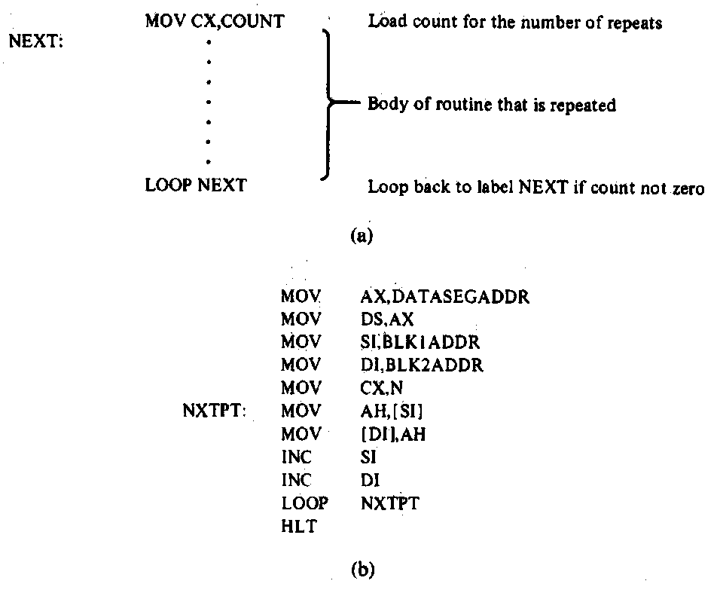
Loop Program Structure
Structure of a loop
  CX = initial count
  Loop body: code to be repeated
  Loop instruction– determines if loop is complete or if the body is to repeat
Example: block move
Microprocessors I: Lecture 5
Notes:
Chapter 6 part 2

Slide 16
Loop example 1
Rewrite the post-tested loop seen earlier using a loop instruction:
  MOV CL, 5
  L: SHL AX, 1
  DEC CL
  JNZ L
Solution:
  MOV CL, 5
  L: SHL AX, 1
  LOOP L
Microprocessors I: Lecture 5

Slide 17
Loop example 2
Describe the operation of the following program (Example 6.15-6.16).
What is the final value of SI if the 15 bytes between 0A001 and 0A00F have the following values?
  00 01 02 03 04 05 06 07 08 09 0A 0B 0C 0D 0E
MOV DL, 05
MOV AX, 0A00
MOV DS, AX
MOV SI, 0000
MOV CX, 000F
AGAIN: INC SI
CMP [SI], DL
LOOPNE AGAIN
Microprocessors I: Lecture 5

Slide 18
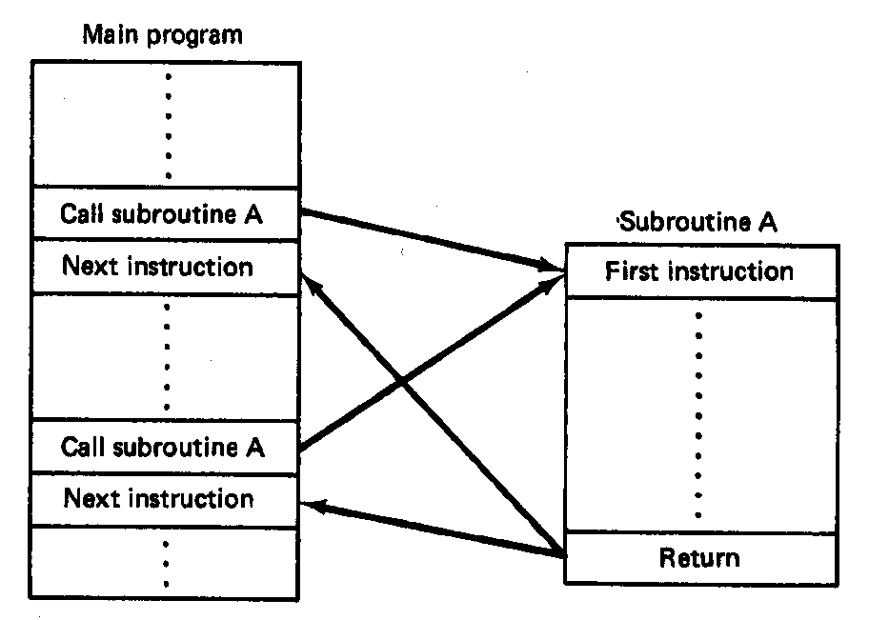
Subroutines
Subroutine: special program segment that can be “called” from any point in program
  Implements HLL functions/procedures
  Written to perform operation that must be repeated in program
  Actual subroutine code only written once
Microprocessors I: Lecture 5
Notes:
Chapter 6 part 2

Slide 19
Subroutine operation
When called, address of next instruction saved
  State may need to be saved before call
  Parameters can be passed
Control of program transferred to subroutine
After subroutine finished, return instruction goes back to saved address
Microprocessors I: Lecture 5
Notes:
Chapter 6 part 2

Slide 20
80386 subroutines
Specify starting point with pseudo-op
  <name> PROC NEAR → same segment
  <name> PROC FAR → different segment
May save state/allocate variables at start
  If so, will restore at end of subroutine
Last instruction returns to saved address
  Always RET
Pseudo-op after RET indicates routine end
  <name> ENDP
Microprocessors I: Lecture 5

Slide 21
Subroutine example
SQUARE PROC NEAR
PUSH AX ; Save AX to stack
MOV AL, BL ; Copy BL to AL
IMUL BL ; AX = BL * AL
; = original BL squared
MOV BX, AX ; Copy result to BX
POP AX ; Restore AX
RET
SQUARE ENDP
Microprocessors I: Lecture 5

Slide 22
Call/return
Calling subroutine: CALL <proc>
  Address of next instruction saved on stack
    Either IP (near) or CS, IP (far)
  <proc> can be 16- or 32-bit label/immediate, register, memory operand
    16-bit immediate added to IP
    16-bit register/memory replaces IP
    32-bit values replace CS/IP
Ending subroutine: RET
  Saved address restored to IP (& CS if needed)
Microprocessors I: Lecture 5

Slide 23
Example
Assuming AX = 2 and BX = 4, show the results of the following sequence (Ex. 6.11):
  Assume the addresses of the first three instructions are CS:0005, CS:0008, and CS:0009, respectively
  CALL SUM
  RET ; End main function
  SUM PROC NEAR
  MOV DX, AX
  ADD DX, BX
  RET
  SUM ENDP
Microprocessors I: Lecture 5

Slide 24
Example results
  CALL SUM
  RET ; End main function
  SUM PROC NEAR
  MOV DX, AX DX = AX = 4
  ADD DX, BX DX = DX + BX = 4 + 2 = 6
  RET
  SUM ENDP
Microprocessors I: Lecture 5

Slide 25
Saving state
May need to save state before routine starts
  Overwritten registers (that aren’t return values)
  Flags
Placing data on stack: PUSH
  Store data “above” current TOS; decrement SP
    Stack grows toward lower addresses
    New SP points to start of data just stored
  Basic PUSH stores word or double word
  Directly storing flags: PUSHF
  Storing all 16-/32-bit general purpose registers: PUSHA/PUSHAD
Microprocessors I: Lecture 5

Slide 26
Restoring state
Removing data from TOS: POP
  Data removed from TOS; SP incremented
  Basic POP removes word/double word
  Directly removing flags: POPF
  Removing all 16-/32-bit general purpose registers: POPA/POPAD
POP instructions generally executed in reverse order of corresponding PUSH instructions
Microprocessors I: Lecture 5

Slide 27
Revisiting subroutine example
SQUARE PROC NEAR
PUSH AX ; Save AX to stack
MOV AL, BL ; Copy BL to AL
IMUL BL ; AL = BL * AL
; = original BL squared
MOV BX, AX ; Copy result to BX
POP AX ; Restore AX
RET
SQUARE ENDP
Microprocessors I: Lecture 5

Slide 28
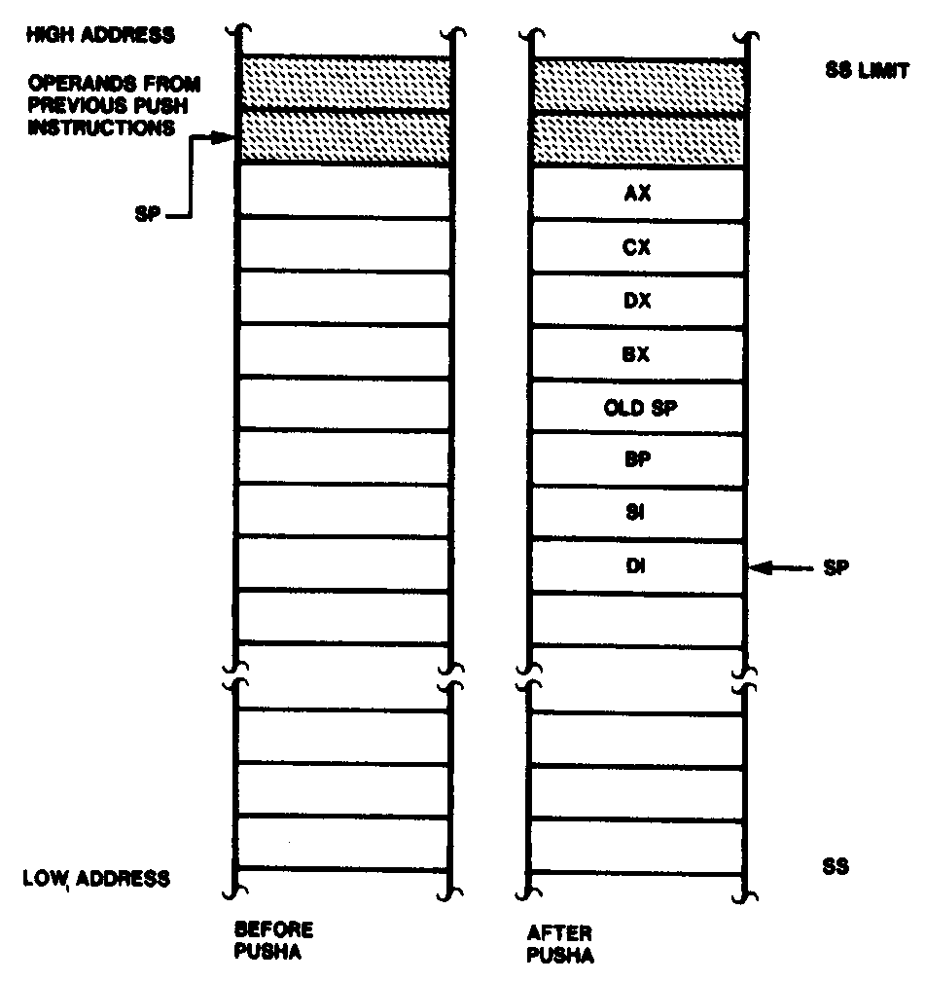
Push All and Pop All Operations
Microprocessors I: Lecture 5
Notes:
Chapter 6 part 2

Slide 29
Stack examples
Assume initial state shown in handout
What is the resulting stack state of each of the following sequences?
  PUSH BX
  PUSH AX
  PUSH EBX
  PUSH EAX
  PUSHA
Microprocessors I: Lecture 5

Slide 30
Solution
What is the resulting stack state of each of the following sequences?
  PUSH BX
  PUSH AX
  4 bytes pushed to stack, so SP decremented by 4 → ESP = 00001FFCH
  AX is at top of stack; BX is below that
  PUSH EBX
  PUSH EAX
  8 bytes pushed to stack, so SP decremented by 8 → ESP = 00001FF8H
  EAX is at top of stack; EBX is below that
  PUSHA
  8 words = 16 bytes pushed to stack, so SP decremented by 16 → ESP = 00001FF0H
  As shown in slide 13, DI is at top of stack, followed by SI, BP, old SP, BX, DX, CX, and AX
Microprocessors I: Lecture 5

Slide 31
Final notes
Next time (Friday, 7/26)
  Miscellaneous instructions
  HLL and x86 assembly
Announcements/reminders
  HW 4 to be posted; due Tuesday, 7/30
  Exam 2: Thursday, August 1
Microprocessors I: Lecture 5

