Slide 1
EECE.4810/EECE.5730 Operating Systems
Instructor:
Dr. Michael Geiger
Spring 2020
Lecture 1:
Course overview
Introduction to operating systems

Slide 2
Lecture outline
Course overview
Instructor information
Course materials
Course policies
Resources
Course outline
Brief prerequisite review
General introduction to operating systems

Slide 3
Course meeting time, instructor info
Lectures: MW 2-3:15, Ball 210
Instructor: Dr. Michael Geiger
E-mail: Michael_Geiger@uml.edu
Phone: 978-934-3618 (x43618 on campus)
Office: Ball Hall 301A
Office hours: M/W 10-11:30 & 1-1:50, Tu 12:30-2, or by appt.
Teaching assistant: Varun Garg
E-mail: Varun_Garg@student.uml.edu
Office hours: TBD; will be posted ASAP

Slide 4
Notes on instructor contact
Student questions are top priority during office hours
No need for appointment during office hours—just drop in!
Any changes to office hours will be announced on Blackboard
We encourage questions via e-mail, but please allow up to 24 hours for a response

Slide 5
Course materials
Recommended Text:
T. Anderson and M. Dahlin, Operating Systems: Principles and Practice, 2nd Edition, 2014, Recursive Books. ISBN: 978-0985673529
Course tools: All programming assignments will be done in (or via remote access to) the Linux lab, Ball 410
You will get card access to this lab and a Linux account ASAP

Slide 6
Additional course materials
Course websites:
http://mjgeiger.github.io/OS/sp20/index.htm
http://mjgeiger.github.io/OS/sp20/schedule.htm
Will contain lecture slides, handouts, assignments
Course Blackboard site
Will post announcements/email class
Assignments to be submitted here
May use discussion board feature
Login via https://lowell.umassonline.net/

Slide 7
Grading and exam dates
Grading breakdown
Programming assignments/homework: 55%
Exam 1: 15%
Exam 2: 15%
Exam 3: 15%
Students in EECE.5730 will have more work
Additional problems on exams
Potentially additional work on assignments
Exam dates tentative
Exam 1: Week 5 (2/17-2/21)
Exam 2: Week 10 (3/23-3/27)
Exam 3: TBD (during finals)

Slide 8
Programming assignments
Group projects
May work in groups of up to 3 students
Expect to have 3-4 large projects during semester
Small programs
To be done individually
Planning (hoping) to offer 3-4 of these this term
All code must
Be submitted via Blackboard (as .zip archive)
Be written in C or C++
Run on Ball 410 machines
Late policy: -10% per day, -100% if >5 days late

Slide 9
Academic honesty
Don’t share code outside your group
Don’t write programs together (unless it’s a group assignment)
Any copied solutions, whether from another student or an outside source, are subject to penalty

Slide 10
Course “rules”
A couple of unofficial rules:
Please call me “Dr. Geiger” or “Prof. Geiger”
Not “Michael,” “Mike,” or “Geiger”
Please don’t talk when I’m talking
Doing so distracts your classmates and me
If you have a question, please raise your hand and ask—I want questions during lecture!

Slide 11
Tentative outline: what you should learn
Processes and process management
Multithreading and synchronization
CPU scheduling
Memory management
Memory allocation
Virtual memory management
Storage management
File systems
Disk management
I/O systems
Distributed systems
Protection and security

Slide 12
Brief prerequisite review
Programming in C and C++
Examples typically presented in C
Must be comfortable with structures/objects
Data structures
Linked lists
Stacks
Queues
Trees

Slide 13
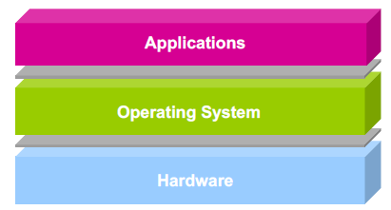
What is an operating system?
Software layer between application programs and physical hardware
Makes system easier to use for programs
Manages allocation of resources to use hardware fairly/efficiently

Slide 14
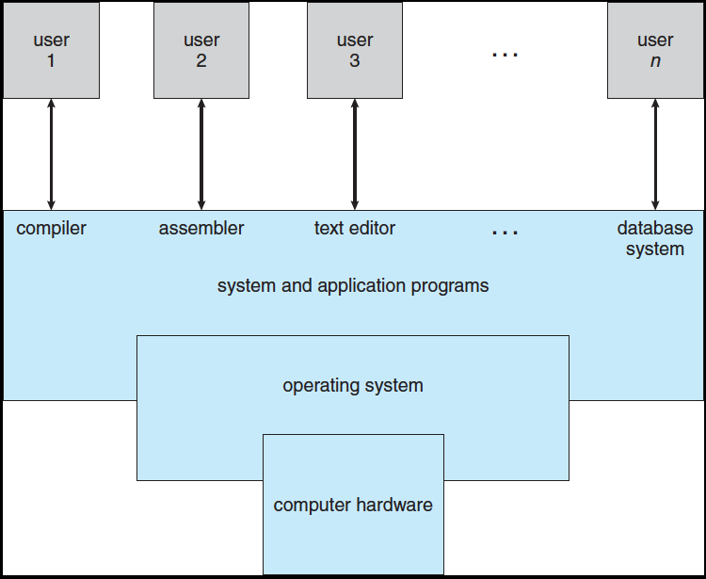
Computing system
Supports 1 or more users
System programs: parts of OS invoked only when necessary
Kernel: part of OS always running

Slide 15
OS and hardware
Abstractions to make hardware easier to use
CPU → threads
Memory → address space
Persistent storage → file system
Manages shared hardware resources
Two interfaces handled by OS
What’s physically available in hardware?
What does the user’s application see as available?

Slide 16
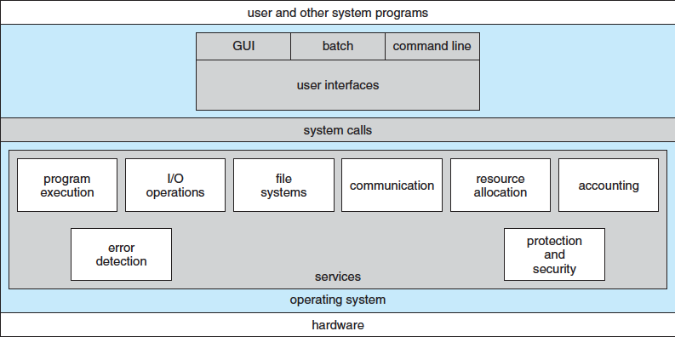
OS and applications
One view of OS
User application is “main” program
Requests services from kernel as needed
Typically done through system calls

Slide 17
OS and applications
Another view of OS
Kernel is main program
Kernel calls programs as subroutines
Think of how main() must return 0 to indicate completion
System calls invoke other system programs or functions within kernel
Essentially allows programs to behave as if each program is running on its own computer

Slide 18
User-friendly services
User interface: command line, GUI
Program execution: load program into memory, run it, and end it
I/O operations: input to user programs or to OS
File system manipulation: read/write, create/delete, search files
Communication: same computer or network
Error detection: in CPU, memory, devices, program

Slide 19
System services
Resource allocation: sharing of hardware among multiple users or processes
CPU cycles, main memory, files, I/O devices
Accounting: tracking resource usage
Protection: controlling access to resources
Includes data local to each process
Security: requiring user authentication and defending devices against invalid access

Slide 20
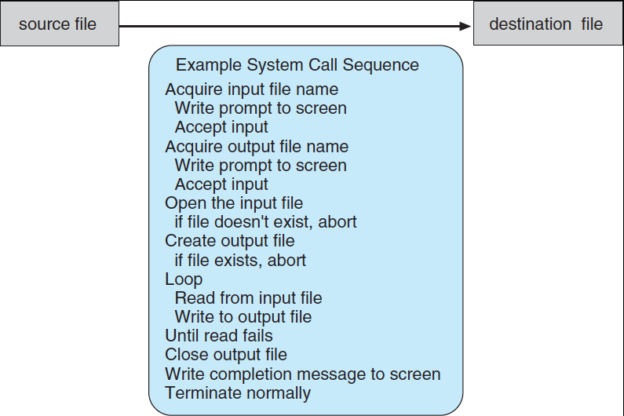
System calls
Provide services to user applications
Available as functions written in C/C++/assembly

Slide 21
System call types
Process control
Examples: create/terminate process, terminate process, load/execute process, get process attributes
File management
Examples: create/delete file, open/close file, read/write file, reposition file pointer
Device management
Examples: request access to device, release device, read/write device
Communications
Examples: send/receive messages, access shared memory, attach/detach remote devices
Protection
Examples: get/set permissions, allow/deny user access

Slide 22
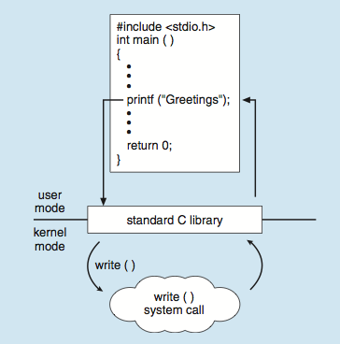
Standard C Library Example
C program invoking printf() library call, which calls write() system call

Slide 23
Final notes
Next time
Processes
Process management

Slide 24
Acknowledgements
These slides are adapted from the following sources:
Silberschatz, Galvin, & Gagne, Operating Systems Concepts, 9th edition
Chen & Madhyastha, EECS 482 lecture notes, University of Michigan, Fall 2016

