Slide 1
EECE.3170 Microprocessor Systems Design I
Instructors: Dr. Lin Li & Dr. Michael Geiger
Fall 2019
Lecture 17:
Jump and loop instructions

Slide 2
Lecture outline
Announcements/reminders
HW 3 due 10/21
Today’s lecture
Review
Compare instructions
Conditional instructions (CMOVcc, SETcc)
Jump instructions
Loop instructions

Slide 3
Review: compare
CMP D, S
Flags show result of (D) – (S)
Result == 0 → (D) == (S)
Result < 0 → (D) < (S)
Result > 0 → (D) > (S)
Condition codes: mnemonics implying certain flag conditions

Slide 4
Review: Condition codes (cont.)
Testing overflow
O (OF = 1), NO (OF =0)
Testing carry flag
C (CF = 1)
NC (CF = 0)
Testing sign flag
S (SF = 1), NS (SF = 0)
Testing parity flag
P or PE (PF = 1)
NP or PO (PF = 0)

Slide 5
Review: Condition codes (cont.)
Testing equality/zero result
E or Z (ZF = 1)
NE or NZ (ZF = 0)
Signed comparison
L or NGE (SF XOR OF = 1)
NL or GE (SF XOR OF = 0)
LE or NG ((SF XOR OF) OR ZF = 1)
NLE or G ((SF XOR OF) OR ZF = 0)
Unsigned comparison
“Below” → less than, “above” → greater than
B, NAE (CF = 1)
NB, AE (CF = 0)
BE or NA (CF OR ZF = 1)
NBE or A (CF OR ZF = 0)

Slide 6
Review: conditional instructions
Conditional move
Move performed only if condition is true
Examples:
CMOVZ AX, [SI] → move if ZF == 1
CMOVG EBX, EAX → move if greater than
SETcc D
Sets single byte destination to 1 (0x01) if condition true; all 0s (0x00) if condition false
Can be used to build up complex conditions

Slide 7
Review: SETcc example
Show the results of the following instructions, assuming that
“A” = (0x100) = 0x0001
“B” = (0x102) = 0x0003
“C” = (0x104) = 0x1011
“D” = (0x106) = 0x1011
“E” = (0x108) = 0xABCD
“F” = (0x10A) = 0xDCBA
Tests complex condition:
((A <= B && C == D) || E != F)
MOV AX, [0x100]
CMP AX, [0x102]
SETLE BL
MOV AX, [0x104]
CMP AX, [0x106]
SETE BH
AND BL, BH
MOV AX, [0x108]
CMP AX, [0x10A]
SETNE BH
OR BL, BH

Slide 8
Jump instructions
Used to change flow of program
Next instruction specified by operand
Two general types
Unconditional: JMP <target>
Always goes to address indicated by <target>
Conditional: Jcc <target>
Jump only occurs if condition true
cc replaced by valid condition code
Most codes discussed in previous lecture
Additional codes: CXZ/ECXZ
→ CX/ECX register is zero

Slide 9
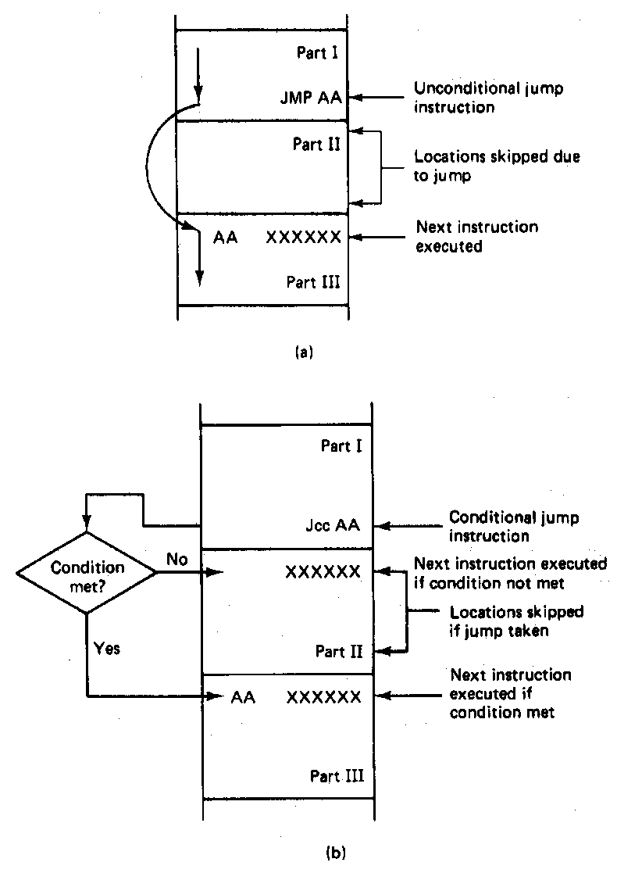
Jump Instructions

Slide 10
Example: program structure 1
Given the instructions below, what are the resulting register values if:
AX = 0x0010, BX = 0x0010
AX = 0x1234, BX = 0x4321
What type of high-level program structure does this sequence demonstrate?
Instructions
CMP AX, BX
JE L1
ADD AX, 1
JMP L2
L1: SUB AX, 1
L2: MOV [0x100], AX

Slide 11
Example solution
First case: AX = BX = 0x0010
CMP AX, BX → Shows AX == BX
JE L1 → Cond. true—jump to L1
ADD AX, 1
JMP L2
L1: SUB AX, 1 → AX = AX – 1 = 0x000F
L2: MOV [0x100], AX → Store 000F at 0x100

Slide 12
Example solution (cont.)
Second case: AX = 0x1234, BX = 0x4321
CMP AX, BX → Shows AX < BX
JE L1 → Cond. false—no jump
ADD AX, 1 → AX = AX + 1 = 0x1235
JMP L2 → Unconditional jump to L2
L1: SUB AX, 1
L2: MOV [0x100], AX → Store 0x1235 at 0x100

Slide 13
Example solution (cont.)
High-level program structure: if/else statement
If part: compare + jump (if (AX == BX))
Else part: what follows if condition false
Unconditional jump used to skip “if” part
Both parts have same exit (L2)

Slide 14
Example: program structure 2
Given the instructions below, what are the resulting register values if, initially, AX = 0x0001?
What type of high-level program structure does this sequence demonstrate?
Instructions
MOV CL, 5
L: SHL AX, 1
DEC CL
JNZ L

Slide 15
Example solution
MOV CL, 5 → CL = 5
L: SHL AX, 1 → AX: 1 → 2 → 4 → 8 → 16 → 32
DEC CL → CL: 5 → 4 → 3 → 2 → 1 → 0
JNZ L → Jumps to L as long as CL ≠ 0
Overall structure: loop
Essentially a for loop: for (CL = 5; CL != 0; CL--)
For loops are technically pre-tested (loop condition checked at start of each iteration)
No difference between end of one iteration and start of next
We know condition is true in first iteration—5 ≠ 0

Slide 16
Example: program structure 3
Given the instructions below, what are the resulting register values if, initially, AX = 0x0001?
What type of high-level program structure does this sequence demonstrate?
Instructions
MOV CX, 5
L: JCXZ END
ADD AX, AX
DEC CX
JMP L
END: MOV [0x10], AX

Slide 17
Example solution
MOV CX, 5 → CX = 5
L: JCXZ END → Jumps to “END” when CX = 0
ADD AX, AX → AX: 1 → 2 → 4 → 8 → 16 → 32
DEC CX → CX: 5 → 4 → 3 → 2 → 1 → 0
JMP L
END: MOV [0x10], AX

Slide 18
Loop instructions
Common operations in basic loops
Compare
Conditional jump
Decrement loop counter (CX)
Loop instructions combine all into one op
All decrement CX by 1, then check if CX == 0
<target> must be short-label (8-bit immediate)
LOOP <target>: Return to <target> if CX != 0
LOOPE/LOOPZ <target>: Return to <target> if
(CX != 0) && (ZF == 1)
LOOPNE/LOOPNZ <target>: Return to <target> if (CX != 0) && (ZF != 1)

Slide 19
Loop example 1
Rewrite the post-tested loop seen earlier using a loop instruction:
MOV CL, 5
L: SHL AX, 1
DEC CL
JNZ L
Solution:
MOV CL, 5
L: SHL AX, 1
LOOP L

Slide 20
Loop example 2
Describe the operation of the following program (Example 6.15-6.16).
What is the final value of ESI if the 15 bytes between 0x0A001 and 0x0A00F have the following values?
00 01 02 03 04 05 06 07 08 09 0A 0B 0C 0D 0E
MOV DL, 05
MOV EAX, 0x0000A000
MOV ESI, 0
MOV CX, 0x000F
AGAIN:INC SI
CMP [EAX + ESI], DL
LOOPNE AGAIN

Slide 21
Final notes
Next time:
Subroutines
Reminders:
HW 3 due 10/21

