Slide 1
EECE.3170 Microprocessor Systems Design I
Instructors: Dr. Lin Li & Dr. Michael Geiger
Fall 2019
Lecture 20
HLL → assembly

Slide 2
Announcements/reminders
HW 3 due Monday, 10/21
HW 4 to be posted; due date TBD
Exam 2: Friday, 11/1 in class
Will again be allowed one note sheet, calculator

Slide 3
Today’s lecture
Review
Subroutines
Basics of stack usage
Translation from HLL → assembly
Data representations
Stack accesses
Array accesses
Conditional statements
Loops

Slide 4
Review: subroutines
Subroutines: low-level functions
When called, address of next instruction saved
Return instruction ends routine; goes to that point
May need to save state on stack
x86 specifics
CALL <proc>: call procedure
<proc> can be label (16-/32-bit imm), reg, mem
Saves address of next instruction to stack
RET: return from procedure
Saving state to stack: push instructions
Store data “above” current TOS; decrement SP
Basic PUSH stores word or double word
Directly storing flags: PUSHF
Storing all 16-/32-bit general purpose registers: PUSHA/PUSHAD
Restoring state: POP/POPF/POPA/POPAD

Slide 5
HLL → assembly
Given some brief examples already; want to think about common HLL concepts and their assembly counterparts
Compiling HLL to assembly
Data accesses
Stack usage with function calls
Conditional statements (if-then-else)
Loops

Slide 6
Sample program
int X[10], Y[10]; // integer arrays
int i, j; // index variables
for (i = 0; i < 10; i++) { // outer loop
X[i] = i * 2; // set X[i]
for (j = 0; j < 10; j++) { // inner loop
if (j < 5) // set Y[j]
Y[j] = X[i] + j; // based on
else // value of j
Y[j] = X[i] – j;
}
}

Slide 7
Data representations
Program references four pieces of data
Two integer arrays: X[10], Y[10]
Two integer index variables: i, j
Compilers must account for:
Data size: is variable a double word, word, or byte?
Characters (char) are always 8 bits → 1 byte
Other types system-dependent
In x86, integers (int) are 32 bits → 4 bytes → double word
Short integers (short) are 16 bits → 2 bytes → word
Data location: where is data allocated?
Depends on how it’s allocated …
If writing assembly by hand, static data → directly allocated in memory
If compiled code or function call, allocated on stack
Variables declared inside functions, function arguments

Slide 8
Static data accesses
Global declarations in high-level program
Stored in data segment
Offset into data segment declared as symbol
Example (from testfile2.asm)
mov eax, DWORD PTR _c

Slide 9
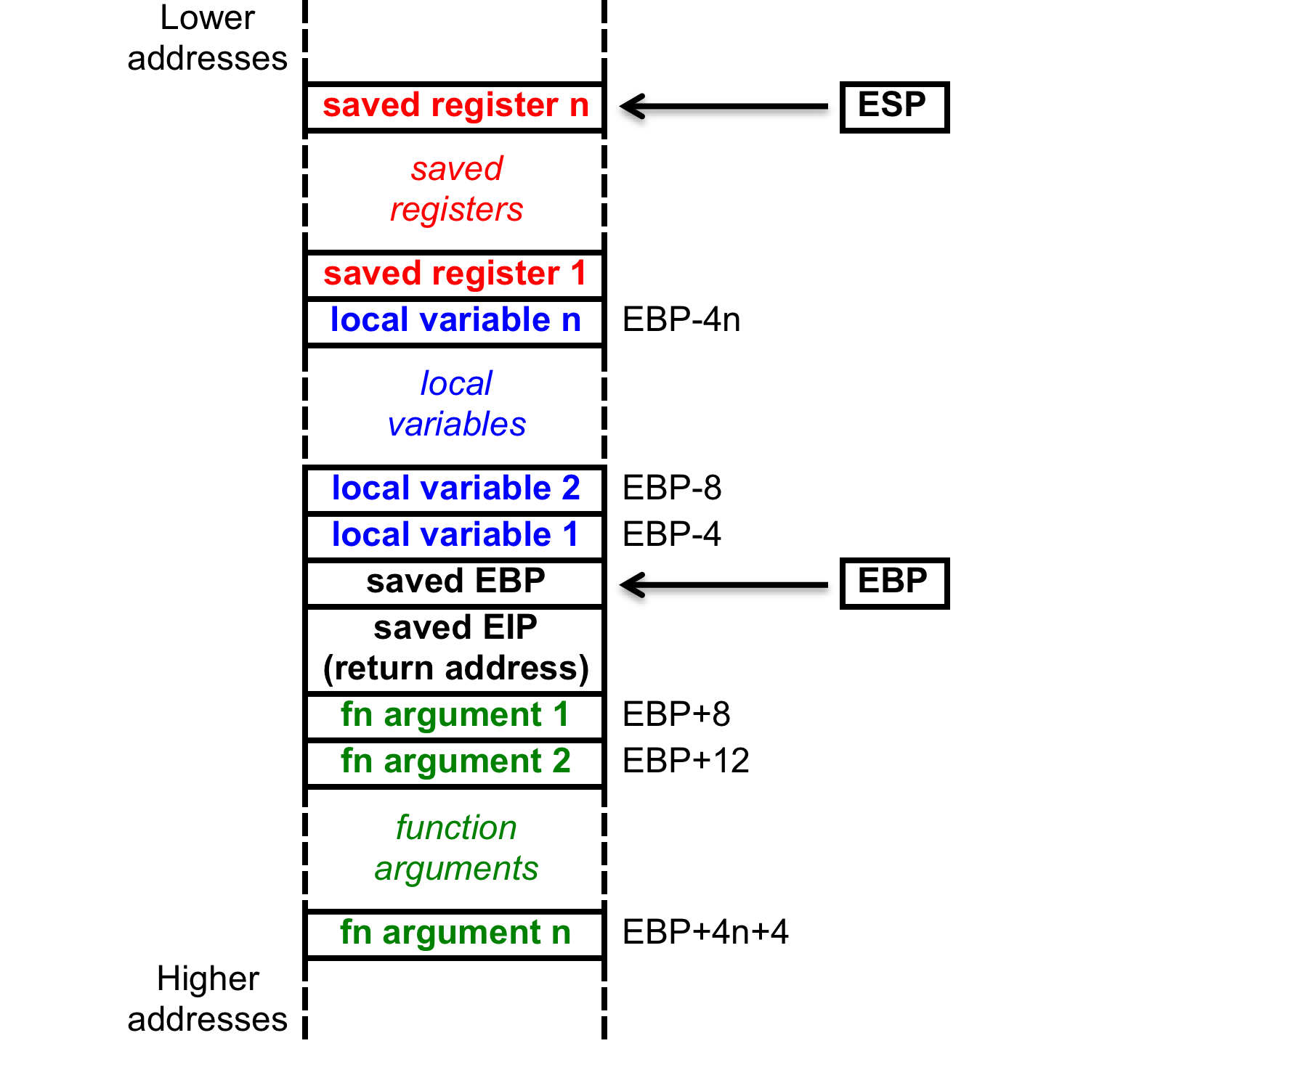
Stack accesses
On function call
SP or ESP: points to current top of stack
Lowest address in current stack frame
BP or EBP: used to reference data within frame
Arguments
Local variables

Slide 10
Stack accesses (cont.)
Arguments start at offset 8 from EBP
Local variables start at offset -4 from EBP
Starting offset of each variable can be defined as symbol
Ex. (testfile1.asm) _j$ = -120; size = 4
_i$ = -108; size = 4
_Y$ = -96; size = 40
_X$ = -48; size = 40
mov DWORD PTR _i$[ebp], 0
→ sets i = 0

Slide 11
Array accesses
To access array element, need
Base address of array
Offset into array
Offset = index * (size of each element)
For example, X[2] is 2*4 = 8 bytes into array X
In some ISAs, need to explicitly calculate this address
Multiply index by element size
Add to base address
x86 uses scaled addressing → multiplication done in memory access
Example: code for X[i] = i * 2 from testfile1:
mov eax, DWORD PTR _i$[ebp]
shl eax, 1
mov ecx, DWORD PTR _i$[ebp]
mov DWORD PTR _X$[ebp+ecx*4], eax

Slide 12
Conditional statements
If-then-else statements typically take form similar to:
<code to evaluate condition>
<conditional jump to else if false>
<code if condition true>
jmp end
else: <code if condition false>
end: …
<code to evaluate condition>
Always requires a conditional branch
Must add label to branch to “else” statement
Once statement for “if” condition is complete, jump past “else” statement
Requires insertion of another label for jump target

Slide 13
Conditional statements (cont.)
Body of inner loop:
if (j < 5)
Y[j] = X[i] + j;
else
Y[j] = X[i] – j;
cmp DWORD PTR _j$[ebp], 5
jge SHORT $LN2@main
mov eax, DWORD PTR _i$[ebp]
mov ecx, DWORD PTR _X$[ebp+eax*4]
add ecx, DWORD PTR _j$[ebp]
mov edx, DWORD PTR _j$[ebp]
mov DWORD PTR _Y$[ebp+edx*4], ecx
jmp SHORT $LN1@main
$LN2@main:
mov eax, DWORD PTR _i$[ebp]
mov ecx, DWORD PTR _X$[ebp+eax*4]
sub ecx, DWORD PTR _j$[ebp]
mov edx, DWORD PTR _j$[ebp]
mov DWORD PTR _Y$[ebp+edx*4], ecx
$LN1@main:

Slide 14
Loops
For loops are essentially three parts
Initializing loop index
Checking boundary condition
Similar idea to if-then-else statements, but simpler
If condition is false, end of loop
Branch to label at first instruction after loop
Usually done at start of loop, since no iterations should occur unless condition is true
End of loop then contains jump back to beginning
Incrementing loop index
While loops only require the boundary condition check

Slide 15
Loops (cont.)
for (j = 0; j < 10; j++) {// inner loop
mov DWORD PTR _j$[ebp], 0
jmp SHORT $LN5@main
$LN4@main:
mov eax, DWORD PTR _j$[ebp]
add eax, 1
mov DWORD PTR _j$[ebp], eax
$LN5@main:
cmp DWORD PTR _j$[ebp], 10
jge SHORT $LN3@main ; jmp to end
.
. ; Loop body here
.
jmp SHORT $LN4@main
$LN3@main:

Slide 16
Practice problems
See today’s handout for
Description of how stack frame should be created
Description of where to access function arguments, local variables
Functions to be written
int fact(int n): Calculate and return n!
int max(int v1, int v2): Return largest value between v1 and v2
void swap(int *a, int *b): Given addresses a & b, swap contents
Solutions to be posted as PDF online
C versions in slides that follow; assembly in PDF file
Will be covered in class today as well

Slide 17
Factorial in C
int fact(int n) {
int i;
int fact = 1;
for (i = n; i > 1; i--)
fact *= i;
return fact;
}

Slide 18
Maximum value function in C
int max(int v1, int v2) {
if (v1 > v2)
return v1;
else
return v2;
}

Slide 19
Swap in C
void swap(int *a, int *b) {
int temp;
temp = *a;
*a = *b;
*b = temp;
}

Slide 20
Final notes
Next set of lectures: PIC microcontrollers and ISA
Reminders:
HW 3 due Monday, 10/21
HW 4 to be posted; due date TBD
Exam 2: Friday, 11/1 in class
Will again be allowed one note sheet, calculator

