Slide 1
EECE.4810/EECE.5730 Operating Systems
Instructor:
Dr. Michael Geiger
Spring 2018
Lecture 7:
Synchronization (continued)

Slide 2
Lecture outline
Announcements/reminders
Program 2 to be posted; due date TBD
Exam 1: Wednesday, 2/21
Covers through today (Tues. lecture just review)
Will be allowed one 8.5” x 11” double-sided note sheet
No electronic devices, other notes allowed
Thursday 2/15 office hours: 11:30 AM-1 PM
Today’s lecture
Review
Critical sections
Locks
More on synchronization
Condition variables
Monitors

Slide 3
Review: Critical section
Code section that needs to be run atomically with respect to selected other pieces of code
A and B often same piece of code
Protects access to shared resource
Critical section requirements:
Mutual exclusion: ≤1 thread executes CS at a time
Progress: if >1 thread attempts CS at same time, 1 thread guaranteed to be selected
Bounded waiting: if thread T requests access to its CS, limit on # times other threads can access their CS before T does

Slide 4
Critical section example
Dekker’s algorithm: 1st known CS solution (pre-synch primitives) for two threads
Shared variables:
boolean flag[2]; // Both initially false
int turn; // Initialized to 0 or 1
Process P_{i} (i == 0 or 1) shown in handout/next slide; other process is P_{j} (j == 1 or 0)
Prove algorithm satisfies CS properties
Mutual exclusion (only 1 thread in CS at time)
Progress (1 thread guaranteed to access CS if >1 req)
Bounded waiting (limit on time thread will wait for CS)

Slide 5
Dekker’s algorithm code for P_{i}
do {
flag[i] = true;
while (flag[j] == true) {
if (turn == j) {
flag[i] = false;
while (turn == j)
; // do nothing
flag[i] = true;
}
}
/* critical section would be placed here */
turn = j;
flag[i] = false;
} while (true);

Slide 6
Critical section solution
Solution satisfies the conditions as follows:
Mutual exclusion: If both processes set their flag variables to true, only process whose turn it is will move forward
Progress: turn chooses the process to move forward if both attempt to enter the critical section simultaneously
Bounded waiting: Since one process sets turn to value of other process, waiting process will be allowed to enter its critical section next

Slide 7
Review: Locks
A lock (or mutex) prevents another thread from entering a critical section
“Lock fridge while checking milk & shopping”
Two operations:
lock(): wait until lock is free, then acquire it
do {
if (lock is free) { // code in red
acquire lock // is atomic
break out of loop
}
} while (1);
unlock(): release lock

Slide 8
Review: thread-safe queue
Correction from Monday: queue example intended to show usefulness of locks, not addition to lock to manage waiting
Thread-safe queue: queue shared between several threads
Synch. primitives necessary to restrict access
Maintain invariant: condition “always” true
Lock queue when manipulating shared data
Queues commonly used in OS
Track processes/threads waiting for resources
Thread-safe queue necessary so multiple kernel threads can enqueue/dequeue items

Slide 9
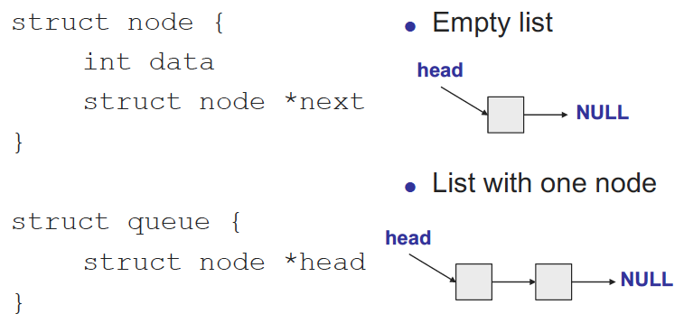
Case study: thread-safe shared queue

Slide 10
Shared queue: no synch
void enqueue(struct node *new_element) {
// Find queue tail
for (ptr = head;
ptr->next != NULL; ptr = ptr->next) {}
// Add new elem to tail
ptr->next = new_element;
new_element->next = NULL;
}
struct node *dequeue() {
struct node *elem = NULL;
// If queue not empty,
// remove first node
if (head->next != NULL) {
elem = head->next;
head->next =
head->next->next;
}
return element;
}

Slide 11
Shared queue: simple synch
void enqueue(struct node *new_element) {
qmutex.lock();
// Find queue tail
for (ptr = head;
ptr->next != NULL; ptr = ptr->next) {}
// Add new elem to tail
ptr->next = new_element;
new_element->next = NULL;
qmutex.unlock();
}
struct node *dequeue() {
struct node *elem = NULL;
qmutex.lock();
// If queue not empty,
// remove first node
if (head->next != NULL) {
elem = head->next;
head->next =
head->next->next;
}
qmutex.unlock();
return element;
}

Slide 12
Fine-grained locking
One lock per queue → only one thread can access queue at once
One lock per node: fine-grained locking
What’s the major benefit?
Lock each node as queue is traversed, release once it’s safe, allowing other threads to traverse queue
Hand-over-hand locking necessary

Slide 13
Avoiding busy waiting
Have dequeuer “go to sleep”
Put dequeuer on waiting list, then go to sleep
if (queue is empty) {
add self to waiting list
go to sleep
}
Wait to be awoken once something’s in queue

Slide 14
Ordering constraints
What if you want dequeue() to wait if queue is empty?
What’s problem with solution below?
struct node *dequeue() {
struct node *elem = NULL;
qmutex.lock();
// Wait for queue to not be empty
qmutex.unlock();
while (head->next == NULL);
qmutex.lock();
// Remove element, then unlock queue and return
elem = head->next;
head->next = head->next->next;
qmutex.unlock();
return elem;
}

Slide 15
Ordering constraints, pt. 2
What if you want dequeue() to wait if queue is empty?
What’s problem with solution below?
struct node *dequeue() {
struct node *elem = NULL;
qmutex.lock();
// Wait for queue to not be empty
while (head->next == NULL) {
qmutex.unlock();
qmutex.lock();
}
// Remove element, then unlock queue and return
elem = head->next;
head->next = head->next->next;
qmutex.unlock();
return elem;
}

Slide 16
Synchronization types
Mutual exclusion
Ensures only one thread in critical section
“Not at the same time”
lock/unlock
Condition variables
Used when one thread must wait for another to do something
“Before/after”
dequeue() must wait for enqueue() if empty

Slide 17
Condition variables
Enable thread to sleep inside critical section by (steps in red are atomic):
Release lock
Put thread on waiting list
Go to sleep
After being woken, re-acquire lock()
Each condition variable tracks list of threads waiting on that specific condition
Each condition variable associated with lock

Slide 18
Condition variable operations
wait(&lock)
Atomically release lock, add thread to waiting list, then go to sleep
Thread must hold lock when calling wait()
Must re-acquire lock before exiting wait()
signal()
Wake up one thread waiting on condition variable
If no thread waiting, does nothing
broadcast()
Wake up all threads waiting on condition variable
If no thread waiting, does nothing

Slide 19
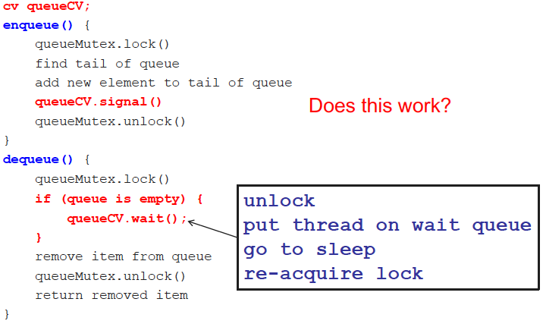
Thread-safe queue with CVs

Slide 20
Final notes
Next time (Tuesday, 2/20)
Introduce Program 2
Preview Exam 1
Reminders:
Program 2 to be posted; due date TBD
Exam 1: Wednesday, 2/21
Covers through today (Tues. lecture just review)
Will be allowed one 8.5” x 11” double-sided note sheet
No electronic devices, other notes allowed
Thursday 2/15 office hours: 11:30 AM-1 PM

Slide 21
Acknowledgements
These slides are adapted from the following sources:
Silberschatz, Galvin, & Gagne, Operating Systems Concepts, 9th edition
Chen & Madhyastha, EECS 482 lecture notes, University of Michigan, Fall 2016
Pthread example programs obtained from: https://computing.llnl.gov/tutorials/pthreads/

