Slide 1
EECE.4810/EECE.5730 Operating Systems
Instructor:
Dr. Michael Geiger
Spring 2018
Lecture 16:
Memory management: segmentation and paging

Slide 2
Lecture outline
Announcements/reminders
Program 3 to be posted; due TBD
Today’s lecture: Segmentation and paging

Slide 3
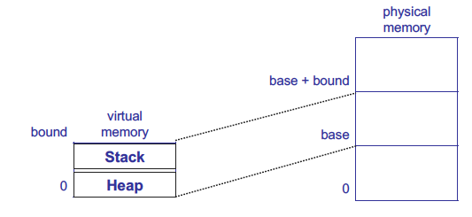
Growing memory regions independently
How can these regions grow independently?
Each needs own space! → segmentation/paging

Slide 4
Segmentation
Base & bounds groups entire address space together
Programs more logically organized into units
Main program, functions, stack, heap, etc.
Segment: contiguous region of memory
Base & bounds = 1 segment
Generalized segmentation allows >1 segment per program
Each process has a segment table
Entry in table = segment
HW support
Segment table base register (STBR) points to segment table
Segment table length register (STLR) indicates number of segments
Segment can be located anywhere in physical memory
Each segment has: start, length, access permission
Processes can share segments
Same start, length, same/different access permissions

Slide 5
Segmentation
Notes:
This should seem a bit strange: the virtual address space has gaps in it! Each segment gets mapped to contiguous locations in physical memory, but may be gaps between segments.
This is a little like walking around in the dark, and there are huge pits in the ground where you die if you step in the pit.
But! of course, a correct program will never step off into a pit, so ok.
A correct program will never address gaps; if it does, trap to kernel and then core dump. Minor exception: stack, heap can grow. In UNIX, sbrk() increases size of heap segment. For stack, just take fault, system automatically increases size of stack.
Detail: Protection mode in segmentation table entries. For example, code segment would be read-only (only execution and loads are allowed). Data and stack segment would be read-write (stores allowed).
What must be saved/restored on context switch? Typically, segment table stored in CPU, not in memory, because it’s small.
Contents must be saved/restored.

Slide 6
Segment table
Segment # | V | Base | Bounds | Access
0 | 1 | 4000 | 700 | read/exec | code segment
1 | 1 | 0 | 500 | read/write | data segment
2 | 0 | n/a | n/a |  | unused segment
3 | 1 | 2000 | 1000 | read/write | stack segment
Protection handled by segment table contents
Valid bit (V) indicates if segment in use
Access indicates privileges (read/write/execute)
Virtual address: segment #, offset
Segment number must be valid
Offset must be < bound
If either false, trap to OS → invalid address

Slide 7
Segmentation
Pros?
Can share code/data segments between processes
Can protect code segment from being overwritten
Can transparently grow stack/heap as needed
Cons?
Complex memory management
Need to find chunk of a particular size
May need to rearrange memory from time to time to make room for new segment or growing segment
External fragmentation: wasted space between chunks

Slide 8
Segmentation example
Segment # | V | Base | Bounds | Access
0 | 1 | 219 | 600 | read/write
1 | 1 | 2300 | 14 | read/write
2 | 1 | 90 | 100 | read/exec
3 | 1 | 1327 | 580 | read/write
4 | 0 | 1952 | 96 | read
Given segment table above, what are physical addresses for following virtual addresses (of form <seg #>, <offset>)?
0, 430
1, 10
2, 500
3, 400
4, 112

Slide 9
Example solution
Segment # | V | Base | Bounds | Access
0 | 1 | 219 | 600 | read/write
1 | 1 | 2300 | 14 | read/write
2 | 1 | 90 | 100 | read/exec
3 | 1 | 1327 | 580 | read/write
4 | 0 | 1952 | 96 | read
Given segment table above, what are physical addresses for following virtual addresses (of form <seg #>, <offset>)?
0, 430 → 219 + 430 = 649
1, 10 → 2300 + 10 = 2310
2, 500 → offset > bound → illegal access
3, 400 → 1327 + 400 = 1727
4, 112 → segment 4 not valid → illegal access

Slide 10
Paged Translation
Manage memory in fixed size units, or pages
Often refer to pages in virtual address space, frames in physical address space
Finding a free frame is easy
Bitmap allocation: 0011111100000001100
Each bit represents one physical page frame
Each process has its own page table
Stored in physical memory
Hardware registers
pointer to page table start
page table length
Notes:
Simpler, because allows use of a bitmap. What's a bitmap?
001111100000001100
Each bit represents one page of physical memory -- 1 means allocated, 0 means unallocated. Lots simpler than base&bounds or segmentation

Slide 11
Paged Translation (Abstract)

Slide 12
Paged Translation (Implementation)

Slide 13
Paging Questions
With paging, what is saved/restored on a process context switch?
Pointer to page table, size of page table
Page table itself is in main memory
What if page size is very small?
What if page size is very large?
Internal fragmentation: if we don’t need all of the space inside a fixed size chunk
Notes:
Means lots of space taken up with page table entries.

Slide 14
Paging basics
Major benefits
No need for bounds checking
Easy to allocate fixed-size units
Simple translation
Virtual address: page number & offset
Use page # to index into page table
Physical address: frame number & offset
Page # simply replaced by frame #--no arithmetic
Organization
Usually one page size (some systems support >1)
Page size determines offset size (log₂(page size))
VA > PA
Larger virtual address space than physical address space
# page table entries (PTE) determines page # size
# frames determines frame # size

Slide 15
Paging examples
Consider logical address space of 256 pages with 4 KB page size, mapped onto physical memory of 64 frames
How many bits are in the virtual address?
How many bits are in the physical address?
What’s the total size of each address space (virtual and physical)?

Slide 16
Paging examples
Consider logical address space of 256 pages with 4 KB page size, mapped onto phsyical memory of 64 frames
Offset size = log₂(4 KB) = log₂(2¹² bytes) = 12 bits
How many bits are in the virtual address?
Page # size = log₂(256 pages) = log₂(2⁸ pages) = 8 bits
VA size = 8 + 12 = 20 bits
How many bits are in the physical address?
Frame # size = log₂(64 frames) = log₂(2⁶ frames) = 6 bits
VA size = 6 + 12 = 18 bits
What’s the total size of each address space (virtual and physical)?
Address space size = 2^{address} ^{size}
Virtual address space = 2²⁰ = 1 MB
Physical address space = 2¹⁸ = 256 KB

Slide 17
Paging issues
What’s biggest issue with large virtual address space?
Size of page table → space in memory, speed of translation
How do we determine page to evict if physical address space is full?

Slide 18
Page table organization
Page size strikes balance between
Internal fragmentation (large pages)
Unreasonably large page table (small pages)
Large VA space → large page table
Example: Say processor has 32-bit virtual address, 4 KB page size, and each page table entry holds 4 bytes. What’s size of page table?
4 KB page size → 12-bit offset
20 bits for page # → 2²⁰ pages → 2²⁰ PTEs
2²⁰ PTEs * 4 bytes per PTE = 2²² byte page table = 4 MB
Page table itself would take 2²²/2¹² = 2¹⁰ = 1K pages!!!
Alternative page table organizations
Multilevel page table
Hashed page table
Inverted page table

Slide 19
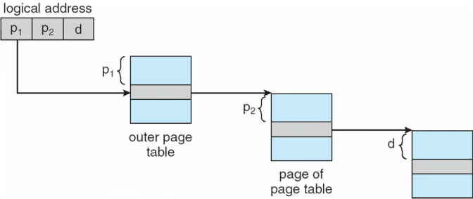
Multi-level page table
Space saving technique
Outer page table points to second-level page table
Second-level page table points to physical frame
Could extend to >2 levels

Slide 20
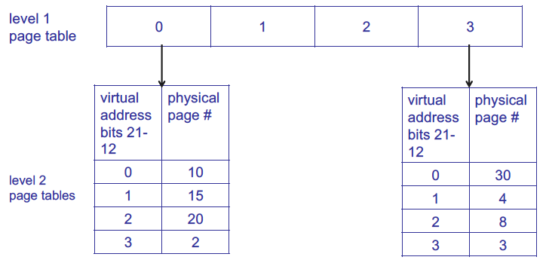
Multi-level page table example
Example assumes 4 KB page size, 1K PTEs at each level

Slide 21
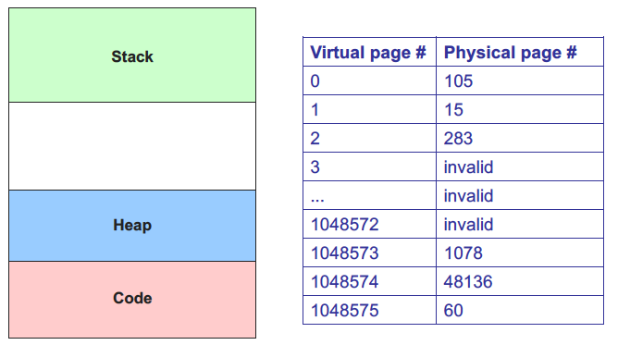
Sparse address spaces: basic page table

Slide 22
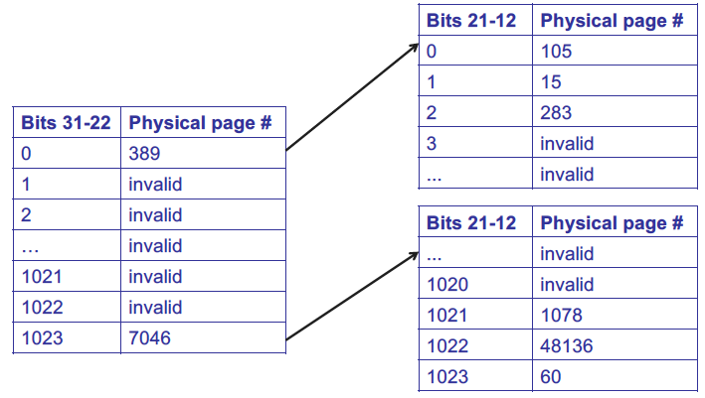
Sparse address spaces: 2-level page table

Slide 23
Multi-level page table
Benefits?
Saves space over 1-level page table
Particularly effective for sparse address spaces
Downsides?
May still have large tables at each level
Multiple lookups per translation

Slide 24
Hashed Page Tables
Common in address spaces > 32 bits
The virtual page number is hashed into a page table
This page table contains a chain of elements hashing to the same location
Each element contains (1) the virtual page number (2) the value of the mapped page frame (3) a pointer to the next element
Virtual page numbers are compared in this chain searching for a match
If a match is found, the corresponding physical frame is extracted

Slide 25
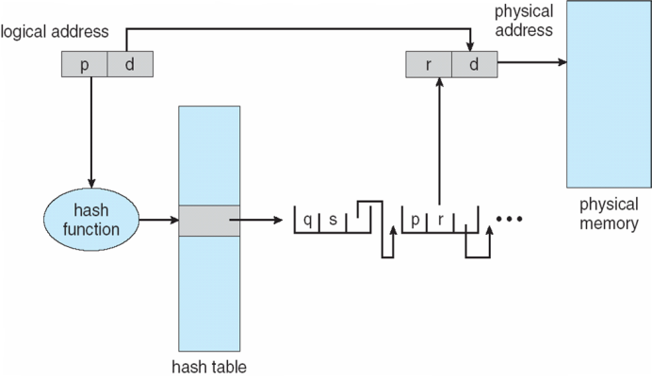
Hashed Page Table

Slide 26
Hashed page table
Benefits?
Even more space-effective than multilevel
Downsides?
Lookup time may be even longer

Slide 27
Inverted Page Table
Rather than each process having a page table and keeping track of all possible logical pages, track all physical pages
One entry for each real page of memory
Entry consists of the virtual address of the page stored in that real memory location, with information about the process that owns that page
Decreases memory needed to store each page table, but increases time needed to search the table when a page reference occurs
Use hash table to limit the search to one — or at most a few — page-table entries
TLB can accelerate access
But how to implement shared memory?
One mapping of a virtual address to the shared physical address

Slide 28
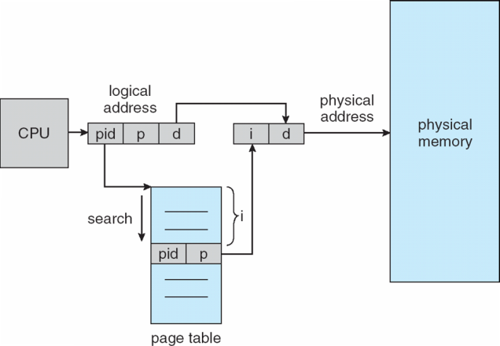
Inverted Page Table Architecture

Slide 29
Virtual memory performance
Address translation accesses memory to get PTE → every memory access twice as long
Solution: store recently used translations
Translation lookaside buffer (TLB): a cache for page table entries
“Tag” is the virtual page #
TLB small → often fully associative
TLB entry also contains valid bit (for that translation); reference & dirty bits (for the page itself!)

Slide 30
Details of Page Table
Page Table
Physical
Memory Space
Virtual Address
frame
12
frame
V page no.
offset
frame
frame
Page Table
Page Table
Base Reg
V
Access
Rights
PA
index
into
page
table
virtual address
table located
in physical
memory
P page no.
offset
12
Physical Address
Page table maps virtual page numbers to physical frames (“PTE” = Page Table Entry)
Virtual memory => treat memory ≈ cache for disk

Slide 31
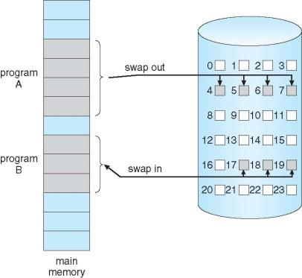
Demand Paging
Could bring entire process into memory at load time
Or bring a page into memory only when it is needed
Less I/O needed, no unnecessary I/O
Less memory needed
Faster response
More users
Similar to paging system with swapping (diagram on right)
Page is needed ⇒ reference to it
invalid reference ⇒ abort
not-in-memory ⇒ bring to memory
Lazy swapper – never swaps a page into memory unless page will be needed
Swapper that deals with pages is a pager

Slide 32
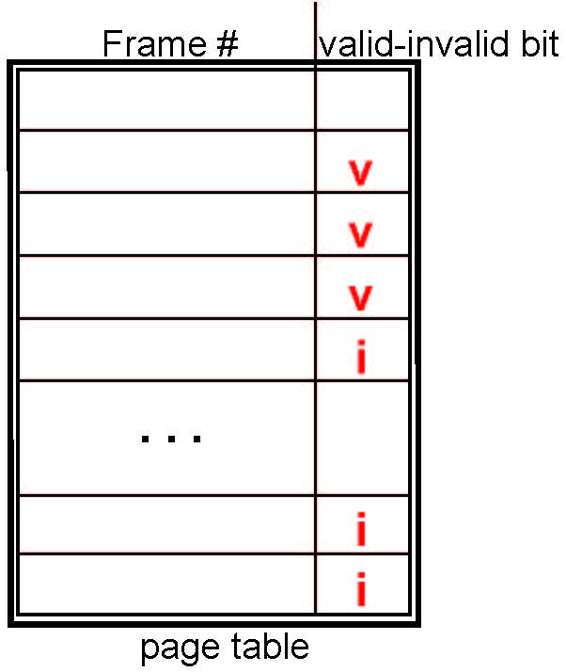
Valid-Invalid Bit
With each page table entry a valid–invalid bit is associated (v ⇒ in-memory – memory resident, i ⇒ not-in-memory)
Initially valid–invalid bit is set to i on all entries
During MMU address translation, if valid–invalid bit in page table entry is i ⇒ page fault

Slide 33
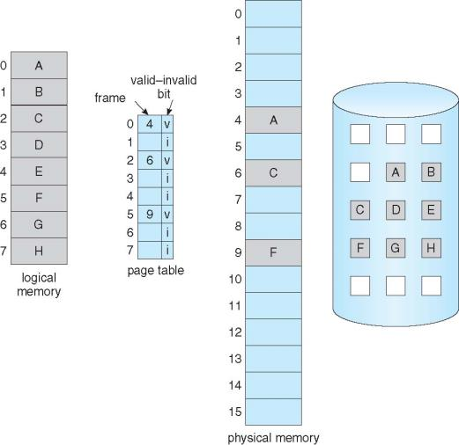
Page table with non-resident pages

Slide 34
Page Fault
If there is a reference to a page, first reference to that page will trap to operating system:
page fault
Operating system looks at another table to decide:
Invalid reference ⇒ abort
Just not in memory
Find free frame
Swap page into frame via scheduled disk operation
Reset tables to indicate page now in memory Set validation bit = v
Restart the instruction that caused the page fault

Slide 35
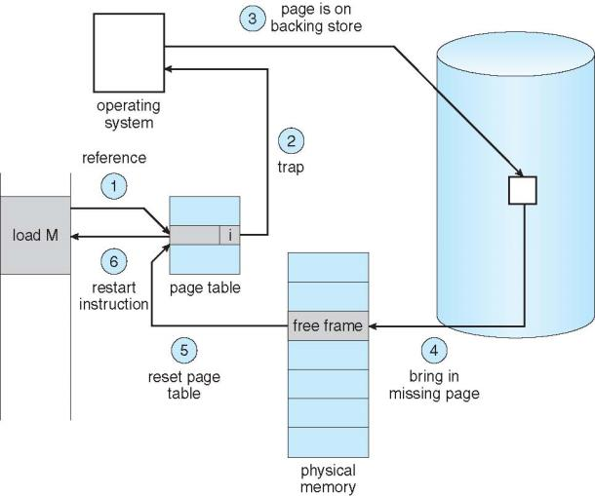
Steps in Handling a Page Fault

Slide 36
Page replacement
How do we determine page to evict if physical address space is full?
Goal: minimize page faults
Possible algorithms
Random
FIFO
Replace page brought into memory longest time ago
Page may still be frequently used
Optimal
Replace page that won’t be used for longest time in future
Minimizes misses, but requires future knowledge
Can we approximate optimal replacement?

Slide 37
Page replacement
LRU: least recently used replacement
Past reference pattern predicts future
Page accessed longest ago likely to be accessed furthest in future
Why?
Programs display temporal locality
What info necessary to implement LRU?
Past access history—difficult to track
Approximated using reference bits
Ref bit = 1 if page accessed within recent interval
Cleared periodically

Slide 38
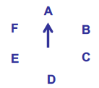
Page replacement (continued)
Clock algorithm
Resident pages around “clock”
When eviction necessary, consider page referenced by clock “hand”
If ref bit = 0, not recently referenced—evict
If ref bit = 1, clear ref bit and move to next page

Slide 39
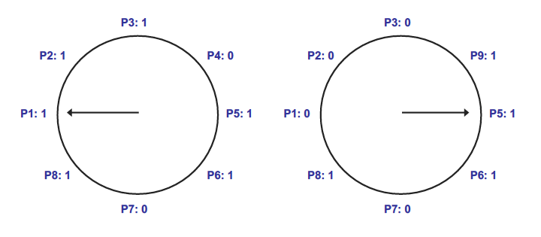
Clock algorithm example
In example above, 8 resident pages
Consider pages starting with P1
P4 is first non-referenced page—evicted for P9
Reference bit clear for P1-P3

Slide 40
Clock algorithm implementation

Slide 41
Dirty bits
What happens on eviction?
Simplest case: evicted page written back to disk
When is write to disk actually necessary?
Only if page has been modified
Dirty bit tracks changed pages
Dirty bit = 1 → page modified
How can dirty bit be used to modify eviction policy?
More performance-effective to evict non-dirty pages—no need to take time to write to disk

Slide 42
Virtual memory example
Assume the current process uses the page table below:
Which virtual pages are present in physical memory?
Which resident pages are candidates for eviction?
Assuming 1 KB pages and 16-bit addresses, what physical addresses would the virtual addresses below map to?
0x041C
0x08AD
0x157B
Virtual page # | Valid bit | Reference bit | Dirty bit | Frame #
0 | 1 | 1 | 0 | 4
1 | 1 | 1 | 1 | 7
2 | 0 | 0 | 0 | --
3 | 1 | 0 | 0 | 2
4 | 0 | 0 | 0 | --
5 | 1 | 0 | 1 | 0

Slide 43
Virtual memory example soln.
Which virtual pages are present in physical memory?
All those with valid PTEs: 0, 1, 3, 5
Which resident pages are candidates for eviction?
All those with valid PTEs and ref bit = 0: 3, 5
Assuming 1 KB pages and 16-bit addresses (both VA & PA), what PA, if any, would the VA below map to?
1 KB pages → 10-bit page offset (unchanged in PA)
Remaining bits: virtual page # → upper 6 bits
Virtual page # chooses PTE; frame # used in PA
0x041C = 0000 0100 0001 1100₂
Upper 6 bits = 0000 01 = 1
PTE 1 → frame # 7 = 000111
PA = 0001 1100 0001 1100₂ = 0x1C1C
0x08AD = 0000 1000 1010 1101₂
Upper 6 bits = 0000 10 = 2
PTE 2 is not valid → page fault
0x157B = 0001 0101 0111 1011₂
Upper 6 bits = 0001 01 = 5
PTE 5 → frame # 0 = 000000
PA = 0000 0001 0111 1011₂ = 0x017B

Slide 44
Final notes
Next time
Finish paging discussion
File systems (time permitting)
Return Exam 2
Reminders:
Program 3 to be posted; due TBD

Slide 45
Acknowledgements
These slides are adapted from the following sources:
Silberschatz, Galvin, & Gagne, Operating Systems Concepts, 9th edition
Anderson & Dahlin, Operating Systems: Principles and Practice, 2nd edition
Chen & Madhyastha, EECS 482 lecture notes, University of Michigan, Fall 2016

