Slide 1
EECE.4810/EECE.5730 Operating Systems
Instructor:
Dr. Michael Geiger
Spring 2018
Lecture 1:
Course overview
Introduction to operating systems

Slide 2
Lecture outline
Today’s lecture
Course overview
Instructor information
Course materials
Course policies
Resources
Course outline

Slide 3
Course meeting time, instructor info
Lectures: MW 2-3:15, Ball 314
Instructor: Dr. Michael Geiger
E-mail: Michael_Geiger@uml.edu
Phone: 978-934-3618 (x43618 on campus)
Office: Ball Hall 301A
Office hours: M 9-10:30, W 9-10:30, Th 1:30-3
Student questions are top priority during these hours
Available by appointment other days/times
Feel free to stop by office any time
Teaching assistant: Anil Gaihre
E-mail: Anil_Gaihre@student.uml.edu
Office hours: days/times TBD; will be in Ball 410

Slide 4
Course materials
Reference Textbooks:
A. Silberschatz, P.B. Galvin, and G. Gagne, Operating System Concepts, 9th Edition, 2012, Wiley. ISBN: 978-1118063330
T. Anderson and M. Dahlin, Operating Systems: Principles and Practice, 2nd Edition, 2014, Recursive Books. ISBN: 978-0985673529
Course tools: All programming assignments will be done in (or via remote access to) the Linux lab, Ball 410
You will get card access to this lab and a Linux account ASAP

Slide 5
Additional course materials
Course websites:
http://mjgeiger.github.io/OS/sp18/index.htm
http://mjgeiger.github.io/OS/sp18/schedule.htm
Will contain lecture slides, handouts, assignments
Discussion group through piazza.com:
Allow common questions to be answered for everyone
Do not post code to the discussion group
All course announcements will be posted here
Will use as class mailing list—please enroll ASAP

Slide 6
Homework assignments
Group projects
May work in groups of up to 3 students unless otherwise specified
Expect to have 4-5 projects throughout semester
Problem sets
To be done individually
Typed solutions preferred
Homework submitted electronically must be in a single file, with no archive files accepted
Failure to follow this rule results in 10 point deduction

Slide 7
Academic honesty
All assignments are to be done individually unless explicitly specified otherwise by the instructor
Any copied solutions, whether from another student or an outside source, are subject to penalty
You may discuss general topics or help one another with specific errors, but do not share assignment solutions
Must acknowledge assistance from classmate in submission

Slide 8
Course “rules”
A couple of unofficial rules:
Please call me “Dr. Geiger”
“Professor Geiger” is okay (although I’m technically not a professor, I’m a lecturer)
“Michael,” “Mike,” or “Geiger” is not okay
Please don’t talk when I’m talking
Doing so distracts your classmates and me
If you have a question, please raise your hand and ask—I want questions during lecture!

Slide 9
Grading and exam dates
Grading breakdown
Programming assignments/homework: 55%
Exam 1: 15%
Exam 2: 15%
Exam 3: 15%
Please note: Students in EECE.5730 will have more work than students in EECE.4810
Additional assignments and/or additional problems on assignments or exams
Exam dates
Exam 1: Wednesday, 2/21
Exam 2: Wednesday, 3/28
Exam 3: TBD (during finals)

Slide 10
Tentative outline: what you should learn
Processes and process management
Multithreading and synchronization
CPU scheduling
Memory management
Memory allocation
Virtual memory management
Storage management
File systems
Disk management
I/O systems
Distributed systems
Protection and security

Slide 11
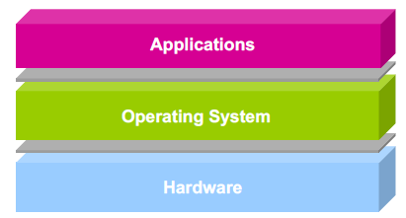
What is an operating system?
Software layer between application programs and physical hardware
Makes system easier to use for programs
Manages allocation of resources to use hardware fairly/efficiently

Slide 12
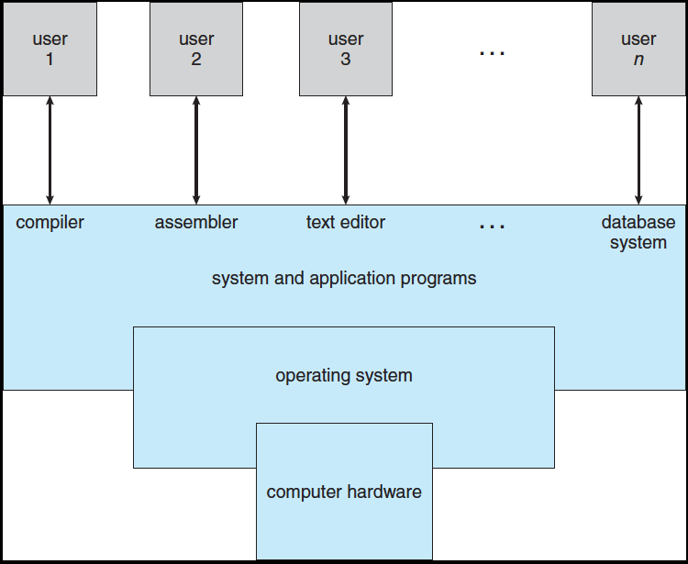
Computing system
Supports 1 or more users
System programs: parts of OS invoked only when necessary
Kernel: part of OS always running

Slide 13
OS and hardware
Abstractions to make hardware easier to use
CPU → threads
Memory → address space
Persistent storage → file system
Manages shared hardware resources
Two interfaces handled by OS
What’s physically available in hardware?
What does the user’s application see as available?

Slide 14
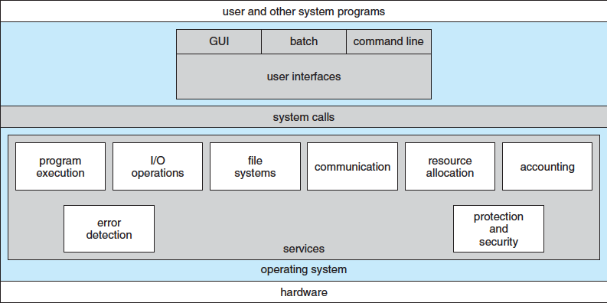
OS and applications
One view of OS
User application is “main” program
Requests services from kernel as needed
Typically done through system calls

Slide 15
OS and applications
Another view of OS
Kernel is main program
Kernel calls programs as subroutines
Think of how main() must return 0 to indicate completion
System calls invoke other system programs or functions within kernel
Essentially allows programs to behave as if each program is running on its own computer

Slide 16
User-friendly services
User interface: command line, GUI
Program execution: load program into memory, run it, and end it
I/O operations: input to user programs or to OS
File system manipulation: read/write, create/delete, search files
Communication: same computer or network
Error detection: in CPU, memory, devices, program

Slide 17
System services
Resource allocation: sharing of hardware among multiple users or processes
CPU cycles, main memory, files, I/O devices
Accounting: tracking resource usage
Protection: controlling access to resources
Includes data local to each process
Security: requiring user authentication and defending devices against invalid access

Slide 18
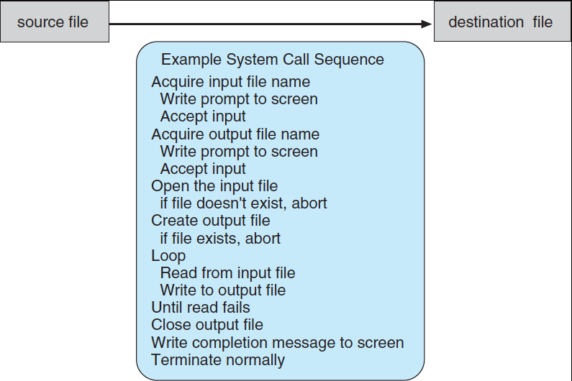
System calls
Provide services to user applications
Available as functions written in C/C++/assembly

Slide 19
System call types
Process control
Examples: create/terminate process, terminate process, load/execute process, get process attributes
File management
Examples: create/delete file, open/close file, read/write file, reposition file pointer
Device management
Examples: request access to device, release device, read/write device
Communications
Examples: send/receive messages, access shared memory, attach/detach remote devices
Protection
Examples: get/set permissions, allow/deny user access

Slide 20
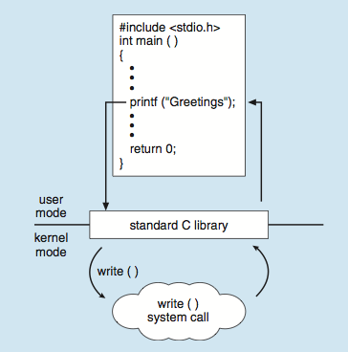
Standard C Library Example
C program invoking printf() library call, which calls write() system call

Slide 21
Final notes
Next time: start processes and process management
Reminders:
Sign up for the course discussion group on Piazza!

Slide 22
Acknowledgements
These slides are adapted from the following sources:
Silberschatz, Galvin, & Gagne, Operating Systems Concepts, 9th edition
Chen & Madhyastha, EECS 482 lecture notes, University of Michigan, Fall 2016

