Slide 1
EECE.4810/EECE.5730 Operating Systems
Instructor:
Dr. Michael Geiger
Spring 2018
Lecture 4:
Inter-process communication (IPC)

Slide 2
Lecture outline
Announcements/reminders
Sign up for the course discussion group on Piazza!
Currently no TA assigned to course
Please don’t contact Anil with questions!
Program 1 to be posted later today; due Monday, 2/12
Linux lab (Ball 410) accounts set up
Please contact me for your Linux account info
Will request card access for you ASAP
Today’s lecture: inter-process communication
Shared memory IPC
Message passing IPC

Slide 3
Interprocess Communication
Processes may be independent or cooperating
Cooperating process can affect or be affected by other processes, including sharing data
Reasons for cooperating processes:
Information sharing (i.e., shared files)
Computation speedup (if procs can run in parallel)
Modularity (divide up program/system)
Convenience
Cooperating processes need interprocess communication (IPC)
Two models of IPC
Shared memory
Message passing

Slide 4
IPC Models
(a) Message passing (b) Shared memory

Slide 5
Producer-Consumer Problem
Paradigm for cooperating processes, producer process produces information that is consumed by a consumer process
unbounded-buffer places no practical limit on the size of the buffer
bounded-buffer assumes that there is a fixed buffer size

Slide 6
Shared Memory IPC
One process creates shared region; allows others to access
Benefits:
Minimal OS involvement: just syscall to set up region
Otherwise, user processes manage communication
Typically need system-level synchronization primitives to ensure accesses to shared region seen in same order by all processes
Producer-consumer: share 1+ variables
Unbounded buffer—no set size limit
Bounded buffer—fixed-length circular buffer

Slide 7
Shared Memory Example: POSIX
POSIX: Portable OS Interface
Standards for compatibility between OS
Defines API, shells, utilities for compatibility with UNIX
POSIX Shared Memory
Organized using memory-mapped files
In other words, shared region is treated as a file
Producer responsible for creating file, writing to shared memory
Consumer responsible for reading from shared memory

Slide 8
Shared memory producer/consumer
Producer process responsible for:
Creating shared region
Region created as file under POSIX
Establishing size of region
Writing data to shared region
Consumer process responsible for:
Reading data from shared region
Removing region from file system when done
Each processes must map region into its address space
OS ensures accesses to “different” memory regions in each process actually map to same physical memory

Slide 9
POSIX shared memory producer
shm_open(): create region to be shared as file (allocated within file system)
1st arg: name
2nd arg: mode for opening
O_CREAT: create if region does not exist
O_RDWR: region is both readable & writeable
3rd arg: file permissions
0666: user, group, and world have RW permissions
Returns file descriptor

Slide 10
POSIX shared memory producer (2)
ftruncate(): resize shared object
Newly created object defaults to size 0
mmap(): establishes mem-mapped file containing shared object → shared object now in process’s address space
1st arg: starting address of mapping (if 0, let kernel choose address)
2nd arg: object size
3rd arg: memory protection
Writeable to producer
4th arg: determine if shareable
5th arg: file descriptor
6th arg: offset into file

Slide 11
POSIX shared memory producer (3)
mmap() returns pointer
Shared region can be written as a string
sprintf() takes string pointer as first argument; remaining arguments like printf()
Producer removes file from address space (munmap()) and closes it when done in this example

Slide 12
POSIX shared memory consumer
Consumer also opens/maps file
Uses read protection for mmap()
Removes shared object when it’s done
shm_unlink() function
Note: in this example, we know consumer will run after producer
Errors occur if that’s not the case—consumer has nothing to read
Also removes need for synchronization

Slide 13
Message Passing IPC
OS provides mechanisms for processes to communicate and synchronize
Benefits
Good for small amounts of data—no synch. conflicts
Easier in distributed system—leverage existing links
Potentially faster on multi-core—no cache coherence issue
Message system – processes communicate with each other without resorting to shared variables
IPC facility provides two operations:
send(message)
receive(message)
The message size is either fixed or variable
Fixed is easier at system level; harder for programmer

Slide 14
Direct Communication
Processes must name each other explicitly:
send (P, message) – send a message to process P
receive(Q, message) – receive a message from process Q
Properties of communication link
Links are established automatically
A link is associated with exactly one pair of communicating processes
Between each pair there exists exactly one link
The link may be unidirectional, but is usually bi-directional

Slide 15
Indirect Communication
Messages are directed and received from mailboxes (also referred to as ports)
Each mailbox has a unique id
Processes can communicate only if they share a mailbox
Properties of communication link
Link established only if processes share a common mailbox
A link may be associated with many processes
Each pair of processes may share several communication links
Link may be unidirectional or bi-directional

Slide 16
Indirect Communication
Operations
create a new mailbox (port)
send and receive messages through mailbox
destroy a mailbox
Primitives are defined as:
send(A, message) – send a message to mailbox A
receive(A, message) – receive a message from mailbox A

Slide 17
Indirect Communication
Mailbox sharing
P₁, P₂, and P₃ share mailbox A
P₁, sends; P₂ and P₃ receive
Who gets the message?
Solutions
Allow a link to be associated with at most two processes
Allow only one process at a time to execute a receive operation
Allow the system to select arbitrarily the receiver. Sender is notified who the receiver was.

Slide 18
Message Passing Example: Mach
Mach: microkernel-based OS
Microkernel: kernel contains minimal services
Process, memory management, IPC
Other OS services: system & user-level programs
Designed with distributed systems in mind
Basis for some modern OS (Tru64 UNIX, Mac OS X)
Mach communication is message based
Even system calls are messages
Each task gets two mailboxes at creation: Kernel and Notify
Notify: notifications of event occurrences

Slide 19
Message Passing Example: Mach
Only three system calls needed for message transfer
msg_send(), msg_receive(), msg_rpc()
RPC: remote procedure call
Mailboxes needed for communication, created via port_allocate()
Messages: fixed-length header, variable length body
Send and receive are flexible, for example four options if mailbox full:
Wait indefinitely (send only)
Wait at most n milliseconds
Return immediately
Temporarily cache a message (server task)

Slide 20
Message Passing Example: Windows
Message-passing centric via advanced local procedure call (LPC) facility
Only works between processes on the same system
Uses ports (like mailboxes) to establish and maintain communication channels
Communication works as follows:
The client opens a handle to the subsystem’s connection port object.
The client sends a connection request.
The server creates two private communication ports and returns the handle to one of them to the client.
The client and server use the corresponding port handle to send messages or callbacks and to listen for replies.

Slide 21
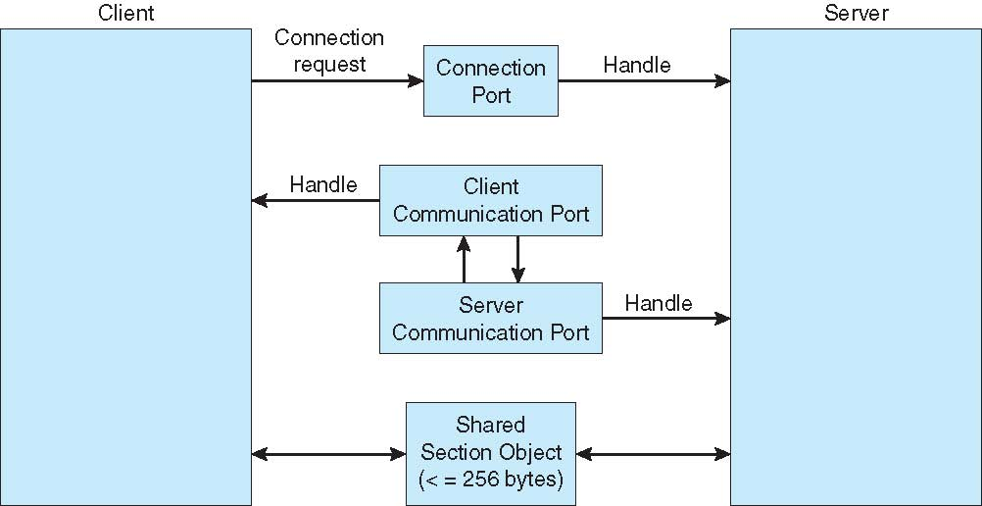
Local Procedure Calls in Windows

Slide 22
Final notes
Next time
Threads
Reminders:
Sign up for the course discussion group on Piazza!
Currently no TA assigned to course
Please don’t contact Anil with questions!
Program 1 to be posted later today; due Monday, 2/12
Linux lab (Ball 410) accounts set up
Please contact me for your Linux account info
Will request card access for you ASAP

Slide 23
Acknowledgements
These slides are adapted from the following sources:
Silberschatz, Galvin, & Gagne, Operating Systems Concepts, 9th edition
Chen & Madhyastha, EECS 482 lecture notes, University of Michigan, Fall 2016
Example code was downloaded from:

