Slide 1
EECE.3170
Microprocessor Systems Design I
Instructor: Dr. Michael Geiger
Fall 2016
Lecture 27:
PIC assembly programming (continued)

Slide 2
Lecture outline
Announcements/reminders
  HW 7 posted; due 11/28
  Visit my office (Perry 118A) to check out a PICkit for HW 8
    Contact me if you don’t have a group
Today’s lecture: sample programming sequences
  Delay loop
  State machine
Microprocessors I: Lecture 27

Slide 3

A Delay Subroutine
; ***********************************************************************************
; TenMs subroutine and its call inserts a delay of exactly ten milliseconds
; into the execution of code.
; It assumes a 4 MHz crystal clock. One instruction cycle = 4 * Tosc.
; TenMsH equ 13 ; Initial value of TenMs Subroutine's counter
; TenMsL equ 250
; COUNTH and COUNTL are two variables
TenMs
nop ; one cycle
movlw TenMsH ; Initialize COUNT
movwf COUNTH
movlw TenMsL
movwf COUNTL
Ten_1
decfsz COUNTL,F ; Inner loop
goto Ten_1
decfsz COUNTH,F ; Outer loop
goto Ten_1
return
Microprocessors I: Lecture 27
Notes:
Chapter 9

Slide 4
Delay subroutine questions
What factors determine amount of delay?
  Clock period (1/frequency)
  Clock cycles per instruction
  Number of instructions in loop
  Initial values of counter (COUNTL/COUNTH)
    TenMsH/TenMsL: constants used to initialize counter
What’s downside of using loop for delay?
  Processor does nothing but wait
Under what conditions does this function decrement the upper byte (COUNTH)?
  When COUNTL == 0
    First decfsz skips goto
    Second decfsz changes COUNTH
Microprocessors I: Lecture 27

Slide 5
Delay subroutine questions (cont.)
Under what conditions does function return?
  COUNTL == COUNTH == 0
How many times does each instruction execute?
  Everything before Ten_1 label: 1 time
  First decfsz/goto pair: depends on loop iteration
    First iteration: decfsz → 250 times, goto → 249 times
      goto skipped in last iteration
    All others: decfsz → 256 times, goto → 255 times
      Start by decrementing 0x00 → 0xFF (255)
  Second decfsz/goto pair: decfsz 13 times, goto 12 times
  return instruction: 1 time
Microprocessors I: Lecture 27

Slide 6
Blinking LED example
Assume three LEDs (Green, Yellow, Red) are attached to Port D bit 0, 1 and 2. Write a program for the PIC16F874 that toggles the three LEDs every half second in sequence: green, yellow, red, green, ….
For this example, assume that the system clock is 4MHz.
Microprocessors I: Lecture 27

Slide 7
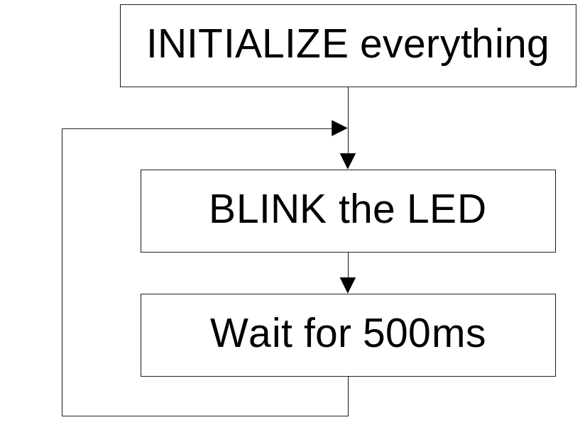
Top Level Flowchart
Initialize: Initialize port D, initialize the counter for 500ms.
Blink: Toggle the LED in sequence, green, yellow, red, green, …. Which LED to be toggled is determined by the previous state.
Wait for 500ms: Keep the LED on for 500ms and then toggle the next one.
Microprocessors I: Lecture 27

Slide 8

Strategy to “Blink”
The LEDs are toggled in sequence - green, yellow, red, green, yellow, red…
Let’s look at the lower three bits of PORTD
  001=green, 010=yellow, 100=red
The next LED to be toggled is determined by the current LED.
001->010->100->001->…
Microprocessors I: Lecture 27

Slide 9
Inefficient “Blink” Subroutine
Blink
btfsc PORTD, 0 ; is it Green?
goto toggle1 ; yes, goto toggle1
btfsc PORTD, 1 ; else is it Yellow?
goto toggle2 ; yes, goto toggle2
;toggle0
bcf PORTD, 2 ; otherwise, must be red, change to green
bsf PORTD, 0 ; 100->001
return
toggle1
bcf PORTD, 0 ; change from green to yellow
bsf PORTD, 1 ; 001->010
return
toggle2
bcf PORTD, 1 ; change from yellow to red
bsf PORTD, 2 ; 010->100
return
Microprocessors I: Lecture 27

Slide 10
Inefficient “Blink” Subroutine Questions
Under what conditions will this function jump to “toggle1”?
  Lowest bit of PORTD = 1 (001, 011, 111)
Under what conditions will this function jump to “toggle2”?
  Lowest bit of PORTD = 0; second bit = 1 (010, 110)
If function gets into error state, how does it take to recover to valid state (only 1 bit == 1)?
  Depends on error state—1 or 2 function calls
Is there another way to toggle bits when changing state?
  What logical operation lets you toggle bits?
    XOR (1s in positions to change; 0s elsewhere)
Microprocessors I: Lecture 27

Slide 11
Another way to code “Blink” ---- Table Use
BlinkTable
movf PORTD, W ; Copy present state of LEDs into W
andlw B'00000111' ; and keep only LED bits
addwf PCL,F ; Change PC with PCLATH and offset in W
retlw B'00000001' ; (000 -> 001) reinitialize to green
retlw B'00000011' ; (001 -> 010) green to yellow
retlw B'00000110' ; (010 -> 100) yellow to red
retlw B'00000010' ; (011 -> 001) reinitialize to green
retlw B'00000101' ; (100 -> 001) red to green
retlw B'00000100' ; (101 -> 001) reinitialize to green
retlw B'00000111' ; (110 -> 001) reinitialize to green
retlw B'00000110' ; (111 -> 001) reinitialize to green
In calling program
call BlinkTable ; get bits to change into W
xorwf PORTD, F ; toggle them into PORTD
Microprocessors I: Lecture 27

Slide 12
Table Use Questions
What do the first two instructions do?
  Isolate lowest 3 bits of PORTD
  Ensure value in W is between 0-7
What does the addwf instruction do?
  Adding to PCL → effectively goto instruction
  Value in W = offset from addwf instruction
    If W = 0, add 0 to PCL → “jumps” to next instruction
    If W = 1, add 1 to PCL → “jumps” 1 extra instruction
    …
    If W = 7, add 7 to PCL → “jumps” 7 extra instructions
Why do we need 8 retlw instructions?
  8 possible values for lowest bits of PORTD
  8 possible states—3 valid ones (001, 010, 100) and 5 error states
Microprocessors I: Lecture 27

Slide 13
Table Use Questions (continued)
How is each return value used?
  Bit mask used in xorwf instruction
  Accomplishes appropriate state transition
  Valid states go through desired pattern
    001 XOR 011 = 010
    010 XOR 110 = 100
    100 XOR 101 = 001
  All error states transition back to 001
Why are upper 5 bits of return values = 0?
  May have other devices hooked up to port—don’t want to change state of those devices
  0 XOR 0 = 0; 1 XOR 0 = 1 → XOR with 0 doesn’t change bit
Microprocessors I: Lecture 27

Slide 14
Final notes
Next time:
  PICkit intro
Reminders
  HW 7 posted; due 11/28
  Visit my office (Perry 118A) to check out a PICkit for HW 8
    Contact me if you don’t have a group
Microprocessors I: Lecture 27

