Slide 1
EECE.2160 ECE Application Programming
Instructor:
Dr. Michael Geiger
Summer 2018
Lecture 5:
PE2: Loops and conditionals
Exam 1 Preview

Slide 2
Lecture outline
Announcements/reminders
Program 3 due Friday, 6/1
Program 4 to be posted; due Thursday, 6/7
Exam 1: Monday, 6/4
Will be allowed one double-sided 8.5” x 11” note sheet
No calculators or other electronic devices allowed
Review
While/do-while loops
For loops
Today’s lecture
PE2: Conditionals and loops
Exam 1 Preview

Slide 3
Review: while/do-while loops
Used for repetition of code
while (<expression>)
<statement> ← loop body
do { <statements> } while ( <expression> );

Slide 4
Review: for loops
for (<init var>; <test>; <change var>)
<statements>
Operators to directly change variable
x++, x-- → post-increment/decrement
++x, --x → pre-increment/decrement
+=, -=, *=, /= → augmented assignment

Slide 5
Today’s program should:
Prompt user to enter an input character and an integer, n.
If not correctly formatted, print error, clear line, and repeat
Depending on the character entered, do the following:
‘F’ or ‘f’: Compute and print the factorial of n, n!
For example, if the user enters F 5, print 5! = 120
‘P’ or ‘p’: Compute 2^{n}, but only if n >= 0.
For example, if the user enters p 2, print 2^2 = 4
Print an error if n < 0.
‘X’ or ‘x’: Exit the program
In all other cases, print an error:
For example: Invalid command Z entered
If the user enters any command other than ‘X’ or ‘x’, return to the initial prompt and repeat the program.

Slide 6
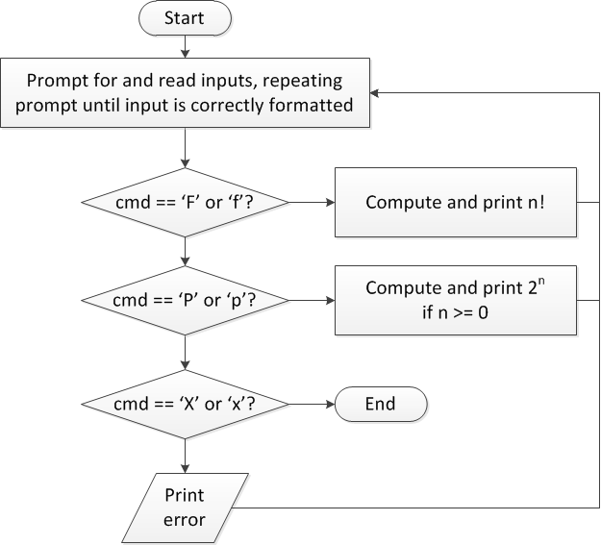
Flow charts: overall flow

Slide 7
Discussion: Overall flow
Whole program contains loop
Repeats process until user enters ‘X’ or ‘x’
Use while or do-while—unknown # of iterations
Since exit condition ends program, infinite loop
Testing cmd: switch statement
Checking equality of cmd to constant values
Exiting program: return statement
Use return at any point to end current function (including main)

Slide 8
Code: overall flow (skeleton code)
while (1) { // Loop repeats until user enters 'X' or 'x'
/* Code to read cmd, n */
/* Evaluate cmd and perform appropriate operation */
switch (cmd) {
case 'F':
case 'f':
/* Calculate n! */
break;
case 'P':
case 'p':
/* Calculate 2^n, if n >= 0; print error otherwise */
break;
case 'X':
case 'x':
return; // Exit program
default:
printf("Invalid command %c entered\n", cmd);
}
}

Slide 9
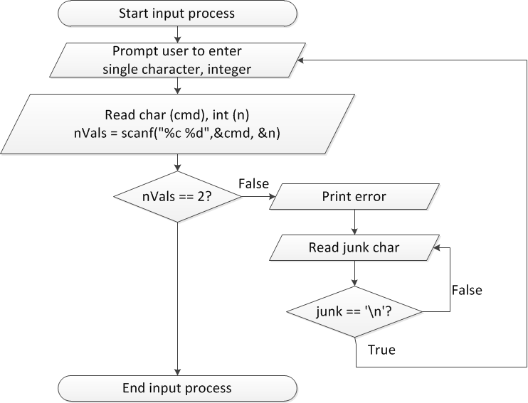
Flow charts: reading input

Slide 10
Discussion: Reading input
Loop that repeats as long as input incorrect
Loop inside that one to handle reading of remainder of line
Read character until you reach end of line
Both while/do-while loops

Slide 11
Code: Reading input
do {
printf("Enter command and integer: ");
nVals = scanf("%c %d", &cmd, &n);
// Otherwise, print error & clear line
if (nVals != 2) {
printf("Incorrectly formatted input\n“);
do {
scanf("%c", &junk);
} while (junk != '\n');
}
} while (nVals != 2);

Slide 12
Input errors
In general, may want to repeat prompt if any error occurs
Logical OR of all error conditions to continue loop
Prioritize error testing—format errors usually first
Why test inputs if they weren’t read correctly?
Example: also test for n < 0 as an error
do {
printf("Enter command and integer: ");
nVals = scanf("%c %d", &cmd, &n);
if (nVals != 2) {
// Handle error
}
else if (n < 0) { ← Test after we know no
// Handle error formatting error
}
} while ((nVals != 2) || (n < 0));

Slide 13
Next step
Write flowcharts for
Computing n!
Computing 2^{n} if n >= 0
Complete code

Slide 14
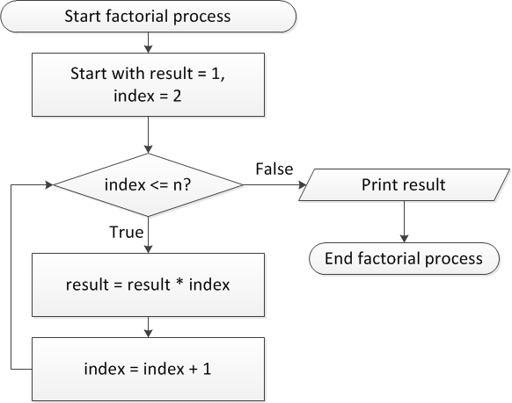
Flow charts: Calculating n!

Slide 15
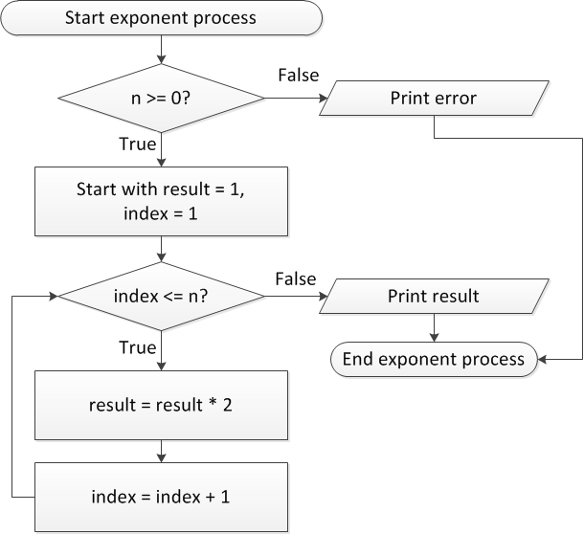
Flow charts: Calculating 2^{n}

Slide 16
Discussion: Factorial/2^{n}
Loop for each process covers fixed range of values
Use for loop
Can declare single variable to hold both results, since only one will be calculated

Slide 17
Code: factorial
result = 1;
for (i = n; i > 1; i--) {
result *= i;
}
printf("%d! = %d\n", n, result);
Slightly different approach than flow chart
Counts down instead of counting up
No benefit to doing one over the other

Slide 18
Code: 2^{n}
if (n < 0)
printf("Error: bad n value\n");
else {
result = 1;
for (i = 0; i < n; i++) {
result *= 2;
}
printf("2^%d = %d\n", n, result);
}

Slide 19
Iterative methods (Program 4)
Repeat calculation until correct value reached
“Correctness” defined as:
Difference between old, new value <= max error
Max error == .000001 in Prog. 4
General process:
newVal = <initial value>;
do {
oldVal = newVal;
newVal = <equation based on oldVal>;
} while (fabs(newVal – oldVal) > max_err);
You can’t use <math.h>, so you’ll need your own way of computing absolute value (fabs())

Slide 20
Exam 1 notes
Allowed one 8.5” x 11” double-sided sheet of notes
No other notes
No electronic devices (calculator, phone, etc.)
Exam will last 2 hours and 20 minutes
We’ll start at 8:00—please be on time!!
Covers all lectures through today
You will not be tested on design process, IDEs
Material starts with basic C program structure
3 questions (each with multiple parts, so actually ~10 questions) + 1 extra credit question
Operators, printf(), scanf()
Conditional statements
While/do-while loops
Extra credit may cover any (or all) of these topics

Slide 21
Test policies
Prior to passing out exam, your instructor will verify that you only have one note sheet
If you have multiple sheets, I will take all notes
You will not be allowed to remove anything from your bag after that point in time
If you need an additional pencil, eraser, or piece of scrap paper during the exam, ask me
Only one person will be allowed to use the bathroom at a time
You must leave your cell phone either with me or clearly visible on the table near your seat

Slide 22
Review: Data types, variables, constants
Four basic data types
int, float, double, char
Variables
Have name, type, value, memory location
Variable declarations: examples
int x;
float a, b;
double m = 2.35;

Slide 23
Review: printf() basics
printf(<string>); <string> = characters enclosed in double quotes
May include escape sequence, e.g. \n (new line)
To print variable/expression values, insert %<type> in your printf() format string
%c: single character
%d or %i: signed decimal integer
%f: float; %lf: double
Prints 6 digits after decimal point by default
To control # digits, use precision
"%.4lf" prints with 4 digits (4th digit rounds)
"%.0lf" prints with 0 digits (round to nearest integer)
Each %<type> corresponds to expression that follows
printf("a=%.3f, b=%.2f", a, b);

Slide 24
Review: scanf()
To read input, use format specifiers in scanf() format string, followed by addresses of variables
scanf("%d %f",&hours,&rate);
Space in format string only matters if using %c format specifier
If input format doesn’t match specifier, scanf() stops and returns # values successfully read
Given: n = scanf("%d %d”, &x, &y);
If input is: 3 5 → x = 3, y = 5, n = 2
If input is: 3 A → x = 3, y = ?, n = 1
If input is: A 3 → x = ?, y = ?, n = 0

Slide 25
Review: C operators
Operator | Associativity
Innermost ( ) | Left to right
Unary - | Right to left
* / % | Left to right
+ - | Left to right

Slide 26
Review: Operators and statements
Operators can be used either with constants or variables
More complex statements are allowed
e.g. x = 1 + 2 - 3;
Parentheses help you prioritize parts of statement
Makes difference with order of operations
x = 1 + 2 * 3
is different than
x = (1 + 2) * 3

Slide 27
Review: if statements
Conditional execution using if statements:
Form:
if (<expression>)
<statement>
[ else brackets show
<statement> ] else is optional
Expression frequently uses relational operators to test equality/inequality
< > <= >= == !=
e.g., if (x <= 5)
Can combine conditions using logical operators
AND : && OR: ||
e.g., if ((x <= 5) && (x > 0))
Can test if condition is false using logical NOT: !
e.g., if (!(x < 5))

Slide 28
Review: range checking
Common application of if statements: checking to see if value falls inside/outside desired range
Value inside range → inside both endpoints
AND together tests for each endpoint
Ex: if (x >= 1 && x <= 10)
Value outside range → outside either endpoint
OR together tests for each endpoint
Ex: if (x < 1 || x > 10)

Slide 29
Review: switch statements
When checking multiple exact values for expression, more sense to use switch statement
switch (<expr>) {
case <val1> :
...
break;
case <val2> :
...
break;
...
default:
...
}
break allows you to exit switch statement after completing code
Otherwise, program will continue to run through cases until finding break
default covers any values without specific case

Slide 30
Review: while/do-while loops
Used for repetition of code
while (<expression>)
<statement> ← loop body
do { <statements> } while ( <expression> );

Slide 31
Review: for loops
for (<init var>; <test>; <change var>)
<statements>
Operators to directly change variable
x++, x-- → post-increment/decrement
++x, --x → pre-increment/decrement
+=, -=, *=, /= → augmented assignment

Slide 32
Final notes
Next time
Exam 1
Reminders:
Program 3 due Friday, 6/1
Program 4 to be posted; due Thursday, 6/7
Exam 1: Monday, 6/4
Will be allowed one double-sided 8.5” x 11” note sheet
No calculators or other electronic devices allowed

