Slide 1
16.317
Microprocessor Systems Design I
Instructor: Dr. Michael Geiger
Fall 2015
Lecture 27:
Exam 2 Review

Slide 2
Lecture outline
Announcements/reminders
  HW 5 to be posted; due date TBD
  No lecture Wednesday (Veterans Day)
Today’s lecture
  Exam 2 Review
Microprocessors I: Lecture 27

Slide 3
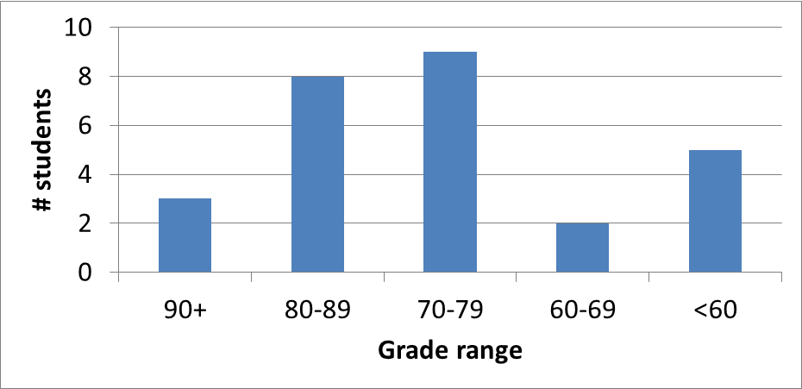
Exam stats & grade distribution
Question-by-question averages:
  Q1: 8.0 / 16 (50%)
  Q2: 13.2 / 16 (83%)
  Q3: 16.5 / 28 (59%)
  Q4: 25.0 / 40 (62%)
Extra credit
  16 students
  4.7 / 10 average
Average: 62.7
Median: 63.5
Std. deviation: 18.5
Max: 98
Microprocessors I: Lecture 27

Slide 4
Figuring out where you stand
Homework: 55% (4 done; 3 graded; 6 or 7 total)
Exams: 45% (15% + 15% + 15%)
~1/3 of your grade still to be determined
Estimating your grade
  Homework avg (HWA) =
  (HW1 + HW2 + HW3) / 3
  Exam avg (EA) =
  ((Exam1) + (Exam2)) / 2
  Overall avg = HWA * 0.55 + EA * 0.45
Microprocessors I: Lecture 27

Slide 5
Figuring out where you stand
Estimated avg. = HWA * 0.55 + EA * 0.45
Current course averages
  Without extra credit: ~76%, SD ≈ 16.7
  With extra credit: ~76.7%, SD ≈ 17.1
Key points
  Curve would add ~3-4 points
    Very possible there will be no grading curve
  Minimum grade to earn a C (required to pass class)
    With curve: 69
    Without curve: 73
    THESE NUMBERS WILL ALMOST CERTAINLY CHANGE BEFORE SEMESTER’S END—THESE FIGURES ARE JUST ROUGH ESTIMATES!!!!!
Microprocessors I: Lecture 27

Slide 6
Final notes
Next time:
  PICkit intro (Friday, 11/13)
Reminders:
  HW 5 to be posted; due date TBD
  No lecture Friday (Veterans Day)
Microprocessors I: Lecture 27

