Slide 1
EECE.2160 ECE Application Programming
Instructor:
Dr. Michael Geiger
Fall 2017
Lecture 6:
PE1: Flowcharts and debugging

Slide 2
Lecture outline
Announcements/reminders
Program 2 due 9/20
Program 1 regrades due 9/22
When you submit a regrade, please e-mail the TAs (Zhendong_Wang@student.uml.edu, LiN_Li@student.uml.edu) and CC me
Review
Basic variable input with scanf()
Today’s lecture
PE1: Flowcharts and debugging

Slide 3
Review: scanf()
To read input, use format specifiers in scanf() format string, followed by addresses of variables
scanf("%d %f",&hours,&rate);
Space in format string only matters if using %c format specifier
If format of input does not match format specifier, scanf() stops and returns # values successfully read

Slide 4
scanf() and scanf_s()
Visual Studio users will see an error message when using scanf()
Function is technically not secure (not that it matters for our purposes)
Suggests use of scanf_s()
Windows-specific “secure” scan function
Preferred method of removing warnings:
#define _CRT_SECURE_NO_WARNINGS
That line must come before
#include <stdio.h>

Slide 5
Example
Variables: int i; double d; char c;
What values are read for each of the following inputs and scanf() calls? Assume the input is as follows: 34 5.7
scanf("%d%lf", &i, &d)
scanf("%d %lf", &i, &d)
scanf("%lf%d", &d, &i)
scanf("%d%c", &i, &c)
scanf("%d %c", &i, &c)

Slide 6
Example solution
What values are read for each of the following inputs and scanf() calls?
scanf("%d%lf", &i, &d)
→ i = 34, d = 5.7
scanf("%d %lf", &i, &d)
→ i = 34, d = 5.7
scanf("%lf%d", &d, &i)
→ d = 34, i = 5
scanf("%d%c", &i, &c)
→ i = 34, c = ' ' (space)
scanf("%d %c", &i, &c)
→ i = 34, c = '5'

Slide 7
Flowcharts
Graphical representation of process
Shows all steps and their order
In programming, use to organize program before writing code
Basic elements
Process
Terminator (start/end)
Input/Output
Connector
Decision
Connector (off page)

Slide 8
Example: Quadratic Equation Solver
Start
Output
“Quadratic Equation Solver”
Output
“Enter A, B, C: ”
Input A, B, C

Slide 9
Quadratic Equation Solver (cont.)
A = 0?
TRUE
Output
X
FALSE
DISC=B*B-4*A*C
DISC = 0?
TRUE
Output
X
FALSE
DISC>0?
TRUE
Output
X1,X2
FALSE
Output
XREAL + XIMAG i
XREAL – XIMAG i
Done

Slide 10
Exercise: Flowchart
Design a flowchart to solve the following:
Prompt a user to enter four numbers on a single line, which represent the contents of a 2x2 array
After reading the values, your program should print the matrix represented by these values
For example, if the user enters “1 2 3 4”, print:
1 2
3 4
Assume all values have the same number of digits
Also, calculate the matrix determinant and print it on a separate line
In the example above, determinant = (1x4) - (2x3) = 4-6 = -2

Slide 11
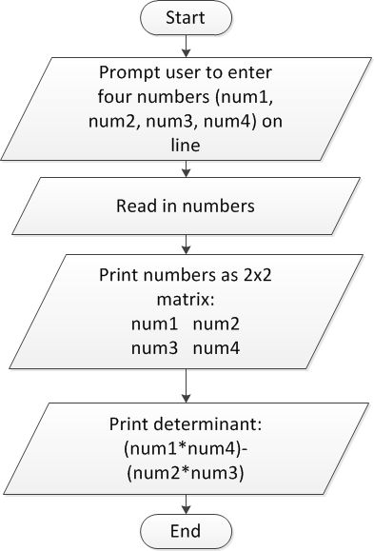
Flowchart: solution

Slide 12
Converting flowchart to program
What data are used in the process?
Can those data be represented as constants?
If not, what variables are needed?
How many?
What type(s)?
How should variables be named?
What C statement corresponds to each process step?
Input statements: scanf()
Output statements: printf()
Terminators: start/end of main() function
Will generalize later to any function
General process steps: basic expressions
May need multiple lines of code

Slide 13
Debugging
Most IDEs allow ability to view state of program while running through debugger
View variable values
Execute program:
One line at a time (single step)
By running until reaching a pre-defined stopping point (breakpoint)
Can isolate bugs without altering program
Alternate solution: inserting print statements to show program state at various points
Disadvantages
Inefficient--repeated compilation, must keep adding statements
May actually alter operation of other statements

Slide 14
Final notes
Next time
Conditional statements: if
Reminders:
Program 2 due 9/20
Program 1 regrades due 9/22
When you submit a regrade, please e-mail the TAs (Zhendong_Wang@student.uml.edu, LiN_Li@student.uml.edu) and CC me

