Slide 1
EECE.2160 ECE Application Programming
Instructor:
Dr. Michael Geiger
Fall 2017
Lecture 9:
Switch statements

Slide 2
Lecture outline
Announcements/reminders
Program 3 due 9/29
Exam 1: Wednesday, 10/4
Will be allowed one double-sided 8.5” x 11” note sheet
No calculators or other electronic devices allowed
Looking way ahead: Final Exam schedule set
Saturday, 12/16, 3-6 PM
Review
Range checking with if statements
Today’s lecture
Switch statements
Debugger demonstration

Slide 3
Program 3 notes: conditional statements
Use conditional statements for
Error checking
Formatting error (scanf() can’t read input)
Invalid operator
Invalid input values (each input must be either 0 or 1)
Determining which operator your user entered
Depending on how you structure this part of your code, could test for invalid operator error here
Don’t use conditional statements to determine correct output for each expression
&, |, ^ are valid C operators!!!!!

Slide 4
Program 3 notes: bitwise operators
Example: user enters & operator
Wrong way to find result: “truth table”
if (in1 == 0 || in2 == 0)
result = 0;
else if (in1 == 1 && in2 == 1)
result = 1;
Right way: just use built-in operator!
result = in1 & in2;

Slide 5
Review: range checking
Common application of if statements: checking to see if value falls inside/outside desired range
Value inside range → inside both endpoints
AND together tests for each endpoint
Ex: if (x >= 1 && x <= 10)
Value outside range → outside either endpoint
OR together tests for each endpoint
Ex: if (x < 1 || x > 10)

Slide 6
switch statements
Nesting several if/else if statements can get tedious
If each condition is simply checking equality of same variable or expression, can use switch

Slide 7
switch/case statement - General form
switch ( <expression> ) { case <value1> : <statements> [ break; ]
case <value2> : <statements> [ break; ]
.
.
. [ default: <statements> [ break; ] ]
}

Slide 8
switch/case statement
Check if <expression> matches any value in case statements
If <expression> == <value1>, execute <statements> in that case
If <expression> == <value2>, execute <statements> in that case
If <expression> does not equal any of the values, go to default case (if present)

Slide 9
Switch statements and break
Each case is just a starting point—switch does not automatically skip other cases!
Example:
switch (x) {
case 0:
x = 3;
case 1:
x = x * 4;
default:
x = x – 1;
}
If x == 0:
Start at case 0 → x = 3;
Then, go to case 1 → x = x * 4 = 3 * 4 = 12
Then, go to default: → x = x – 1 = 12 – 1 = 11

Slide 10
Switch statements and break
Use break to exit at end of case
You may not always want to use break—will see examples later
Rewriting previous example:
switch (x) {
case 0:
x = 3;
break;
case 1:
x = x * 4;
break;
default:
x = x – 1;
}

Slide 11
switch/case statement - example
#include <stdio.h>
int main() { char grd; printf("Enter Letter Grade: "); scanf("%c",&grd); printf(“You are ");
// continued next slide

Slide 12
switch/case statement - example
switch (grd) { case 'A' :
printf("excellent"); break; case 'B' :
printf("good"); break; case 'C' :
printf("average"); break; case 'D' :
printf("poor"); break; case 'F' :
printf("failing"); break; default :
printf(“incapable of reading directions"); break; } return 0;
}

Slide 13
Example: switch statement
What does the program on the previous slides print if the user enters:
A
B+
c
X
Recognize, of course, that it always prints:
Enter Letter Grade:

Slide 14
Example solution
What does the program on the previous slides print if the user enters:
A
You are excellent
B+
Only first character is read—’B’
You are good
c
This program is case-sensitive—’C’ and ‘c’ are two different characters!
Will go to default case
You are incapable of reading directions
X
No case for ‘X’—goes to default case
You are incapable of reading directions

Slide 15
switch/case statement - Alt example
switch (grd) { case 'A' : case 'a': case 'B' : case 'b': printf("doing very well"); break; case 'C' : case 'c': case 'D' : case 'd': printf("not doing too well"); break; case 'F' : case ‘f': printf("failing"); break; default :
printf("incapable of reading directions"); break; } return 0;
}

Slide 16
Debugger demonstration
Demonstration of Visual Studio debugger
Variables
Watch window
Autos window
Locals window
Single step options
Step over
Step into/step out
Breakpoints
Setting breakpoints
Running to next breakpoint

Slide 17
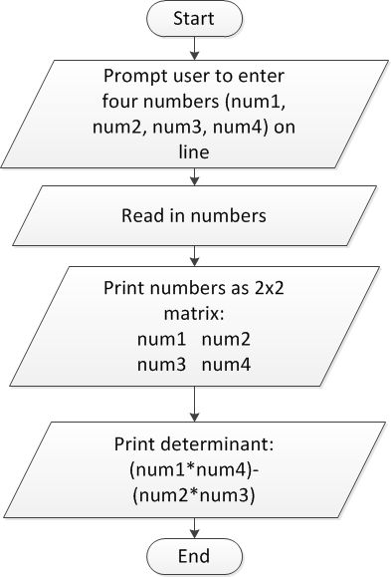
Review: PE1 flowchart

Slide 18
Final notes
Next time
While loops
Reminders:
Program 3 due 9/29
Exam 1: Wednesday, 10/4
Will be allowed one double-sided 8.5” x 11” note sheet
No calculators or other electronic devices allowed
Looking way ahead: Final Exam schedule set
Saturday, 12/16, 3-6 PM

