Slide 1
EECE.4810/EECE.5730 Operating Systems
Instructor:
Dr. Michael Geiger
Spring 2019
Lecture 10:
Synchronization

Slide 2
Lecture outline
Announcements/reminders
Program 2 to be posted; due date TBD
Exam 1 date still TBD
Respond to scheduling poll ASAP
Today’s lecture
Review: Pthread examples
Synchronization
Locks
Condition variables
Monitors

Slide 3
Review: Threads
Thread: active sequence of instructions
Basic unit of CPU utilization
Thread creation is lightweight
Multiple threads in same process can share address space
Each thread needs own PC, register copies, stack + SP
Threads provide concurrency within application
HW support necessary for parallelism
Major issue: non-deterministic ordering
Solutions require atomic operations
Avoid race condition: solution depends on timing/ordering of earlier events

Slide 4
Review: Pthread specification
Synchronous threading: parent thread needs to terminate the child thread.
Programming preparation:
#include <pthread.h>
int pthread_attr_init(pthread_attr_t *attr);
Initializes the thread attributes object pointed to by attr with default attribute values.
int pthread_create(pthread_t *thread, const pthread_attr_t *attr, void *(*start_routine) (void *), void *arg);
Starts a new thread in the calling process.
int pthread_join(pthread_t thread, void **retval);
Waits for the thread specified by thread to terminate.
Compile: gcc -lpthread

Slide 5
Review: Pthread data types
pthread_t: Thread ID
pthread_attr_t: Structure specifying
Scope: does thread compete for resources vs. all threads on system, or only own process?
Linux only supports system scope
Detach state: will parent thread wait for thread to join, or is new thread independent?
Stack address/size: process can define, or let system handle it
Scheduling policy/priority: can be inherited from parent or set separately

Slide 6
Synchronization
Constrain interleavings between threads
Goal: force all possible interleavings to produce correct result
Correct concurrent program should work regardless of processor speed
Try to constrain as little as possible
Some events are independent—order irrelevant
Order only matters in dependent events
Synchronization: Controlling execution and order of threads

Slide 7
Synchronization
do{
curr_reqt = recv_reqt();
reqt_queue[ptr] = curr_reqt;
ptr++;
}while(true)
do{
curr_reqt = reqt_queue[ptr];
ptr--;
process(curr_reqt);
}while(true)
Producer
Consumer
load mem[ptr], reg;
add reg, 1;
store reg, mem[ptr];
load mem[ptr], reg;
add reg, -1;
store reg, mem[ptr];
If instructions are interleaved, we have a problem …

Slide 8
“Too much milk” problem
Problem definition
Janet & Peter want to keep refrigerator stocked with at most one milk jug
If either sees fridge empty, she/he buys milk
Simple solution (no synchronization)
Peter Janet
if (!hasMilk) { if (!hasMilk) {
buy milk buy milk
hasMilk = true; hasMilk = true;
} }

Slide 9
Mutual exclusion
Ensure that only 1 thread is doing a certain thing at one time (other threads excluded)
Example: only 1 person shops at a time
Constrains thread interleaving: can’t operate at the same time

Slide 10
Atomic operation solution
Atomically do the following operations:
Load the value of hasMilk from memory to register.
Compare hasMilk (reg) with false.
If hasMilk (reg) is false, swap it to true.
Write hasMilk (reg) value back to memory.
return original hasMilk (reg) to while condition
Peter/Janet
while (Atomic-Compare-and-Swap(hasMilk,false,true) == false)
{
buy milk;
}

Slide 11
Critical section
Code section that needs to be run atomically with respect to selected other pieces of code
Independent threads can still interrupt
If A and B are critical sections with respect to each other, multiple threads can’t interleave events from A and B
A and B mutually exclude each other
A and B often same piece of code
Critical sections must be atomic with respect to each other because they access shared resource
In “too much milk”, critical section is
if (!hasMilk) buy milk

Slide 12
Critical section solution
Code section that only can be run by one thread!
Peter
if (hasMilk == false) {
//Critical section
buy milk;
hasMilk = true;
//Exit critical section
}
Janet
if (hasMilk == false) {
//Critical section
buy milk;
hasMilk = true;
//Exit critical section
}

Slide 13
Critical section requirements
Mutual exclusion: ≤1 thread executes CS at a time
Progress: if >1 thread attempts CS at same time, 1 thread guaranteed to be selected
Bounded waiting: if thread T requests access to its CS, limit on # times other threads can access their CS before T does

Slide 14
Critical section example
Dekker’s algorithm: 1st known CS solution (pre-synch primitives) for two threads
Shared variables:
boolean flag[2]; // Both initially false
int turn; // Initialized to 0 or 1
Process P_{i} (i == 0 or 1) shown in handout/next slide; other process is P_{j} (j == 1 or 0)
Prove algorithm satisfies CS properties
Mutual exclusion (only 1 thread in CS at time)
Progress (1 thread guaranteed to access CS if >1 req)
Bounded waiting (limit on time thread will wait for CS)

Slide 15
Dekker’s algorithm code for P_{i}
do {
flag[i] = true;
while (flag[j] == true) {
if (turn == j) {
flag[i] = false;
while (turn == j)
; // do nothing—busy waiting
flag[i] = true;
}
}
/* critical section would be placed here */
turn = j;
flag[i] = false;
} while (true);

Slide 16
Critical section solution
Solution satisfies the conditions as follows:
Mutual exclusion: If both processes set their flag variables to true, only process whose turn it is will move forward
Progress: turn chooses the process to move forward if both attempt to enter the critical section simultaneously
Bounded waiting: Since one process sets turn to value of other process, waiting process will be allowed to enter its critical section next

Slide 17
Higher-level synchronization
Higher-level abstraction → easier for programmers
Applications
Concurrent programs
Operating System
High-level synchronization primitives
(mutex, semaphore, condition variable, monitor)
Hardware
Atomic operation support
(load/store, interrupt enable/disable, test/set)

Slide 18
Locks
A lock (or mutex) prevents another thread from entering a critical section
“Lock fridge while checking milk & shopping”
Two operations:
lock(): wait until lock is free, then acquire it
do {
if (lock is free) { // code in red
acquire lock // is atomic
break out of loop
}
} while (1);
unlock(): release lock

Slide 19
Lock usage
Lock initialized to free
Thread acquires lock before entering crit. section
Waits if needed
Thread that acquired lock releases when done with critical section
Locks make earlier problem trivial
Peter
milk.lock()
if (noMilk) {
buy milk
}
milk.unlock()
Janet
milk.lock()
if (noMilk) {
buy milk
}
milk.unlock()

Slide 20
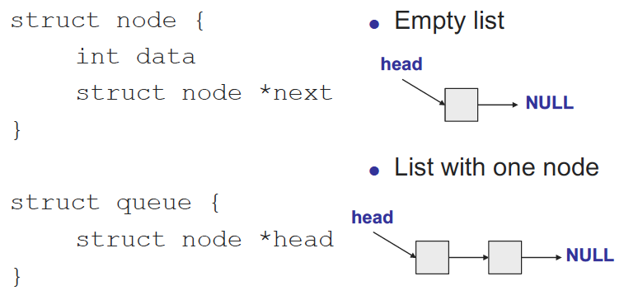
Case study: thread-safe shared queue

Slide 21
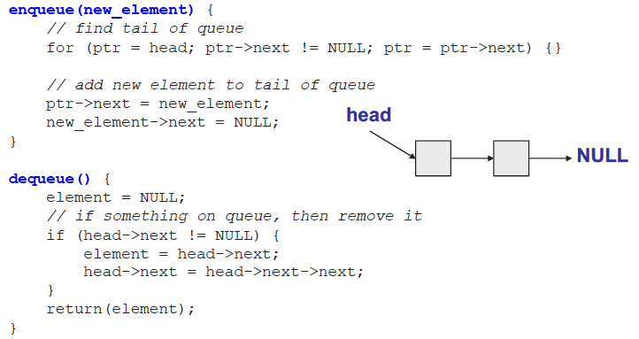
Shared queue (continued)
Potential problems with this approach?
What happens if >1 thread accesses queue at once?

Slide 22
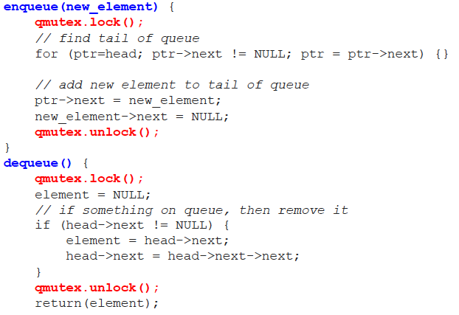
Shared queue with locks

Slide 23
Invariants
When can enqueue() unlock?
Must restore queue to stable state
Stable state is called invariant
Condition that is “always” true for queue
For example, each node appears exactly once when traversing list from head to tail
Hold lock when you’re manipulating shared data (and therefore breaking invariant)

Slide 24
Fine-grained locking
One lock per queue → only one thread can access queue at once
One lock per node: fine-grained locking
What’s the major benefit?
Lock each node as queue is traversed, release once it’s safe, allowing other threads to traverse queue

Slide 25

Fine-grained locking example
lock A
get pointer to B
unlock A
lock B
read B
unlock B
What’s potential downside of this approach?

Slide 26
Hand-over-hand locking
lock A
get pointer to B
lock B
unlock A
read B
unlock B
Lock next node before releasing last node

Slide 27
Final notes
Next time
Continue synchronization discussion
Reminders:
Program 2 to be posted; due date TBD
Exam 1 date still TBD
Respond to scheduling poll ASAP

Slide 28
Acknowledgements
These slides are adapted from the following sources:
Silberschatz, Galvin, & Gagne, Operating Systems Concepts, 9th edition
Chen & Madhyastha, EECS 482 lecture notes, University of Michigan, Fall 2016
Dr. Hang Liu

