Slide 1
EECE.4810/EECE.5730 Operating Systems
Instructor:
Dr. Michael Geiger
Spring 2019
Lecture 12:
Synchronization (continued)

Slide 2
Lecture outline
Announcements/reminders
Program 2 to be posted; due date TBD
Exam 1: Monday, 2/25, 3-5 PM, Ball 214
Survey posted to address conflicts/schedule alt exam
Today’s lecture
Synchronization
Review: Locks
Condition variables
Monitors

Slide 3
Review: Locks
A lock (or mutex) prevents another thread from entering a critical section
“Lock fridge while checking milk & shopping”
Two operations:
lock(): wait until lock is free, then acquire it
do {
if (lock is free) { // code in red
acquire lock // is atomic
break out of loop
}
} while (1);
unlock(): release lock

Slide 4
Review: thread-safe queue
Thread-safe queue: queue shared between several threads
Synch. primitives necessary to restrict access
Queues commonly used in OS
Track processes/threads waiting for resources
Thread-safe queue necessary so multiple kernel threads can enqueue/dequeue items

Slide 5
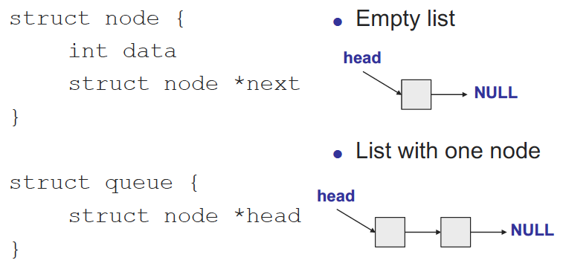
Case study: thread-safe shared queue

Slide 6
Shared queue: no synch
void enqueue(struct node *new_element) {
// Find queue tail
for (ptr = head;
ptr->next != NULL; ptr = ptr->next) {}
// Add new elem to tail
ptr->next = new_element;
new_element->next = NULL;
}
struct node *dequeue() {
struct node *elem = NULL;
// If queue not empty,
// remove first node
if (head->next != NULL) {
elem = head->next;
head->next =
head->next->next;
}
return element;
}

Slide 7
Shared queue: simple synch
void enqueue(struct node *new_element) {
qmutex.lock();
// Find queue tail
for (ptr = head;
ptr->next != NULL; ptr = ptr->next) {}
// Add new elem to tail
ptr->next = new_element;
new_element->next = NULL;
qmutex.unlock();
}
struct node *dequeue() {
struct node *elem = NULL;
qmutex.lock();
// If queue not empty,
// remove first node
if (head->next != NULL) {
elem = head->next;
head->next =
head->next->next;
}
qmutex.unlock();
return element;
}

Slide 8
Fine-grained locking
One lock per queue → only one thread can access queue at once
One lock per node: fine-grained locking
What’s the major benefit?
Lock each node as queue is traversed, release once it’s safe, allowing other threads to traverse queue
Hand-over-hand locking necessary

Slide 9
Avoiding busy waiting
Have dequeuer “go to sleep”
Put dequeuer on waiting list, then go to sleep
if (queue is empty) {
add self to waiting list
go to sleep
}
Wait to be awoken once something’s in queue

Slide 10
Ordering constraints
What if you want dequeue() to wait if queue is empty?
What’s problem with solution below?
struct node *dequeue() {
struct node *elem = NULL;
qmutex.lock();
// Wait for queue to not be empty
qmutex.unlock();
while (head->next == NULL);
qmutex.lock();
// Remove element, then unlock queue and return
elem = head->next;
head->next = head->next->next;
qmutex.unlock();
return elem;
}

Slide 11
Ordering constraints, pt. 2
What if you want dequeue() to wait if queue is empty?
What’s problem with solution below?
struct node *dequeue() {
struct node *elem = NULL;
qmutex.lock();
// Wait for queue to not be empty
while (head->next == NULL) {
qmutex.unlock();
qmutex.lock();
}
// Remove element, then unlock queue and return
elem = head->next;
head->next = head->next->next;
qmutex.unlock();
return elem;
}

Slide 12
Synchronization types
Mutual exclusion
Ensures only one thread in critical section
“Not at the same time”
lock/unlock
Condition variables
Used when one thread must wait for another to do something
“Before/after”
dequeue() must wait for enqueue() if empty

Slide 13
Condition variables
Enable thread to sleep inside critical section by (steps in red are atomic):
Release lock
Put thread on waiting list
Go to sleep
After being woken, re-acquire lock()
Each condition variable tracks list of threads waiting on that specific condition
Each condition variable associated with lock

Slide 14
Condition variable operations
wait(&lock)
Atomically release lock, add thread to waiting list, then go to sleep
Thread must hold lock when calling wait()
Must re-acquire lock before exiting wait()
signal()
Wake up one thread waiting on condition variable
If no thread waiting, does nothing
broadcast()
Wake up all threads waiting on condition variable
If no thread waiting, does nothing

Slide 15
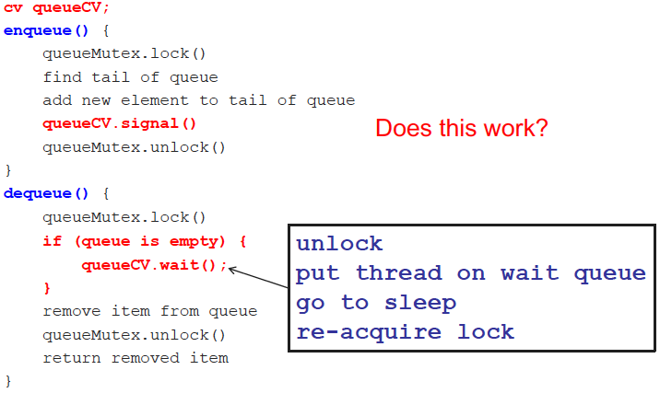
Thread-safe queue with CVs

Slide 16
Monitors
Combine two types of synchronization
Lock for mutual exclusion
Condition variables for ordering constraints
Monitor = shared data + 1+ locks + CVs associated with lock
In OOP, “shared objects”

Slide 17
Programming with monitors
List shared data needed for problem
Assign locks to each group of shared data
Enforces mutual exclusion
Assign condition variables for every condition thread holding lock may have to wait on
Before/after conditions: while (!condition) wait
Call signal() or broadcast() when thread changes something another thread might be waiting for
Need queue of threads associated with every lock, condition variable
Implicitly handled in common thread libraries

Slide 18
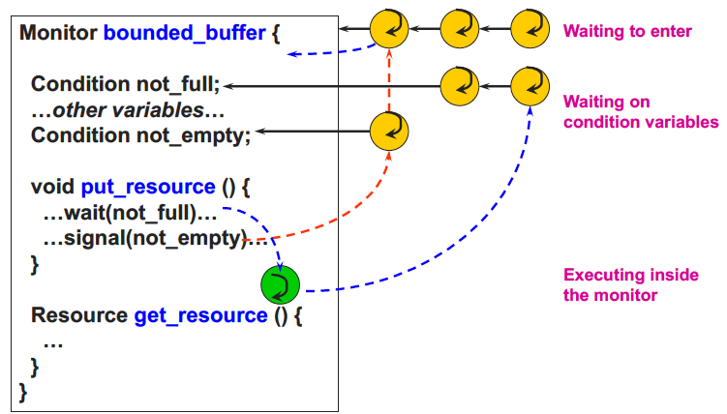
Monitor queues

Slide 19
Typical monitor programming
lock
while (!condition) {
wait
}
do work
signal other thread(s) about work
unlock

Slide 20
Final notes
Next time
Continue synchronization discussion
Reminders:
Program 2 to be posted; due date TBD
Exam 1 date still TBD
Respond to scheduling poll ASAP

Slide 21
Acknowledgements
These slides are adapted from the following sources:
Silberschatz, Galvin, & Gagne, Operating Systems Concepts, 9th edition
Chen & Madhyastha, EECS 482 lecture notes, University of Michigan, Fall 2016
Dr. Hang Liu

