Slide 1
EECE.4810/EECE.5730 Operating Systems
Instructor:
Dr. Michael Geiger
Spring 2018
Lecture 22:
Memory management: background material

Slide 2
Lecture outline
Announcements/reminders
Program 3 due 4/22
Exam 2: Monday, 4/1, 3-5 PM, Ball 214
Will cover everything after Exam 1 (except today)
Allowed two double-sided 8.5” x 11” note sheets
Use poll to request alternate exam if necessary (ASAP)
Today’s lecture: memory background info
Next major topic: memory management
Before we get to that …
What are memory accesses?
What’s the OS role when working with memory?

Slide 3
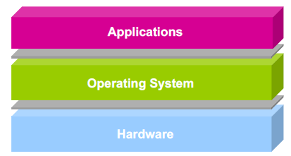
Refresher: What is an operating system?
Software layer between application programs and physical hardware
Yes, I left this unreadable picture in here on purpose
Makes system easier to use for programs
Manages allocation of resources to use hardware fairly/efficiently

Slide 4
OS as resource manager
What does the OS need to manage?
Process creation/deletion
We’ll re-examine process loading in a bit …
Inter-process communication
Process scheduling
Memory allocation and access
Files (on disk)
I/O devices
And more …
What doesn’t the OS manage?
Anything internal to hardware
Relative to CPU: anything off-chip

Slide 5
To be covered …
Programmer’s view of memory
HW view of memory
What’s OS role in working with memory?
Establishing address space at load time
Address translation
See lecture recording for details!

Slide 6
Final notes
Next time
Exam 2 Preview
Reminders:
Program 2 due today
Program 3 to be posted; due TBD
Exam 2: Wednesday, 3/28 in class
Will cover everything after Exam 1

Slide 7
Acknowledgements
These slides are adapted from the following sources:
Silberschatz, Galvin, & Gagne, Operating Systems Concepts, 9th edition
Anderson & Dahlin, Operating Systems: Principles and Practice, 2nd edition
Chen & Madhyastha, EECS 482 lecture notes, University of Michigan, Fall 2016

