Slide 1
EECE.4810/EECE.5730 Operating Systems
Instructor:
Dr. Michael Geiger
Spring 2019
Lecture 24:
Memory management: address translation intro, base and bounds

Slide 2
Lecture outline
Announcements/reminders
Program 3 due 4/22
Exams to be returned Friday or Monday
Today’s lecture: memory management
Address translation basics
Address translation schemes
Base and bounds
Segmentation
Paging

Slide 3
Memory management
Program brought (from disk) into memory and placed within a process to be run
Recall: process = 1+ threads in address space
Thread: set of executing instructions
Address space: all memory used by process as it runs
Characterizing address space
HW view: fixed amount of memory shared between processes
OS: each process has its own, large memory
Logical or virtual address space

Slide 4
Address space-related abstractions
Address independence: same numeric address used in multiple processes, kept logically distinct
Most easily handled with relocatable code
Protection: one process can’t access another’s address space unless explicitly given access
Virtual memory: address space larger than physical memory

Slide 5
Address Binding
Addresses represented in different ways at different stages of a program’s life
Source code addresses usually symbolic
Compiled code addresses bind to relocatable addresses
i.e. “14 bytes from beginning of this module”
Linker or loader will bind relocatable addresses to absolute addresses
i.e. 74014
Each binding maps one address space to another

Slide 6
Address Binding (continued)
Binding of instructions/data to memory addresses happens at 3 different stages
Compile time: If exact memory location known, absolute code can be generated
Must recompile code if starting location changes
Load time: Must generate relocatable code if memory location is not known at compile time
Execution time: Binding delayed until run time if the process can be moved during its execution from one memory segment to another
Execution time binding most common in multiprogrammed systems
Requires OS (& HW) support for address translation
Only scheme in which logical, physical addresses differ

Slide 7
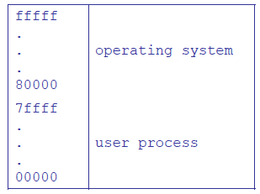
Uni-programmed systems
1 process occupies memory at a time
Always loaded to same memory location
Space saved for OS
Problems?
Long context switch
Inflexibility
Wasted space
Not enough space

Slide 8
Multiprogrammed systems
Multiprogramming: >1 process in memory at once
Major benefit: lower overhead on context switches
Downside: increased complexity
Requires address translation
Support for protection in translation mechanism

Slide 9
Address translation
Convert addresses used in program to actual addresses used in system
Forms of address translation
Static address translation: translate addresses before execution (compile time, load time)
Can provide address independence; protection, virtual memory more difficult (VM almost impossible)
Dynamic address translation: translate addresses during execution
Translation can change as process runs!

Slide 10
Dynamic address translation
Translate every memory reference
Process uses virtual addresses
Hardware uses physical addresses
Translation enforces protection
One process can’t access another’s address space unless allowed
Translation enables virtual memory
Virtual address only in physical memory when necessary
Can change translations on the fly--physical memory addresses assigned when blocks brought in from disk

Slide 11
Address Translation Concept

Slide 12
Forms of address translation
Base and bounds
Contiguous region allocated for entire address space
Segmentation
Address space split into variable-sized segments
Paging
Address space split into fixed-size pages
Tradeoffs between
Flexibility (sharing, growth, VM)
Size of data needed to support translation
Speed of translation

Slide 13
Base and bounds
Each process allocated contiguous block for entire address space
Address space defined by two values
Base (or relocation register): lowest PA used
Bound (or limit): total size of address space
Only OS can change values
HW support: only two registers
Process sees virtual address space
0 ≤ address < bound
Simple translation: PA = VA + base

Slide 14
Virtually Addressed Base and Bounds

Slide 15
Base and bounds pros/cons
What are benefits?
What are downsides?
Does base and bounds support:
Address independence?
Protection?
Virtual memory?
Notes:
Provides level of indirection: OS can move bits around behind the program's back, for instance, if program needs to grow beyond its bounds, or if need to coalesce fragments of memory. Stop program, copy bits, change base and bounds registers, restart.
Because OS manages the translation, we control the vertical, we control the horizontal.
Hardware cost:
2 registers
adder, comparator
Plus, slows down hardware because need to take time to do add/compare on every memory reference.
In 60's, thought to be too expensive!
But get better use of memory, and you get protection. These are really important. CPU speed (especially now) is the easy part.

Slide 16
Base and bounds pros/cons (continued)
Pros
Simple
Fast (2 registers, adder, comparator)
Context switch—save base/bound (mem if needed)
Safe … as far as multiple processes are concerned
Can relocate in physical memory without changing process
Cons
Can’t keep program from accidentally overwriting its own code
Can’t share (partial) code/data with other processes
Can’t grow stack/heap as needed
Fragmentation
Notes:
Provides level of indirection: OS can move bits around behind the program's back, for instance, if program needs to grow beyond its bounds, or if need to coalesce fragments of memory. Stop program, copy bits, change base and bounds registers, restart.
Because OS manages the translation, we control the vertical, we control the horizontal.
Hardware cost:
2 registers
adder, comparator
Plus, slows down hardware because need to take time to do add/compare on every memory reference.
In 60's, thought to be too expensive!
But get better use of memory, and you get protection. These are really important. CPU speed (especially now) is the easy part.

Slide 17
Fragmentation
Internal fragmentation
Wasted space inside partition
Common with fixed-size partitions
External fragmentation
Total memory space exists to satisfy request but is non-contiguous
Result of leftover space as processes exit
Can resolve through compaction
Shuffle memory blocks to make partitions use consecutive addresses

Slide 18
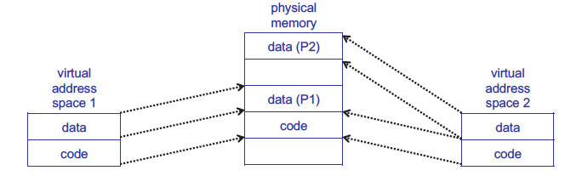
Base and bounds sharing
Even if we split code/data, sharing all or none

Slide 19
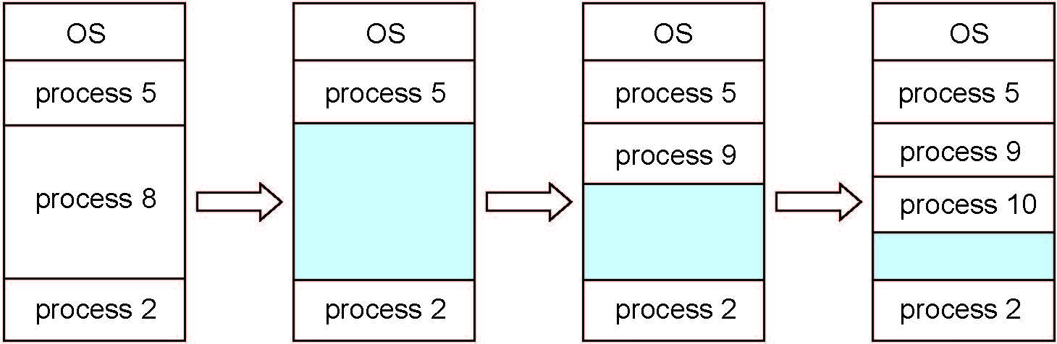
Multiple-partition allocation
Degree of multiprogramming limited by number of partitions
Variable-sized partitions for efficiency
Hole – block of available memory; holes of various size are scattered throughout memory
When a process arrives, it is allocated memory from a hole large enough to accommodate it
Process exiting frees its partition, adjacent free partitions combined
Operating system maintains information about: a) allocated partitions b) free partitions (hole)

Slide 20
Storage Allocation Problem
Given space request and list of holes in memory, how do we satisfy it?
First-fit: Allocate the first hole that is big enough
Best-fit: Allocate the smallest hole that is big enough; must search entire list, unless ordered by size
Produces the smallest leftover hole
Worst-fit: Allocate the largest hole; must also search entire list
Produces the largest leftover hole
Increases likelihood new process can use remaining hole → reduce fragmentation

Slide 21
Storage allocation example
You are given:
List of holes: 300 KB, 600 KB, 350 KB, 200 KB, 750 KB, 125 KB
List of processes with address space sizes: 115 KB, 500 KB, 358 KB, 200 KB, 375 KB
How would these processes be placed using
First-fit?
Best-fit?
Worst-fit?
Which uses memory most efficiently?
Which is most time-efficient?
Time based on time required to search list of holes

Slide 22
Example solution: first fit
Address spaces and how they fit:
115 KB → 300 KB hole
Holes now: 185, 600, 350, 200, 750, 125 KB
500 KB → 600 KB hole
Holes now: 185, 100, 350, 200, 750, 125 KB
358 KB → 750 KB hole
Holes now: 185, 100, 350, 200, 392, 125 KB
200 KB → 350 KB hole
Holes now: 185, 100, 150, 200, 392, 125 KB
375 KB → 392 KB hole
Holes now: 185, 100, 150, 200, 17, 125 KB

Slide 23
Example solution: best fit
Address spaces and how they fit:
115 KB → 125 KB hole
Holes now: 300, 600, 350, 200, 750, 10 KB
500 KB → 600 KB hole
Holes now: 300, 100, 350, 200, 750, 10 KB
358 KB → 750 KB hole
Holes now: 300, 100, 350, 200, 392, 10 KB
200 KB → 200 KB hole
Holes now: 300, 100, 350, 0, 392, 10 KB
375 KB → 392 KB hole
Holes now: 300, 100, 350, 17, 10 KB

Slide 24
Example solution: worst fit
Address spaces and how they fit:
115 KB → 750 KB hole
Holes now: 300, 600, 350, 200, 635, 125 KB
500 KB → 635 KB hole
Holes now: 300, 600, 350, 200, 135, 125 KB
358 KB → 600 KB hole
Holes now: 300, 242, 350, 200, 135, 125 KB
200 KB → 350 KB hole
Holes now: 300, 242, 150, 200, 135, 125 KB
375 KB → doesn’t fit!

Slide 25
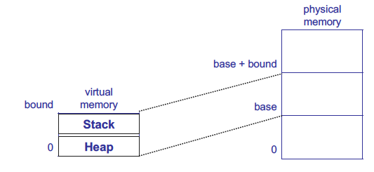
Growing memory regions independently
How can these regions grow independently?
Each needs own space! → segmentation/paging

Slide 26
Final notes
Next time
More on memory management: segmentation, paging
Reminders:
Program 3 due 4/22
Exams to be returned Friday or Monday

Slide 27
Acknowledgements
These slides are adapted from the following sources:
Silberschatz, Galvin, & Gagne, Operating Systems Concepts, 9th edition
Anderson & Dahlin, Operating Systems: Principles and Practice, 2nd edition
Chen & Madhyastha, EECS 482 lecture notes, University of Michigan, Fall 2016

