Slide 1
EECE.4810/EECE.5730 Operating Systems
Instructor:
Dr. Michael Geiger
Spring 2019
Lecture 32:
File systems

Slide 2
Lecture outline
Announcements/reminders
Extra credit problem set to be posted; due Monday, 5/6
Up to 5 points of extra credit on final average
Course evals to be posted online; return at final exam
Final exam: Saturday, 5/11, 8-11 AM, Kitson 305
Today’s lecture: file systems

Slide 3
File System Abstraction
File system: data structure stored on persistent medium with two distinct parts
Files: named collection of persistent data + access control
Directory structure: hierarchical organization of files
Crash and storage error tolerance
Operating system crashes (and disk errors) leave file system in a valid state
Performance
Achieve close to hardware limit in the average case

Slide 4
File details
File: unit of logical storage
Abstract away low-level details of storage device
Contiguous logical address space
Structure of file defines types
At a minimum, OS supports executable file
Other types usually imposed by applications
Text, source, etc.
Extensions → more detailed file typing
File system tracks file attributes (name, ID, type, file pointer, etc.)

Slide 5
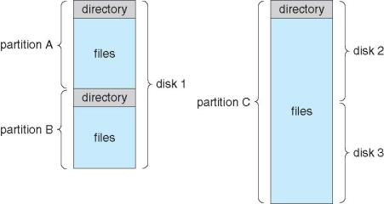
Directory structure
Disk can be split into multiple partitions
Partitions can be raw (no file system) or formatted
Volume: formatted partition (e.g., C:\ on Windows)
Each volume needs its own directory
Effectively table of contents for volume
Tracks information about all files on volume
Imposes hierarchical structure in flat space

Slide 6
Large Directories: B Trees

Slide 7
File system issues to be discussed
How does the file system allocate space for a new file?
How do different allocation schemes affect the way files are accessed?
How does the file system store information about each file (metadata)?
What are the different types of file systems and how do they differ?

Slide 8
Design Challenges
Index structure
How do we locate the blocks of a file?
Index granularity
What block size do we use?
Free space
How do we find unused blocks on disk?
Locality
How do we preserve spatial locality?
Reliability
What if machine crashes in middle of a file system op?

Slide 9
Some File System Design Options
 | FAT | FFS | NTFS
Index structure | Linked list | Tree (fixed, asym) | Tree (dynamic)
granularity | block | block | extent
free space allocation | FAT array | Bitmap (fixed location) | Bitmap (file)
Locality | defrag | Block groups + reserve space | Extents Best fit defrag

Slide 10
Named Data in a File System

Slide 11
Microsoft File Allocation Table (FAT)
Linked list index structure
Simple, easy to implement
Still widely used (e.g., thumb drives)
File table:
Linear map of all blocks on disk
Each file a linked list of blocks

Slide 12
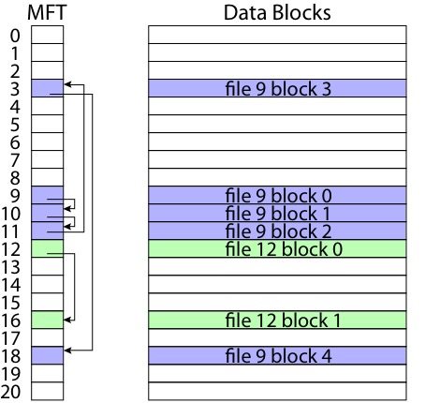
FAT

Slide 13
FAT
Pros:
Easy to find free block
Easy to append to a file
Easy to delete a file
Cons:
Small file access is slow
Random access is very slow
Fragmentation
File blocks for a given file may be scattered
Files in the same directory may be scattered
Problem becomes worse as disk fills

Slide 14
Berkeley UNIX FFS (Fast File System)
inode table
Analogous to FAT table
inode
Metadata
File owner, access permissions, access times, …
Set of 12 data pointers
With 4KB blocks => max size of 48KB files

Slide 15
FFS inode
Metadata
File owner, access permissions, access times, …
Set of 12 data pointers
With 4KB blocks => max size of 48KB files
Indirect block pointer
pointer to disk block of data pointers
Indirect block: 1K data blocks => 4MB (+48KB)

Slide 16
FFS inode
Metadata
File owner, access permissions, access times, …
Set of 12 data pointers
With 4KB blocks => max size of 48KB
Indirect block pointer
pointer to disk block of data pointers
4KB block size => 1K data blocks => 4MB
Doubly indirect block pointer
Doubly indirect block => 1K indirect blocks
4GB (+ 4MB + 48KB)

Slide 17
FFS inode
Metadata
File owner, access permissions, access times, …
Set of 12 data pointers
With 4KB blocks => max size of 48KB
Indirect block pointer
pointer to disk block of data pointers
4KB block size => 1K data blocks => 4MB
Doubly indirect block pointer
Doubly indirect block => 1K indirect blocks
4GB (+ 4MB + 48KB)
Triply indirect block pointer
Triply indirect block => 1K doubly indirect blocks
4TB (+ 4GB + 4MB + 48KB)

Slide 19
FFS Asymmetric Tree
Small files: shallow tree
Efficient storage for small files
Large files: deep tree
Efficient lookup for random access in large files
Sparse files: only fill pointers if needed

Slide 20
FFS
Pros
Efficient storage for both small and large files
Locality for both small and large files
Locality for metadata and data
Cons
Inefficient for tiny files (a 1 byte file requires both an inode and a data block)
Inefficient encoding when file is mostly contiguous on disk (no equivalent to superpages—each block, not group of blocks, has separate pointer)

Slide 21
NTFS
Master File Table
Flexible 1KB storage for metadata and data
Extents
Block pointers cover runs of blocks
Similar approach in linux (ext4)
File create can provide hint as to size of file
Journalling for reliability
Covered next lecture

Slide 22
NTFS Small File

Slide 23
NTFS Medium-Sized File

Slide 24
NTFS Indirect Block

Slide 26
Free-Space Management
File system maintains free-space list to track available blocks/clusters
(Using term “block” for simplicity)
Bit vector or bit map (n blocks)
0
1
2
n-1
…
1 ⇒ block[i] free
0 ⇒ block[i] occupied
bit[i] =

Block number calculation
(number of bits per word) *
(number of 0-value words) +
offset of first 1 bit
CPUs have instructions to return offset within word of first “1” bit

Slide 27
Free-Space Management (Cont.)
Bit map requires extra space
Example:
block size = 4KB = 2¹² bytes
disk size = 2⁴⁰ bytes (1 terabyte)
n = 2⁴⁰/2¹² = 2²⁸ bits (or 32MB)
if clusters of 4 blocks -> 8MB memory
Easy to get contiguous files

Slide 28
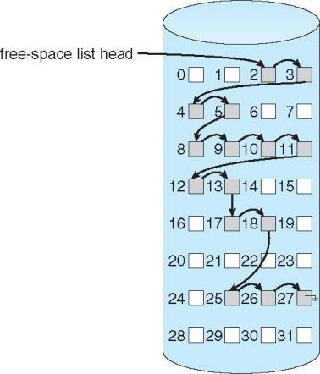
Linked Free Space List on Disk
Linked list (free list)
Cannot get contiguous space easily
No waste of space
No need to traverse the entire list (if # free blocks recorded)

Slide 29
Free-Space Management (Cont.)
Grouping
Modify linked list to store address of next n-1 free blocks in first free block, plus a pointer to next block that contains free-block-pointers (like this one)
Counting
Because space is frequently contiguously used and freed, with contiguous-allocation allocation, extents, or clustering
Keep address of first free block and count of following free blocks
Free space list then has entries containing addresses and counts

Slide 30
Multiple updates and reliability
Reliability major factor for file systems
Losing data (due to system crash, power outage, etc.) in process’s address space is not a problem
Losing data in file system is
Multi-step update is problem if crash in middle
Examples: what happens if crash between 1 & 2?
Transferring money
Deduct $100 from Alice
Add $100 to Bob
Moving file from one directory to another
Delete file from old directory
Add file to new directory
Create new file
Update directory to point to new file header
Write new file header to disk

Slide 31
File System Reliability
What can happen if disk loses power or machine software crashes?
Some operations in progress may complete
Some operations in progress may be lost
Overwrite of a block may only partially complete
File system wants durability (as a minimum!)
Data previously stored can be retrieved (maybe after some recovery step), regardless of failure

Slide 32
Storage Reliability Problem
Single logical file operation can involve updates to multiple physical disk blocks
inode, indirect block, data block, bitmap, …
With remapping, single update to physical disk block can require multiple (even lower level) updates
At a physical level, operations complete one at a time
Want concurrent operations for performance
How do we guarantee consistency regardless of when crash occurs?

Slide 33
Transaction Concept
Transaction is a group of operations
Atomic: operations appear to happen as a group, or not at all (at logical level)
At physical level, only single disk/flash write is atomic
Durable: operations that complete stay completed
Future failures do not corrupt previously stored data
Isolation: other transactions do not see results of earlier transactions until they are committed
Consistency: sequential memory model

Slide 34
Transactions
Commonly used in databases, file systems
Key points for file systems: atomicity and durability (all or nothing)
Example:
begin transaction
write disk
write disk
write disk
end (“commit” transaction)
Need method for making sequence of sector updates atomic

Slide 35
Approach #1: Careful Ordering
Sequence operations in a specific order
Careful design to allow sequence to be interrupted safely
Post-crash recovery
Read data structures to see if there were any operations in progress
Clean up/finish as needed
Approach taken in FAT, FFS (fsck), and many app-level recovery schemes (e.g., Word)

Slide 36

FAT: Append Data to File
Add data block
Add pointer to data block
Update file tail to point to new MFT entry
Update access time at head of file

Slide 37
FAT: Append Data to File
Normal operation:
Add data block
Add pointer to data block
Update file tail to point to new MFT entry
Update access time at head of file
Recovery:
Scan MFT
If entry is unlinked, delete data block
If access time is incorrect, update

Slide 38
FAT: Create New File
Normal operation:
Allocate data block
Update MFT entry to point to data block
Update directory with file name -> file number
What if directory spans multiple disk blocks?
Update modify time for directory
Recovery:
Scan MFT
If any unlinked files (not in any directory), delete
Scan directories for missing update times

Slide 39
FFS: Create a File
Normal operation:
Allocate data block
Write data block
Allocate inode
Write inode block
Update bitmap of free blocks
Update directory with file name -> file number
Update modify time for directory
Recovery:
Scan inode table
If any unlinked files (not in any directory), delete
Compare free block bitmap against inode trees
Scan directories for missing update/access times
Time proportional to size of disk

Slide 40
FFS: Move a File
Normal operation:
Remove filename from old directory
Add filename to new directory
Recovery:
Scan all directories to determine set of live files
Consider files with valid inodes and not in any directory
New file being created?
File move?
File deletion?

Slide 41
Application Level
Normal operation:
Write name of each open file to app folder
Write changes to backup file
Rename backup file to be file (atomic operation provided by file system)
Delete list in app folder on clean shutdown
Recovery:
On startup, see if any files were left open
If so, look for backup file
If so, ask user to compare versions

Slide 42
Careful Ordering
Pros
Works with minimal support in the disk drive
Works for most multi-step operations
Cons
Can require time-consuming recovery after a failure
Difficult to reduce every operation to a safely interruptible sequence of writes
Difficult to achieve consistency when multiple operations occur concurrently

Slide 43
Approach #2: shadowing
Keep 2 copies of file system (old/new)
Store persistent pointer to current version
Write updates to new version
Switch pointer to commit changes
Writing single sector (the one holding pointer) makes series of changes permanent
Optimizations
Don’t copy entire file system—copy only what you need to update (i.e., individual inode)

Slide 44
Shadowing
Pros
Correct behavior regardless of failures
Fast recovery
High throughput (best if updates are batched)
Cons
Potential for high latency
Small changes require many writes
Garbage collection essential for performance

Slide 45
Transactions with logging
Write-ahead logging
Write new data to append-only log
Write commit sector to end of log to commit changes
Single-sector write makes changes permanent
Eventually, new data copied from log to in-place version of file system
Journalling: use logging for atomic updates to file metadata, not actual file data

Slide 46
Redo Logging
Prepare
Write all changes (in transaction) to log
Commit
Single disk write to make transaction durable
Redo
Copy changes to disk
Garbage collection
Reclaim space in log
Recovery
Read log
Redo any operations for committed transactions
Garbage collect log

Slide 47
Before Transaction Start

Slide 48
After Updates Are Logged

Slide 49
After Commit Logged

Slide 50
After Copy Back

Slide 51
After Garbage Collection

Slide 52
Redo Logging
Prepare
Write all changes (in transaction) to log
Commit
Single disk write to make transaction durable
Redo
Copy changes to disk
Garbage collection
Reclaim space in log
Recovery
Read log
Redo any operations for committed transactions
Garbage collect log

Slide 53
Final notes
Next time
Exam 3 Preview (Friday, 5/3)
Reminders:
Extra credit problem set to be posted; due Monday, 5/6
Up to 5 points of extra credit on final average
Course evals to be posted online; return at final exam
Final exam: Saturday, 5/11, 8-11 AM, Kitson 305

Slide 54
Acknowledgements
These slides are adapted from the following sources:
Silberschatz, Galvin, & Gagne, Operating Systems Concepts, 9th edition
Anderson & Dahlin, Operating Systems: Principles and Practice, 2nd edition
Chen & Madhyastha, EECS 482 lecture notes, University of Michigan, Fall 2016

