Slide 1
EECE.4810/EECE.5730 Operating Systems
Instructor:
Dr. Michael Geiger
Spring 2019
Lecture 8:
Threads

Slide 2
Lecture outline
Announcements/reminders
Program 1 due Monday, 2/11
Write one program that does everything
Objective list is an outline that could be used to guide development, but feel free to skip steps
If wait() returns -1, called from process without child!
Santosh Pandey’s OH: M/Th 11:30-1:30, Ball 410
Today’s lecture
Review: IPC
Threads

Slide 3
Review: Interprocess Communication
Shared memory
Communication largely process-managed after OS used to set up shared region
Message passing
OS responsible for send/receive primitives
Direct communication: processes send messages directly to one another
Indirect communication: processes send to/receive from mailboxes

Slide 4
Threads
Recall: Process = 1+ running pieces of code (threads) + everything code can read/write
Thread: active sequence of instructions
Basic unit of CPU utilization
Multiple threads in process may cooperate or be independent
Can implement separate tasks in same app
Ex: in browser, one thread shows images while another retrieves network data
Ex: in server, create separate thread to handle each I/O request

Slide 5
Threads vs. processes
Process creation is heavy-weight
Creates new address space
May be copy of parent space
Can call separate program
Creation of new process invokes OS
Thread creation is lightweight
Threads in same process share address space
Thread creation done through thread library, not OS
Thread starting routines often call new function
Pointer to function passed to thread creator
What information needs to be private to a thread?
What information can be shared?

Slide 6
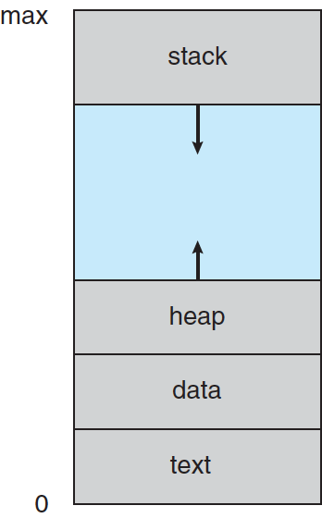
Recall: Process in memory
Text section: code
Data section: global variables
Stack: temp data, usually related to functions
Arguments
Return address
Local variables
Saved registers
Heap: dyn. allocated data
From C malloc(), C++ new …

Slide 7
Single and Multithreaded Processes

Slide 8
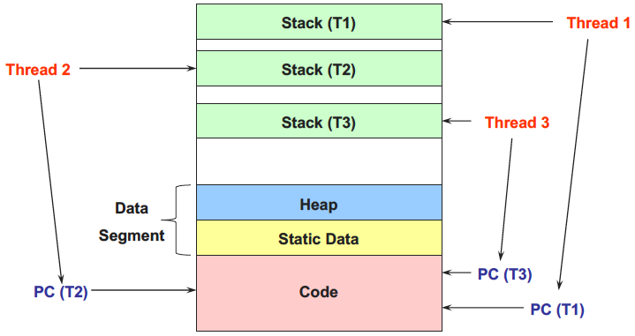
Process in memory--updated

Slide 9
Single and Multithreaded Processes
Each thread needs its own
PC (for its own set of instructions)
Each thread in code section for program, but occupies different region of that code section
Treated almost as separate function call
Register values (each refers to registers by same names)
Stack + SP (each will call its own functions)
Each thread can share
Global data
Heap
Files

Slide 10
Web server
Common example to justify multithreading
Web server may receive multiple simultaneous requests
Must read web pages from disk for each request

Slide 11
Web server option 1
Handle one request at a time
Example schedule
Request 1 arrives
Server receives request 1
Server starts disk I/O 1a
Request 2 arrives
Server waits for disk I/O 1a to finish
Easy to program, but very slow
Can’t overlap disk requests with anything
Computation or receiving other requests

Slide 12
Web server option 2
Event-driven web server (asynchronous I/O)
Issue I/O requests, but don’t wait for them to complete
Request 1 arrives
Server receives request 1
Server starts disk I/O 1a to satisfy request 1
Request 2 arrives
Server receives request 2
Server starts disk I/O 2a to satisfy request 2
Request 3 arrives
Disk I/O 1a finishes
May run faster, but server must track
What requests are being serviced, and what state they’re in
What disk I/Os are outstanding, and what requests they belong to

Slide 13
Multithreaded web server
One thread per request
Thread issues I/O, then waits
Other threads can run while one thread blocked
State of request stored in thread
Thread 1 Thread 2 Thread 3
Request 1 arrives
Receive request 1
Start disk I/O 1a
Request 2 arrives
Receive request 2
Start disk I/O 2a
Request 3 arrives
Receive request 3
Start disk I/O 3a
Disk I/O 1a finishes
Continue handling request 1

Slide 14
Benefits of multithreading
Thread manager handles CPU sharing
Thread can issue blocking I/Os, while others progress
Private state for each thread
Applications get simpler programming model
Illusion of dedicated CPU per thread
Threads share process resources, easier than shared memory or message passing
Threads easier to create and switch than processes
Process can take advantage of multiprocessor architectures

Slide 15
Multicore Programming
Concurrency: more than one task making progress
Single processor, scheduler can provide
Parallelism: system performing more than one task at a time
Data parallelism: data divided into subsets across cores, same operations performed on each
Task parallelism: threads distributed across cores, with each doing unique task
Individual cores may support hardware multithreading

Slide 16
Concurrency vs. Parallelism
Concurrent execution on single-core system:
Parallelism on a multi-core system:

Slide 17
Example: determining # threads
System has four processors available for scheduling
Application does the following
Reads all input sequentially from a single file
Process input data and compute final results
Entirely CPU-bound during this part—no I/O
Print all output sequentially to a single file
To improve the performance of this application by multithreading it, determine:
How many threads should you create to handle input and output? Why?
How many threads should you create to handle computation? Why?

Slide 18
Cooperating threads
Independent threads may still share hardware
Cooperating threads share app resource
Assume each thread has dedicated processor
Main problem: event ordering is non-deterministic
Speed of each processor unpredictable
Thread A ----------------------------------------------------------->
Thread B - - - - - - - - - - - - - - - - - >
Thread C - - - - - - - - - - - - - - - - - - - - - - - - - - - - - - - - >
Global ordering of events
Many possible orderings, some of which produce incorrect results

Slide 19
Non-deterministic ordering
Printing example
Thread A Thread B
Print ABC Print 123
Possible outputs?
Impossible outputs?
Sequential ordering within thread, but many ways to merge per-thread order into global order
What’s being shared between these threads?

Slide 20
Non-deterministic ordering (cont.)
Arithmetic example—assume y is initially 10
Thread A Thread B
x = y + 1 y = y * 2
What’s being shared between these threads?
Possible results?
Arithmetic example 2—assume x is initially 0
Thread A Thread B
x = 0 x = 0
x++ x--
Possible results?
Impossible results?

Slide 21
Atomic operations
To evaluate cooperating threads, must establish set of atomic operations
Operation happens in its entirety or not at all
No event from another thread can occur between the start and end of an atomic operation
Arithmetic example: what if assignment were atomic?
Print example:
What if each print statement were atomic?
What if printing a single character were atomic?
Typical computers
Memory accesses (load/store) atomic
Many other instructions (e.g., FP) are not
Need small atomic operations to build larger ones

Slide 22
Example
Thread A Thread B
i = 0 i = 0
while (i < 10) while (i > -10)
i++ i--
print “A done” print “B done”
Which thread finishes first?
Is winner guaranteed to print first?
Is it guaranteed that one thread will win?
What’s required to guarantee one thread will win?

Slide 23
Multithreaded debugging
Non-deterministic ordering makes debugging difficult
“Heisenbug”: bug that occurs non-deterministically
All possible interleavings must be correct
Race condition: output/result dependent on timing or ordering of earlier events
Becomes bug when unanticipated ordering occurs
Potentially disastrous consequences
Over-radiation in Therac-25
2 modes of operation: direct low-power radiation, high-powered radiation + safeguards
Race condition activated high-powered beam w/o safeguards
Northeast blackout of 2003
Race condition in control software

Slide 24
Synchronization
Constrain interleavings between threads
Goal: force all possible interleavings to produce correct result
Correct concurrent program should work regardless of processor speed
Try to constrain as little as possible
Some events are independent—order irrelevant
Order only matters in dependent events
Synchronization: Controlling execution and order of threads

Slide 25
Final notes
Next time
More examples
Detailed synchronization discussion
Reminders:
Program 1 due Monday, 2/11
Write one program that does everything
Objective list is an outline that could be used to guide development, but feel free to skip steps
If wait() returns -1, called from process without child!
Santosh Pandey’s OH: M/Th 11:30-1:30, Ball 410

Slide 26
Acknowledgements
These slides are adapted from the following sources:
Silberschatz, Galvin, & Gagne, Operating Systems Concepts, 9th edition
Chen & Madhyastha, EECS 482 lecture notes, University of Michigan, Fall 2016

