Slide 1
EECE.2160 ECE Application Programming
Instructors:
Dr. Lin Li & Dr. Michael Geiger
Spring 2019
Lecture 25
Exam 2 Review

Slide 2
Lecture outline
Announcements/reminders
Program 5 due today
Program 6 to be posted; due date TBD
Today’s lecture
Return Exam 2
Exam stats
Notes on overall course grading

Slide 3
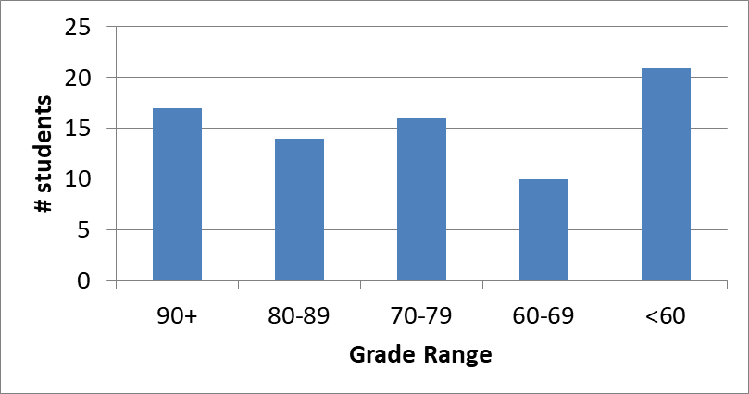
Exam stats & grade distribution
Average: 70.8
Median: 73
Std. deviation: 20.9
Max: 100
Question-by-question averages:
Q1: 27.3 / 35 (78%)
Q2: 23.6 / 40 (59%)
Q3: 19.9 / 25 (80%)
Extra credit
22 students completed
6.4 average

Slide 4
Figuring out where you stand
Programs: 50% (4/9 done)
Exams: 40% (10% + 15% + 15%)
Higher grade from Exam 1/2 counts for 15%
Text exercises: 10%
5% challenge, 5% participation
Mostly complete—6 sets of exercises remain
~40% of your grade still to be determined
Doesn’t include regrade submissions that aren’t done yet

Slide 5
Figuring out where you stand
May be curve, but do not assume there will be
Typical grading scale without curve (from syllabus)
A: 93+
A-: 90-92
B+: 88-89
B: 83-87
B-: 80-82
C+: 78-79
C: 73-77
C-: 70-72
D+: 68-69
D: 60-67
F: < 60

Slide 6
Figuring out where you stand
Will update Blackboard with all grades ASAP
Likely over weekend
Announcement to be posted once that’s done
Once grades are available, consider:
What’s average look like given current grades?
Assuming you maintain same program/exam avg
What would it take to reach desired average?
For example, if you’re currently on track for a C, what would you need to get to a C+? B-?
What’s best case?
Plug in 100% for all remaining assignments/exams
What’s realistic?

Slide 7
Final notes
Next time
More on strings
Reminders:
Program 5 due today
Program 6 to be posted; due date TBD

