Slide 1
EECE.2160 ECE Application Programming
Instructors:
Dr. Michael Geiger & Dr. Lin Li
Spring 2020
Lecture 15:
PE2: Conditionals and loops

Slide 2
Announcements/reminders
Program 4 due 3/2
Late penalties different than normal
-1 if submitted between 3/3-3/6 (3/6 F before break)
-2 if submitted between 3/7-3/16 (3/16 M after break)
Back to normal after that (-4 on 3/17, -8 on 3/18, etc)
Looking ahead: Exam 2 Wednesday, 3/4
Covers material since Exam 1 through end of next week
Allowed one double-sided 8.5” x 11” note sheet
No other notes, no electronic devices
Chapter 5 activities due 3/16
Today’s lecture: PE2 (Loops/conditionals)

Slide 3
PE2: Today’s program should:
Prompt user to enter an input character and an integer, n.
If not correctly formatted, print error, clear line, and repeat
Depending on the character entered, do the following:
‘F’ or ‘f’: Compute and print the factorial of n, n!
For example, if the user enters F 5, print 5! = 120
‘P’ or ‘p’: Compute 2^{n} (if n >= 0)
For example, if the user enters p 2, print 2^2 = 4
Print an error if n < 0.
‘X’ or ‘x’: Exit the program
In all other cases, print an error:
For example: Invalid command Z entered
If the user enters any command other than ‘X’ or ‘x’, return to the initial prompt and repeat the program

Slide 4
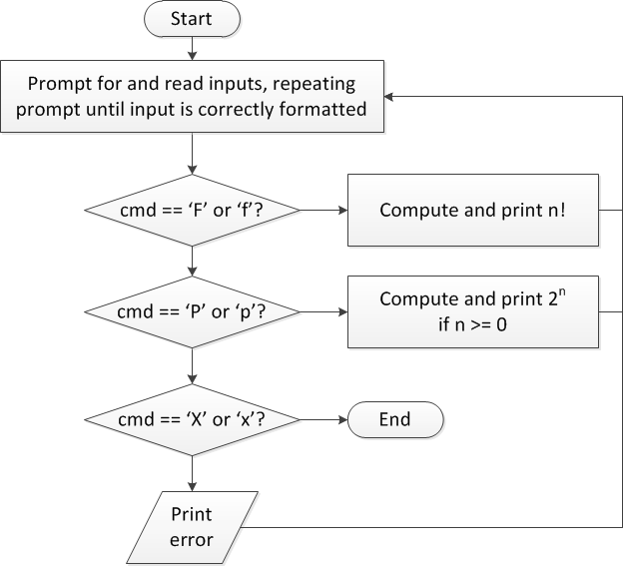
Flow charts: overall flow

Slide 5
Discussion: Overall flow
Whole program contains loop
Repeats process until user enters ‘X’ or ‘x’
Use while or do-while—unknown # of iterations
Since exit condition ends program, “infinite” loop
Testing cmd: switch statement
Checking equality of cmd to constant values
Exiting program: return statement
Use return at any point to end current function (including main)

Slide 6
Code: overall flow (skeleton code)
while (1) { // Loop repeats until user enters 'X' or 'x'
/* Code to read cmd, n */
/* Evaluate cmd and perform appropriate operation */
switch (cmd) {
case 'F':
case 'f':
/* Calculate n! */
break;
case 'P':
case 'p':
/* Calculate 2^n, if n >= 0; print error otherwise */
break;
case 'X':
case 'x':
return 0; // Exit program
default:
printf("Invalid command %c entered\n", cmd);
}
}

Slide 7
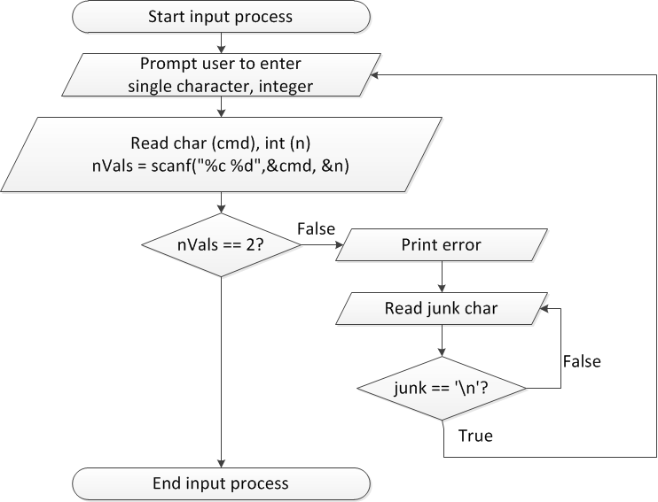
Flow charts: reading input

Slide 8
Discussion: Reading input
Loop that repeats as long as input incorrect
Loop inside that one to handle reading of remainder of line
Read character until you reach end of line
Both while/do-while loops

Slide 9
Code: Reading input
do {
printf("Enter command and integer: ");
nVals = scanf(" %c %d", &cmd, &n);
// Otherwise, print error & clear line
if (nVals != 2) {
printf("Incorrectly formatted input\n“);
do {
scanf("%c", &junk);
} while (junk != '\n');
}
} while (nVals != 2);

Slide 10
Input errors
In general, may want to repeat prompt if any error occurs
Logical OR of all error conditions to continue loop
Prioritize error testing—format errors usually first
Why test inputs if they weren’t read correctly?
Example: also test for n < 0 as an error
do {
printf("Enter command and integer: ");
nVals = scanf("%c %d", &cmd, &n);
if (nVals != 2) {
// Handle error
}
else if (n < 0) { ← Test after we know no
// Handle error formatting error
}
} while ((nVals != 2) || (n < 0));

Slide 11
Error flags
Flag: variable that indicates a particular condition occurred
Allows you to simplify conditional tests later in program
Possible uses
Waiting for some condition—set flag when condition occurs
Testing multiple errors—set/increment flag any time there’s an error
int flag;
do {
flag = 0;
printf("Enter command and integer: ");
nVals = scanf("%c %d", &cmd, &n);
if (nVals != 2) {
// Handle error
flag = 1;
}
else if (n < 0) {
// Handle error
flag = 1;
}
} while (flag == 1);

Slide 12
Finishing PE2: overall flow (review)

Slide 13
Finishing PE2: next steps
Write flowcharts for
Computing n!
Computing 2^{n} if n >= 0
Complete code

Slide 14
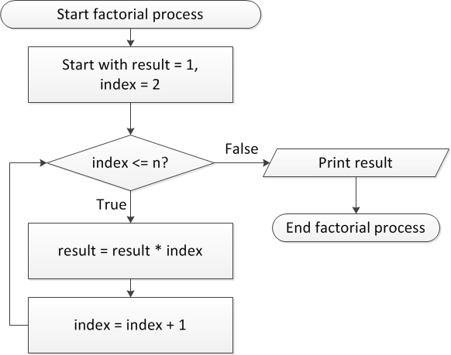
Flow charts: Calculating n!

Slide 15
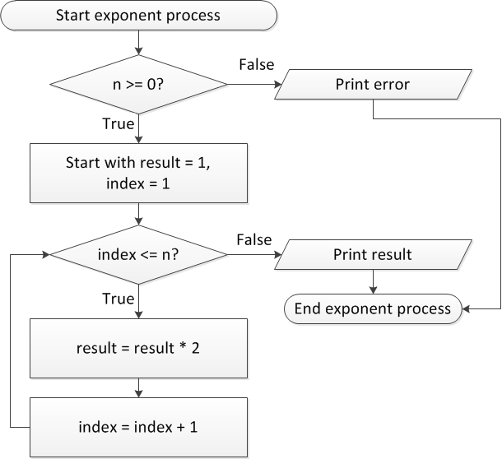
Flow charts: Calculating 2^{n}

Slide 16
Discussion: Factorial/2^{n}
Loop for each process covers fixed range of values
Use for loop
Can declare single variable to hold both results, since only one will be calculated

Slide 17
Code: factorial
result = 1;
for (i = n; i > 1; i--) {
result *= i;
}
printf("%d! = %d\n", n, result);
Slightly different approach than flow chart
Counts down instead of counting up
No benefit to doing one over the other

Slide 18
Code: 2^{n}
if (n < 0)
printf("Error: bad n value\n");
else {
result = 1;
for (i = 0; i < n; i++) {
result *= 2;
}
printf("2^%d = %d\n", n, result);
}

Slide 19
Final notes
Next time
Exam 1 Preview
Reminders:
Program 4 due 3/2
Late penalties different than normal
-1 if submitted between 3/3-3/6 (3/6 F before break)
-2 if submitted between 3/7-3/16 (3/16 M after break)
Back to normal after that (-4 on 3/17, -8 on 3/18, etc)
Looking ahead: Exam 2 Wednesday, 3/4
Covers material since Exam 1 through end of next week
Allowed one double-sided 8.5” x 11” note sheet
No other notes, no electronic devices
Chapter 5 activities due 3/16

