Slide 1
EECE.2160 ECE Application Programming
Instructors:
Dr. Michael Geiger & Dr. Lin Li
Fall 2019
Lecture 16:
Exam 1 Review

Slide 2
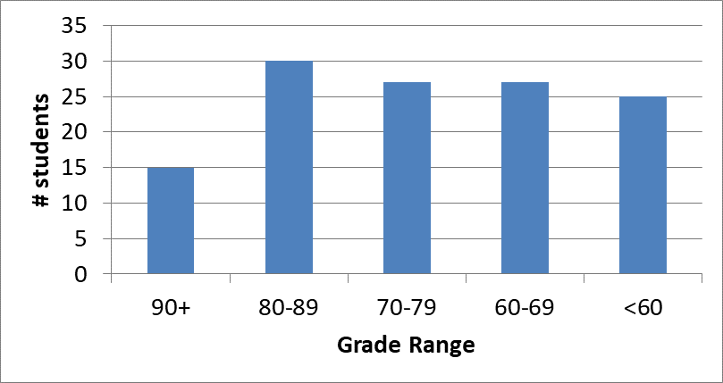
Exam stats & grade distribution
Question-by-question averages:
Q1: 34.1 / 46 (74%)
Q2: 23.6 / 34 (69%)
Q3: 14.1 / 20 (71%)
XC: 4.6 / 10 (23 responses)
Average: 71.8
Median: 73
Std. deviation: 15.9
Max: 99
Doesn’t include XC points

Slide 3
FAQ
Are the exam grades curved?
No—if curve necessary, applied to final average
Typically not needed unless overall avg < 80%
What percentage of my overall grade is this exam?
For most, 15% (programs 50%, Exam 2 10%, Exam 3 15%, text activities 10%)
Minimum of Exams 1 & 2 = 10%, maximum = 15%

Slide 4
FAQ (continued)
Why are the extra credit points listed separately?
Final curve based on scores without extra credit
Extra credit added later to help those who did problems, rather than hurt those who didn’t
Sum of final score + extra credit used for final grade
What about the pace of the class? (Question 3d)
Some people chose “too slow” → class won’t speed up
A few more people chose “too fast” → please see me re: help

