Slide 1
EECE.2160 ECE Application Programming
Instructors:
Dr. Michael Geiger & Dr. Lin Li
Fall
Lecture 20
Program 5 overview

Slide 2
P5 overview
Integral approximation through trapezoidal method
Program split into three files
zyBooks IDE allows you to view one at a time
prog5_integral.c: main() function only
prog5_functions.h: function prototypes
Do not need to modify unless you’re adding function(s)
prog5_functions.c: function definitions
Complete what’s already there

Slide 3
P5 overview (continued)
General program structure
Read input values (endpoints, # trapezoids)
Call integrate() from main() to perform integral
Repeat program?
User should answer Y/N (case insensitive)
main() mostly responsible for input/output
1 large loop for most of main() repeats if ‘Y’/’y’
Smaller loops for each input prompt (like P4)
Error conditions
Formatting errors for each numeric input
Low endpoint must be < high endpoint
# trapezoids must be at least 1

Slide 4
P5: functions
integrate(min, max, trapezoids)
Performs actual integral approximation
f(x)
Function to be integrated
Always fixed as: sin(x) + x² / 10
badInput()
Used to clear line if formatting error occurs
If written correctly, can generally handle errors as:
if (formatting error)
badInput();

Slide 5
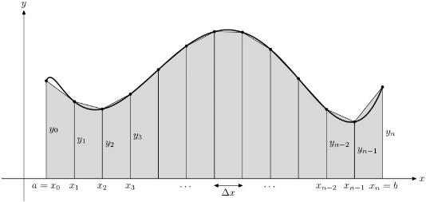
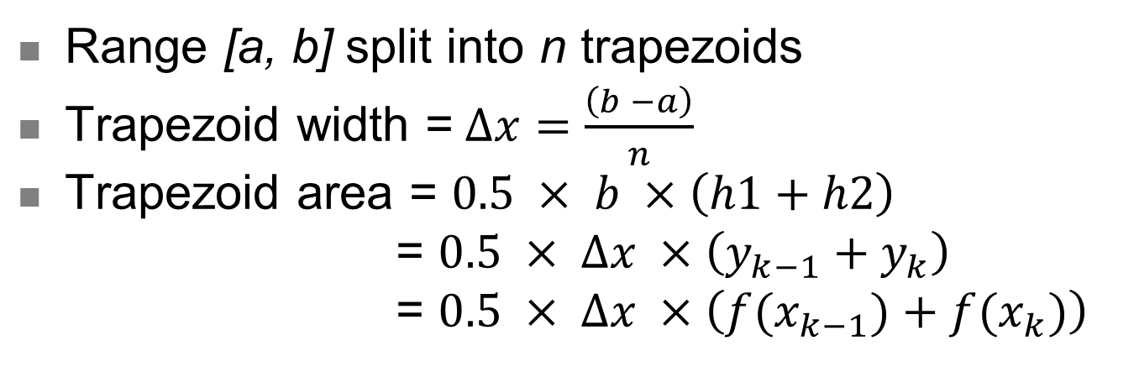
P5: trapezoidal method
Range [a, b] split into n trapezoids
Trapezoid width =$∆x=\frac{\left(b −a\right)}{n}$
Trapezoid area = $0.5 × b ×\left(h1+h2\right)$
= $0.5 × ∆x ×\left(y_{k−1}+y_{k}\right)$
= $0.5 × ∆x ×\left({f(x}_{k−1})+f(x_{k})\right)$

Slide 6
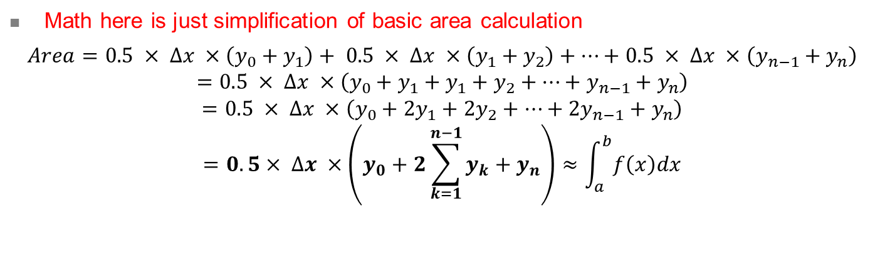
P5: trapezoidal method (continued)
Math here is just simplification of basic area calculation
$$Area=0.5 × ∆x ×\left(y_{0}+y_{1}\right)+ 0.5 × ∆x ×\left(y_{1}+y_{2}\right)+…+0.5 × ∆x ×\left(y_{n−1}+y_{n}\right)$$
$$=0.5 × ∆x ×\left(y_{0}+y_{1}+y_{1}+y_{2}+…+y_{n−1}+y_{n}\right)$$
$$=0.5 × ∆x ×\left(y_{0}+2y_{1}+2y_{2}+…+{2y}_{n−1}+y_{n}\right)$$
$$=0.5× ∆x ×\left(y_{0}+2\sum_{k=1}^{n−1}{y_{k}}+y_{n}\right)≈\int_{a}^{b}{f\left(x\right)dx}$$

Slide 7
P5: implementation warning
Go through x values → generate y values (trapezoid heights)
How should you code that process?
For loop can iterate over range, but be careful
Wrong idea: loop over x values, i.e.
for (x = a; x < b; x += deltaX) {…}
What’s the potential problem?
What data type should x, a, b, & deltaX be?
All variables of type double → approximations
Rounding errors will affect # loop iterations
Is there a whole number you can use with loop?
# iterations can (and should) be based on n
Iterations might not exactly = n (could be n – 1, n + 1, ?)

