Slide 1
EECE.2160 ECE Application Programming
Instructors:
Dr. Lin Li & Dr. Michael Geiger
Spring 2019
Lecture 25
Exam 2 Review

Slide 2
Lecture outline
Announcements/reminders
Program 6 due today
Program 7 to be posted; due date TBD
Today’s lecture
Return Exam 2
Exam stats
Notes on overall course grading

Slide 3
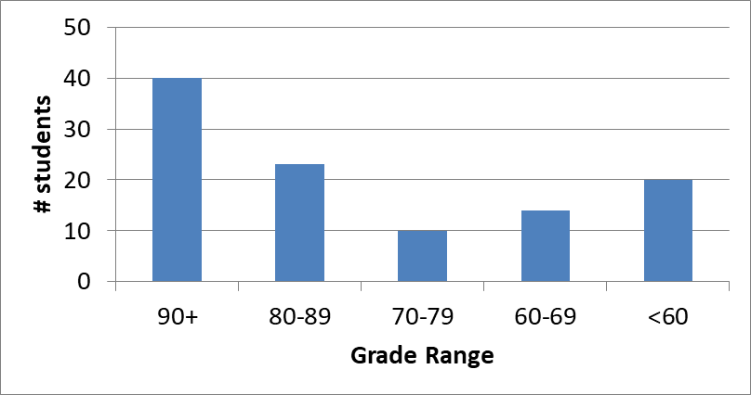
Exam stats & grade distribution
Average: 77.3
Median: 84
Std. deviation: 19.9
Max: 100
Question-by-question averages:
Q1: 19.3 / 25 (77%)
Q2: 32.9 / 41 (80%)
Q3: 25.2 / 34 (74%)
Extra credit
64 students completed
5.0 average

Slide 4
Figuring out where you stand
Programs: 50% (6/8 (or 9) done)
Exams: 40% (10% + 15% + 15%)
Higher grade from Exam 1/2 counts for 15%
Text exercises: 10%
Mostly complete—2 or 3 chapters remain
~30-35% of your grade still to be determined
Doesn’t include regrade submissions that aren’t done yet
REGRADES: If you want to correct work on a previously graded assignment, e-mail Dr. Geiger about reopening that assignment in zyBooks

Slide 5
Figuring out where you stand
May be curve, but do not assume there will be
Typical grading scale without curve (from syllabus)
A: 93+
A-: 90-92
B+: 88-89
B: 83-87
B-: 80-82
C+: 78-79
C: 73-77
C-: 70-72
D+: 68-69
D: 60-67
F: < 60

Slide 6
Figuring out where you stand
Will update Blackboard with all grades ASAP
Only thing that’s not done: filling in missing text grades
Announcement to be posted once that’s done
Once grades are available, consider:
What’s average look like given current grades?
Assuming you maintain same program/exam avg
What would it take to reach desired average?
For example, if you’re currently on track for a C, what would you need to get to a C+? B-?
What’s best case?
Plug in 100% for all remaining assignments/exams
What’s realistic?

Slide 7
Final notes
Next time
More on structures: function examples, nested structures
Reminders:
Program 6 due today
Program 7 to be posted; due date TBD

