Slide 1
EECE.3220 Data Structures
Instructor:
Dr. Michael Geiger
Spring 2017
Lecture 1:
Course overview
Going from C to C++

Slide 2
Lecture outline
Announcements/notes
Program 1 due date TBD (within 2 weeks or so)
All programs to be submitted via Dropbox
E-mail Dr. Geiger for access to shared Dropbox folder
Today’s lecture
Course overview
Instructor information
Course materials
Course policies
Resources
Course outline
Going from C to C++
Introductory look at basic differences

Slide 3
Course meeting time, instructor info
Lectures: MWF 1-1:50, Ball 412
Instructor: Dr. Michael Geiger
E-mail: Michael_Geiger@uml.edu
Phone: 978-934-3618 (x43618 on campus)
Office: 118A Perry Hall
Office hours: M 9:30-11, W 9:30-11, Th 1:30-3
Student questions are top priority during these hours
Will also be in office MW 11-11:45, F 9:30-11:45
Available by appointment other days/times

Slide 4
Course materials
Textbook: Larry Nyhoff, ADTs, Data Structures, and Problem Solving with C++, 2nd edition, 2005, Pearson/Prentice Hall.
ISBN: 0-13-140909-3
Course tools: Need IDE that compiles/runs C++ code
Recommended IDEs (all free; links on web)
Windows: Microsoft Visual Studio Express (MS website)
Mac: Xcode (Mac App Store)
Linux: gcc/gdb (text-based; can run through terminal on Mac as well)

Slide 5
Additional course materials
Course websites:
http://mjgeiger.github.io/eece3220/sp17/index.htm
http://mjgeiger.github.io/eece3220/sp17/schedule.htm
Will contain lecture slides, handouts, assignments
Discussion group through piazza.com:
Allow common questions to be answered for everyone
Do not post code to the discussion group
All course announcements will be posted here
Will use as class mailing list—please enroll ASAP

Slide 6
Academic honesty
All assignments are to be done individually unless explicitly specified otherwise by the instructor
Any copied solutions, whether from another student or an outside source, are subject to penalty
You may discuss general topics or help one another with specific errors, but do not share assignment solutions
Must acknowledge assistance from classmate in submission

Slide 7
Programming assignments
Will submit all code via shared Dropbox folder
Will not get confirmation unless you explicitly ask
Must e-mail Dr. Geiger if submitting late
Penalty after due date: -(2^{n-1}) points per day
i.e., -1 after 1 day, -2 after 2 days, -4 after 3 days …
Assignments that are 8+ days late receive 0
Grading policies document (similar to EECE.2160) to be posted soon

Slide 8
Programming assignments: regrades
You are allowed one penalty-free resubmission per assignment
Each regrade after the first: 1 day late penalty
Must resubmit by regrade deadline, or late penalties will apply
Late penalty still applies if original submission late
“Original submission” → first file submitted containing significant amount of relevant code
In other words, don’t turn in a virtually empty file just to avoid late penalties—it won’t count

Slide 9
Course “rules”
A couple of unofficial rules:
Please call me “Dr. Geiger”
“Professor Geiger” is okay (although I’m technically not a professor, I’m a lecturer)
“Michael,” “Mike,” or “Geiger” is not okay
Please don’t talk when I’m talking
Doing so distracts your classmates and me
If you have a question, please raise your hand and ask—I want questions during lecture!

Slide 10
Grading and exam dates
Grading breakdown
Programming assignments/homework: 55%
Exam 1: 15%
Exam 2: 15%
Exam 3: 15%
Exam dates
Exam 1: Friday, February 17 in class
Exam 2: Friday, March 31 in class
Exam 3: TBD (during finals)

Slide 11
Tentative outline: what you should learn
Fundamentals of C++ programming
Differences between C and C++ (I/O, structs, argument passing)
Object-oriented programming: classes, composition, inheritance
Analyzing algorithmic complexity
How fast is a particular algorithm/data structure, both on average and in the worst case?
Specific types of algorithms: sorting, recursive structure traversal
How to design and use various data structures
Linked lists
Stacks
Queues
Binary trees
Heaps
Priority queues
Hash tables

Slide 12
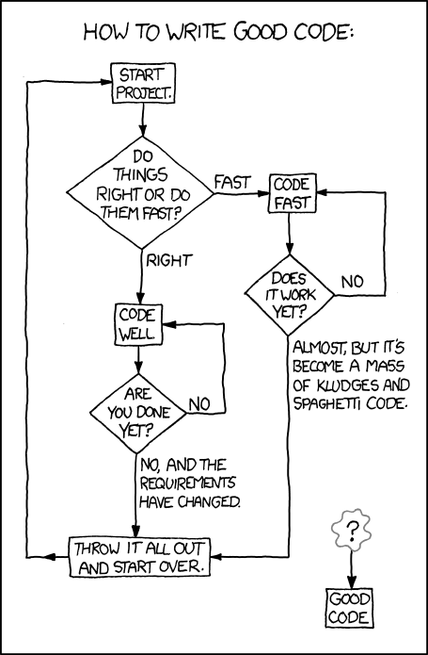
What you’ll really learn … ?
http://xkcd.com/844

Slide 13
C vs. C++: the basics
C is a procedural language
Based around functions (or procedures)—a series of steps to be carried out when called
For a function to operate on data, data must be passed as arguments
C++ is an object-oriented language
Objects contain attributes (data members) and behaviors (member functions)
Function calls (most of them) associated with specific object → no need to pass object to function

Slide 14
Why object-oriented programming?
Object orientation
Natural way of thinking about world (& computer programs)
Object-oriented design (OOD)
Models real-world objects in software
Models communication among objects
Encapsulates attributes and operations (behaviors)
Information hiding
Communication through well-defined interfaces
Object-oriented programming (OOP)
Programmers create user-defined types called classes
Contain data members (attributes) and member functions (behaviors)
Object: specific instance of a given class

Slide 15
Why procedural programming?
If C++ is so great, why learn C in the first place?
C best suited for system-level programming
C language easiest HLL for accessing hardware
Hardware support for procedural programming
Call/return instructions
System stack (or other argument-passing methods)

Slide 16
C vs. C++: simple data types
Most simple data types are the same
From EECE.2160: int, double, float, char
Other matching types (rarely used in EECE.2160)
unsigned: Non-negative whole numbers
Basic int is signed—can be + or –
unsigned is short for “unsigned int”
short: 16-bit integer
Saves space vs. int; has smaller range of values
One additional simple type in C++: bool
Models boolean (true/false) data
Can set variables of type bool equal to true or false
Recall that non-boolean data true if nonzero

Slide 17
C vs. C++: similarities
Most programming constructs are the same
Variable declarations
Arithmetic operators (+, -, *, /, %)
Boolean operators (&&, ||, !)
Relational operators (<, >, <=, >=, ==, !=)
Bitwise operators (&, |, ^, >>, <<)
Control structures (if/else, switch)
Loops (while, do-while, for)
Non-member functions
Arrays and pointers
Structures

Slide 18
C vs. C++: major differences
Input/output
Use redirection operators, not functions
Formatting done through use of manipulators
Object-oriented programming
Use of objects means different ways of organizing and interacting with data
Most function calls operate on single object that isn’t passed to function

Slide 19
Final notes
Next time: more on going from C to C++
Input and output in C++
Structures in C++
Reminders:
Sign up for the course discussion group on Piazza!
Program 1 due date TBD (within 2 weeks or so)
All programs to be submitted via Dropbox
E-mail Dr. Geiger for access to shared Dropbox folder

