Slide 1
EECE.3220 Data Structures
Instructor:
Dr. Michael Geiger
Spring 2017
Lecture 29:
Binary trees (continued)

Slide 2
Lecture outline
Announcements/reminders
Program 4 due 4/14
Program 5 to be posted; due 4/21
Today’s lecture
Review: Binary trees
Sorting algorithms

Slide 3
Review: Trees
A data structure which consists of
a finite set of elements called nodes or vertices
a finite set of directed arcs which connect the nodes
If the tree is nonempty
one of the nodes (the root) has no incoming arc
every other node can be reached by following a unique sequence of consecutive arcs
Binary tree: tree in which each node has at most two children
Binary search tree: binary tree in which each node follows property
value in left child of node ≤ value in node ≤ value in right child of node

Slide 4
Review: Binary Trees as Recursive Data Structures
A binary tree is either empty …
or
Consists of
a node called the root
root has pointers to two disjoint binary (sub)trees called …
right (sub)tree
left (sub)tree
Anchor
Inductive step
Which is either empty … or …
Which is either empty … or …

Slide 5
Review: Tree Traversal is Recursive
If the binary tree is empty then do nothing
Else N: Visit the root, process data L: Traverse the left subtree R: Traverse the right subtree
The "anchor"
The inductive step

Slide 6
Review: Traversal Order
Three possibilities for inductive step …
Left subtree, Node, Right subtree the inorder traversal
Node, Left subtree, Right subtree the preorder traversal
Left subtree, Right subtree, Node the postorder traversal

Slide 7
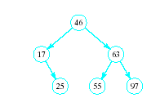

BST Searches
Search begins at root
If that is desired item, done
If item is less, move down left subtree
If item searched for is greater, move down right subtree
If item is not found, we will run into an empty subtree

Slide 8
BST search
You have a BST class template as follows
Data stored in the tree uses type DataType
The BST class contains this node definition:
class BNode {
public:
DataType data; // Actual data
BNode *left; // Left subtree
BNode *right; // Right subtree
// Default constructor
BNode() : left(NULL), right(NULL) {}
};
The BST class contains a single pointer, BNode *root, which is NULL if the tree is empty
Write 2 versions—iterative & recursive—of search function shown below
template <typename DataType>
bool BST<DataType>::search(const DataType &item) {
// insert definition
}

Slide 9
BST search (continued)
For the iterative version, you will have to write a subtree-by-subtree search function:
template <typename DataType>
bool BST<DataType>::searchSub(BNode *subTree, const DataType &item) {
// insert definition
}
The top-level search function will simply call the subtree function:
template <typename DataType>
bool BST<DataType>::search(const DataType &item) {
return searchSub(root, item);
}

Slide 10
BST iterative search
bool BST::search(const DataType &item) {
BNode *p = root;
bool found = false;
while (!found && p != NULL) {
if (item < p->data)
p = p->left;
else if (item > p->data)
p = p->right;
else
found = true;
}
return found;
}

Slide 11
BST recursive search

Slide 12
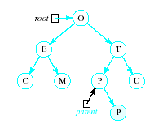
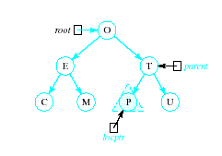
Inserting into a BST
Insert function
Uses modified version of search to locate insertion location or already existing item
Pointer parent trails search pointer locptr, keeps track of parent node
Thus new node can be attached to BST in proper place
R

Slide 13
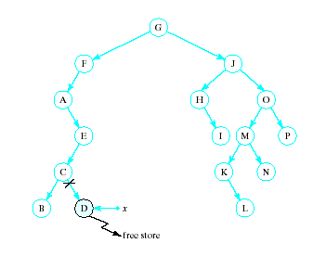
Recursive Deletion
Three possible cases to delete a node, x, from a BST
1. The node, x, is a leaf

Slide 14
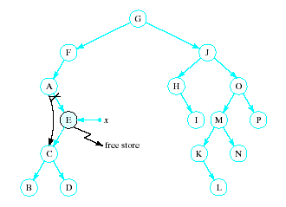
Recursive Deletion
2. The node, x has one child

Slide 15
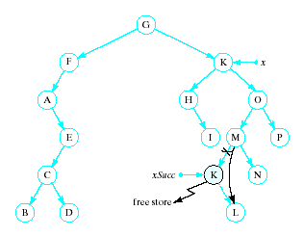
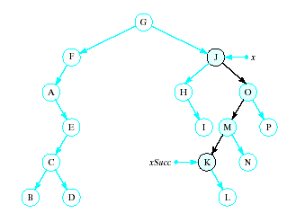
Recursive Deletion
x has two children
Delete node pointed to by xSucc as described for cases 1 and 2
Replace contents of x with inorder successor
K

Slide 16
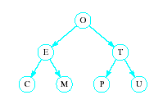
Problem of Lopsidedness
Tree can be balanced
each node except leaves has exactly 2 child nodes

Slide 17
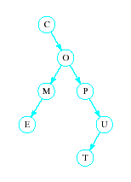
Problem of Lopsidedness
Trees can be unbalanced
not all nodes have exactly 2 child nodes

Slide 18
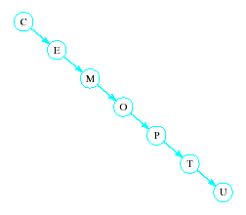
Problem of Lopsidedness
Trees can be totally lopsided
Suppose each node has a right child only
Degenerates into a linked list
Processing time affected by "shape" of tree

Slide 19
Balanced trees
Solutions to lopsidedness problem: balance tree as you insert/remove data
AVL trees
Red/black trees
May cover later in term (time permitting)

Slide 20
Sorting
Consider list x₁, x₂, x₃, … x_{n}
We seek to arrange the elements of the list in order
Ascending or descending
Some O(n²) schemes
easy to understand and implement
inefficient for large data sets

Slide 21


Categories of Sorting Algorithms
Selection sort
Make passes through a list
On each pass reposition correctly some element

Slide 22


Categories of Sorting Algorithms
Exchange sort
Systematically interchange pairs of elements which are out of order
Bubble sort does this
Out of order, exchange
In order, do not exchange

Slide 23
Bubble Sort Algorithm
1. Initialize numCompares to n - 1
2. While numCompares != 0, do following
a. Set last = 1 // location of last element in a swap
b. For i = 1 to numPairs if x_{i} > x_{i + 1} Swap x_{i} and x_{i} ₊ ₁ and set last = i
c. Set numCompares = last – 1
End while

Slide 24
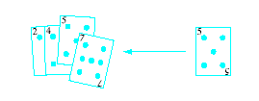
Categories of Sorting Algorithms
Insertion sort
Repeatedly insert a new element into an already sorted list
Note this works well with a linked list implementation

Slide 25
Algorithm for Linear Insertion Sort
For i = 2 to n do the following
a. set nextElement = x[i] and x[0] = nextElement b. set j = i c. While nextElement < x[j – 1] do following set x[j] equal to x[j – 1] increment j by 1 End while
d. set x[j] equal to nextElement
End for

Slide 26
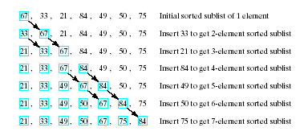
Example of Insertion Sort
Given list to be sorted 67, 33, 21, 84, 49, 50, 75
Note sequence of steps carried out

Slide 27
Improved Schemes
We seek improved computing times for sorts of large data sets
Will continue next time with schemes which can be proven to have average computing time O( n log₂n )
Must be said, no such thing as a universally good sorting scheme
Results may depend just how out of order list is

Slide 28
Final notes
Next time:
Heaps & heapsort
Priority queues
Quicksort
Mergesort
Radix sort
Reminders:
Will likely post Program 4 (stacks) and Program 5 (queues) together
P4 to be due next Friday (4/14), P5 due 4/21

Slide 29
Acknowledgements
These slides are adapted from slides provided with the course textbook:
Larry Nyhoff, ADTs, Data Structures, and Problem Solving with C++, 2nd edition, 2005, Pearson/Prentice Hall. ISBN: 0-13-140909-3

