Slide 1
EECE.3220 Data Structures
Instructor:
Dr. Michael Geiger
Spring 2017
Lecture 30:
Sorting & heaps

Slide 2
Lecture outline
Announcements/reminders
Program 4 due 4/14
Program 5 to be posted; due 4/21
Today’s lecture
Review: Binary trees insert/delete
Sorting algorithms
Heaps

Slide 3
Review: BST iterative search
bool BST::search(const DataType &item) {
BNode *p = root;
bool found = false;
while (!found && p != NULL) {
if (item < p->data)
p = p->left;
else if (item > p->data)
p = p->right;
else
found = true;
}
return found;
}

Slide 4
Review: BST recursive search
template <typename DataType>
bool BST<DataType>::search(const DataType &item) {
return searchSub(root, item);
}
template <typename DataType>
bool BST<DataType>::searchSub(BNode *subTree, const DataType &item) {
if (subTree == NULL)
return false;
else if (item == subTree->data)
return true;
else if (item < subTree->data)
return searchSub(subTree->left, item);
else
return searchSub(subTree->right, item);
}

Slide 5
Review: BST insert/delete
BST insertion
Modified search—find correct position for new node, then insert
New nodes always inserted as leaf node (in non-balanced BST)
BST deletion: 3 cases to consider
Leaf node: simply set parent->leaf ptr = NULL
Node w/1 child: set parent->node ptr =
parent->node->child
Node w/2 children: copy immediate successor to node to be deleted, then delete immediate successor
Immediate successor: go R once, then L as far as possible

Slide 6
Sorting
Consider list x₁, x₂, x₃, … x_{n}
We seek to arrange the elements of the list in order
Ascending or descending
Some O(n²) schemes
easy to understand and implement
inefficient for large data sets

Slide 7


Categories of Sorting Algorithms
Selection sort
Make passes through a list
On each pass reposition correctly some element

Slide 8


Categories of Sorting Algorithms
Exchange sort
Systematically interchange pairs of elements which are out of order
Bubble sort does this
Out of order, exchange
In order, do not exchange

Slide 9
Bubble Sort Algorithm
1. Initialize numCompares to n - 1
2. While numCompares != 0, do following
a. Set last = 1 // location of last element in a swap
b. For i = 1 to numPairs if x_{i} > x_{i + 1} Swap x_{i} and x_{i} ₊ ₁ and set last = i
c. Set numCompares = last – 1
End while

Slide 10
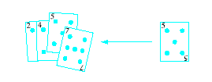
Categories of Sorting Algorithms
Insertion sort
Repeatedly insert a new element into an already sorted list
Note this works well with a linked list implementation

Slide 11
Algorithm for Linear Insertion Sort
For i = 2 to n do the following
a. set nextElement = x[i] and x[0] = nextElement b. set j = i c. While nextElement < x[j – 1] do following set x[j] equal to x[j – 1] increment j by 1 End while
d. set x[j] equal to nextElement
End for

Slide 12
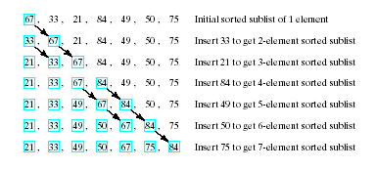
Example of Insertion Sort
Given list to be sorted 67, 33, 21, 84, 49, 50, 75
Note sequence of steps carried out

Slide 13
Improved Schemes
We seek improved computing times for sorts of large data sets
Will continue with schemes which can be proven to have average computing time O( n log₂n )
Must be said, no such thing as a universally good sorting scheme
Results may depend just how out of order list is

Slide 14
Indirect Sorts
Possible that the items being sorted are large structures
Data transfer/swapping time unacceptable
Alternative is indirect sort
Uses index table to store positions of the objects
Manipulate the index table for ordering

Slide 15
Heaps
A heap is a binary tree with properties:
It is complete
Each level of tree completely filled
Except possibly bottom level (nodes in left most positions)
It satisfies heap-order property
Data in each node >= data in children

Slide 16
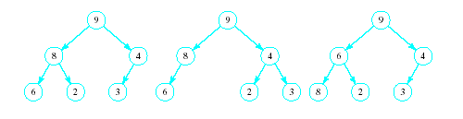
Heaps
Which of the following are heaps?
A
B
C

Slide 17
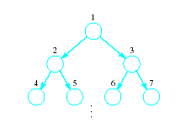
Implementing a Heap
Use an array or vector
Number the nodes from top to bottom
Number nodes on each row from left to right
Store data in i^{th} node in i^{th} location of array (vector)

Slide 18
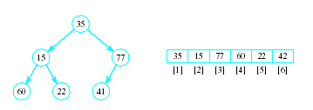
Implementing a Heap
Note the placement of the nodes in the array
Entry 0 in array kept empty to allow space in array to copy element for sorting

Slide 19
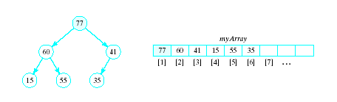
Implementing a Heap
In an array implementation children of i^{th} node are at myArray[2*i] and myArray[2*i+1]
Parent of the i^{th} node is at myArray[i/2]

Slide 20
Basic Heap Operations
Constructor
Set mySize to 0, allocate array
Empty
Check value of mySize
Retrieve max item
Return root of the binary tree, myArray[1]

Slide 21
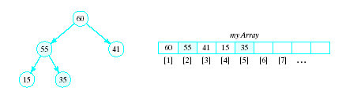
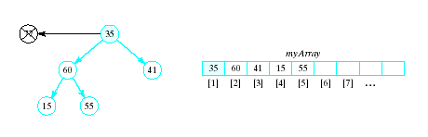
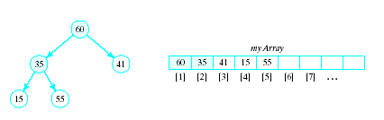
Basic Heap Operations
Delete max item
Max item is the root, replace with last node in tree
Then interchange root with larger of two children
Continue this with the resulting sub-tree(s)
Result called a semiheap

Slide 22
Percolate Down Algorithm
1. Set c = 2 * r // r = current node,
// c = left child
2. While r <= n do following
a. If c < n and myArray[c] < myArray[c + 1] Increment c by 1 b. If myArray[r] < myArray[c] i. Swap myArray[r] and myArray[c] ii. set r = c iii. Set c = 2 * c else Terminate repetition End while

Slide 23
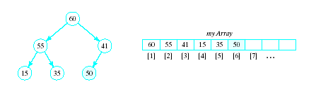
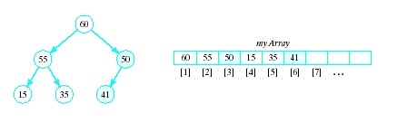
Basic Heap Operations
Insert an item
Amounts to a percolate up routine
Place new item at end of array
Interchange with parent so long as it is greater than its parent

Slide 24
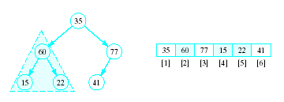
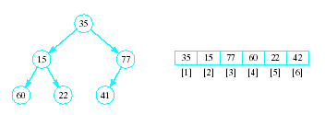
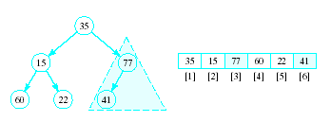
Heapsort
Given a list of numbers in an array
Stored in a complete binary tree
Convert to a heap
Begin at last node not a leaf
Apply percolated down to this subtree
Continue

Slide 25
Heapsort
Algorithm for converting a complete binary tree to a heap – called "heapify" For r = n/2 down to 1: Apply percolate_down to the subtree in myArray[r] , … myArray[n] End for
Puts largest element at root

Slide 26
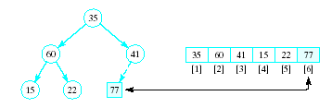
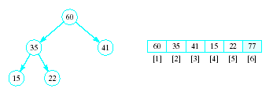
Heapsort
Now swap element 1 (root of tree) with last element
This puts largest element in correct location
Use percolate down on remaining sublist
Converts from semi-heap to heap

Slide 27
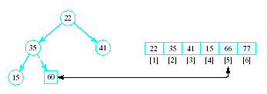
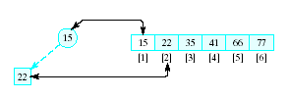
Heapsort
Again swap root with rightmost leaf
Continue this process with shrinking sublist

Slide 28
Heapsort Algorithm
1. Consider x as a complete binary tree, use heapify to convert this tree to a heap
2. for i = n down to 2: a. Interchange x[1] and x[i] (puts largest element at end) b. Apply percolate_down to convert binary tree corresponding to sublist in x[1] .. x[i-1]

Slide 29
Final notes
Next time:
Priority queues
Quicksort
Mergesort
Radix sort
Reminders:
Will likely post Program 4 (stacks) and Program 5 (queues) together
P4 to be due next Friday (4/14), P5 due 4/21

Slide 30
Acknowledgements
These slides are adapted from slides provided with the course textbook:
Larry Nyhoff, ADTs, Data Structures, and Problem Solving with C++, 2nd edition, 2005, Pearson/Prentice Hall. ISBN: 0-13-140909-3

