Slide 1
EECE.3220 Data Structures
Instructor:
Dr. Michael Geiger
Spring 2017
Lecture 31:
Priority queues; more sorting algorithms

Slide 2
Lecture outline
Announcements/reminders
Program 4 due today
Program 5 to be posted; due 4/21
No lecture Monday (Patriots’ Day)
Today’s lecture
Review
O(n²) sorting algorithms
Heaps and heapsort
Priority queues
More sorting algorithms
Quicksort
Merge sort
Radix sort

Slide 3
Review: O(n²) sorting
Sorting algorithms that are easy to understand but inefficient for large data sets
Each uses nested loops to traverse most of list
Selection sort
Identify smallest element in successively smaller sub-lists and move to front of sub-list
Exchange sort
Repeatedly go through list and swap pairs that are out of order
Example: bubble sort
On each iteration, largest value “bubbles” to end
Insertion sort
Repeatedly insert new item into already sorted list
Identify correct position, then move items to make space

Slide 4
Review: Heaps
A heap is a binary tree with properties:
It is complete
Each level of tree completely filled (except possibly bottom)
It satisfies heap-order property
Data in each node >= data in children
Also called a maxheap
If data in node <= data in children, it’s a minheap
Can be efficiently stored in array
Store all nodes at given level from left to right in consecutive locations
If first element @ index 1, then, given index n
Children are at indexes 2*n and 2*n + 1
Parent is at index n/2

Slide 5
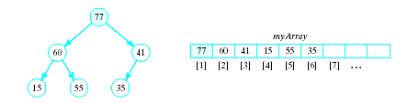
Review: Basic Heap Operations
Constructor
Set mySize to 0, allocate array
Empty
Check value of mySize
Retrieve max item
Return root of the binary tree, myArray[1]

Slide 6
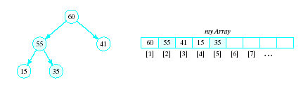
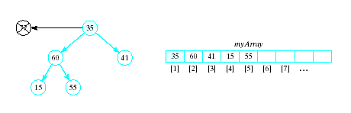
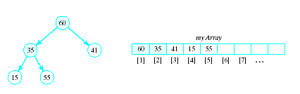
Review: Basic Heap Operations
Delete max item
Max item is the root, replace with last node in tree
Then interchange root with larger of two children
Continue this with the resulting sub-tree(s)
Result called a semiheap

Slide 7
Review: Percolate Down Algorithm
1. Set c = 2 * r // r = current node,
// c = left child
2. While r <= n do following
a. If c < n and myArray[c] < myArray[c + 1] Increment c by 1 b. If myArray[r] < myArray[c] i. Swap myArray[r] and myArray[c] ii. set r = c iii. Set c = 2 * c else Terminate repetition End while

Slide 8
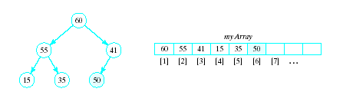
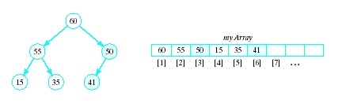
Review: Basic Heap Operations
Insert an item
Amounts to a percolate up routine
Place new item at end of array
Interchange with parent so long as it is greater than its parent

Slide 9
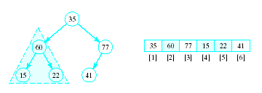
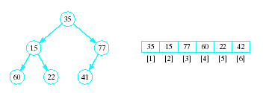
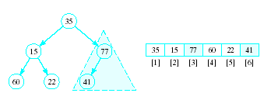
Review: Heapsort
Given a list of numbers in an array
Stored in a complete binary tree
Convert to a heap
Begin at last node not a leaf
Apply percolated down to this subtree
Continue

Slide 10
Review: Heapsort
Algorithm for converting a complete binary tree to a heap – called "heapify" For r = n/2 down to 1: Apply percolate_down to the subtree in myArray[r] , … myArray[n] End for
Puts largest element at root

Slide 11
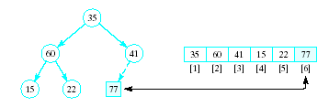
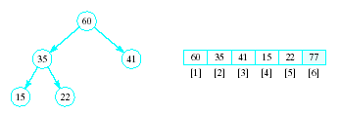
Review: Heapsort
Now swap element 1 (root of tree) with last element
This puts largest element in correct location
Use percolate down on remaining sublist
Converts from semi-heap to heap

Slide 12
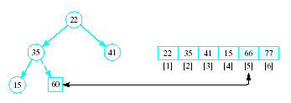
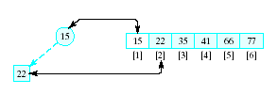
Review: Heapsort
Again swap root with rightmost leaf
Continue this process with shrinking sublist

Slide 13
Review: Heapsort Algorithm
1. Consider x as a complete binary tree, use heapify to convert this tree to a heap
2. for i = n down to 2: a. Interchange x[1] and x[i] (puts largest element at end) b. Apply percolate_down to convert binary tree corresponding to sublist in x[1] .. x[i-1]

Slide 14
Priority Queue
A collection of data elements
Items stored in order by priority
Higher priority items removed ahead of lower
Operations
Constructor
Insert
Find, remove smallest/largest (priority) element
Replace
Change priority
Delete an item
Join two priority queues into a larger one

Slide 15
Priority Queue
Implementation possibilities
As a list (array, vector, linked list)
As an ordered list
Best is to use a heap Basic operations have O(log₂n) time
Priority queue as heap: use priority for ordering
Highest priority item will always be first
All priority queue operations can be written in terms of heap operations

Slide 16
Quicksort
Efficient exchange sorting scheme
Typical exchange involves elements that are far apart
Fewer exchanges required to position element.
Quicksort uses a divide-and-conquer strategy
A recursive approach
Partition original problem into simpler sub-problems
Consider each sub problem independently
Subdivision continues until sub problems obtained are simple enough to be solved directly

Slide 17
Quicksort
Choose some element called a pivot
Perform a sequence of exchanges so that
All elements that are less than this pivot are to its left and
All elements that are greater than the pivot are to its right.
Divides the (sub)list into two smaller sub lists,
Each of which may then be sorted independently in the same way.

Slide 18
Quicksort
If the list has 0 or 1 elements,
return. // the list is sorted
Else do:
Pick an element in the list to use as the pivot.
Split the remaining elements into two disjoint groups:
SmallerThanPivot = {all elements < pivot}
LargerThanPivot = {all elements > pivot}
Return the list rearranged as:
Quicksort(SmallerThanPivot),
pivot,
Quicksort(LargerThanPivot).

Slide 19
Quicksort Example
Given to sort: 75, 70, 65, , 98, 78, 100, 93, 55, 61, 81,
Select, arbitrarily, the first element, 75, as pivot.
Search from right for elements <= 75, stop at first element <75
Search from left for elements > 75, stop at first element >=75
Swap these two elements, and then repeat this process
84
68

Slide 20
Quicksort Example
75, 70, 65, 68, 61, 55, 100, 93, 78, 98, 81, 84
When done, swap pivot into location where search indexes meet
Now, pivot 75 is placed so all elements to the left are <= 75 and all elements to the right are >75.
Need to sort sublists on either side of 75

Slide 21
Quicksort Example
Need to sort (independently):
55, 70, 65, 68, 61 and
100, 93, 78, 98, 81, 84
Let pivot be 55, look from each end for values larger/smaller than 55, swap
Same for 2nd list, pivot is 100
Sort the resulting sublists in the same manner until sublist is trivial (size 0 or 1)
Recursive function to handle this has args
List
Indexes of first, last elements in sublist

Slide 22
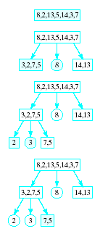
Quicksort
Note visual example of a quicksort on an array
etc. …

Slide 23
Quicksort Performance
O(log₂n) is the average case computing time
If the pivot results in sublists of approximately the same size.
O(n²) worst-case
List already ordered, elements in reverse
When Split() repetitively results, for example, in one empty sublist

Slide 24
Improvements to Quicksort
Quicksort is a recursive function
stack of activation records must be maintained by system to manage recursion.
The deeper the recursion is, the larger this stack will become.
The depth of the recursion and the corresponding overhead can be reduced
sort the smaller sublist at each stage first

Slide 25
Improvements to Quicksort
An arbitrary pivot gives a poor partition for nearly sorted lists (or lists in reverse)
Virtually all the elements go into either SmallerThanPivot or LargerThanPivot
all through the recursive calls.
Quicksort takes quadratic time to do essentially nothing at all.

Slide 26
Improvements to Quicksort
Better method for selecting the pivot is the median-of-three rule,
Select the median of the first, middle, and last elements in each sublist as the pivot.
Often the list to be sorted is already partially ordered
Median-of-three rule will select a pivot closer to the middle of the sublist than will the “first-element” rule.

Slide 27
Improvements to Quicksort
For small files (n <= 20), quicksort is worse than insertion sort;
small files occur often because of recursion.
Use an efficient sort (e.g., insertion sort) for small files.
Better yet, use Quicksort() until sublists are of a small size and then apply an efficient sort like insertion sort.

Slide 28
Mergesort
Sorting schemes are either …
internal -- designed for data items stored in main memory
external -- designed for data items stored in secondary memory.
Previous sorting schemes were all internal sorting algorithms:
required direct access to list elements
not possible for sequential files
made many passes through the list
not practical for files

Slide 29
Mergesort
Mergesort can be used both as an internal and an external sort.
Basic operation in mergesort is merging,
combining two lists that have previously been sorted
resulting list is also sorted.

Slide 30
Merge Algorithm
1. Open File1 and File2 for input, File3 for output
2. Read first element x from File1 and first element y from File2
3. While neither eof File1 or eof File2 If x < y then a. Write x to File3 b. Read a new x value from File1 Otherwise a. Write y to File3 b. Read a new y from File2 End while
4. If eof File1 encountered copy rest of of File2 into File3. If eof File2 encountered, copy rest of File1 into File3

Slide 31


Binary Merge Sort
Given a single file
Split into two files

Slide 32


Binary Merge Sort
Merge first one-element "subfile" of F1 with first one-element subfile of F2
Gives a sorted two-element subfile of F
Continue with rest of one-element subfiles

Slide 33



Binary Merge Sort
Split again
Merge again as before
Each time, the size of the sorted subgroups doubles

Slide 34


Binary Merge Sort
Last splitting gives two files each in order
Last merging yields a single file, entirely in order
Note we always are limited to subfiles of some power of 2

Slide 35


Natural Merge Sort
Allows sorted subfiles of other sizes
Number of phases can be reduced when file contains longer "runs" of ordered elements
Consider file to be sorted, note in order groups

Slide 36


Natural Merge Sort
Copy alternate groupings into two files
Use the sub-groupings, not a power of 2
Look for possible larger groupings

Slide 37

Natural Merge Sort
Merge the corresponding sub files
EOF for F2, Copy remaining groups from F1

Slide 38



Natural Merge Sort
Split again, alternating groups
Merge again, now two subgroups
One more split, one more merge gives sort

Slide 39
Split algorithm for natural mergesort
Splits file F into F1 and F2 by copying sorted subfiles alternately
Open F for input and F1 and F2 for output
While EOF not reached for F
Repeatedly read element of F into F1 until
Next element of F is less than last element copied, or
End of F reached
Repeatedly read element of F into F2 as described above
End while

Slide 40
Merge algorithm for natural mergesort
Merge corresponding sorted subfiles from F1 and F2 to produce F
Open F1 and F2 for input, F for output
Initialize numSubfiles to 0
While EOF not reached for either input file
While no end of a subfile in F1 or F2 reached
If next element in F1 < next element in F2, copy element from F1 to F
Else, copy element from F2 to F
End while
If end of subfile in F1 reached, copy rest of subfile from F2 to F
Else, copy rest of subfile from F1 to F
numSubfiles++
End while
Copy any remaining subfiles to F, incrementing numSubfiles for each

Slide 41
Natural Merge Sort
Repeat the following until numSubfiles == 1
Split F into F1 and F2
Merge F1 and F2 back into F
Worst case for natural merge sort O(n log₂n)

Slide 42
Final notes
Next time:
Radix sort
Sort examples
Hash tables
Reminders:
Program 4 due today
Program 5 to be posted; due 4/21
No lecture Monday (Patriots’ Day)

Slide 43
Acknowledgements
These slides are adapted from slides provided with the course textbook:
Larry Nyhoff, ADTs, Data Structures, and Problem Solving with C++, 2nd edition, 2005, Pearson/Prentice Hall. ISBN: 0-13-140909-3

