Slide 1
EECE.3220 Data Structures
Instructor:
Dr. Michael Geiger
Spring 2017
Lecture 33:
Hash tables

Slide 2
Lecture outline
Announcements/reminders
Program 5 due 4/26
Today’s lecture
Hash tables

Slide 3
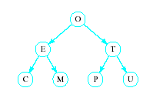
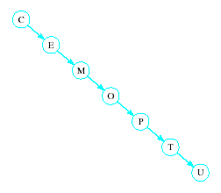
Hash Tables
Recall order of magnitude of searches
Linear search O(n)
Binary search O(log₂n)
Balanced binary tree search O(log₂n)
Unbalanced binary tree can degrade to O(n)

Slide 4
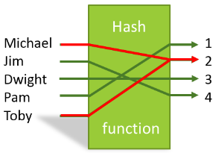
Hash Tables
In some situations faster search is needed
Solution is to use a hash function
Value of key field given to hash function
Location in a hash table is calculated

Slide 5
Hash Functions
Simple function could be to mod the value of the key by some arbitrary integer int h(int i) { return i % someInt; }
Note the max number of locations in the table will be same as someInt
Note that we have traded speed for wasted space
Table must be considerably larger than number of items anticipated

Slide 6
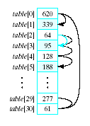
Hash Functions
Observe the problem with same value returned by h(i) for different values of i
Called collisions
A simple solution is linear probing
Linear search begins at collision location
Continues until empty slot found for insertion

Slide 7

Hash Functions
When retrieving a value linear probe until found
If empty slot encountered then value is not in table
If deletions permitted
Slot can be marked so it will not be empty and cause an invalid linear probe

Slide 8
Hash Functions
Strategies for improved performance
Increase table capacity (less collisions)
Use different collision resolution technique
Devise different hash function
Hash table capacity
Size of table must be 1.5 to 2 times the size of the number of items to be stored
Otherwise probability of collisions is too high

Slide 9
Collision Strategies
Linear probing can result in primary clustering
Consider quadratic probing
Probe sequence from location i is i + 1, i – 1, i + 4, i – 4, i + 9, i – 9, …
Secondary clusters can still form
Double hashing
Use a second hash function to determine probe sequence

Slide 10
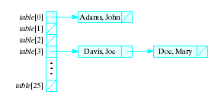
Collision Strategies
Chaining
Table is a list or vector of head nodes to linked lists
When item hashes to location, it is added to that linked list

Slide 11
Improving the Hash Function
Ideal hash function
Simple to evaluate
Scatters items uniformly throughout table
Modulo arithmetic not so good for strings
Possible to manipulate numeric (ASCII) value of first and last characters of a name

Slide 12
Final notes
Next time: TBD—either
Inheritance, or
Balanced binary search trees
Reminders:
Program 5 due 4/26

Slide 13
Acknowledgements
These slides are adapted from slides provided with the course textbook:
Larry Nyhoff, ADTs, Data Structures, and Problem Solving with C++, 2nd edition, 2005, Pearson/Prentice Hall. ISBN: 0-13-140909-3

