Slide 1
EECE.3220 Data Structures
Instructor:
Dr. Michael Geiger
Spring 2017
Lecture 35:
Balanced BSTs

Slide 2
Lecture outline
Announcements/reminders
Program 5 due today
Today’s lecture
Review: Inheritance
Balanced binary search trees

Slide 3
Review: inheritance
Can take existing code base and
Produce specialized version
Example: Square is a more specific Rectangle
Add extensions
Example: Manager class we discussed last time adds extra data/functionality to Employee
Existing class: base class
New class: derived class
Reuses data/functions from base class
Inherits (almost) everything
Access permissions for base class members set in base class
Any class can be a base class → can have hierarchy
Base class can have multiple derived classes

Slide 4
Review: Inheritance example: base class
class Employee
{
private:
string name;
float payRate;
public:
Employee();
Employee(string n, float pr);
string getName();
float getPayRate();
float pay(float hrsWorked);
};

Slide 5
Review: Inheritance example: derived class
class Manager : public Employee
{
private:
bool salaried;
public:
Manager();
Manager(string theName,
float thePayRate,
bool isSalaried);
bool isSalaried();
void setSalaried(bool sal);
float pay(float hrsWorked);
};
The notation above indicates that Manager inherits from Employee
Only declare data/functions that are not shared
Access can be tricky

Slide 6
Review: Constructors and Inheritance
Default constructor for a base class is called automatically in the derived class constructor
Ex: Manager() calls Employee()
Will actually traverse inheritance hierarchy, starting at lowest class
If a derived class needs the parameterized constructor of a base class, it must explicitly invoke it in an initialization list
Manager::Manager(string theName, float thePayRate, bool isSalaried): Employee(theName, thePayRate)
{ salaried = isSalaried; }

Slide 7
Review: Protected data
Problem: Manager pay function can’t access private data in Employee class
Solution: third type of access specifier: protected
Protected data in a class can be directly accessed by
Functions within that class
Functions within derived classes of that class
Still effectively private data to outside world

Slide 8
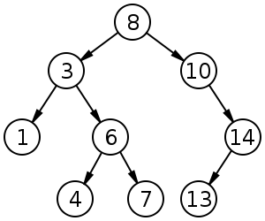
Review: Binary search tree
Binary search tree: binary tree in which each node follows property
value in left child of node ≤ value in node ≤ value in right child of node
Source: https://commons.wikimedia.org/w/index.php?curid=488330

Slide 9
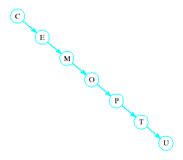
Review: Problem of Lopsidedness
Trees can be totally lopsided
Suppose each node has a right child only
Degenerates into a linked list
Processing time affected by "shape" of tree

Slide 10
Balanced BSTs
AVL trees
Red-black trees

Slide 11
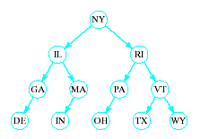
Tree Balancing: AVL Trees
Consider a BST of state abbreviations
When tree is nicely balanced, search time is O(log₂n)
If abbreviations entered in order DE, GA, IL, IN, MA, MI, NY, OH, PA, RI, TX, VT, WY
BST degenerates into linked list with search time O(n)

Slide 12
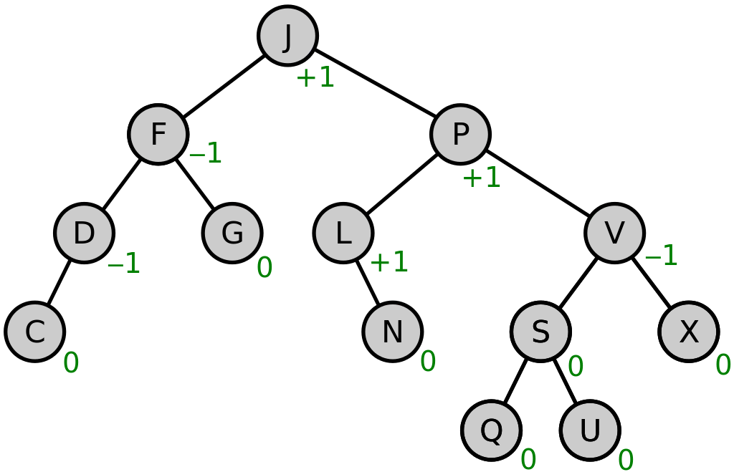
AVL Trees
A height balanced tree
Named with initials of Russian mathematicians who devised them
Defined as
Binary search tree
Balance factor of each node is 0, 1, or -1
(Balance factor of a node = height of left sub tree minus height of right subtree)
Source: https://commons.wikimedia.org/w/index.php?curid=49182185

Slide 13
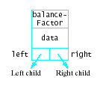
AVL Trees
Consider linked structure to represent AVL tree nodes
Includes data member for the balance factor

Slide 14
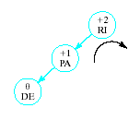

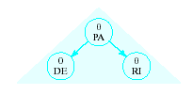
AVL Trees
Insertions may require adjustment of the tree to maintain balance
Given tree
Becomes unbalanced
Requires right rotation on subtree of RI
Producing balanced tree
Insert DE

Slide 15
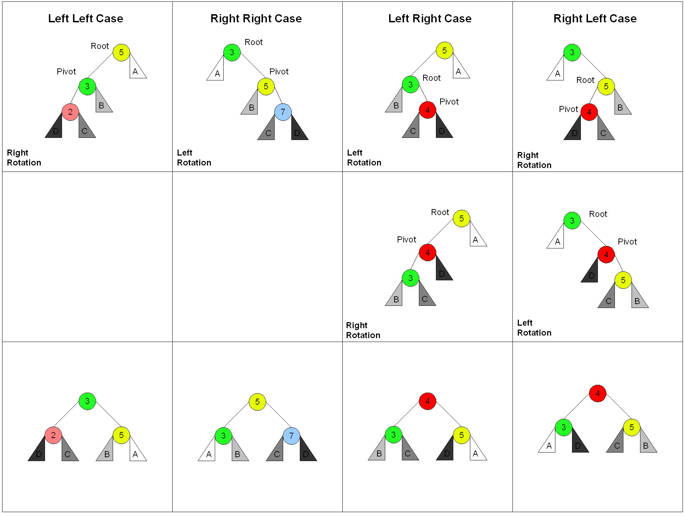
Tree rotations

Slide 16
Basic Rebalancing Rotations
Simple right rotation Use when inserted item in left subtree of left child of nearest ancestor with factor +2
Simple left rotation Use when inserted item in right subtree of right child of nearest ancestor with factor -2
Left-right rotation When inserted item in right subtree of left child of nearest ancestor with factor +2
Right-left rotation When inserted item in left subtree of right child of nearest ancestor with factor -2

Slide 17
Basic Rebalancing Rotations
Rotations carried out by resetting links
Right rotation with A = nearest ancestor of inserted item with balance factor +2 and B = left child
Resent link from parent of A to B
Set left link of A equal to right link of B
Set right link of B to point A
Next slide shows this sequence

Slide 18
Basic Rebalancing Rotations
Right-Left rotation Item C inserted in right subtree of left child B of nearest ancestor A
Set left link of A to point to root of C
Set right link of B equal to left link of C
Set left link of C to point to B Now the right rotation
Resent link from parent of A to point to C
Set link of A equal to right link of C
Set right link of C to point to A

Slide 19
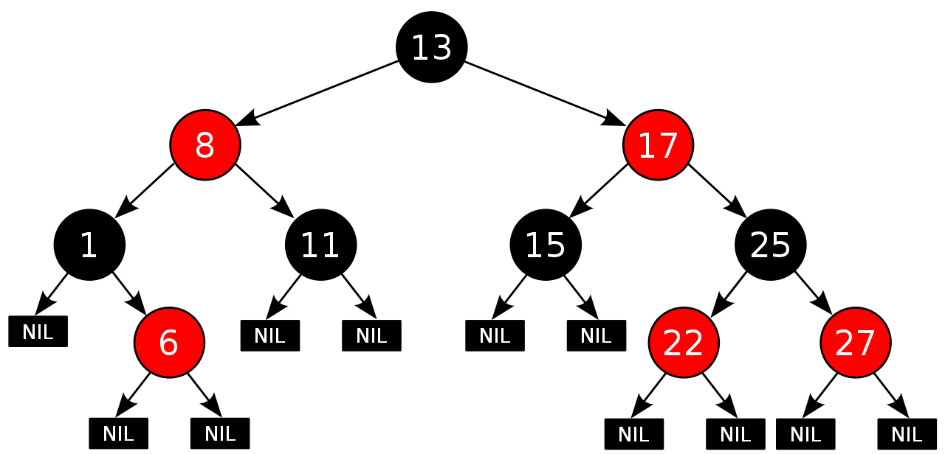
Red-black trees
BST in which each node has a color
Some implementations consider links, not nodes, w/color
Not perfectly height balanced, but path from root to furthest leaf is no more than 2x path from root to closest leaf

Slide 20
Red-black tree properties
Root node is black
All NULL pointers treated as black
If a node is red, both child nodes are black
Every path from a node to a NULL pointer contains the same number of black nodes
Source: https://commons.wikimedia.org/w/index.php?curid=31167379

Slide 21
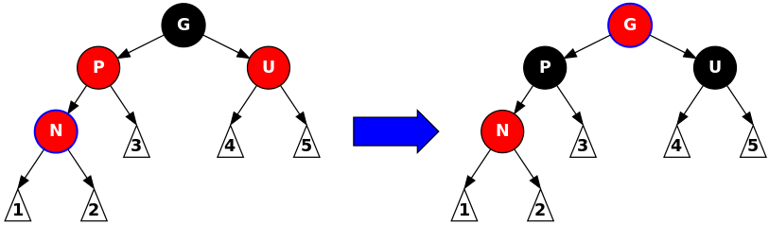
Red-black tree operations
Insertion:
Add node N as in BST and color red
Check following cases:
N is root of tree → repaint black
N’s parent is black → no change
N’s parent and “uncle” (other node with same parent) both red → recolor N’s parent, uncle, and grandparent
If grandparent is tree root, recolor black
Source: https://commons.wikimedia.org/w/index.php?curid=31167379

Slide 22
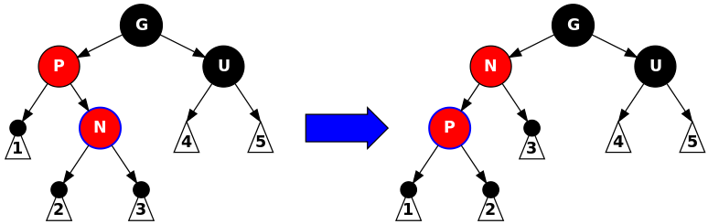
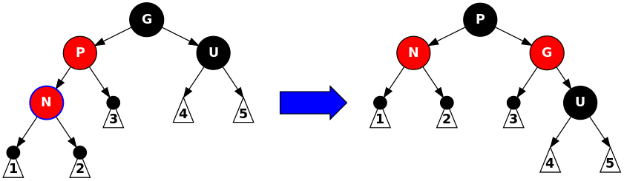
Red-black tree operations
Insertion:
Add node N as in BST and color red
Check following cases:
Parent is red, uncle is black → rotate and recolor
Source: https://commons.wikimedia.org/w/index.php?curid=31167379

Slide 23
Final notes
Next time
Exam 3 Preview
Reminders:
Program 5 due today

Slide 24
Acknowledgements
These slides are adapted from slides provided with the course textbook:
Larry Nyhoff, ADTs, Data Structures, and Problem Solving with C++, 2nd edition, 2005, Pearson/Prentice Hall. ISBN: 0-13-140909-3

