Slide 1
EECE.3220 Data Structures
Instructor:
Dr. Michael Geiger
Spring 2017
Lecture 36:
Exam 3 Preview

Slide 2
Lecture outline
Announcements/reminders
Program 6 (extra credit) posted; due 5/3
Will add test cases more details soon
Q&A session to be Th 5/4; time/room TBD
Final exam: F 5/5 3-6 PM, Ball 412
Course eval to be submitted at final exam
Link to be posted on site; blank copies available outside office
Today’s lecture: Exam 3 Preview

Slide 3
Exam 3 notes
Allowed one 8.5” x 11” double-sided sheet of notes
No other notes, electronic devices (calculator, phone)
Exam will last three hours but will be written for ~50 minutes
Covers all lectures after Exam 2 except Lecture 35 (Wednesday)
Question types (will provide more detailed outline once exam is written)
Multiple choice
Code reading
Code writing

Slide 4
Review: Templates
Templates allow us to write general functions/classes and specify the data type later
template keyword indicates that what follows is a pattern, not a full definition
Generic typename specified in angle brackets with typename (or class) keyword
At least one templated parameter must be used
Desired type automatically bound if calling function
Desired type must be specified if declaring object

Slide 5
Review: Function template example
General form:
template <typename type>
function definition
Rewriting swap with templates:
template <typename T>
void swap(T &v1, T &v2) {
T temp = v1;
v1 = v2;
v2 = temp;
}
Calling swap:
int x = 10;
int y = 20;
swap(x, y);

Slide 6
Review: Class template example
template <typename T>
class AQueue {
public:
AQueue();
bool isEmpty();
void enqueue(T val);
void dequeue();
T front();
void display(ostream &out);
private:
T Qarr[CAPACITY];
int Qfront, Qback;
};

Slide 7
Review: Class template example: enqueue
template <typename T>
void AQueue<T>::enqueue(T val) {
int newBack = (Qback + 1) % CAPACITY;
if (newBack != Qfront) {
Qarr[newBack] = val;
Qback = newBack;
}
else
cerr << "Queue is full--can't enqueue\n";
}

Slide 8
Review: Recursion
Some functions call other functions
Recursive functions call themselves
A recursive function has two parts
Anchor / base case: function value is defined for one or more specific argument values
Inductive / recursive case: function value for current argument value defined in terms of previously defined function values and/or arguments
Common uses
Graph/tree traversal (e.g., BSTs)
Divide and conquer algorithms (e.g., quicksort)

Slide 9
Review: Recursive example
Recursive power function
double power(double x, unsigned n){
if (n == 0)
return 1.0;
else
return x * power(x, n – 1);
}

Slide 10
Review: Strings
String data type found in <string> library
Concepts to work with strings
Relational operators: ==, !=, <, >, <=, >=
Character-by-character comparison using ASCII
Concatenation: +, +=
Choosing single character: [], at()
at() provides boundary checking
Substrings: substr() function
If s1 = “ECE 264”
→ s1.substr(0,3) = “ECE” → 3 chars starting at position 0
s1.substr(4) = “ 264” → all chars from position 4 to end of string
Checking string length: length(), empty() functions

Slide 11
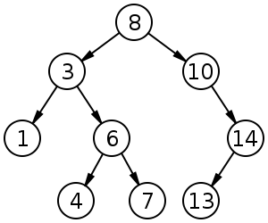
Review: Binary search tree
Binary search tree: binary tree in which each node follows property
value in left child of node ≤ value in node ≤ value in right child of node
Source: https://commons.wikimedia.org/w/index.php?curid=488330

Slide 12
Review: Binary Trees as Recursive Data Structures
A binary tree is either empty …
or
Consists of
a node called the root
root has pointers to two disjoint binary (sub)trees called …
right (sub)tree
left (sub)tree
Anchor
Inductive step
Which is either empty … or …
Which is either empty … or …

Slide 13
Review: BST iterative search
bool BST::search(const DataType &item) {
BNode *p = root;
bool found = false;
while (!found && p != NULL) {
if (item < p->data)
p = p->left;
else if (item > p->data)
p = p->right;
else
found = true;
}
return found;
}

Slide 14
Review: BST recursive search
template <typename DataType>
bool BST<DataType>::search(const DataType &item) {
return searchSub(root, item);
}
template <typename DataType>
bool BST<DataType>::searchSub(BNode *subTree, const DataType &item) {
if (subTree == NULL)
return false;
else if (item == subTree->data)
return true;
else if (item < subTree->data)
return searchSub(subTree->left, item);
else
return searchSub(subTree->right, item);
}

Slide 15
Review: BST insert/delete
BST insertion
Modified search—find correct position for new node, then insert
New nodes always inserted as leaf node (in non-balanced BST)
BST deletion: 3 cases to consider
Leaf node: simply set parent->leaf ptr = NULL
Node w/1 child: set parent->node ptr =
parent->node->child
Node w/2 children: copy immediate successor to node to be deleted, then delete immediate successor
Immediate successor: go R once, then L as far as possible

Slide 16
Review: Heaps
A heap is a binary tree with properties:
It is complete
Each level of tree completely filled (except possibly bottom)
It satisfies heap-order property
Data in each node >= data in children
Also called a maxheap
If data in node <= data in children, it’s a minheap
Can be efficiently stored in array
Store all nodes at given level from left to right in consecutive locations
If first element @ index 1, then, given index n
Children are at indexes 2*n and 2*n + 1
Parent is at index n/2

Slide 17
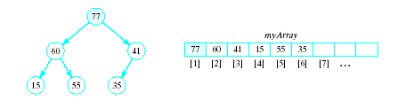
Review: Basic Heap Operations
Constructor
Set mySize to 0, allocate array
Empty
Check value of mySize
Retrieve max item
Return root of the binary tree, myArray[1]

Slide 18
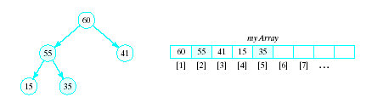
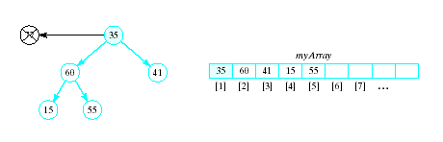
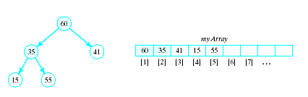
Review: Basic Heap Operations
Delete max item
Max item is the root, replace with last node in tree
Then interchange root with larger of two children
Continue this with the resulting sub-tree(s)
“Percolate down”
Result called a semiheap

Slide 19
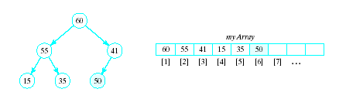
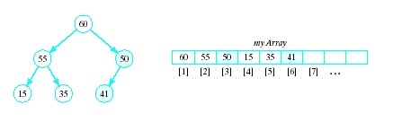
Review: Basic Heap Operations
Insert an item
Amounts to a percolate up routine
Place new item at end of array
Interchange with parent so long as it is greater than its parent

Slide 20
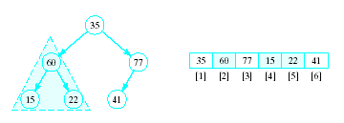
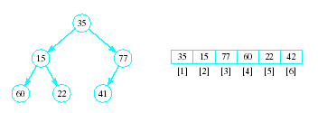
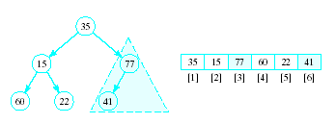
Review: Heapsort
Given a list of numbers in an array
Stored in a complete binary tree
Convert to a heap
Begin at last node not a leaf
Apply percolate down to this subtree
Continue

Slide 21
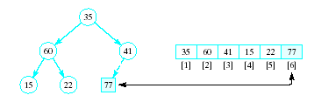
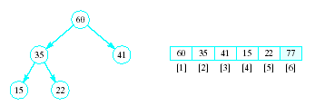
Review: Heapsort
Now swap element 1 (root of tree) with last element
This puts largest element in correct location
Use percolate down on remaining sublist
Converts from semi-heap to heap

Slide 22
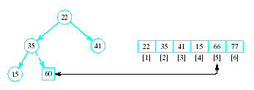
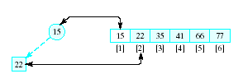
Review: Heapsort
Again swap root with rightmost leaf
Continue this process with shrinking sublist

Slide 23
Review: Heapsort Algorithm
1. Consider x as a complete binary tree, use heapify to convert this tree to a heap
2. for i = n down to 2: a. Interchange x[1] and x[i] (puts largest element at end) b. Apply percolate_down to convert binary tree corresponding to sublist in x[1] .. x[i-1]

Slide 24
Review: Priority Queue
A collection of data elements
Items stored in order by priority
Higher priority items removed ahead of lower
Commonly implemented in heap
Highest priority item → top of heap
Write priority queue operations in terms of heap operations
Example: remove highest priority = remove top of heap

Slide 25
Review: Quicksort
Efficient exchange sorting scheme
Uses divide-and-conquer approach
Quicksort steps
Choose pivot
Perform exchanges so list is ordered as
{items < pivot}, pivot, {items > pivot}
Search from right until item < pivot found
Search from left until item > pivot found
Exchange the two
Stop exchanges once indexes equal, then swap pivot with that spot
Return list rearranged as
{ quicksort({items < pivot}), pivot, quicksort({items > pivot}) }

Slide 26
Review: Mergesort
Mergesort can be used both as an internal and an external sort.
Basic operation in mergesort is merging,
combining two lists that have previously been sorted
resulting list is also sorted.
Repeatedly do the following
Split file (list) into two files (lists)
Merge sorted subfiles (sublists) together into one file

Slide 27


Review: Natural Merge Sort
Copy alternate groupings into two files
Use the sub-groupings, not a power of 2
Look for possible larger groupings

Slide 28

Review: Natural Merge Sort
Merge the corresponding sub files
EOF for F2, Copy remaining groups from F1

Slide 29



Review: Natural Merge Sort
Split again, alternating groups
Merge again, now two subgroups
One more split, one more merge gives sort

Slide 30
Review: Split for natural mergesort
Splits file F into F1 and F2 by copying sorted subfiles alternately
Open F for input and F1 and F2 for output
While EOF not reached for F
Repeatedly read element of F into F1 until
Next element of F is less than last element copied, or
End of F reached
Repeatedly read element of F into F2 as described above
End while

Slide 31
Review: Merge for natural mergesort
Merge corresponding sorted subfiles from F1 and F2 to produce F
Open F1 and F2 for input, F for output
Initialize numSubfiles to 0
While EOF not reached for either input file
While no end of a subfile in F1 or F2 reached
If next element in F1 < next element in F2, copy element from F1 to F
Else, copy element from F2 to F
End while
If end of subfile in F1 reached, copy rest of subfile from F2 to F
Else, copy rest of subfile from F1 to F
numSubfiles++
End while
Copy any remaining subfiles to F, incrementing numSubfiles for each

Slide 32
Review: Natural Merge Sort
Repeat the following until numSubfiles == 1
Split F into F1 and F2
Merge F1 and F2 back into F
Worst case for natural merge sort O(n log₂n)

Slide 33
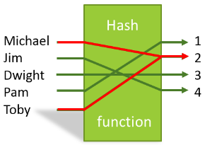
Review: Hash Tables
In some situations faster search is needed
Solution is to use a hash function
Value of key field given to hash function
Location in a hash table is calculated

Slide 34
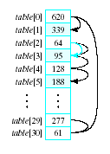
Review: Linear probing
Observe the problem with same value returned by h(i) for different values of i
Called collisions
A simple solution is linear probing
Linear search begins at collision location
Continues until empty slot found for insertion

Slide 35
Review: other collision strategies
Linear probing can result in primary clustering
Consider quadratic probing
Probe sequence from location i is i + 1, i – 1, i + 4, i – 4, i + 9, i – 9, …
Secondary clusters can still form
Double hashing
Use a second hash function to determine probe sequence

Slide 36
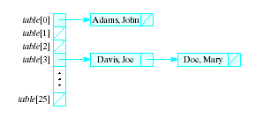
Review: other collision strategies
Chaining
Table is a list or vector of head nodes to linked lists
When item hashes to location, it is added to that linked list

Slide 37
Final notes
Next time
Exam 3
Reminders:
Program 6 (extra credit) posted; due 5/3
Will add test cases more details soon
Q&A session to be Th 5/4; time/room TBD
Final exam: F 5/5 3-6 PM, Ball 412
Course eval to be submitted at final exam
Link to be posted on site; blank copies available outside office

