Slide 1
16.482 / 16.561
Computer Architecture and Design
Instructor: Dr. Michael Geiger
Spring 2015
Lecture 5:
Dynamic scheduling

Slide 2
Lecture outline
Announcements/reminders
  HW 4 due today
  Midterm exam: Thursday, 6/4
    Will be allowed two double-sided 8.5” x 11” note sheets, calculator
Review
  Dynamic branch prediction
Today’s lecture
  Dependences and hazards (review)
  Dynamic scheduling
  Midterm exam preview
Computer Architecture Lecture 5

Slide 3
Review: Dynamic Branch Prediction
Want to avoid branch delays
Dynamic branch predictors: hardware to predict branch outcome (T/NT) in 1 cycle
  Use branch history to determine predictions
  Doesn’t calculate target
Branch history table: basic predictor
  Which line of table should we use?
    Use appropriate bits of PC to choose BHT entry
    # index bits = log₂(# BHT entries)
  What’s prediction?
  How does actual outcome affect next prediction?
Computer Architecture Lecture 5

Slide 4
Review: BHT
Solution: 2-bit scheme where change prediction only if get misprediction twice
Red: “stop” (branch not taken)
Green: “go” (branch taken)
T
NT
Predict Taken
11
10
Predict Taken
T
T
NT
NT
Predict Not
Taken
01
00
Predict Not
Taken
T
NT
Computer Architecture Lecture 5

Slide 5
Review: Correlated predictors, BTB
Correlated branch predictors
  Track both individual branches and overall program behavior (global history)
    Makes some branches easier to predict
  To make a prediction
    Branch address chooses row
    Global history chooses column
    Once entry chosen, make prediction in same way as basic BHT (11/10 → predict T, 00/01→predict NT)
Branch target buffers
  Save previously calculated branch targets
  Use branch address to do fully associative search
Computer Architecture Lecture 5

Slide 6
Data Dependence and Hazards
Instr_{J} is data dependent (aka true dependence) on Instr_{I} if:
  Instr_{J} tries to read operand before Instr_{I} writes it
  or Instr_{J} is data dependent on Instr_{K} which is dependent on Instr_{I}
If two instructions are data dependent, they cannot execute simultaneously or be completely overlapped
If data dependence caused a hazard in pipeline,
called a Read After Write (RAW) hazard
I: add $1,$2,$3
J: sub $4,$1,$3
Computer Architecture Lecture 5

Slide 7
Name dependences
Name dependence: 2 instructions use same register or memory location, but no data flow between instructions associated with that name
Name dependences only cause problems if program order is changed
  In-order program suffers no hazards from these dependences
Can be resolved through register renaming
  Will revisit with dynamic scheduling
Computer Architecture Lecture 5

Slide 8
Name Dependence #1: Anti-dependence
Anti-dependence: Instr_{J} writes operand before Instr_{I} reads it
If anti-dependence causes a hazard in the pipeline, called a Write After Read (WAR) hazard
I: sub $4,$1,$3
J: add $1,$2,$3
K: mul $6,$1,$7
Computer Architecture Lecture 5

Slide 9
Name Dependence #2: Output dependence
Output dependence: Instr_{J} writes operand before Instr_{I} writes it.
If output dependence causes a hazard in the pipeline, called a Write After Write (WAW) hazard
I: sub $1,$4,$3
...
J: add $1,$2,$3
K: mul $6,$1,$7
Computer Architecture Lecture 5

Slide 10
Loop-carried dependences
Easy to identify dependences in basic blocks
Trickier across loop iterations
  Example:
L: add $t0, $t1, $t2
lw $t2, 0($t0)
cmp $t2, $zero
bne L
  $t2 from lw used in next loop iteration
Loop-carried dependence: dependence in which value from one iteration used in another
Computer Architecture Lecture 5

Slide 11
Dependence example
Given the code below
  Loop: ADD $1, $2, $3
  I0: ADD $3, $1, $5
  I1: LW $6, 0($3)
  I2: LW $7, 4($3)
  I3: SUB $8, $7, $6
  I4: DIV $7, $8, $1
  I5: ADDI $4, $4, 1
  I6: SW $8, 0($3)
  I7: SLTI $9, $4, 50
  I8: BNEZ $9, Loop
  List the data dependences
    Assuming a 5-stage pipeline with no forwarding, which of these would cause RAW hazards?
  List the anti-dependences
  List the output dependences
Computer Architecture Lecture 5

Slide 12
Dependence example solution
Data dependences (RAW hazards underlined)
  $1: Loop → I0
  $1: Loop → I4
  $3: I0 → I1
  $3: I0 → I2
  $3: I0 → I6
  $3: I0 → Loop (LC)
  $6: I1 → I3
  $7: I2 → I3
  $8: I3 → I4
  $8: I3 → I6
  $4: I5 → I7
  $9: I7 → I8
Computer Architecture Lecture 5

Slide 13
Dependence example solution (cont.)
Anti-dependences
  $3: Loop → I0
  $7: I3 → I4
Output dependences
  $7: I2 → I4
Computer Architecture Lecture 5

Slide 14
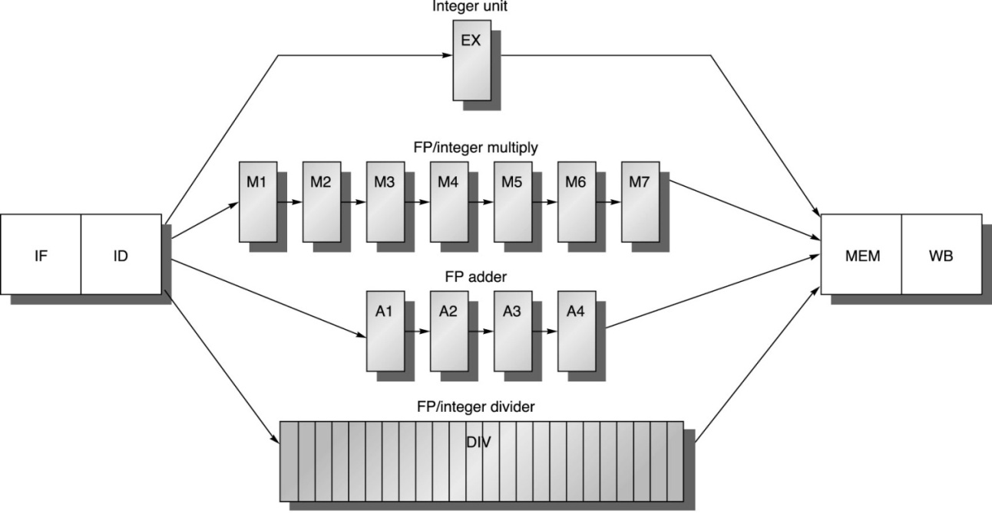
Realistic pipeline
A 5-stage pipeline is unrealistic for a modern microprocessor
  Floating point (FP) ops take much more time than integer ops
  Solution: Pipelined execution units
    Allow integer ops (ADD, SUB, etc.) to finish in 1 cycle
    Allow multiple FP ops of a particular type to execute at once
      Example: in pipeline below, can have up to 4 ADD.D instructions at once
  May also pipeline memory accesses (not shown below)
Computer Architecture Lecture 5

Slide 15
MIPS floating point
32 SP floating point registers (F0-F31)
Registers paired for double precision ops
  For example, in a double-precision add, “F0” refers to the register pair F0/F1
Arithmetic instructions similar to integer
  “.s” or “.d” at end of instruction for single/double
  add.d, sub.d, mult.d, div.d
Data transfer
  Load: L.S / L.D
  Store: S.S / S.D
Computer Architecture Lecture 5

Slide 16
Latency and stalls
For our purposes, an instruction’s latency is equal to the number of pipeline stages in which that instruction does useful work
In the realistic pipeline slide:
  Integer ops have a 1 cycle latency (EX)
  Multiply ops have a 7 cycle latency (M1-M7)
  FP adds have a 4 cycle latency (A1-A4)
  Divide ops have a 24 cycle latency (D1-D24)
  Memory ops have a 1+1 = 2 cycle latency
    Address calculation in EX, memory access in MEM
Computer Architecture Lecture 5

Slide 17
Determining stalls
Most of the time, assuming forwarding:
(# cycles between dependent instructions) = (latency of producing instruction – 1)
  If no instructions between those dependent instructions, those cycles become stalls
  Note: cycle that gets stalled is the cycle in which value is used
Computer Architecture Lecture 5

Slide 18
Case #1: ALU to ALU
Most common case:
  Instruction produces result during EX stage(s)
  Dependent instruction uses result in its own EX stage(s)
  Easy to see stalls = (latency – 1) here
  Note: same rule applies for ALU → load/store if ALU result is used for address calculation
 | 1 | 2 | 3 | 4 | 5 | 6 | 7 | 8 | 9 | 10
ADD.D | IF | ID | EX1 | EX2 | EX3 | M | WB
ADD.D |  | IF | ID | S | S | EX1 | EX2 | EX3 | M | WB
Computer Architecture Lecture 5

Slide 19
Case #2: Load to ALU
Load produces result at end of memory stage
ALU op uses result at start of EX stage(s)
If you consider total latency (EX + MEM) for load, stalls = (latency – 1)
 | 1 | 2 | 3 | 4 | 5 | 6 | 7 | 8 | 9
L.D | IF | ID | EX | M | WB
ADD.D |  | IF | ID | S | EX1 | EX2 | EX3 | M | WB
Computer Architecture Lecture 5

Slide 20
Case #3: ALU to store
Assumes ALU result is stored into memory
Appears only one stall is needed …
  What’s problem?
 | 1 | 2 | 3 | 4 | 5 | 6 | 7 | 8 | 9 | 10
ADD.D | IF | ID | EX1 | EX2 | EX3 | M | WB
S.D |  | IF | ID | EX | S | M | WB
Computer Architecture Lecture 5

Slide 21
Case #3: ALU to store (cont.)
Structural hazard on MEM/WB stages
  Requires additional stall
Note that hazard shouldn’t exist
  ADD.D doesn’t really use MEM stage
  S.D doesn’t really use WB stage
  Current pipeline forces us to share hardware; smarter design will alleviate this problem and reduce stalls
 | 1 | 2 | 3 | 4 | 5 | 6 | 7 | 8 | 9 | 10
ADD.D | IF | ID | EX1 | EX2 | EX3 | M | WB
S.D |  | IF | ID | EX | S | S | M | WB
Computer Architecture Lecture 5

Slide 22
Case #4: Load to store
The one exception to the rule
  Value loaded from memory; stored to new location
    Used for memory copying
  # stalls = (memory latency – 1)
    Forwarding from one memory stage to the next
    0 cycles in our examples
 | 1 | 2 | 3 | 4 | 5 | 6 | 7 | 8 | 9 | 10
L.D | IF | ID | EX | M | WB
S.D |  | IF | ID | EX | M | WB
Computer Architecture Lecture 5

Slide 23
Out-of-order execution
Variable latencies make out-of-order execution desirable
How do we prevent WAR and WAW hazards?
How do we deal with variable latency?
  Forwarding for RAW hazards harder
Instruction
add r3, r1, r2
mul r6, r4, r5
div r8, r6, r7
add r7, r1, r2
sub r8, r1, r2
1 2 3 4 5 6 7 8 9 10 11 12 13 14
IF ID EX M WB
IF ID E1 E2 E3 E4 E5 E6 E7 M WB
IF ID x x x x x x E1 E2 E3 E4 …
IF ID EX M WB
IF ID EX M WB
Computer Architecture Lecture 5

Slide 24
HW Schemes: Instruction Parallelism
Key idea: Allow instructions behind stall to proceed
DIVD F0,F2,F4
ADDD F10,F0,F8
SUBD F12,F8,F14
Enables out-of-order execution and allows out-of-order completion (e.g., SUBD)
  In a dynamically scheduled pipeline, all instructions still pass through issue stage in order (in-order issue)
Note: Dynamic execution creates WAR and WAW hazards and makes exceptions harder
Computer Architecture Lecture 5

Slide 25
Tomasulo’s Algorithm
Control & buffers distributed with Function Units (FU)
  FU buffers called “reservation stations”; have pending operands
Registers in instructions replaced by values or pointers to reservation stations(RS) (register renaming)
  Renaming avoids WAR, WAW hazards
  More reservation stations than registers, so can do optimizations compilers can’t
Results to FU from RS, not through registers, over Common Data Bus that broadcasts results to all FUs
  Avoids RAW hazards by executing an instruction only when its operands are available
Load and Stores treated as FUs with RSs as well
Integer instructions can go past branches (predict taken), allowing FP ops beyond basic block in FP queue
Computer Architecture Lecture 5

Slide 26
Tomasulo Organization
From Mem
FP Op
Queue
FP Registers
Load Buffers
Load1
Load2
Load3
Load4
Load5
Load6
Store
Buffers
Add1
Add2
Add3
Mult1
Mult2
Reservation
Stations
To Mem
FP adders
FP multipliers
Common Data Bus (CDB)
Computer Architecture Lecture 5
Notes:
Resolve RAW memory conflict? (address in memory buffers)
Integer unit executes in parallel

Slide 27
Reservation Station Components
Op:Operation to perform in the unit (e.g., + or –)
Vj, Vk: Value of Source operands
  Store buffers has V field, result to be stored
Qj, Qk: Reservation stations producing source registers (value to be written)
  Note: Qj,Qk=0 => ready
  Store buffers only have Qi for RS producing result
A: Address (memory operations only)
Busy: Indicates reservation station or FU is busy
Computer Architecture Lecture 5
Notes:
What you might have thought
1. 4 stages of instruction executino
2.Status of FU: Normal things to keep track of (RAW & structura for busyl):
Fi from instruction format of the mahine (Fi is dest)
Add unit can Add or Sub
Rj, Rk - status of registers (Yes means ready)
Qj,Qk - If a no in Rj, Rk, means waiting for a FU to write result; Qj, Qk means wihch FU waiting for it
3.Status of register result (WAW &WAR)s:
which FU is going to write into registers
Scoreboard on 6600 = size of FU
6.7, 6.8, 6.9, 6.12, 6.13, 6.16, 6.17
FU latencies: Add 2, Mult 10, Div 40 clocks

Slide 28
Implementing Register Renaming
Register result status table
  Indicates which instruction will write each register, if one exists
    Holds name of reservation station with producing instruction
  Blank when no pending instructions that will write that register
  When instructions try to read register file, check this table first
    If entry is empty, can read value from register file
    If entry is full, read name of reservation station that holds producing instruction
F0 | F2 | F4 | F6 | F8
Load1 |  | Add1 | Mult1
Computer Architecture Lecture 5

Slide 29
Instruction execution in Tomasulo’s
Fetch: place instruction into Op Queue (IF)
Issue: get instruction from FP Op Queue (IS)
  Find free reservation station (RS)
  If RS free, check register result status and CDB for operands
    If available, get operands
    If not available, read new register name(s) and place in Qj / Qk
  Rename result by setting appropriate field in register result status
Execute: operate on operands (EX)
  Instruction starts when both operands ready and func. unit free
  Checks common data bus (CDB) while waiting
    We allow EX to start in same cycle operand is received
  Number of EX (and MEM) cycles depends on latency
Computer Architecture Lecture 5

Slide 30
Instruction execution in Tomasulo’s
Memory access: only happens if needed! (MEM)
Write result: finish execution, send result (WB)
  Broadcast result on CDB
    Waiting instructions read value from CDB
  Write to register file only if result is newest value for that register
    Check register result status—see if RS names match
  Assume only 1 CDB unless told otherwise
    Potential structural hazard!
    Oldest instruction should broadcast result first
Computer Architecture Lecture 5

Slide 31
Renaming example
Given the following available reservation stations:
  Add1-Add4 (ADD.D/SUB.D)
  Mult1-Mult2 (MULT.D/DIV.D)
  Load1-Load2 (L.D)
Rewrite the code below with renamed registers, replacing register names with appropriate reservation stations. It may help to track the register result status for each instruction.
L.D F2, 0(R1)
ADD.D F0, F2, F6
SUB.D F6, F0, F2
MULT.D F2, F6, F0
DIV.D F6, F2, F6
S.D F6, 8(R1)
Computer Architecture Lecture 5

Slide 32
Solution
Assume reservation stations are assigned in order
Resulting code
L.D Load1, 0(R1)
ADD.D Add1, Load1, F6
SUB.D Add2, Add1, Load1
MULT.D Mult1, Add2, Add1
DIV.D Mult2, Mult1, Add2
S.D Mult2, 8(R1)
Computer Architecture Lecture 5

Slide 33
Tomasulo’s example
Assume the following latencies
  2 cycles (1 EX, 1 MEM) for memory operations
  3 cycles for FP add/subtract
  10 cycles for FP multiply
  40 cycles for FP divide
We’ll look at execution of the following code (solution to be posted separately)
  L.D F6, 32(R2)
  L.D F2, 44(R3)
  MUL.D F0, F2, F4
  SUB.D F8, F6, F2
  DIV.D F10, F0, F6
  ADD.D F6, F8, F2
Computer Architecture Lecture 5

Slide 34
Dynamic loop unrolling
Why can Tomasulo’s overlap loop iterations?
  Register renaming
    Multiple iterations use different physical destinations for registers (dynamic loop unrolling).
  Reservation stations
    Permit instruction issue to advance past integer control flow operations
    Also buffer old values of registers - totally avoiding the WAR stall
Computer Architecture Lecture 5

Slide 35
Tomasulo’s advantages
Distribution of the hazard detection logic
  distributed reservation stations and the CDB
  If multiple instructions waiting on single result, & each instruction has other operand, then instructions can be released simultaneously by broadcast on CDB
  If a centralized register file were used, the units would have to read their results from the registers when register buses are available
Elimination of stalls for WAW and WAR hazards
Computer Architecture Lecture 5

Slide 36
Tomasulo Drawbacks
Complexity
Many associative stores (CDB) at high speed
Performance limited by Common Data Bus
  Each CDB must go to multiple functional units
  ⇒ high capacitance, high wiring density
  Number of functional units that can complete per cycle limited to one!
    Multiple CDBs ⇒ more FU logic for parallel assoc stores
Non-precise interrupts!
  We will address this later
Computer Architecture Lecture 5

Slide 37
Midterm exam notes
Allowed to bring:
  Two 8.5” x 11” double-sided sheets of notes
  Calculator
No other notes or electronic devices (phone, laptop, etc.)
Will be provided with list of MIPS instructions
Exam will last until 4:00
  Will start at 1:00—please be on time
Covers all lectures through today
  Material starts with MIPS instruction set
Question formats
  Problem solving
  Some short answer—may be asked to explain concepts
  Similar to homework, but shorter
Old exams are on website
  Note: not all material the same
Computer Architecture Lecture 5

Slide 38
Test policies
Prior to passing out exam, I will verify that you only have two note sheets
  If you have too many sheets, I will take all notes
You will not be allowed to remove anything from your bag after that point in time
You will not be allowed to share anything with a classmate
  If you need an additional pencil, eraser, or piece of scrap paper during the exam, ask me
Only one person will be allowed to use the bathroom at a time
  You must leave your cell phone either with me or clearly visible on the table near your seat
Computer Architecture Lecture 5

Slide 39
Review: MIPS integer registers
Name | Register number | Usage
$zero | 0 | Constant value 0
$v0-$v1 | 2-3 | Values for results and expression evaluation
$a0-$a3 | 4-7 | Function arguments
$t0-$t7 | 8-15 | Temporary registers
$s0-$s7 | 16-23 | Callee save registers
$t8-$t9 | 24-25 | Temporary registers
$gp | 28 | Global pointer
$sp | 29 | Stack pointer
$fp | 30 | Frame pointer
$ra | 31 | Return address
List gives mnemonics used in assembly code
  Can also directly reference by number ($0, $1, etc.)
Conventions
  $s0-$s7 are preserved on a function call (callee save)
  Register 1 ($at) reserved for assembler
  Registers 26-27 ($k0-$k1) reserved for operating system
Computer Architecture Lecture 5

Slide 40
Review: MIPS data transfer instructions
For all cases, calculate effective address first
  MIPS doesn’t use segmented memory model like x86
  Flat memory model → EA = address being accessed
lb, lh, lw
  Get data from addressed memory location
  Sign extend if lb or lh, load into rt
lbu, lhu, lwu
  Get data from addressed memory location
  Zero extend if lb or lh, load into rt
sb, sh, sw
  Store data from rt (partial if sb or sh) into addressed location
Computer Architecture Lecture 5

Slide 41
Review: MIPS computational instructions
Arithmetic
  Signed: add, sub, mult, div
  Immediate: addi
    Immediates are sign-extended
Logical
  and, or, nor, xor
  andi, ori, xori
    Immediates are zero-extended
Shift (logical and arithmetic)
  srl, sll – shift right (left) logical
    Shift the value in rs by shamt digits to right or left
    Fill empty positions with 0s
    Store the result in rd
  sra – shift right arithmetic
    Same as above, but sign-extend the high-order bits
  Can be used for multiply / divide by powers of 2
Computer Architecture Lecture 5

Slide 42
Review: computational instructions (cont.)
Set less than
  Used to evaluate conditions
    Set rd to 1 if condition is met, set to 0 otherwise
  slt, sltu
    Condition is rs < rt
  slti, sltiu
    Condition is rs < immediate
    Immediate is sign-extended
Load upper immediate (lui)
  Shift immediate 16 bits left, append 16 zeros to right, put 32-bit result into rd
Computer Architecture Lecture 5

Slide 43
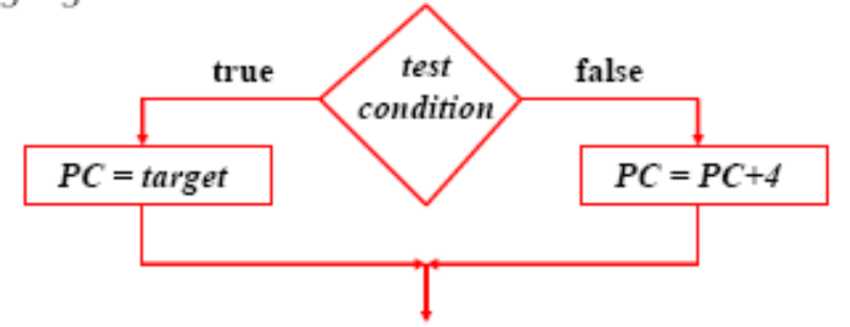
Review: MIPS control instructions
Branch instructions test a condition
  Equality or inequality of rs and rt
    beq, bne
    Often coupled with slt, sltu, slti, sltiu
  Value of rs relative to rt
    Pseudoinstructions: blt, bgt, ble, bge
Target address → add sign extended immediate to the PC
  Since all instructions are words, immediate is shifted left two bits before being sign extended
Computer Architecture Lecture 5

Slide 44
Review: Binary multiplication
Generate shifted partial products and add them
Hardware can be condensed to two registers in iterating multiplier
  N-bit multiplicand
  2N-bit running product / multiplier
  At each step
    Check LSB of multiplier
    Add multiplicand/0 to left half of product/multiplier
    Shift product/multiplier right
Other multipliers (i.e., tree multiplier) trade more hardware for faster multiplication
Computer Architecture Lecture 3

Slide 45
Review: IEEE Floating-Point Format
single: 8 bits
double: 11 bits
single: 23 bits
double: 52 bits
S
Exponent
Fraction
S: sign bit (0 ⇒ non-negative, 1 ⇒ negative)
Normalize significand: 1.0 ≤ |significand| < 2.0
  Significand is Fraction with the “1.” restored
Actual exponent = (encoded value) - bias
  Single: Bias = 127; Double: Bias = 1023
FP addition: match exponents, add, then normalize result
FP multiplication: add exponents, multiply significands, normalize results
Computer Architecture Lecture 5
Notes:
Morgan Kaufmann Publishers
Chapter 3 — Arithmetic for Computers

Slide 46
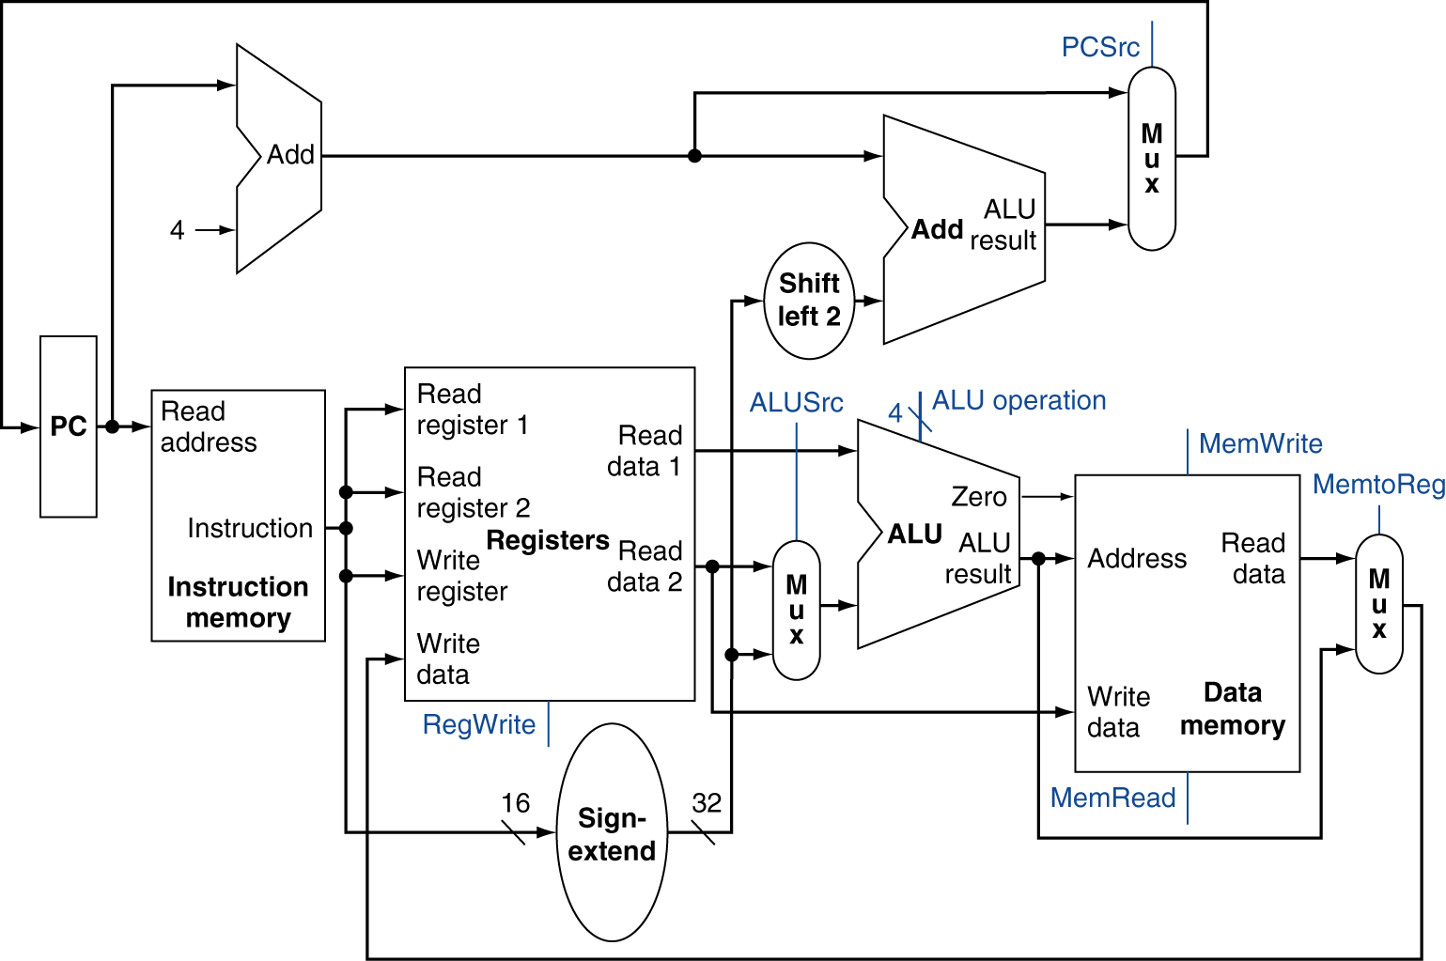
Review: Simple MIPS datapath
Chooses PC+4 or branch target
Chooses ALU output or memory output
Chooses register or sign-extended immediate
Computer Architecture Lecture 5

Slide 47
Review: Pipelining
Pipelining → low CPI and a short cycle
  Simultaneously execute multiple instructions
  Use multi-cycle “assembly line” approach
  Use staging registers between cycles to hold information
Hazards: situation that prevents instruction from executing during a particular cycle
  Structural hazards: hardware conflicts
  Data hazards: dependences cause instruction stalls; can resolve using:
    No-ops: compiler inserts stall cycles
    Forwarding: add hardware paths to ALU inputs
  Control hazards: must wait for branches
    Can move target, comparison into ID → only 1 cycle delay
Computer Architecture Lecture 5

Slide 48
Review: Pipeline diagram
 | Cycle 1 | 2 | 3 | 4 | 5 | 6 | 7 | 8
lw | IF | ID | EX | MEM | WB
add |  | IF | ID | EX | MEM | WB
beq |  |  | IF | ID | EX | MEM | WB
sw |  |  |  | IF | ID | EX | MEM | WB
Pipeline diagram shows execution of multiple instructions
  Instructions listed vertically
  Cycles shown horizontally
  Each instruction divided into stages
  Can see what instructions are in a particular stage at any cycle
Computer Architecture Lecture 5

Slide 49
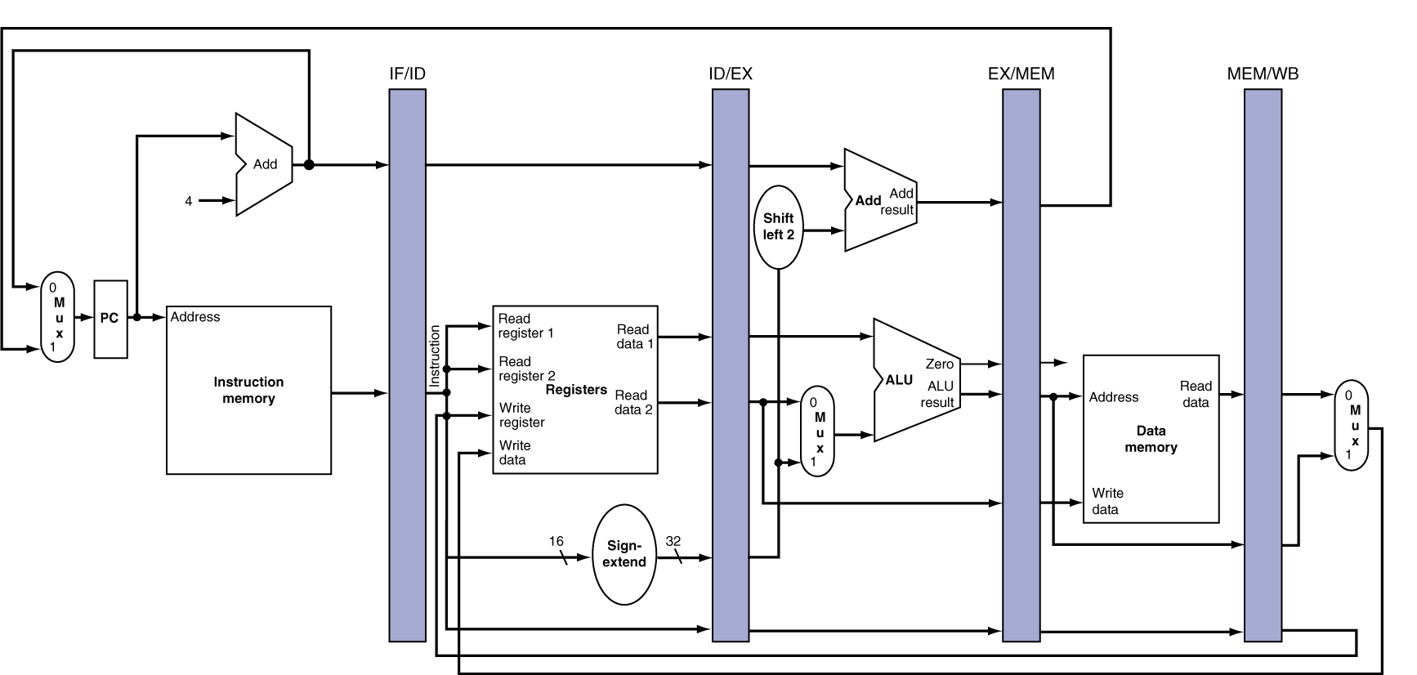
Review: Pipeline registers
Need registers between stages for info from previous cycles
Register must be able to hold all needed info for given stage
  For example, IF/ID must be 64 bits—32 bits for instruction, 32 bits for PC+4
May need to propagate info through multiple stages for later use
  For example, destination reg. number determined in ID, but not used until WB
Computer Architecture Lecture 5
Notes:
Morgan Kaufmann Publishers
Chapter 4 — The Processor

Slide 50
Review: Dynamic Branch Prediction
Want to avoid branch delays
Dynamic branch predictors: hardware to predict branch outcome (T/NT) in 1 cycle
  Use branch history to determine predictions
  Doesn’t calculate target
Branch history table: basic predictor
  Which line of table should we use?
    Use appropriate bits of PC to choose BHT entry
    # index bits = log₂(# BHT entries)
  What’s prediction?
  How does actual outcome affect next prediction?
Computer Architecture Lecture 5

Slide 51
Review: BHT
Solution: 2-bit scheme where change prediction only if get misprediction twice
Red: “stop” (branch not taken)
Green: “go” (branch taken)
T
NT
Predict Taken
11
10
Predict Taken
T
T
NT
NT
Predict Not
Taken
01
00
Predict Not
Taken
T
NT
Computer Architecture Lecture 5

Slide 52
Review: Correlated predictors, BTB
Correlated branch predictors
  Track both individual branches and overall program behavior (global history)
    Makes some branches easier to predict
  To make a prediction
    Branch address chooses row
    Global history chooses column
    Once entry chosen, make prediction in same way as basic BHT (11/10 → predict T, 00/01→predict NT)
Branch target buffers
  Save previously calculated branch targets
  Use branch address to do fully associative search
Computer Architecture Lecture 5

Slide 53
Review: Dynamic scheduling
Dynamic scheduling - hardware rearranges the instruction execution to reduce stalls while maintaining data flow and exception behavior
  Key idea: Allow instructions behind stall to proceed
  Allow out-of-order execution and out-of-order completion
  We use Tomasulo’s Algorithm
  Decode stage now handles:
    Issue—check for structural hazards and assign instruction to functional unit (via reservation station)
      Check for register values
  Reservation stations implicitly perform register renaming
    Resolves potential WAW, WAR hazards
  Results broadcast over common data bus
Computer Architecture Lecture 5

Slide 54
Final notes
Next time: Midterm exam
Announcements/reminders
  HW 4 due today
  Midterm exam: Thursday, 6/4
    Will be allowed two double-sided 8.5” x 11” note sheets, calculator
Computer Architecture Lecture 5

