Slide 1
EECE.3220 Data Structures
Instructor:
Dr. Michael Geiger
Spring 2019
Lecture 33:
Priority queues
Hash tables

Slide 2
Lecture outline
Announcements/reminders
Program 4 due today
Program 5 due 5/9 (extra credit)
Course evals to be posted online; return at final
Final exam: Wednesday, 5/8, 3-6 PM, Ball 208
Today’s lecture
Priority queues
Hash tables

Slide 3
Review: Trees
A data structure which consists of
a finite set of elements called nodes or vertices
a finite set of directed arcs which connect the nodes
If the tree is nonempty
one of the nodes (the root) has no incoming arc
every other node can be reached by following a unique sequence of consecutive arcs
Binary tree: tree in which each node has at most two children
Binary search tree: binary tree in which each node follows property
value in left child of node ≤ value in node ≤ value in right child of node

Slide 4
Review: Heaps
A heap is a binary tree with properties:
It is complete
Each level of tree completely filled (except possibly bottom)
It satisfies heap-order property
Data in each node >= data in children
Also called a maxheap
If data in node <= data in children, it’s a minheap
Can be efficiently stored in array
Store all nodes at given level from left to right in consecutive locations
If first element @ index 1, then, given index n
Children are at indexes 2*n and 2*n + 1
Parent is at index n/2

Slide 5
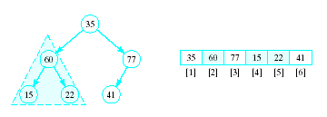
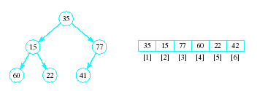
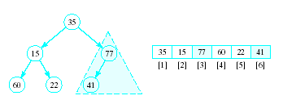
Review: Heapsort
Given a list of numbers in an array
Stored in a complete binary tree
Convert to a heap
Begin at last node not a leaf
Apply percolate down to this subtree
Continue

Slide 6
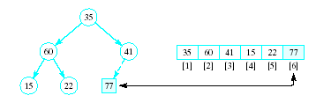
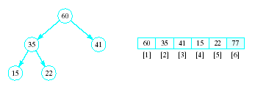
Review: Heapsort
Now swap element 1 (root of tree) with last element
This puts largest element in correct location
Use percolate down on remaining sublist
Converts from semi-heap to heap

Slide 7
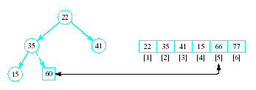
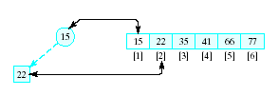
Review: Heapsort
Again swap root with rightmost leaf
Continue this process with shrinking sublist

Slide 8
Priority Queue
A collection of data elements
Items stored in order by priority
Higher priority items removed ahead of lower
Operations
Constructor
Insert
Find, remove smallest/largest (priority) element
Replace
Change priority
Delete an item
Join two priority queues into a larger one

Slide 9
Priority Queue
Implementation possibilities
As a list (array, vector, linked list)
As an ordered list
Best is to use a heap Basic operations have O(log₂n) time
Priority queue as heap: use priority for ordering
Highest priority item will always be first
All priority queue operations can be written in terms of heap operations

Slide 10
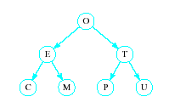
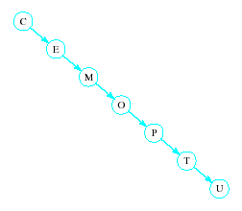
Hash Tables
Recall order of magnitude of searches
Linear search O(n)
Binary search O(log₂n)
Balanced binary tree search O(log₂n)
Unbalanced binary tree can degrade to O(n)

Slide 11
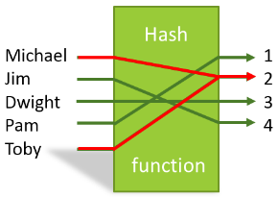
Hash Tables
In some situations faster search is needed
Solution is to use a hash function
Value of key field given to hash function
Location in a hash table is calculated

Slide 12
Hash Functions
Simple function could be to mod the value of the key by some arbitrary integer int h(int i) { return i % someInt; }
Note the max number of locations in the table will be same as someInt
Note that we have traded speed for wasted space
Table must be considerably larger than number of items anticipated

Slide 13
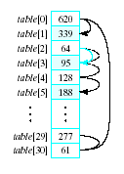
Hash Functions
Observe the problem with same value returned by h(i) for different values of i
Called collisions
A simple solution is linear probing
Linear search begins at collision location
Continues until empty slot found for insertion

Slide 14

Hash Functions
When retrieving a value linear probe until found
If empty slot encountered then value is not in table
If deletions permitted
Slot can be marked so it will not be empty and cause an invalid linear probe

Slide 15
Hash Functions
Strategies for improved performance
Increase table capacity (less collisions)
Use different collision resolution technique
Devise different hash function
Hash table capacity
Size of table must be 1.5 to 2 times the size of the number of items to be stored
Otherwise probability of collisions is too high

Slide 16
Collision Strategies
Linear probing can result in primary clustering
Consider quadratic probing
Probe sequence from location i is i + 1, i – 1, i + 4, i – 4, i + 9, i – 9, …
Secondary clusters can still form
Double hashing
Use a second hash function to determine probe sequence

Slide 17
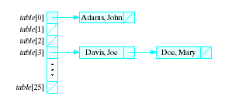
Collision Strategies
Chaining
Table is a list or vector of head nodes to linked lists
When item hashes to location, it is added to that linked list

Slide 18
Improving the Hash Function
Ideal hash function
Simple to evaluate
Scatters items uniformly throughout table
Modulo arithmetic not so good for strings
Possible to manipulate numeric (ASCII) value of first and last characters of a name

Slide 19
Final notes
Next time:
Exam 3 Preview
Reminders:
Program 4 due today
Program 5 due 5/9 (extra credit)
Course evals to be posted online; return at final
Final exam: Wednesday, 5/8, 3-6 PM, Ball 208

Slide 20
Acknowledgements
These slides are adapted from slides provided with the course textbook:
Larry Nyhoff, ADTs, Data Structures, and Problem Solving with C++, 2nd edition, 2005, Pearson/Prentice Hall. ISBN: 0-13-140909-3

