Slide 1
16.216
ECE Application Programming
Instructor: Dr. Michael Geiger
Summer 2015
Lecture 4:
Loops: for
PE2: Conditionals and loops
Exam 1 Preview

Slide 2
Lecture outline
Announcements/reminders
  Program 3 due Tuesday, 6/2
  Exam 1: Friday, 5/29
    Allowed one 8.5” x 11” sheet of notes
    Exam will only last one hour
Review
  Conditional statements
    if
    switch
  Loops
    while
    do-while
Today’s lecture
  For loops
  PE2: Conditionals and loops
  Exam 1 Preview
ECE Application Programming: Lecture 4

Slide 3
Review: if statements
Conditional execution using if statements:
  Form:
  if (<expression>)
  <statement>
  [ else brackets show
  <statement> ] else is optional
Expression frequently uses relational operators to test equality/inequality
  < > <= >= == !=
  e.g., if (x <= 5)
Can combine conditions using logical operators
  AND : && OR: ||
  e.g., if ((x <= 5) && (x > 0))
Can test if condition is false using logical NOT: !
  e.g., if (!(x < 5))
ECE Application Programming: Lecture 4

Slide 4
Real programming issue: iOS bug
Errant code in SSL authentication fixed Feb. 2014 (iOS 7.0.6)
  SSL = Secure Sockets Layer
  Used for encryption
Relevant code fails to correctly authenticate server key
  Keys must be digitally signed
  Authentication checks to ensure key is genuine
ECE Application Programming: Lecture 4

Slide 5
Errant code
Here’s the code (source: https://www.imperialviolet.org/2014/02/22/applebug.html)
static OSStatus
SSLVerifySignedServerKeyExchange(SSLContext *ctx, bool isRsa,
SSLBuffer signedParams,
uint8_t *signature, UInt16 signatureLen) {
OSStatus err;
...
if ((err = SSLHashSHA1.update(&hashCtx, &serverRandom)) != 0)
goto fail;
if ((err = SSLHashSHA1.update(&hashCtx, &signedParams)) != 0)
goto fail;
goto fail;
if ((err = SSLHashSHA1.final(&hashCtx, &hashOut)) != 0)
goto fail;
...
fail:
SSLFreeBuffer(&signedHashes);
SSLFreeBuffer(&hashCtx);
return err;
}
Should be in
conditional
statement!
ECE Application Programming: Lecture 4

Slide 6
Key points
Second goto isn’t conditionally executed
  Skips key part of authentication
  Code after second goto is “dead” (unreachable)
Be careful with conditional statements/loops and braces
  When in doubt, it never hurts to use { }
Don’t use goto statements
  Use of goto isn’t reason for bug ...
  ... but they’re considered to be bad practice
ECE Application Programming: Lecture 4

Slide 7
Review: switch statements
When checking multiple exact values for expression, more sense to use switch statement
  switch (<expr>) {
  case <val1> :
  ...
  break;
  case <val2> :
  ...
  break;
  ...
  default:
  ...
  }
break allows you to exit switch statement after completing code
  Otherwise, program will continue to run through cases until finding break
default covers any values without specific case
ECE Application Programming: Lecture 4

Slide 8
Review: while/do-while loops
Used for repetition of code
while (<expression>)
  <statement> ← loop body
do {
<statements>
} while ( <expression> );
ECE Application Programming: Lecture 4

Slide 9
Justifying for loops
Common loop structure
  Initialize variable
  Loop until that variable reaches certain limit
  At end of each iteration, change variable by fixed amount
Example: squares program
i = 0;
while (i <= 10) {
iSquared = i * i;
printf("%2d%10d\n", i, iSquared);
i = i + 1;
}
ECE Application Programming: Lecture 4

Slide 10
for loops
for loops include all three aspects in one construct
Form:
for (<init var>; <test>; <change var>)
<statements>
<init var> is basic assignment
<test> same type of condition as if, while
<change var> change variable by fixed amount
Example: for (i = 0; i < 20; i++)
  … You may be wondering what i++ means
ECE Application Programming: Lecture 4

Slide 11
Changing variables
Can do operation + assignment w/one operator
Simply adding/subtracting 1:
  x++ → x = x + 1 (post-increment)
  x-- → x = x – 1 (post-decrement)
  ++x → x = x + 1 (pre-increment)
  --x → x = x – 1 (pre-decrement)
Augmented assignment: change variable by amount other than 1
  x += y → x = x + y
  x -= y → x = x – y
  x *= y → x = x * y
  x /= y → x = x / y
ECE Application Programming: Lecture 4

Slide 12
Pre- vs. post-increment/decrement
Pre-increment/decrement: perform increment/ decrement, then evaluate expression
Post-increment/decrement: evaluate expression, then perform increment/decrement
Example: what does the following print?
int n = 5;
printf(“n = %d\n”, ++n);
printf(“Now, n = %d\n”, n++);
printf(“Finally, n = %d\n”, n);
ECE Application Programming: Lecture 4

Slide 13
Example soln.
int n = 5;
printf(“n = %d\n”, ++n);
printf(“Now, n = %d\n”, n++);
printf(“Finally, n = %d\n”, n);
Output:
n = 6 (n pre-incremented)
Now, n = 6 (n post-incremented)
Finally, n = 7 (Shows effect of n++)
ECE Application Programming: Lecture 4

Slide 14
Simple usage of for loop
Common sequence of code:
x=0;
while (x<12)
{
printf("%d ",x);
x++;
}
Output:
0 1 2 3 4 5 6 7 8 9 10 11
ECE Application Programming: Lecture 4
Notes:
ECE 160 - Intro to Computer Engineering I
03/07/2005
(c) 2005, P. H. Viall

Slide 15
Intro to for loops
Common sequence of code:
x=0;
while (x<12)
{
printf("%d ",x);
x++;
}
Equivalent for construct
for (x=0 ; x<12 ; x++ )
{
printf("%d ",x);
}
Initial value
Test condition
Body of loop (may be 0, 1, or several statements)
End of loop change
ECE Application Programming: Lecture 4

Slide 16
Repetition with for loop
Rewriting squares program with loop
int main() {
int i; // Number to square
int iSquared; // Square of the number
printf(" i i^2\n"); // Column headings
// Compute and display the squares of numbers 0 to 10
for (i = 0; i <= 10; i++) { // Loop until i > 10
iSquared = i * i;
printf("%2d%10d\n", i, iSquared);
}
return 0;
}
ECE Application Programming: Lecture 4

Slide 17
Repetition with for loop (cont.)
Generalizing program:
int main() {
int i; // Number to square
int iSquared; // Square of the number
int iStart; // Initial value
int iStop; // Last value
int iStep; // Increment
printf(“Enter start, stop, and increment: “);
scanf(“%d %d %d”, &iStart, &iStop, &iStep);
printf(" i i^2\n"); // Column headings
// Compute and display the squares of numbers iStart to iStop
// with increment iStep
for (i = iStart; i <= iStop; i += iStep) {
iSquared = i * i;
printf("%2d%10d\n", i, iSquared);
}
return 0;
}
ECE Application Programming: Lecture 4

Slide 18
Example: for loops
What does each of the following print?
for (i=5; i<40; i+=8)
{
printf("%d ", i);
}
for (i=10; i<=100; i=i+10)
{
if (i%20)
printf("%d ", i);
}
for (i=-5; i<-10; i--)
{
printf("%d ", i);
}
for (i=5; i<10; i+=i%2)
{
printf("%d ", i++);
}
ECE Application Programming: Lecture 4

Slide 19
Example solution
What does each of the following print?
for (i=5; i<40; i+=8)
{
printf("%d ", i);
}
OUTPUT: 5 13 21 29 37
for (i=10; i<=100; i=i+10)
{
if (i%20)
printf("%d ", i);
}
OUTPUT: 10 30 50 70 90
for (i=-5; i<-10; i--)
{
printf("%d ", i);
}
OUTPUT: No output
for (i=5; i<10; i+=i%2)
{
printf("%d ", i++);
}
OUTPUT: 5 6 8
ECE Application Programming: Lecture 4

Slide 20
Today’s program should:
Prompt user to enter an input character and an integer, n.
  If not correctly formatted, print error, clear line, and repeat
Depending on the character entered, do the following:
  ‘F’ or ‘f’: Compute and print the factorial of n, n!
    For example, if the user enters F 5, print 5! = 120
  ‘P’ or ‘p’: Compute 2^{n}, but only if n >= 0.
    For example, if the user enters p 2, print 2^2 = 4
    Print an error if n < 0.
  ‘X’ or ‘x’: Exit the program
  In all other cases, print an error:
    For example: Invalid command Z entered
If the user enters any command other than ‘X’ or ‘x’, return to the initial prompt and repeat the program.
ECE Application Programming: Lecture 4

Slide 21
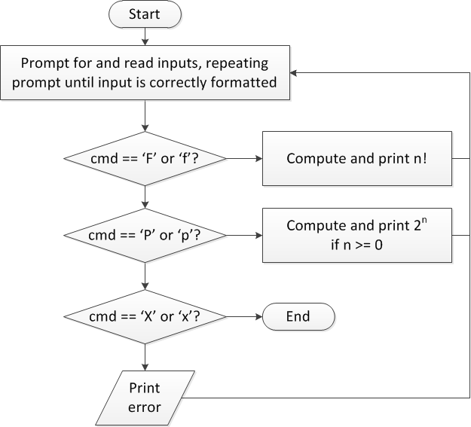
Flow charts: overall flow
ECE Application Programming: Lecture 4

Slide 22
Discussion: Overall flow
Whole program contains loop
  Repeats process until user enters ‘X’ or ‘x’
  Use while or do-while—unknown # of iterations
  Since exit condition ends program, infinite loop
Testing cmd: switch statement
  Checking equality of cmd to constant values
Exiting program: return statement
  Use return at any point to end current function (including main)
ECE Application Programming: Lecture 4

Slide 23
Code: overall flow (skeleton code)
while (1) { // Loop repeats until user enters 'X' or 'x'
/* Code to read cmd, n */
/* Evaluate cmd and perform appropriate operation */
switch (cmd) {
case 'F':
case 'f':
/* Calculate n! */
break;
case 'P':
case 'p':
/* Calculate 2^n, if n >= 0; print error otherwise */
break;
case 'X':
case 'x':
return; // Exit program
default:
printf("Invalid command %c entered\n", cmd);
}
}
ECE Application Programming: Lecture 4

Slide 24
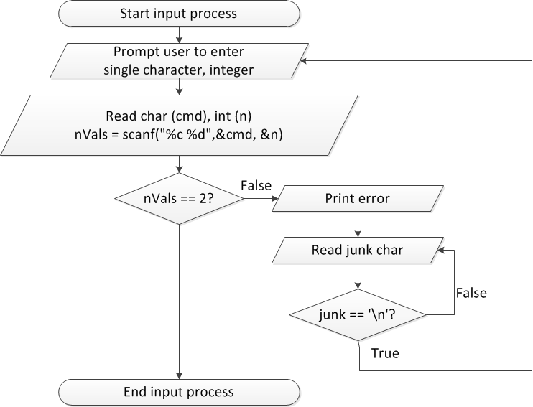
Flow charts: reading input
ECE Application Programming: Lecture 4

Slide 25
Discussion: Reading input
Loop that repeats as long as input incorrect
Loop inside that one to handle reading of remainder of line
  Read character until you reach end of line
Both while/do-while loops
ECE Application Programming: Lecture 4

Slide 26
Code: Reading input
do {
printf("Enter command and integer: ");
nVals = scanf("%c %d", &cmd, &n);
// Otherwise, print error & clear line
if (nVals != 2) {
printf("Incorrectly formatted input\n“);
do {
scanf("%c", &junk);
} while (junk != '\n');
}
} while (nVals != 2);
ECE Application Programming: Lecture 4

Slide 27
Next step
Write flowcharts for
  Computing n!
  Computing 2^{n} if n >= 0
Complete code
ECE Application Programming: Lecture 4

Slide 28
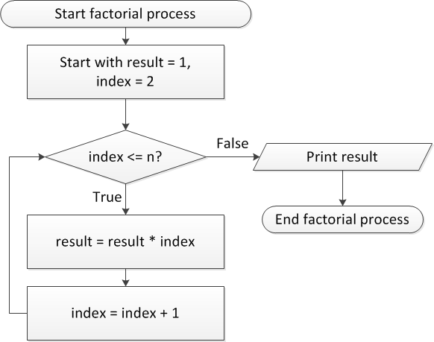
Flow charts: Calculating n!
ECE Application Programming: Lecture 4

Slide 29
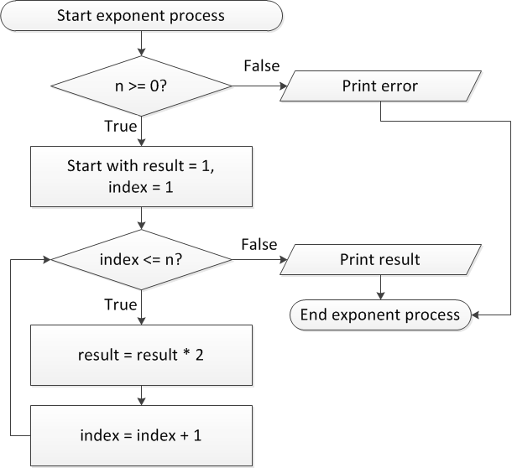
Flow charts: Calculating 2^{n}
ECE Application Programming: Lecture 4

Slide 30
Discussion: Factorial/2^{n}
Loop for each process covers fixed range of values
  Use for loop
Can declare single variable to hold both results, since only one will be calculated
ECE Application Programming: Lecture 4

Slide 31
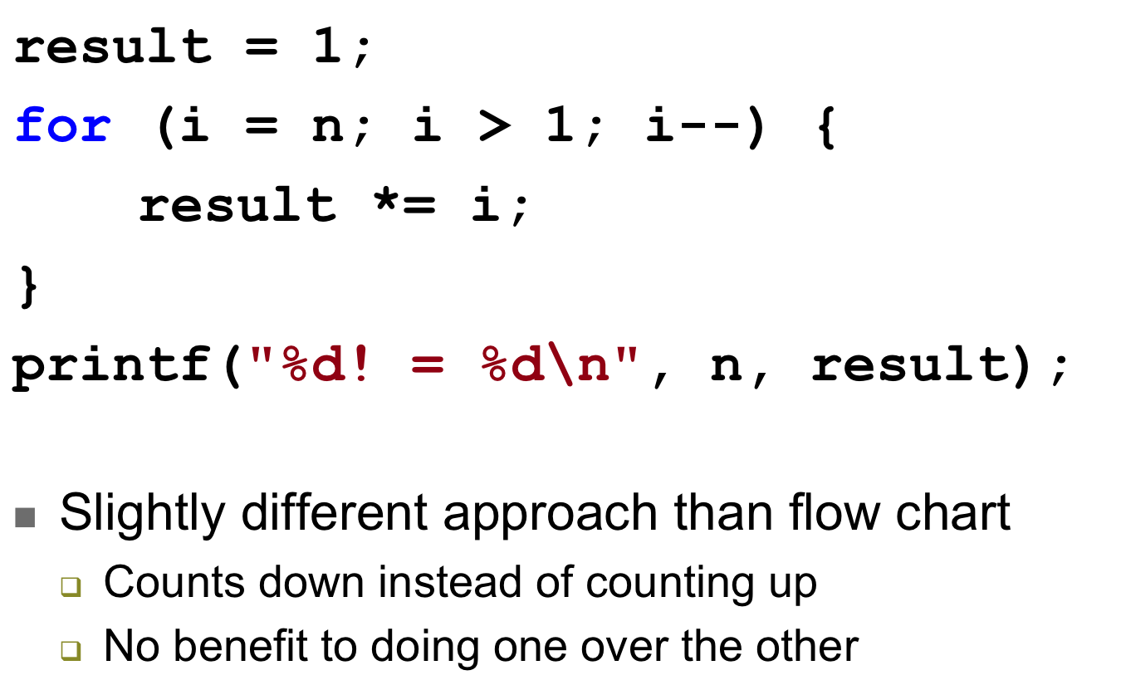
Code: factorial
ECE Application Programming: Lecture 4

Slide 32
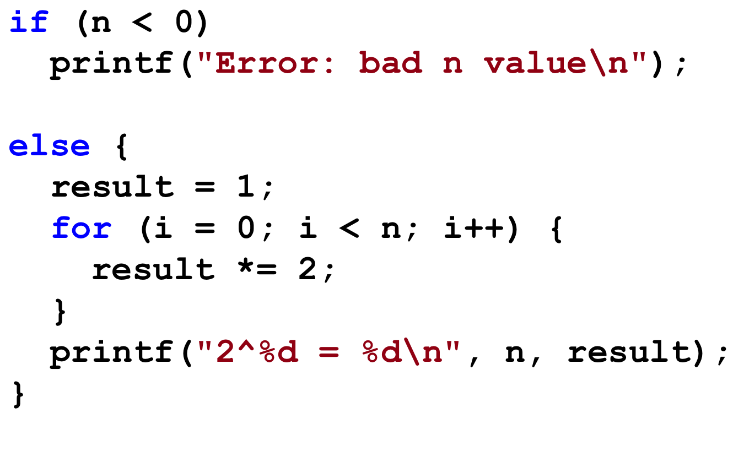
Code: 2^{n}
ECE Application Programming: Lecture 4

Slide 33
Exam 1 notes
Allowed one 8.5” x 11” double-sided sheet of notes
No other notes
No electronic devices (calculator, phone, etc.)
Exam will last 1 hour
  We’ll start at 9:00—please be on time!!
Covers all lectures through today
  You will not be tested on design process, IDEs
  Material starts with basic C program structure
3 questions
  1 multiple choice
  1 code reading
  1 code writing (complete 2 of 3 parts; all 3 for extra credit)
ECE Application Programming: Lecture 4

Slide 34
Test policies
Prior to passing out exam, I will verify that you only have one note sheet
  If you have multiple sheets, I will take all notes
You will not be allowed to remove anything from your bag after that point in time
  If you need an additional pencil, eraser, or piece of scrap paper during the exam, ask me
Only one person will be allowed to use the bathroom at a time
  You must leave your cell phone either with me or clearly visible on the table near your seat
ECE Application Programming: Lecture 4

Slide 35
Review: Basic C program structure
Preprocessor directives
  #include: typically used to specify library files
  #define: generally used to define macros
    We’ll use to define constants
Main program
  Starts with: int main() or void main()
  Enclosed in block: specified by { }
  Ends with return 0;
    Indicates successful completion
    Not used if main() is void
Basic output
  Call printf(<string>);
  <string> can be replaced by characters enclosed in double quotes
    May include escape sequence, e.g. \n (new line)
ECE Application Programming: Lecture 4

Slide 36
Review: Data types, variables, constants
Four basic data types
  int, float, double, char
Constants
  Discussed viable ranges for all types
  #define to give symbolic name to constant
Variables
  Have name, type, value, memory location
Variable declarations: examples
  int x;
  float a, b;
  double m = 2.35;
ECE Application Programming: Lecture 4

Slide 37
Review: printf() and scanf() basics
To print variables (or constants), insert %<type> in your printf() format string
  %c: single character
  %d or %i: signed decimal integer
  %f: float; %lf: double
    Prints 6 digits after decimal point by default
    To control # digits, use precision
      "%.4lf" prints with 4 digits (4th digit rounds)
      "%.0lf" prints with 0 digits (round to nearest integer)
Each %<type> must correspond to a variable or constant that follows
  printf("a=%.3f, b=%.2f", a, b);
To read input, use same format specifiers in scanf() format string, followed by addresses of variables
  scanf("%d %f",&hours,&rate);
ECE Application Programming: Exam 1 Preview

Slide 38
Review: C operators
Operator | Associativity
Innermost ( ) | Left to right
Unary - | Right to left
* / % | Left to right
+ - | Left to right
ECE Application Programming: Lecture 4

Slide 39
Review: Operators and statements
Operators can be used either with constants or variables
More complex statements are allowed
  e.g. x = 1 + 2 - 3;
Parentheses help you prioritize parts of statement
  Makes difference with order of operations
  x = 1 + 2 * 3
  is different than
  x = (1 + 2) * 3
ECE Application Programming: Lecture 4

Slide 40
Review: if statements
Conditional execution using if statements:
  Form:
  if (<expression>)
  <statement>
  [ else brackets show
  <statement> ] else is optional
Expression frequently uses relational operators to test equality/inequality
  < > <= >= == !=
  e.g., if (x <= 5)
Can combine conditions using logical operators
  AND : && OR: ||
  e.g., if ((x <= 5) && (x > 0))
Can test if condition is false using logical NOT: !
  e.g., if (!(x < 5))
ECE Application Programming: Lecture 4

Slide 41
Review: switch statements
When checking multiple exact values for expression, more sense to use switch statement
  switch (<expr>) {
  case <val1> :
  ...
  break;
  case <val2> :
  ...
  break;
  ...
  default:
  ...
  }
break allows you to exit switch statement after completing code
  Otherwise, program will continue to run through cases until finding break
default covers any values without specific case
ECE Application Programming: Lecture 4

Slide 42
Review: while/do-while loops
Used for repetition of code
while (<expression>)
  <statement> ← loop body
do {
<statements>
} while ( <expression> );
ECE Application Programming: Lecture 4

Slide 43
Review: for loops
for (<init var>; <test>; <change var>)
<statements>
Operators to directly change variable
  x++, x-- → post-increment/decrement
  ++x, --x → pre-increment/decrement
  +=, -=, *=, /= → augmented assignment
ECE Application Programming: Lecture 4

Slide 44
Final notes
Next time: Exam 1 (9-10 AM tomorrow)
Reminders:
  Program 3 due Tuesday, 6/2
  Exam 1: Friday, 5/30
    Allowed one 8.5” x 11” sheet of notes
ECE Application Programming: Lecture 4

