Slide 1
EECE.4810/EECE.5730 Operating Systems
Instructor:
Dr. Michael Geiger
Spring 2017
Lecture 12:
Paging (continued)

Slide 2
Lecture outline
Announcements/reminders
Midterm schedule: W 3/8 or Th 3/9 (see next slide)
HW 3 to be posted today, due 3:15 PM, 3/6
No late submissions accepted
Project 1 coming …
HW 2 graded; returned Monday
Some of you need to speak to me directly about your grade
Today’s lecture: more paging details
More paging details

Slide 3
Midterm schedule
Main time: W 3/8, 2-5 PM, Olney 517 (27 students)
You must take the exam at this time if you are available
Room changed since Monday’s original announcement
2nd time: Th 3/9, 9 AM-12 PM, Pasteur 411
(14 students)
This time is only for students who are unavailable Wednesday
3rd time: Th 3/9, 12-3 PM, Ball 301E (7 students)
This time is only for students who are unavailable for the first two times
If you are unavailable at all 3 times, contact me directly to schedule your exam (5? students)
No exams will be scheduled on Friday, 3/10

Slide 4
Review: Paged Translation (Abstract)

Slide 5
Review: Paged Translation (Implementation)

Slide 6
Page table organization
Page size strikes balance between
Internal fragmentation (large pages)
Unreasonably large page table (small pages)
Large VA space → large page table
Example: Say processor has 32-bit virtual address, 4 KB page size, and each page table entry holds 4 bytes. What’s size of page table?
4 KB page size → 12-bit offset
20 bits for page # → 2²⁰ pages → 2²⁰ PTEs
2²⁰ PTEs * 4 bytes per PTE = 2²² byte page table = 4 MB
Page table itself would take 2²²/2¹² = 2¹⁰ = 1K pages!!!
Alternative page table organizations
Multilevel page table
Hashed page table
Inverted page table

Slide 7
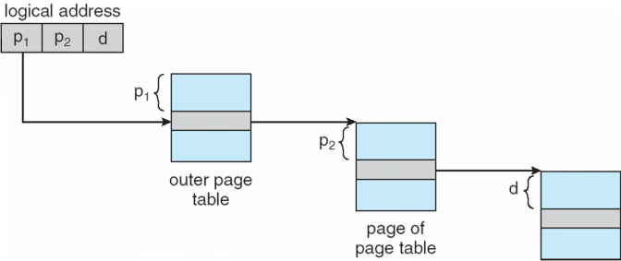
Multi-level page table
Space saving technique
Outer page table points to second-level page table
Second-level page table points to physical frame
Could extend to >2 levels

Slide 8
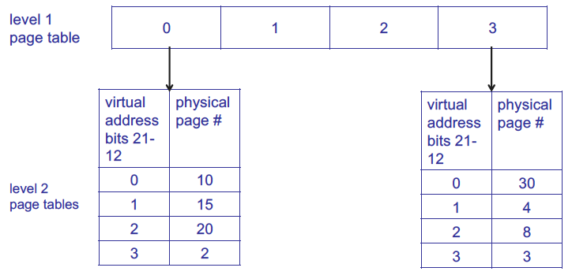
Multi-level page table example
Example assumes 4 KB page size, 1K PTEs at each level

Slide 9
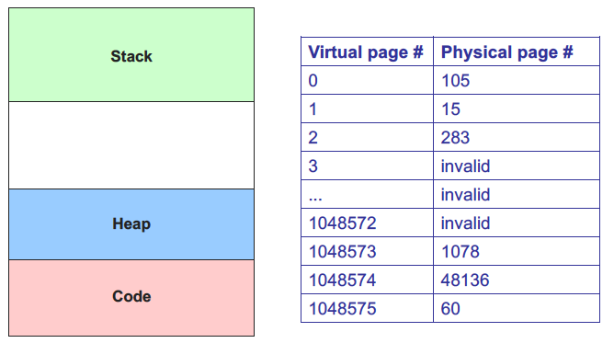
Sparse address spaces: basic page table

Slide 10
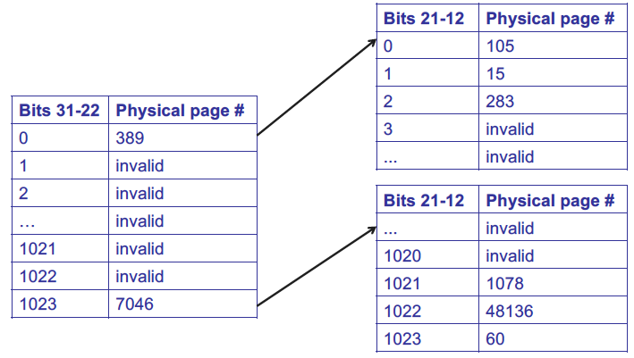
Sparse address spaces: 2-level page table

Slide 11
Multi-level page table
Benefits?
Saves space over 1-level page table
Particularly effective for sparse address spaces
Downsides?
May still have large tables at each level
Multiple lookups per translation

Slide 12
Hashed Page Tables
Common in address spaces > 32 bits
The virtual page number is hashed into a page table
This page table contains a chain of elements hashing to the same location
Each element contains (1) the virtual page number (2) the value of the mapped page frame (3) a pointer to the next element
Virtual page numbers are compared in this chain searching for a match
If a match is found, the corresponding physical frame is extracted

Slide 13
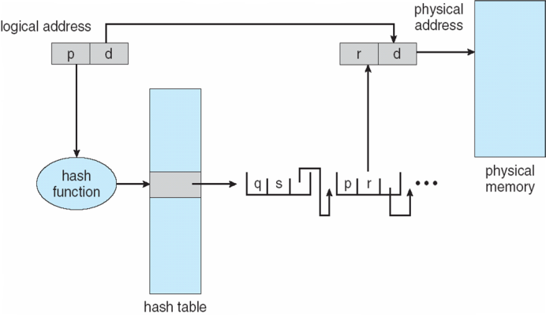
Hashed Page Table

Slide 14
Hashed page table
Benefits?
Even more space-effective than multilevel
Downsides?
Lookup time may be even longer

Slide 15
Inverted Page Table
Rather than each process having a page table and keeping track of all possible logical pages, track all physical pages
One entry for each real page of memory
Entry consists of the virtual address of the page stored in that real memory location, with information about the process that owns that page
Decreases memory needed to store each page table, but increases time needed to search the table when a page reference occurs
Use hash table to limit the search to one — or at most a few — page-table entries
TLB can accelerate access
But how to implement shared memory?
One mapping of a virtual address to the shared physical address

Slide 16
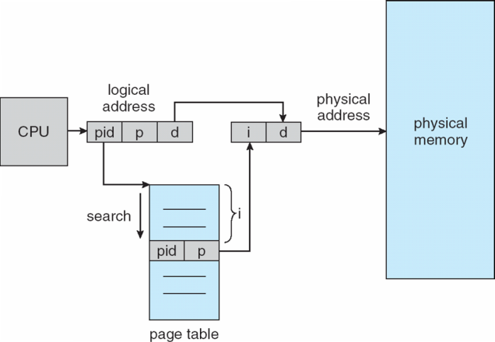
Inverted Page Table Architecture

Slide 17
Virtual memory performance
Address translation accesses memory to get PTE → every memory access twice as long
Solution: store recently used translations
Translation lookaside buffer (TLB): a cache for page table entries
“Tag” is the virtual page #
TLB small → often fully associative
TLB entry also contains valid bit (for that translation); reference & dirty bits (for the page itself!)

Slide 18
Details of Page Table
Page Table
Physical
Memory Space
Virtual Address
frame
12
frame
V page no.
offset
frame
frame
Page Table
Page Table
Base Reg
V
Access
Rights
PA
index
into
page
table
virtual address
table located
in physical
memory
P page no.
offset
12
Physical Address
Page table maps virtual page numbers to physical frames (“PTE” = Page Table Entry)
Virtual memory => treat memory ≈ cache for disk

Slide 19
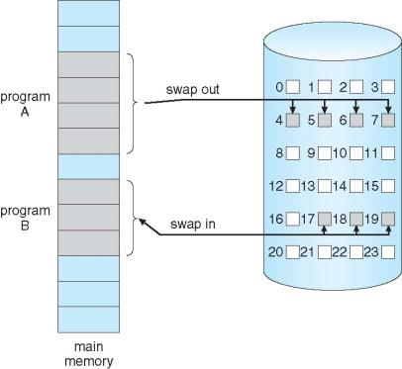
Demand Paging
Could bring entire process into memory at load time
Or bring a page into memory only when it is needed
Less I/O needed, no unnecessary I/O
Less memory needed
Faster response
More users
Similar to paging system with swapping (diagram on right)
Page is needed ⇒ reference to it
invalid reference ⇒ abort
not-in-memory ⇒ bring to memory
Lazy swapper – never swaps a page into memory unless page will be needed
Swapper that deals with pages is a pager

Slide 20
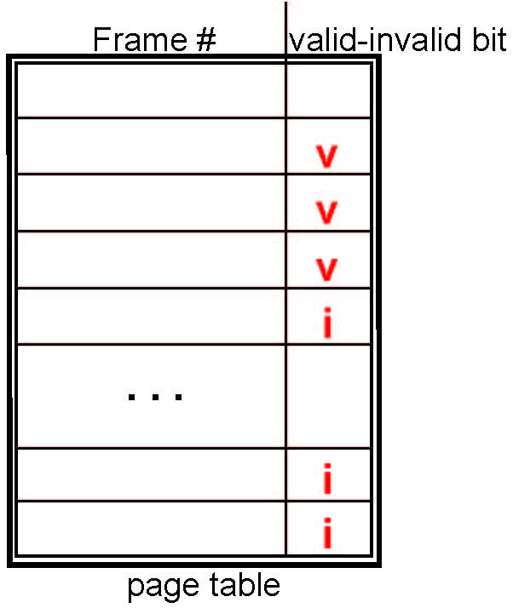
Valid-Invalid Bit
With each page table entry a valid–invalid bit is associated (v ⇒ in-memory – memory resident, i ⇒ not-in-memory)
Initially valid–invalid bit is set to i on all entries
During MMU address translation, if valid–invalid bit in page table entry is i ⇒ page fault

Slide 21
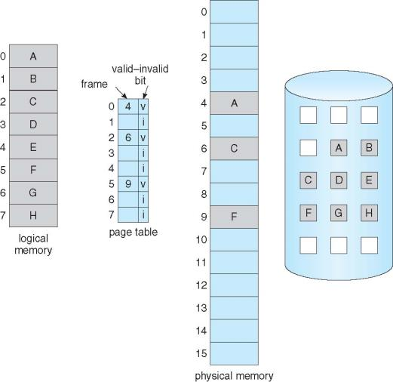
Page table with non-resident pages

Slide 22
Page Fault
If there is a reference to a page, first reference to that page will trap to operating system:
page fault
Operating system looks at another table to decide:
Invalid reference ⇒ abort
Just not in memory
Find free frame
Swap page into frame via scheduled disk operation
Reset tables to indicate page now in memory Set validation bit = v
Restart the instruction that caused the page fault

Slide 23
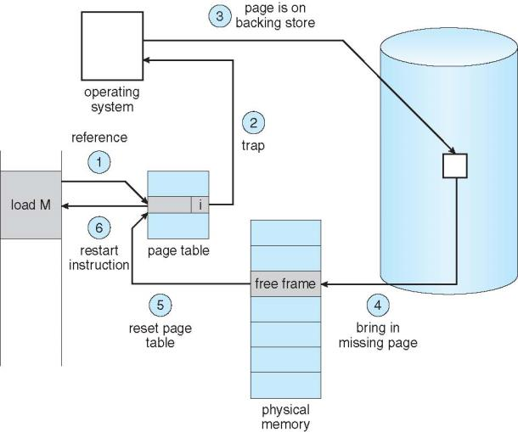
Steps in Handling a Page Fault

Slide 24
Page replacement
How do we determine page to evict if physical address space is full?
Goal: minimize page faults
Possible algorithms
Random
FIFO
Replace page brought into memory longest time ago
Page may still be frequently used
Optimal
Replace page that won’t be used for longest time in future
Minimizes misses, but requires future knowledge
Can we approximate optimal replacement?

Slide 25
Page replacement
LRU: least recently used replacement
Past reference pattern predicts future
Page accessed longest ago likely to be accessed furthest in future
Why?
Programs display temporal locality
What info necessary to implement LRU?
Past access history—difficult to track
Approximated using reference bits
Ref bit = 1 if page accessed within recent interval
Cleared periodically

Slide 26
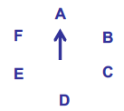
Page replacement (continued)
Clock algorithm
Resident pages around “clock”
When eviction necessary, consider page referenced by clock “hand”
If ref bit = 0, not recently referenced—evict
If ref bit = 1, clear ref bit and move to next page

Slide 27
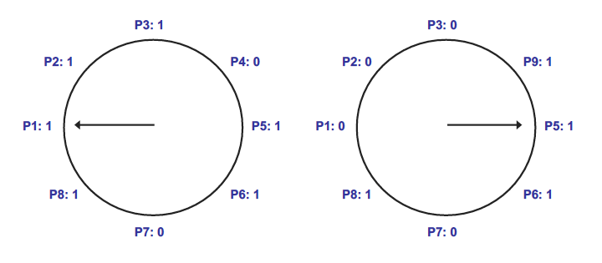
Clock algorithm example
In example above, 8 resident pages
Consider pages starting with P1
P4 is first non-referenced page—evicted for P9
Reference bit clear for P1-P3

Slide 28
Clock algorithm implementation

Slide 29
Dirty bits
What happens on eviction?
Simplest case: evicted page written back to disk
When is write to disk actually necessary?
Only if page has been modified
Dirty bit tracks changed pages
Dirty bit = 1 → page modified
How can dirty bit be used to modify eviction policy?
More performance-effective to evict non-dirty pages—no need to take time to write to disk

Slide 30
Virtual memory example
Assume the current process uses the page table below:
Which virtual pages are present in physical memory?
Which resident pages are candidates for eviction?
Assuming 1 KB pages and 16-bit addresses, what physical addresses would the virtual addresses below map to?
0x041C
0x08AD
0x157B
Virtual page # | Valid bit | Reference bit | Dirty bit | Frame #
0 | 1 | 1 | 0 | 4
1 | 1 | 1 | 1 | 7
2 | 0 | 0 | 0 | --
3 | 1 | 0 | 0 | 2
4 | 0 | 0 | 0 | --
5 | 1 | 0 | 1 | 0

Slide 31
Virtual memory example soln.
Which virtual pages are present in physical memory?
All those with valid PTEs: 0, 1, 3, 5
Which resident pages are candidates for eviction?
All those with valid PTEs and ref bit = 0: 3, 5
Assuming 1 KB pages and 16-bit addresses (both VA & PA), what PA, if any, would the VA below map to?
1 KB pages → 10-bit page offset (unchanged in PA)
Remaining bits: virtual page # → upper 6 bits
Virtual page # chooses PTE; frame # used in PA
0x041C = 0000 0100 0001 1100₂
Upper 6 bits = 0000 01 = 1
PTE 1 → frame # 7 = 000111
PA = 0001 1100 0001 1100₂ = 0x1C1C
0x08AD = 0000 1000 1010 1101₂
Upper 6 bits = 0000 10 = 2
PTE 2 is not valid → page fault
0x157B = 0001 0101 0111 1011₂
Upper 6 bits = 0001 01 = 5
PTE 5 → frame # 0 = 000000
PA = 0000 0001 0111 1011₂ = 0x017B

Slide 32
Final notes
Next time: Midterm exam preview
Reminders:
Midterm schedule: W 3/8 or Th 3/9 (see 2nd slide)
HW 3 to be posted today, due 3:15 PM, 3/6
No late submissions accepted
Project 1 coming …
HW 2 graded; to be returned today
Some of you need to speak to me directly about your grade

Slide 33
Acknowledgements
These slides are adapted from the following sources:
Silberschatz, Galvin, & Gagne, Operating Systems Concepts, 9th edition
Anderson & Dahlin, Operating Systems: Principles and Practice, 2nd edition
Chen & Madhyastha, EECS 482 lecture notes, University of Michigan, Fall 2016

