Slide 1
EECE.4810/EECE.5730 Operating Systems
Instructor:
Dr. Michael Geiger
Spring 2017
Lecture 13:
Midterm Exam Preview

Slide 2
Lecture outline
Announcements/reminders
Midterm attendance poll (almost) complete
I’ve directly e-mailed missing students
HW 3 due 3:15 PM today
No late submissions accepted
Project 1 coming …
Today’s lecture: midterm exam preview
Schedule
Exam guidelines
Review of relevant material

Slide 3
Midterm schedule
Main time: W 3/8, 2-5 PM, Olney 517
You must take the exam at this time if you are available
2nd time: Th 3/9, 9 AM-12 PM, Pasteur 411
This time is only for students who are unavailable Wednesday
3rd time: Th 3/9, 12-3 PM, Pasteur 413
This time is only for students who are unavailable for the first two times
If you are unavailable at all 3 times, contact me directly to schedule your exam
No exams will be scheduled on Friday, 3/10

Slide 4
Midterm exam notes
Allowed two 8.5” x 11” double-sided sheets of notes
No other notes; no electronic devices (calculator, phone)
Exam will last 3 hours—please be on time
Covers lectures 2-12
6 questions, each with multiple parts
Process management (creation, deletion, etc.)
Inter-process communication
General multithreading
Synchronization
Scheduling
Memory management
Formats include short answer (i.e., explain concept) or problem-solving (i.e. 1 correct numeric answer)
EECE.5730 students will have additional work on some problems

Slide 5
Test policies
Prior to passing out exam, your instructor will verify that you only have two note sheets
If you have >2 sheets, I will take all notes
You will not be allowed to remove anything from your bag after you receive your exam
If you need an additional pencil, eraser, or piece of scrap paper during the exam, ask me
Only one person will be allowed to use the bathroom at a time
You must leave your cell phone either with me or clearly visible on the table near your seat

Slide 6
Review: Processes
Process: program in execution
1+ running pieces of code (threads) + everything code can read/write
Program counter
Registers
Address space
Address space: all code/data stored in memory
Text section: code
Data section: global variables
Stack: temporary data related to functions
Heap: dynamically allocated data

Slide 7
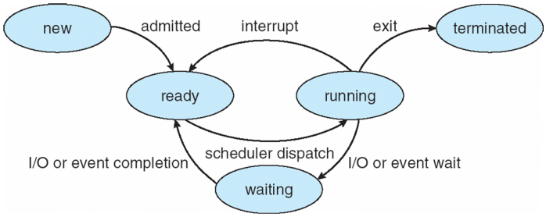
Review: Process State
new: Process is being created
running: Instructions are being executed
waiting: Process waiting for some event to occur
ready: Process waiting to be assigned to a processor
terminated: Process has finished execution

Slide 8
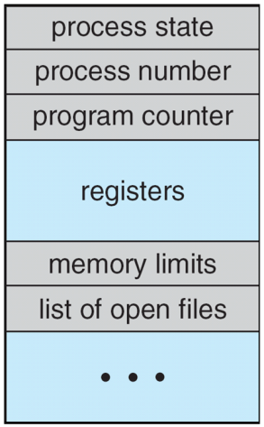
Review: Process Control Block (PCB)
Stored in memory
Used by OS to track process
Some info updated with every change
Process state
Scheduling queue pointers
Accounting info
Memory management
I/O status,
File list
Some info updated on context switch
Running → waiting/ready state
Save copies of PC, regs to PCB
Restored when running again

Slide 9
Review: Process creation
Each process has to be created by another process
Creator is called parent process
Created process is child process
Children can create other processes, forming process tree
Parent/child processes may share resources
Parent/child processes may execute concurrently, or parent may wait for child to terminate

Slide 10
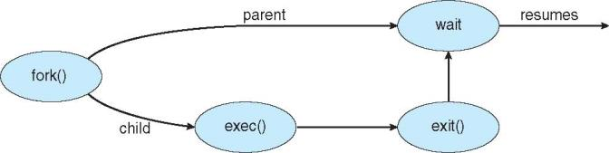
Review: Process creation (cont.)
Address space
Initially, child duplicate of parent
Child can load a separate program
UNIX examples
fork() system call creates new process
exec() system call used after a fork() to replace the process’ memory space with a new program

Slide 11
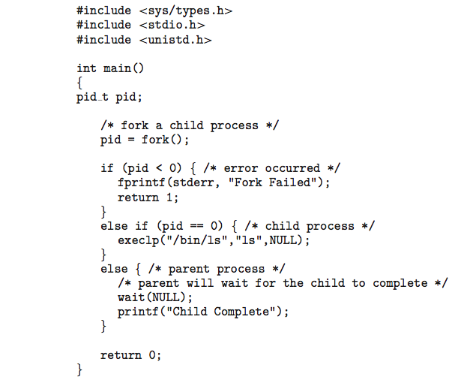
Review: Forking Separate Process
fork() return value
<0 if error
0 if child process
Remember, child initially copy of parent
>0 if parent
Actually returns PID of child
Child starts new executable using exec() or variation
execlp(): first argument is file to run
Others are arguments to that executable
Last execlp() arg must be NULL

Slide 12
Review: Forking Separate Process
Parent uses wait() system call to wait for child to finish
If expecting child to return status of completion, argument to wait() is address of int
i.e. wait(&status);
Process ends using exit() system call
May be explicit, implicit (return from main → exit())
Returns status data from child to parent (via wait())

Slide 13
Review: Process Termination
Parent may wait() for child termination
wait() returns child PID, passes return status through pointer argument
pid = wait(&status);
If child terminates before parent invokes wait(), process is a zombie
If parent terminated without wait() , process is an orphan
Return status must be checked
In Linux, orphans assigned init as parent

Slide 14
Review: Interprocess Communication
May want processes to cooperate for
Information sharing (i.e., shared files)
Computation speedup (if procs can run in parallel)
Modularity (divide up program/system)
Convenience
Cooperating processes need 1 of 2 forms of interprocess communication (IPC)
Shared memory
Message passing

Slide 15
Review: IPC Models
(a) Message passing (b) Shared memory

Slide 16
Review: Interprocess Communication
Shared memory
Communication largely process-managed after OS used to set up shared region
Message passing
OS responsible for send/receive primitives
Direct communication: processes send messages directly to one another
Indirect communication: processes send to/receive from mailboxes

Slide 17
Review: Threads
Thread: active sequence of instructions
Basic unit of CPU utilization
Thread creation is lightweight
Multiple threads in same process can share address space
Each thread needs own PC, register copies, stack + SP
Threads provide concurrency within application
HW support necessary for parallelism
Major issue: non-deterministic ordering
Solutions require atomic operations
Avoid race condition: solution depends on timing/ordering of earlier events

Slide 18
Review: Critical section
Code section that needs to be run atomically with respect to selected other pieces of code
If A and B are critical sections with respect to each other, multiple threads can’t interleave events from A and B
A and B mutually exclude each other
A and B often same piece of code
Critical sections must be atomic with respect to each other because they access shared resource

Slide 19
Review: Locks
A lock (or mutex) prevents another thread from entering a critical section
“Lock fridge while checking milk & shopping”
Two operations:
lock(): wait until lock is free, then acquire it
do {
if (lock is free) { // code in red
acquire lock // is atomic
break out of loop
}
} while (1);
unlock(): release lock
To minimize waiting, implement shared queue
Can lock entire queue or use fine-grained locking

Slide 20
Review: Condition variables
Avoid busy waiting by enabling thread to sleep inside critical section by (steps in red are atomic):
Release lock
Put thread on waiting list
Go to sleep
After being woken, call lock()
Each condition variable tracks list of threads waiting on that specific condition
Each condition variable associated with lock

Slide 21
Review: Condition variable operations
wait()
Atomically release lock, add thread to waiting list, then go to sleep
Thread must hold lock when calling wait()
signal()
Wake up one thread waiting on condition variable
If no thread waiting, does nothing
broadcast()
Wake up all threads waiting on condition variable
If no thread waiting, does nothing

Slide 22
Review: Semaphores
Generalized lock/unlock
Definition
Integer initialized to user-specific value
Supports two atomic operations
down(): wait for semaphore value to become positive, then atomically decrement by 1
Text calls this wait(); originally P()
To avoid busy waiting, semaphore can maintain list of waiters
Process calls block() once added to list
up(): increment semaphore value
Text calls this signal(); originally V()
If maintaining list, remove process from list and wake up
wakeup() call signals blocked process

Slide 23
Review: Using semaphores
Semaphore types
Counting semaphore: Range of values unrestricted
Binary semaphore: values == 0 or 1 (same as lock)
Can implement both mutual exclusion and ordering
Mutual exclusion
Initialize semaphore to 1
down();
critical section
up();
Ordering
Typically initialize to 0
Say thread A must wait for thread B
Thread A Thread B
down(); complete task
continue work up();

Slide 24
Review: Deadlock
Cyclical wait for resources, which prevents involved threads from making progress
Necessary conditions
Limited resource: not enough to serve all threads simultaneously
Hold and wait: threads hold resources while waiting to acquire other resources
No preemption: thread system can’t force one thread to give up resources
Cyclical chain of requests

Slide 25
Review: Deadlock prevention
Eliminate one of four necessary conditions
Increase resources to decrease waiting
Eliminate hold and wait: move resource acquisition to beginning
If can’t (atomically) get all resources, release everything
Phase 1a: acquire all resources
Phase 1b: while (!done) {work}
Phase 2: release all resources

Slide 26
Review: Banker’s Algorithm
Similar to reserving all resources at beginning, but with more concurrency
State maximum resource needs in advance (without acquiring)
May block when thread attempts to acquire resource
General structure
Phase 1a: state maximum resource need
Phase 1b: while (!done) {
acquire some resource (block
if not safe)
work
}
Phase 2: release all resources

Slide 27
Review: Scheduling
Scheduling CPU burst times according to one or more metrics
Classifying schedulers by decision timing
When is next process chosen to run?
Nonpreemptive scheduler
Only make decision when process switches from running → waiting state (interrupt, I/O request, etc.)
Processes are not forced to give up CPU
Preemptive scheduler
Make decision when new process arrives in ready queue (waiting → ready) or predefined time quantum expires (running → ready)
Processes can be forced to give up CPU

Slide 28
Review: Scheduling Criteria
Several possible, often conflicting goals
Want to maximize
CPU utilization: keep CPU as busy as possible
Throughput: rate at which processes complete per time unit
Fairness: ensure CPU shared (relatively) equally
Want to minimize
Turnaround time: amount of time to execute a particular process, from arrival to completion (includes waiting time)
Sometimes called latency or response time …
… although our text defines response time as time to first “response” (output) from program, not completion
Waiting time: amount of time a process has been waiting in the ready queue
Starvation: Thread/process does not get access to resources
Want to avoid, not just minimize!

Slide 29
Review: Scheduling algorithms
First-come, first-served (FCFS) or FIFO
Schedule tasks in order they arrive in ready queue
Shortest job first (SJF)
Always schedule job with shortest remaining burst
Shortest remaining time first (SRTF) or STCF
Preemptive version of SJF
Priority scheduling
Priority associated with process; highest priority 1st
Round robin
Each process gets CPU for fixed period of time
Earliest deadline first
Real-time scheduling algorithm

Slide 30
Review: Address spaces
Multiprogrammed system—keep multiple processes resident in main memory
OS should provide
Address independence: same numeric address used in multiple processes, kept logically distinct
Protection: one process can’t access another’s address space unless explicitly given access
Virtual memory: address space larger than physical memory
OS typically binds relocatable virtual addresses to physical address at execution time
Requires dynamic address translation on every reference

Slide 31
Review: Forms of address translation
Base and bounds
Contiguous region allocated for entire address space
Segmentation
Address space split into variable-sized segments
Paging
Address space split into fixed-size pages
Tradeoffs between
Flexibility (sharing, growth, VM)
Size of data needed to support translation
Speed of translation

Slide 32
Review: Base and bounds
Each process allocated contiguous block for entire address space
Address space defined by two values
Base (or relocation register): lowest PA used
Bound (or limit): total size of address space
Only OS can change values
HW support: only two registers
Process sees virtual address space
0 ≤ address < bound
Simple translation: PA = VA + base

Slide 33
Review: Segmentation
Segment: contiguous region of memory
Base & bounds = 1 segment
Generalized segmentation allows >1 segment per program
Each process has a segment table
Entry in table = segment
Maps segment # to base/bounds for that segment
Segment can be anywhere in physical memory
Each segment has: start, length, access permission
Processes can share segments
Same start, length, same/different access permissions

Slide 34
Review: Segmentation
Notes:
This should seem a bit strange: the virtual address space has gaps in it! Each segment gets mapped to contiguous locations in physical memory, but may be gaps between segments.
This is a little like walking around in the dark, and there are huge pits in the ground where you die if you step in the pit.
But! of course, a correct program will never step off into a pit, so ok.
A correct program will never address gaps; if it does, trap to kernel and then core dump. Minor exception: stack, heap can grow. In UNIX, sbrk() increases size of heap segment. For stack, just take fault, system automatically increases size of stack.
Detail: Protection mode in segmentation table entries. For example, code segment would be read-only (only execution and loads are allowed). Data and stack segment would be read-write (stores allowed).
What must be saved/restored on context switch? Typically, segment table stored in CPU, not in memory, because it’s small.
Contents must be saved/restored.

Slide 35
Review: Segment table
Segment # | V | Base | Bounds | Access
0 | 1 | 4000 | 700 | read/exec | code segment
1 | 1 | 0 | 500 | read/write | data segment
2 | 0 | n/a | n/a |  | unused segment
3 | 1 | 2000 | 1000 | read/write | stack segment
Protection handled by segment table contents
Valid bit (V) indicates if segment in use
Access indicates privileges (read/write/execute)
Virtual address: segment #, offset
Segment number must be valid
Offset must be < bound
If either false, trap to OS → invalid address

Slide 36
Review: Paged Translation
Manage memory in fixed size units
Virtual memory blocks: pages
Physical memory blocks: frames
Bitmap tracks free frames
Each process has its own page table
Tracks translation, permissions, etc.
Translation
Virtual address: page # & offset
Page # indexes into page table → get frame #
Physical address: frame # & offset
Notes:
Simpler, because allows use of a bitmap. What's a bitmap?
001111100000001100
Each bit represents one page of physical memory -- 1 means allocated, 0 means unallocated. Lots simpler than base&bounds or segmentation

Slide 37
Review: Paged Translation (Abstract)

Slide 38
Review: Paged Translation (Implementation)

Slide 39
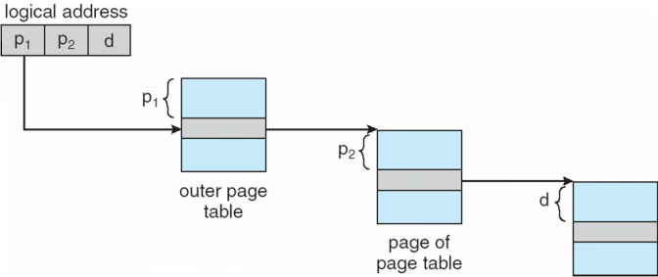
Review: Multi-level page table
Space saving technique
Outer page table points to second-level page table
Second-level page table points to physical frame
Could extend to >2 levels

Slide 40
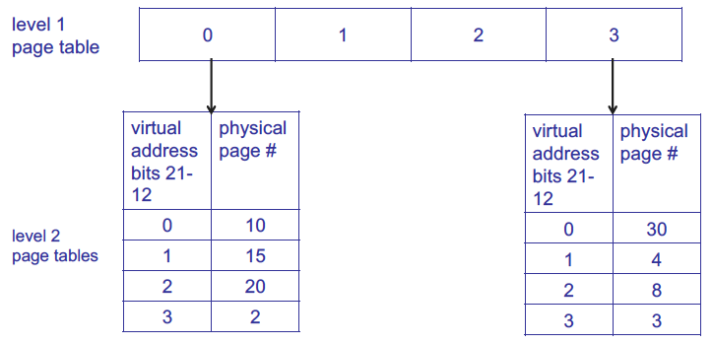
Review: Multi-level page table
1st level page table points to 2nd level page tables
Example assumes 4 KB page size, 1K PTEs at each level

Slide 41
Review: Hashed Page Tables
Common in address spaces > 32 bits
The virtual page number is hashed into a page table
This page table contains a chain of elements hashing to the same location
Each element contains (1) the virtual page number (2) the value of the mapped page frame (3) a pointer to the next element
Virtual page numbers are compared in this chain searching for a match
If a match is found, the corresponding physical frame is extracted

Slide 42
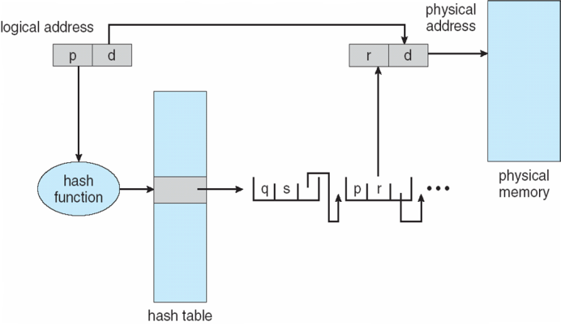
Review: Hashed Page Table

Slide 43
Review: Inverted Page Table
Rather than each process having a page table and keeping track of all possible logical pages, track all physical pages
One entry for each real page of memory
Entry consists of the virtual address of the page stored in that real memory location, with information about the process that owns that page
Decreases memory needed to store each page table, but increases time needed to search the table when a page reference occurs
Use hash table to limit the search to one — or at most a few — page-table entries
TLB can accelerate access
But how to implement shared memory?
One mapping of a virtual address to the shared physical address

Slide 44
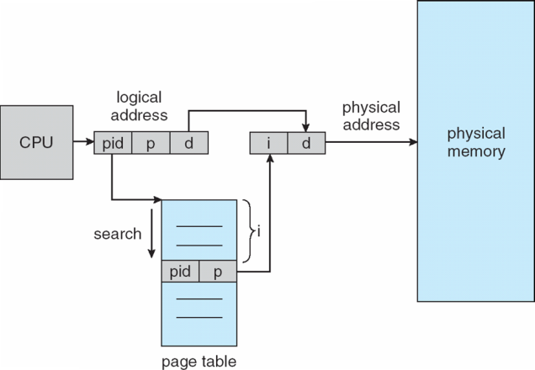
Review: Inverted Page Table Architecture

Slide 45
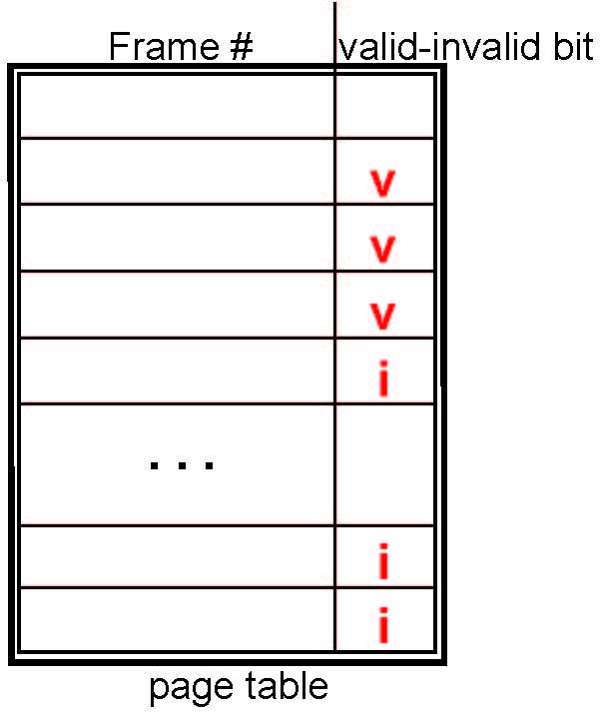
Review: Valid-Invalid Bit
With each page table entry a valid–invalid bit is associated (v ⇒ in-memory – memory resident, i ⇒ not-in-memory)
Initially valid–invalid bit is set to i on all entries
During MMU address translation, if valid–invalid bit in page table entry is i ⇒ page fault

Slide 46
Review: Page replacement
How do we determine page to evict if physical address space is full?
Goal: minimize page faults
Closest optimal approximation: least recently-used (LRU)
Use reference bits to approximate LRU
Clock algorithm commonly used to manage clearing of reference bits

Slide 47
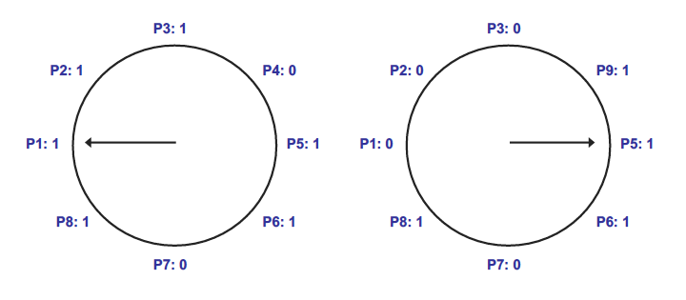
Review: Clock algorithm
In example above, 8 resident pages
Consider pages starting with P1
P4 is first non-referenced page—evicted for P9
Reference bit clear for P1-P3

Slide 48
Review: Dirty bits
What happens on eviction?
Simplest case: evicted page written back to disk
When is write to disk actually necessary?
Only if page has been modified
Dirty bit tracks changed pages
Dirty bit = 1 → page modified
How can dirty bit be used to modify eviction policy?
More performance-effective to evict non-dirty pages—no need to take time to write to disk

Slide 49
Final notes
Next time: Midterm exam
Please be on time for whatever exam time you’re attending
Wed 2-5 in Olney 517 (1st choice)
Th 9-12 in Pasteur 411 (2nd choice)
Th 12-3 in Pasteur 413 (3rd choice)
Reminders:
HW 3 due 3:15 PM today
No late submissions accepted
Project 1 coming …

