Slide 1
EECE.4810/EECE.5730 Operating Systems
Instructor:
Dr. Michael Geiger
Spring 2017
Lecture 14:
File systems and mass storage

Slide 2
Lecture outline
Announcements/reminders
Project 1 coming …
… and there probably won’t be a Project 2 …
… since, at this point, you don’t have Project 1 ...
Today’s lecture
File system intro
Mass storage structures
File system details

Slide 3
I/O and file systems
OS-provided abstractions for storage
Heterogeneous devices treated as uniform
Few storage media (disks) used for many storage objects (files)
Simple naming mapped to rich naming
HW: numeric; SW: symbolic
HW: flat space; SW: structured
Provides flexible block assignment
(Appearance of) Fast access
Consistency even with crashes
Provided via device drivers
Processes used to interface with hardware
For applications, interface looks same
HW-specific details hidden inside drivers

Slide 4
Storage Devices
Magnetic disks
Storage that rarely becomes corrupted
Large capacity at low cost
Block level random access (but slow)
Better performance for streaming access
Solid state disks
Non-volatile memory used like hard drive
More reliable, faster than magnetic disks
More expensive, shorter life span than magnetic disks
Much faster—sometimes too fast for busses!
Flash memory
Storage that rarely becomes corrupted
Capacity at intermediate cost (50x disk)
Block level random access
Good performance for reads; worse for random writes

Slide 5
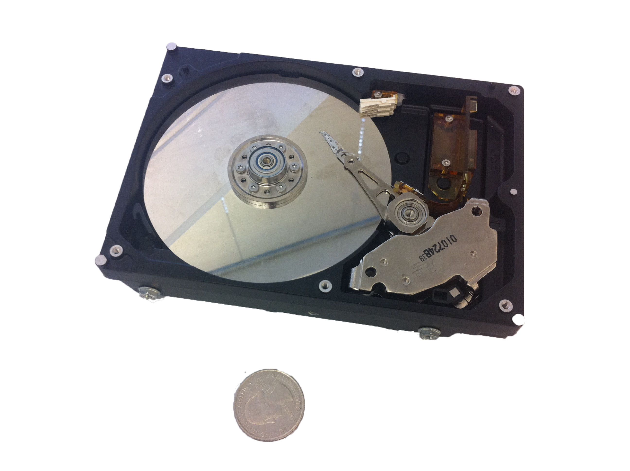
Magnetic Disk
Notes:
Mentioned that disk and flash device has a CPU in it – it needs it for the complex reasoning it needs to make; e.g., disk head scheduling is now done by the disk device itself, as is remapping. Disks in very olden times very smart – because the CPU was insanely expensive. When CPU’s were moderately expensive, then I/O devices became dumb – so that you could build a cheaper overall system, the file system had to do more work. Now, the CPU is very cheap, so can include more intelligence on the device.

Slide 6
Notes:
Head and track are not to scale – head is actually much much bigger than a track.
Track ~ 1 micron wide
Wavelength of light is ~ 0.5 micron
Resolution of human eye: 50 microns
Outer edge of disk is travelling at 30 mph, with the head riding on top of the disk surface with a cushion of a few atoms

Slide 7
Disk Tracks
~ 1 micron wide
Wavelength of light is ~ 0.5 micron
Resolution of human eye: 50 microns
100K tracks on a typical 2.5” disk
Separated by unused guard regions
Reduces likelihood neighboring tracks are corrupted during writes (still a small non-zero chance)
Track length varies across disk
Outside: More sectors per track, higher bandwidth
Disk is organized into regions of tracks with same # of sectors/track
Only outer half of radius is used
Most of the disk area in the outer regions of the disk

Slide 8
Disk Performance
Disk Latency =
Seek Time + Rotation Time + Transfer Time
Seek Time: time to move disk arm over track (1-20ms)
Fine-grained position adjustment necessary for head to “settle”
Head switch time ~ track switch time (on modern disks)
Rotation Time: time to wait for disk to rotate under disk head
Disk rotation: 4 – 15ms (depending on price of disk)
On average, only need to wait half a rotation
Transfer Time: time to transfer data onto/off of disk
Disk head transfer rate: 50-100MB/s (5-10 usec/sector)
Host transfer rate dependent on I/O connector (USB, SATA, …)

Slide 9
Disk Structure
Disk drives are addressed as large 1-dimensional arrays of logical blocks, where the logical block is the smallest unit of transfer
Low-level formatting creates logical blocks on physical media
The 1-dimensional array of logical blocks is mapped into the sectors of the disk sequentially
Sector 0 is the first sector of the first track on the outermost cylinder
Mapping proceeds in order through that track, then the rest of the tracks in that cylinder, and then through the rest of the cylinders from outermost to innermost
Logical to physical address should be easy
Except for bad sectors
Non-constant # of sectors per track via constant angular velocity

Slide 10
Disk Scheduling
Disks are slow, so to increase perfomance
Avoid doing I/O
Reduce overhead
Amortize overhead over larger request
Can reduce overhead through disk scheduling
Only necessary if multiple requests
Scheduling metrics
First-come, first-served (FCFS)
Shortest seek time first (SSTF)
SCAN / C-SCAN
LOOK / C-LOOK

Slide 11
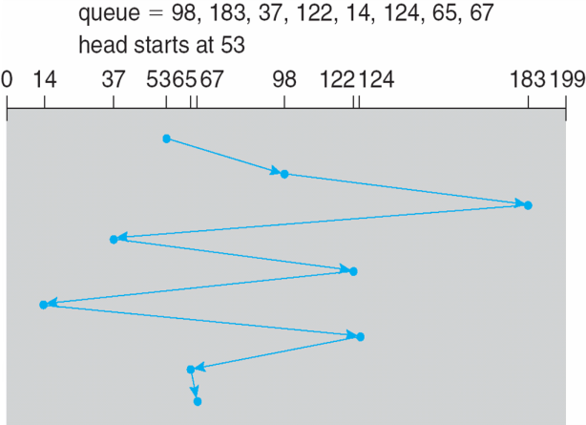
FCFS
Illustration shows total head movement of 640 cylinders

Slide 12
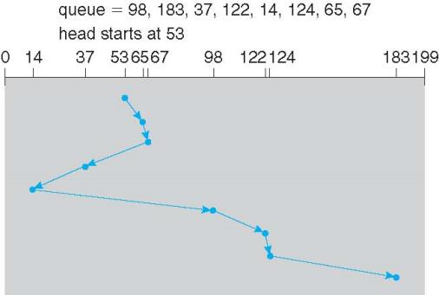
SSTF
Shortest Seek Time First selects the request with the minimum seek time from the current head position
SSTF scheduling is a form of SJF scheduling; may cause starvation of some requests
Illustration shows total head movement of 236 cylinders
Downsides?
What if cluster of requests at far side of disk?

Slide 13
SCAN
SCAN: move disk arm in one direction, until all requests satisfied, then reverse direction
Also called “elevator scheduling”

Slide 14
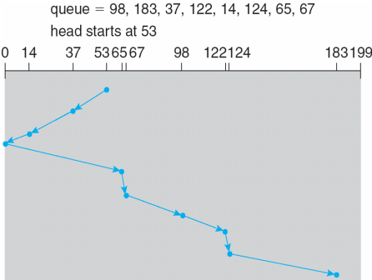
SCAN (cont.)
Illustration shows total head movement of 208 cylinders
But note that if requests are uniformly dense, largest density at other end of disk and those wait the longest

Slide 15
C-SCAN
C-SCAN: move disk arm in one direction, until all requests satisfied, then start again from farthest request
More uniform wait time than SCAN

Slide 16
C-LOOK
LOOK a version of SCAN, C-LOOK a version of C-SCAN
Arm only goes as far as the last request in each direction, then reverses direction immediately, without first going all the way to the end of the disk

Slide 17
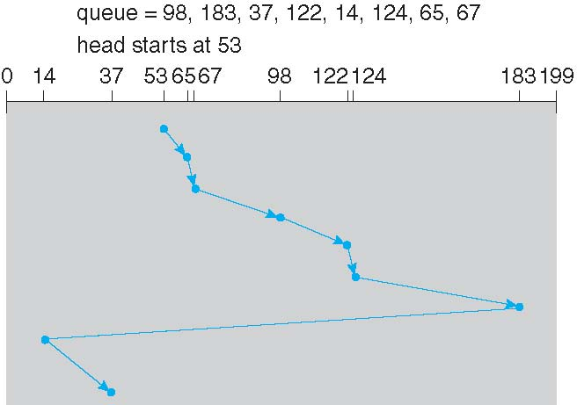
C-LOOK (Cont.)

Slide 18
Selecting a Disk-Scheduling Algorithm
SSTF is common and has a natural appeal
SCAN and C-SCAN perform better for systems that place a heavy load on the disk
Less starvation
Requests for disk service can be influenced by the file-allocation method
And metadata layout
The disk-scheduling algorithm should be written as a separate module of the operating system, allowing it to be replaced with a different algorithm if necessary
Either SSTF or LOOK is a reasonable choice for the default algorithm
What about scheduling on SSD?
FCFS—no seek time, rotational latency to worry about
Can improve performance by merging adjacent writes

Slide 19
Disk Management
Low-level formatting, or physical formatting — Dividing a disk into sectors that the disk controller can read and write
Each sector can hold header information, plus data, plus error correction code (ECC)
Usually 512 bytes of data but can be selectable
To use a disk to hold files, the operating system still needs to record its own data structures on the disk
Partition the disk into one or more groups of cylinders, each treated as a logical disk
Logical formatting or “making a file system”
To increase efficiency most file systems group blocks into clusters
Disk I/O done in blocks
File I/O done in clusters

Slide 20
Disk Management (Cont.)
Boot block initializes system
The bootstrap is stored in ROM
Bootstrap loader program stored in boot blocks of boot partition

Slide 21
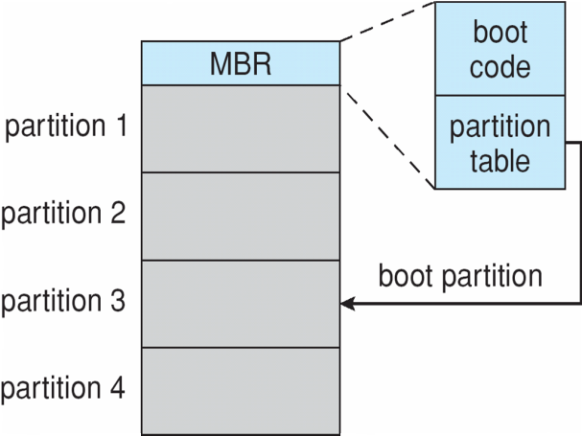
Booting from a Disk in Windows

Slide 22
File System Abstraction
File system: data structure stored on persistent medium
Persistent, named data
Hierarchical organization (directories, subdirectories)
Access control on data
File: named collection of data
Linear sequence of bytes (or a set of sequences)
Read/write or memory mapped
Crash and storage error tolerance
Operating system crashes (and disk errors) leave file system in a valid state
Performance
Achieve close to the hardware limit in the average case

Slide 23
File System Workload
How are files used?
Most files are read/written sequentially
Some files are read/written randomly
Ex: database files, swap files
Some files have a pre-defined size at creation
Some files start small and grow over time
Ex: program stdout, system logs

Slide 24
File System Design
For small files:
Small blocks for storage efficiency
Concurrent ops more efficient than sequential
Files used together should be stored together
For large files:
Storage efficient (large blocks)
Contiguous allocation for sequential access
Efficient lookup for random access
May not know at file creation
Whether file will become small or large
Whether file is persistent or temporary
Whether file will be used sequentially or randomly

Slide 25
File System Abstraction
Directory
Group of named files or subdirectories
Mapping from file name to file metadata location
Path
String that uniquely identifies file or directory
Ex: /cse/www/education/courses/cse451/12au
Links
Hard link: link from name to metadata location
Soft link: link from name to alternate name
Mount
Mapping from name in one file system to root of another

Slide 26
File System Interface
UNIX file open is a Swiss Army knife:
Open the file, return file descriptor
Options:
if file doesn’t exist, return an error
If file doesn’t exist, create file and open it
If file does exist, return an error
If file does exist, open file
If file exists but isn’t empty, nix it then open
If file exists but isn’t empty, return an error
…

Slide 27
Final notes
Next time: Continue with file systems

Slide 28
Acknowledgements
These slides are adapted from the following sources:
Silberschatz, Galvin, & Gagne, Operating Systems Concepts, 9th edition
Anderson & Dahlin, Operating Systems: Principles and Practice, 2nd edition
Chen & Madhyastha, EECS 482 lecture notes, University of Michigan, Fall 2016

