Slide 1
EECE.4810/EECE.5730 Operating Systems
Instructor:
Dr. Michael Geiger
Spring 2017
Lecture 14:
File systems: file concepts

Slide 2
Lecture outline
Announcements/reminders
Final Exam time scheduled by registrar: Saturday, 5/6, 8-11 AM
Today’s lecture
Review
Mass storage
File system intro
File concepts

Slide 3
Review: Storage Devices
Magnetic disks
Performance takes into account:
Seek time: time for head to move from track to track
Rotation time: time for platter to turn to appropriate sector
Transfer time: time to read one sector
Mechanical nature makes random access slow, streaming access faster
Disk scheduling reduces overhead for multiple requests
FCFS: first-come, first-served
SSTF: order requests based on seek time
SCAN / C-SCAN: move disk arm in one direction, then back
Go all the way to inner/outer tracks
SCAN reads both directions; C-SCAN reads in one
LOOK / C-LOOK: like SCAN / C-SCAN, but stop at innermost / outermost request
Solid state disks
Faster, require no scheduling (other than FCFS)
More expensive, shorter lifetime than magnetic disk

Slide 4
Review: File System Abstraction
File system: data structure stored on persistent medium with two distinct parts
Files: named collection of persistent data + access control
Directory structure: hierarchical organization of files
Crash and storage error tolerance
Operating system crashes (and disk errors) leave file system in a valid state
Performance
Achieve close to hardware limit in the average case

Slide 5
File ADT
File: unit of logical storage
Abstract away low-level details of storage device
Contiguous logical address space
Generally, files store one of two types of info
Data (numeric, character, binary)
Program
Mapped to disk blocks (sectors)
Smallest unit of disk access usually 1 sector
Internal fragmentation common: why?
Wasted space at end of last sector

Slide 6
File structures
Types defined by structure
Text file: set of characters organized into lines
Source file: set of functions
Executable file: code loader can bring into memory and run
More specific types determined by file extensions
Creating application may be stored with file
May be strictly enforced by OS (Mac OS) or simply used as hints (UNIX)
Structure often imposed by application, not OS
What’s downside of OS directly supporting many structures?
OS complex, slow; files may be required to match OS structure
At a minimum, what file type/structure must OS support?
Executable files so system can run/load program
Other files can be represented as raw data; interpreted by app
Control characters can simulate more restrictive types

Slide 7
File attributes
File system tracks attributes within directory structure
Name: only info kept in human-readable form
Identifier: unique number identifies file within file system
Type: needed for systems that support different types
Location: pointer to file location on device
Size: current file size
Protection: controls who can do reading, writing, executing
Time, date, and user identification: data for protection, security, and usage monitoring
Many variations, including extended file attributes such as file checksum
Directory structure kept on disk

Slide 8
File Operations
Operations provide programmer interface to file system
What operations should file system provide?
Create
Write – at write pointer location
Read – at read pointer location
Reposition within file - seek
Delete
Truncate – remove some data from file without deleting entire file
Open(F_{i}) – search the directory structure on disk for entry F_{i}, and move the content of entry to memory
Close (F_{i}) – move the content of entry Fi in memory to directory structure on disk

Slide 9
Working with open files
Open-file table: tracks open files
Should table be kept on per-user basis or centrally?
Central table: easier to manage removal of table entries if multiple readers
Per-user table: easier to track position of multiple readers
Solution: some information kept on per-process basis, other info kept in single system-wide table
Per-process info
File pointer: pointer to last read/write location
Access rights: operations allowed by this process
Centralized info
File-open count: number of processes accessing file
Table entry can be removed when count == 0
Disk location of the file: cache of data access information

Slide 10
File accesses
Sequential access
Information processed in order
Most common access mode (e.g. editors, compilers)
Read or write operations access file, then increment file pointer
File pointer can be reset to beginning
Direct (relative) access
File contains fixed-length logical records
Operations must specify block number, -or- position operation must be done before read/write
Block numbers relative to start of file
Easier to build other methods on top of this method
Example: indexed files—direct access to index file, which contains pointers to blocks with related data

Slide 11
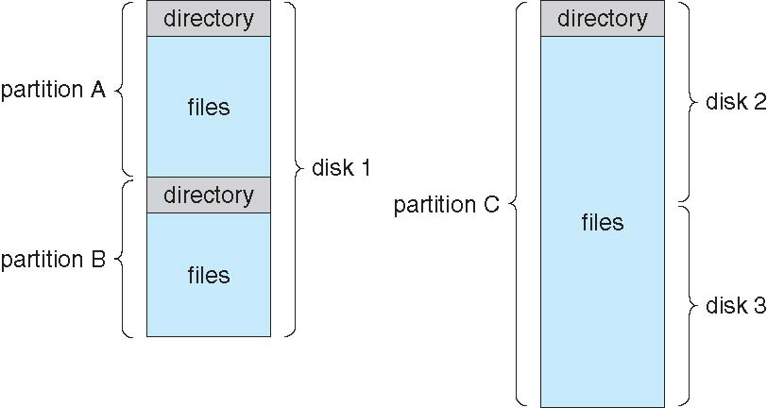
Directory structure
Disk can be split into multiple partitions
Partitions can be raw (no file system) or formatted
Volume: formatted partition (e.g., C:\ on Windows)
Each volume needs its own directory
Effectively table of contents for volume
Tracks information about all files on volume
Imposes hierarchical structure in flat space

Slide 12
Directory operations
Directory essentially symbol table that translates names into entries
What operations should be supported?
Search for file
May include finding all files with names matching pattern
Create file
Delete file
List contents of directory
Rename file
Traverse file system (go through sub-directories)

Slide 13
Directory Organization
Goals of directory organization
Efficiency – locating a file quickly
Naming – convenient to users
Two users can have same name for different files
The same file can have several different names
Grouping – logical grouping of files by properties, (e.g., all Java programs, all games, …)

Slide 14
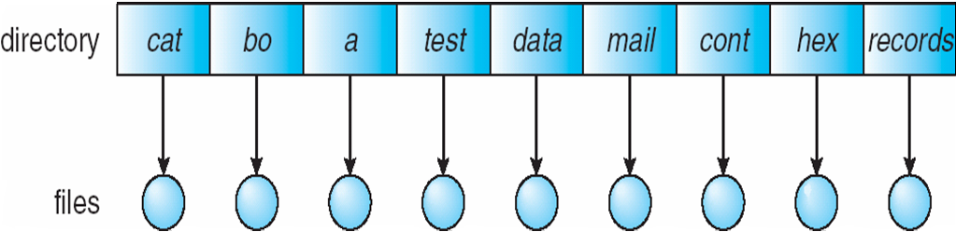
Single-Level Directory
A single directory for all users
What potential naming issues arise?
Hard to identify unique names, particularly with multiple users
What potential grouping issues arise?
With all files at same “level,” hard to create groups within a single level

Slide 15
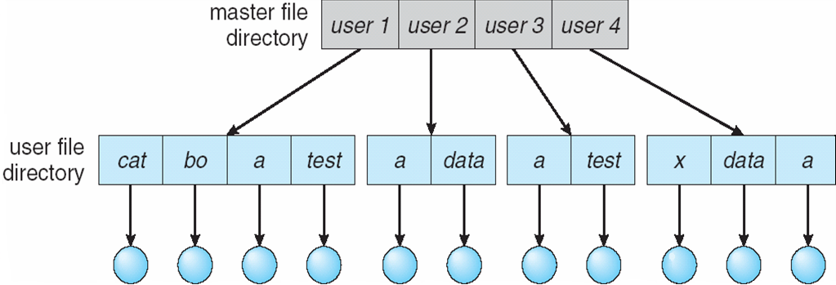
Two-Level Directory
Separate directory for each user
User name + file name = path name (e.g., /user 1/cat)
Additional info needed for volume (e.g., C:\user 2\data)
Can have the same file names for different user
Efficient searching (search on per-user basis only)
Still no grouping capability

Slide 16
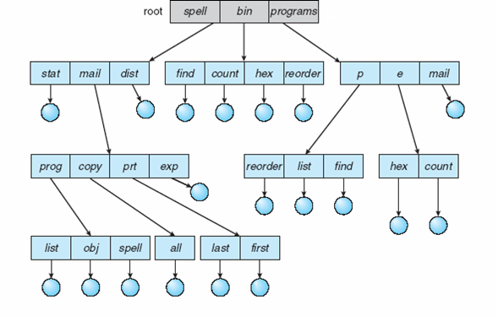
Tree-Structured Directories

Slide 17
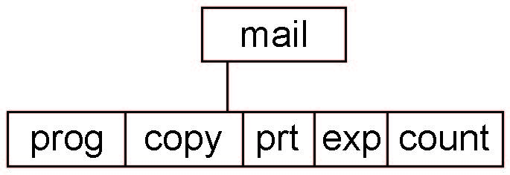
Tree-Structured Directories (Cont)
Absolute or relative path name
Absolute name is full path
Relative name—relative to current subdirectory or some other subdirectory
Creating a new file is done in current directory
Delete a file
rm <file-name>
Creating a new subdirectory is done in current directory
mkdir <dir-name>
Example: if in current directory /mail
mkdir count
Deleting “mail” ⇒ deleting the entire subtree rooted by “mail”

Slide 18
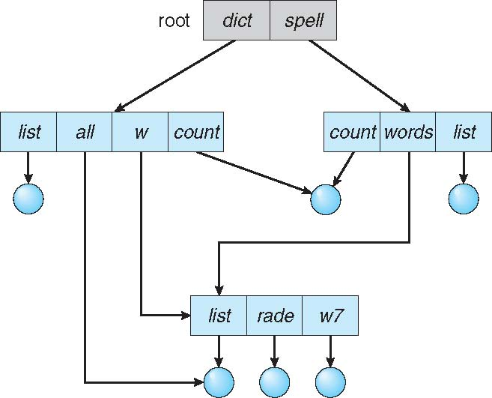
Acyclic-Graph Directories
Have shared subdirectories and files

Slide 19
Acyclic-Graph Directories (Cont.)
Two different names (aliasing)
If dict deletes list ⇒ dangling pointer
Solutions:
Backpointers, so we can delete all pointers Variable size records a problem
Backpointers using a daisy chain organization
Entry-hold-count solution
New directory entry type
Link – another name (pointer) to an existing file
Resolve the link – follow pointer to locate the file

Slide 20
File Sharing
Sharing of files on multi-user systems is desirable
Sharing may be done through a protection scheme
On distributed systems, files may be shared across a network
Network File System (NFS) is a common distributed file-sharing method
If multi-user system
User IDs identify users, allowing permissions and protections to be per-user Group IDs allow users to be in groups, permitting group access rights
Owner of a file / directory
Group of a file / directory

Slide 21
File Sharing – Remote File Systems
Uses networking to allow file system access between systems
Manually via programs like FTP
Automatically, seamlessly using distributed file systems
Semi automatically via the world wide web
Client-server model allows clients to mount remote file systems from servers
Server can serve multiple clients
Client and user-on-client identification is insecure or complicated
NFS is standard UNIX client-server file sharing protocol
CIFS is standard Windows protocol
Standard operating system file calls are translated into remote calls
Distributed Information Systems (distributed naming services) such as LDAP, DNS, NIS, Active Directory implement unified access to information needed for remote computing

Slide 22
File Sharing – Consistency Semantics
Specify how multiple users are to access a shared file simultaneously
Similar to Ch 5 process synchronization algorithms
Tend to be less complex due to disk I/O and network latency (for remote file systems
Andrew File System (AFS) implemented complex remote file sharing semantics
Unix file system (UFS) implements:
Writes to an open file visible immediately to other users of the same open file
Sharing file pointer to allow multiple users to read and write concurrently
AFS has session semantics
Writes only visible to sessions starting after the file is closed

Slide 23
Protection
File owner/creator should be able to control:
what can be done
by whom
Types of access
Read
Write
Execute
Append
Delete
List

Slide 24
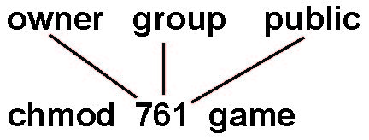
Access Lists and Groups
Mode of access: read, write, execute
Three classes of users on Unix / Linux
RWX
a) owner access 7 ⇒ 1 1 1 RWX
b) group access 6 ⇒ 1 1 0
RWX
c) public access 1 ⇒ 0 0 1
Ask manager to create a group (unique name), say G, and add some users to the group.
For a particular file (say game) or subdirectory, define an appropriate access.
Attach a group to a file chgrp G game

Slide 25
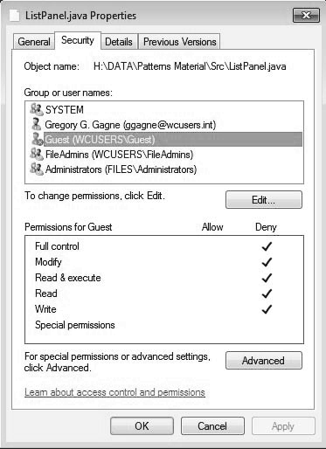
Windows 7 Access-Control List Management

Slide 26
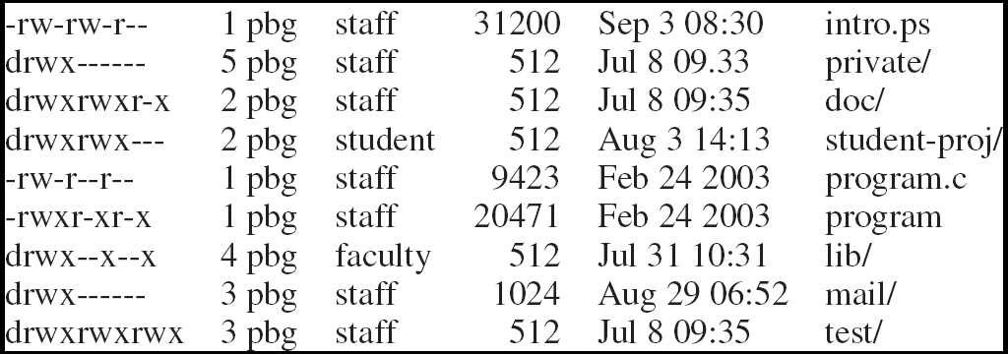
A Sample UNIX Directory Listing
Info generated using ls –l command
First column: access rights
d indicates directory
Followed by rights for user, group, others
Second column: # links/directories inside a directory
Third column: user ID (e.g., pbg)
Fourth column: group ID (e.g., staff)
Fifth column: file size in bytes
Directory size always 512 in this example—doesn’t show size of files inside
Sixth column: last date/time modified
Seventh column: file/directory name

Slide 27
File system issues to be discussed
How does the file system allocate space for a new file?
How do different allocation schemes affect the way files are accessed?
How does the file system store information about each file (metadata)?
What are the different types of file systems and how do they differ?

Slide 28
Final notes
Next time: File system implementation
Announcements/reminders
Final Exam time scheduled by registrar: Saturday, 5/6, 8-11 AM

Slide 29
Acknowledgements
These slides are adapted from the following sources:
Silberschatz, Galvin, & Gagne, Operating Systems Concepts, 9th edition
Anderson & Dahlin, Operating Systems: Principles and Practice, 2nd edition
Chen & Madhyastha, EECS 482 lecture notes, University of Michigan, Fall 2016

