Slide 1
EECE.4810/EECE.5730 Operating Systems
Instructor:
Dr. Michael Geiger
Spring 2017
Lecture 16:
File systems: implementation

Slide 2
Lecture outline
Announcements/reminders
Final Exam time scheduled by registrar: Saturday, 5/6, 8-11 AM
Today’s lecture
Review
File and directory concepts
File system implementation

Slide 3
Review: File details
File: unit of logical storage
Abstract away low-level details of storage device
Contiguous logical address space
Structure of file defines types
At a minimum, OS supports executable file
Other types usually imposed by applications
Text, source, etc.
Extensions → more detailed file typing
File system tracks file attributes (name, ID, type, file pointer, etc.)

Slide 4
Review: File Operations
Operations provide programmer interface to file system
What operations should file system provide?
Create
Write – at write pointer location
Read – at read pointer location
Reposition within file - seek
Delete
Truncate – remove some data from file without deleting entire file
Open(F_{i}) – search the directory structure on disk for entry F_{i}, and move the content of entry to memory
Close (F_{i}) – move the content of entry Fi in memory to directory structure on disk

Slide 5
Review: Working with open files
Open-file table: tracks open files
Per-process info
File pointer: pointer to last read/write location
Access rights: operations allowed by this process
Centralized info
File-open count: number of processes accessing file
Table entry can be removed when count == 0
Disk location of the file: cache of data access information
Accesses supported as sequential or direct (relative to start of file)

Slide 6
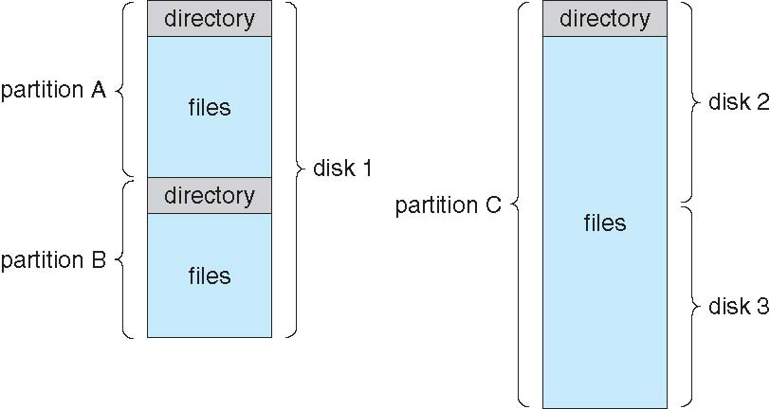
Review: Directory structure
Disk can be split into multiple partitions
Partitions can be raw (no file system) or formatted
Volume: formatted partition (e.g., C:\ on Windows)
Each volume needs its own directory
Effectively table of contents for volume
Tracks information about all files on volume
Imposes hierarchical structure in flat space

Slide 7
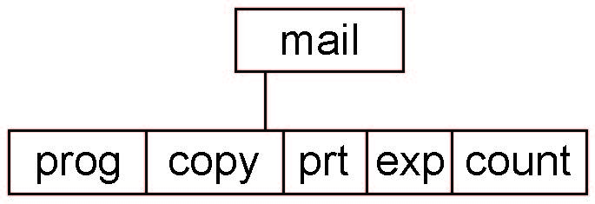
Review: Tree-Structured Directories
Absolute or relative path name
Absolute name is full path
Relative name—relative to current subdirectory or some other subdirectory
Creating a new file is done in current directory
Delete a file
rm <file-name>
Creating a new subdirectory is done in current directory
mkdir <dir-name>
Example: if in current directory /mail
mkdir count
Deleting “mail” ⇒ deleting the entire subtree rooted by “mail”

Slide 8
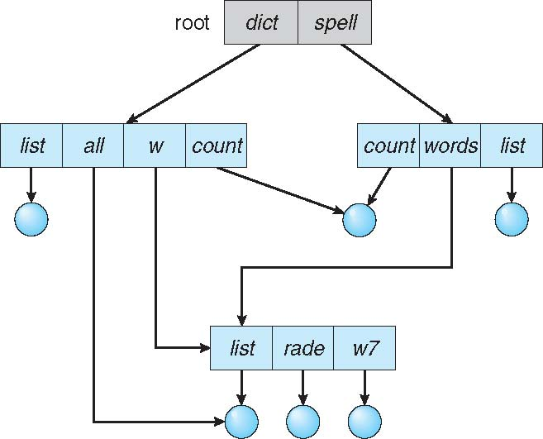
Acyclic-Graph Directories
Have shared subdirectories and files

Slide 9
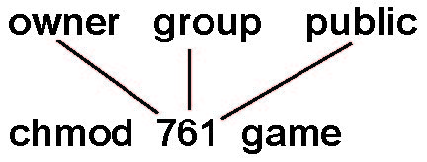
Review: Access Lists and Groups
Provides protection mechanism
Mode of access: read, write, execute
Three classes of users on Unix / Linux
RWX
a) owner access 7 ⇒ 1 1 1 RWX
b) group access 6 ⇒ 1 1 0
RWX
c) public access 1 ⇒ 0 0 1
Ask manager to create a group (unique name), say G, and add some users to the group.
For a particular file (say game) or subdirectory, define an appropriate access.
Attach a group to a file chgrp G game

Slide 10
File system issues to be discussed
How does the file system allocate space for a new file?
How do different allocation schemes affect the way files are accessed?
How does the file system store information about each file (metadata)?
What are the different types of file systems and how do they differ?

Slide 11
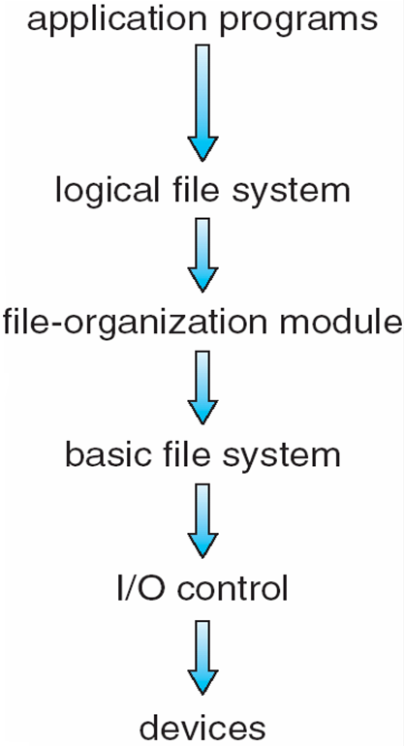
Layered File System
Device drivers manage I/O at I/O control layer
Takes device-specific commands (“read drive 1, cylinder 72, track 2, sector 10”)
Basic file system
Translates higher-level commands (“read block 123”) to device driver
Manages memory buffers/caches
Buffers: data in transit
Caches: frequently used data

Slide 12
Layered File System (continued)
File organization module handles files, logical addresses, physical block
Logical → physical translation
Manages free space and disk allocation
Logical file system handles metadata
File name → file #, file handle, location through file control blocks / inodes
Directory management
Protection

Slide 13
File-System Implementation
We have system calls at the API level, but how do we implement their functions?
On-disk and in-memory structures
Boot control block contains info needed by system to boot OS from that volume
Needed if volume contains OS, usually first block of volume
Volume control block (superblock, master file table) contains volume details
Total # of blocks, # of free blocks, block size, free block pointers or array
Directory structure organizes the files
Names and inode numbers, master file table

Slide 14
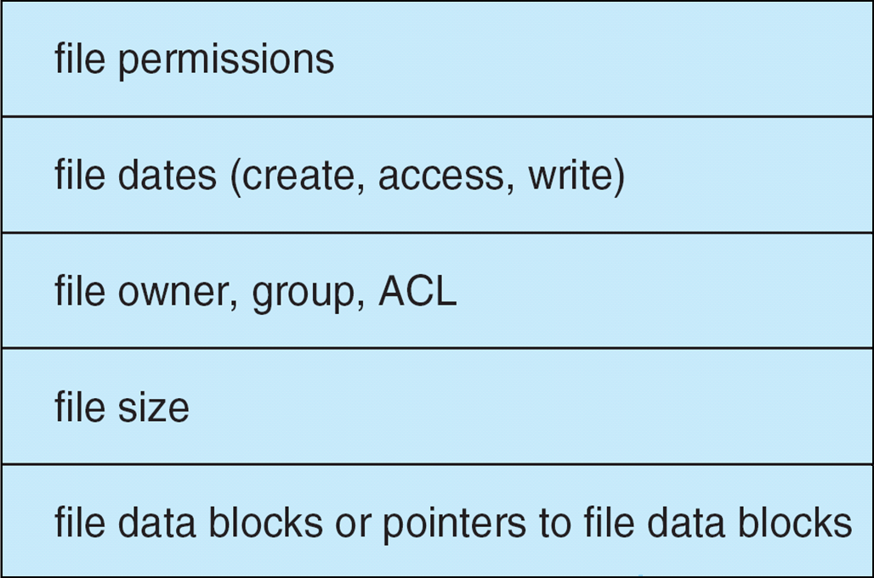
File-System Implementation (Cont.)
Per-file File Control Block (FCB) contains many details about the file
inode number, permissions, size, dates
NFTS stores into in master file table using relational DB structures

Slide 15
Directory Implementation
Linear list of file names with pointer to the data blocks
Simple to program
Time-consuming to execute
Linear search time
Could keep ordered alphabetically via linked list or use B+ tree
Hash Table – linear list with hash data structure
Decreases directory search time
Collisions – situations where two file names hash to the same location
Only good if entries are fixed size, or use chained-overflow method

Slide 16
Allocation Methods - Contiguous
An allocation method refers to how disk blocks are allocated for files:
Contiguous allocation – each file occupies set of contiguous blocks
Best performance in most cases
Simple – only starting location (block #) and length (number of blocks) are required
Problems include finding space for file, knowing file size, external fragmentation, need for compaction off-line (downtime) or on-line

Slide 17
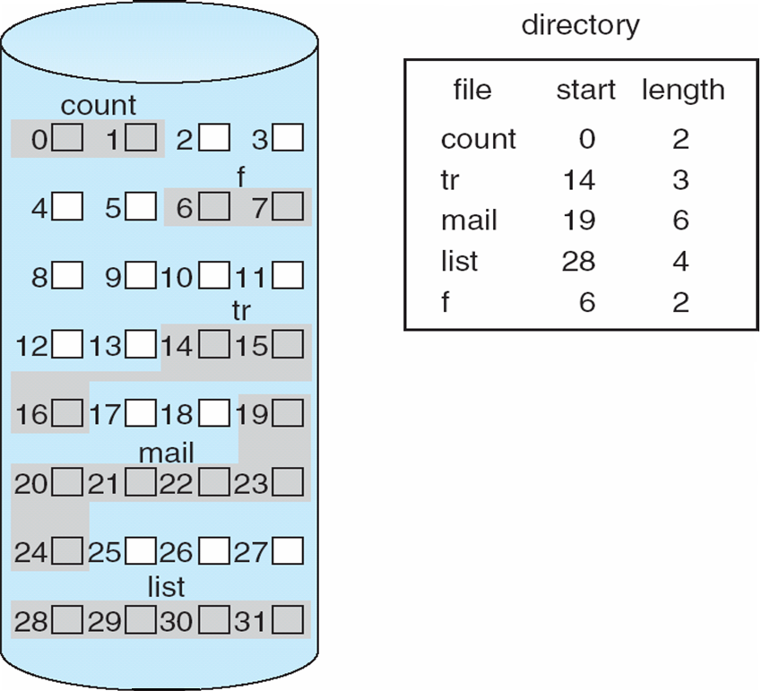
Contiguous Allocation
Mapping from logical to physical
Q
LA/512
R
Block to be accessed = Q + starting address
Displacement into block = R

Slide 18
Extent-Based Systems
Many newer file systems use a modified contiguous allocation scheme
Extent-based file systems allocate disk blocks in extents
An extent is a contiguous set of disk blocks
Extents are allocated for file allocation
A file consists of one or more extents
Each extent = location + block count

Slide 19
Allocation Methods - Linked
Linked allocation – each file a linked list of blocks
File ends at nullpointer
No external fragmentation
Each block contains pointer to next block
No compaction, external fragmentation
Free space management system called when new block needed
Improve efficiency by clustering blocks into groups but increases internal fragmentation
Reliability can be a problem
Locating a block can take many I/Os and disk seeks

Slide 20
Allocation Methods – Linked (Cont.)
FAT (File Allocation Table) variation
Beginning of volume has table, indexed by block number
Much like a linked list, but faster on disk and cacheable
New block allocation simple

Slide 21
Linked Allocation
Each file is a linked list of disk blocks: blocks may be scattered anywhere on the disk
block =
pointer
Mapping
Q
LA/511
R
Block to be accessed is the Qth block in the linked chain of blocks representing the file.
Displacement into block = R + 1

Slide 22
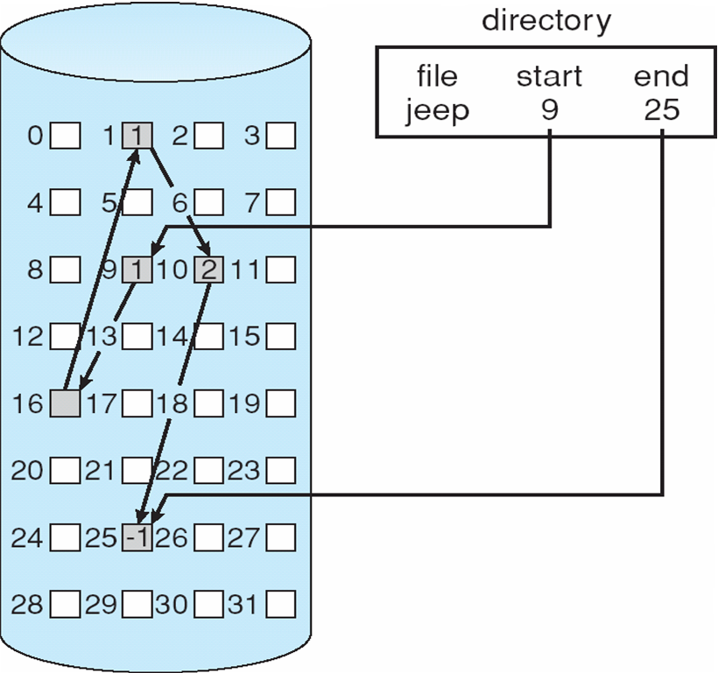
Linked Allocation

Slide 23
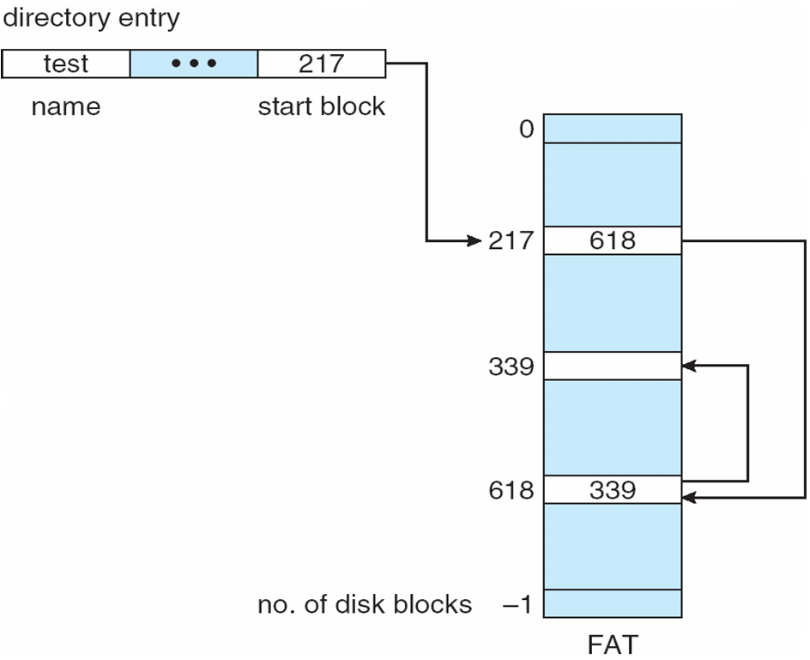
File-Allocation Table

Slide 24
Allocation Methods - Indexed
Indexed allocation
Each file has its own index block(s) of pointers to its data blocks
Logical view

Slide 25
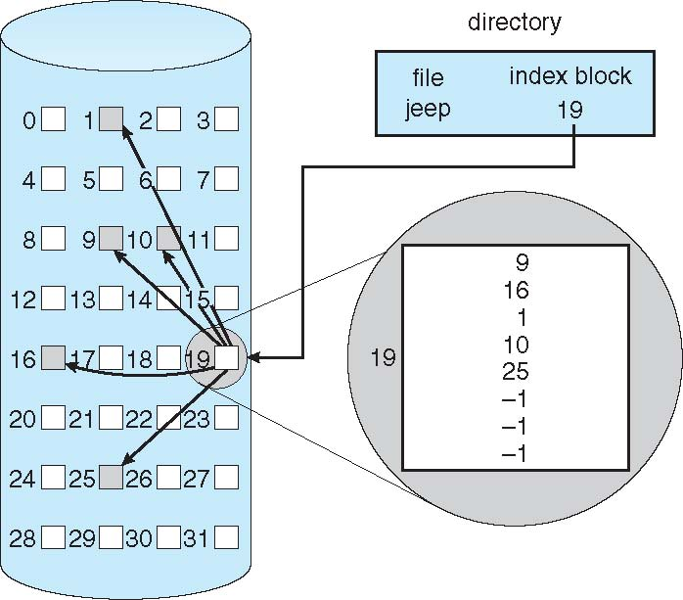
Example of Indexed Allocation

Slide 26
Indexed Allocation (Cont.)
Need index table
Random access
Dynamic access without external fragmentation, but have overhead of index block
Mapping from logical to physical in a file of maximum size of 256K bytes and block size of 512 bytes. We need only 1 block for index table
Q
LA/512
R
Q = displacement into index table
R = displacement into block

Slide 27
Indexed Allocation – Mapping (Cont.)
Mapping from logical to physical in a file of unbounded length (block size of 512 words)
Linked scheme – Link blocks of index table (no limit on size)
Q₁
LA / (512 x 511)
R₁
Q₁ = block of index table
R₁ is used as follows:
Q₂
R₁ / 512
R₂
Q₂ = displacement into block of index table
R₂ displacement into block of file:

Slide 28
Indexed Allocation – Mapping (Cont.)
Two-level index (4K blocks could store 1,024 four-byte pointers in outer index -> 1,048,567 data blocks and file size of up to 4GB)
Q₁
LA / (512 x 512)
R₁
Q₁ = displacement into outer-index
R₁ is used as follows:
Q₂
R₁ / 512
R₂
Q₂ = displacement into block of index table
R₂ displacement into block of file:

Slide 29
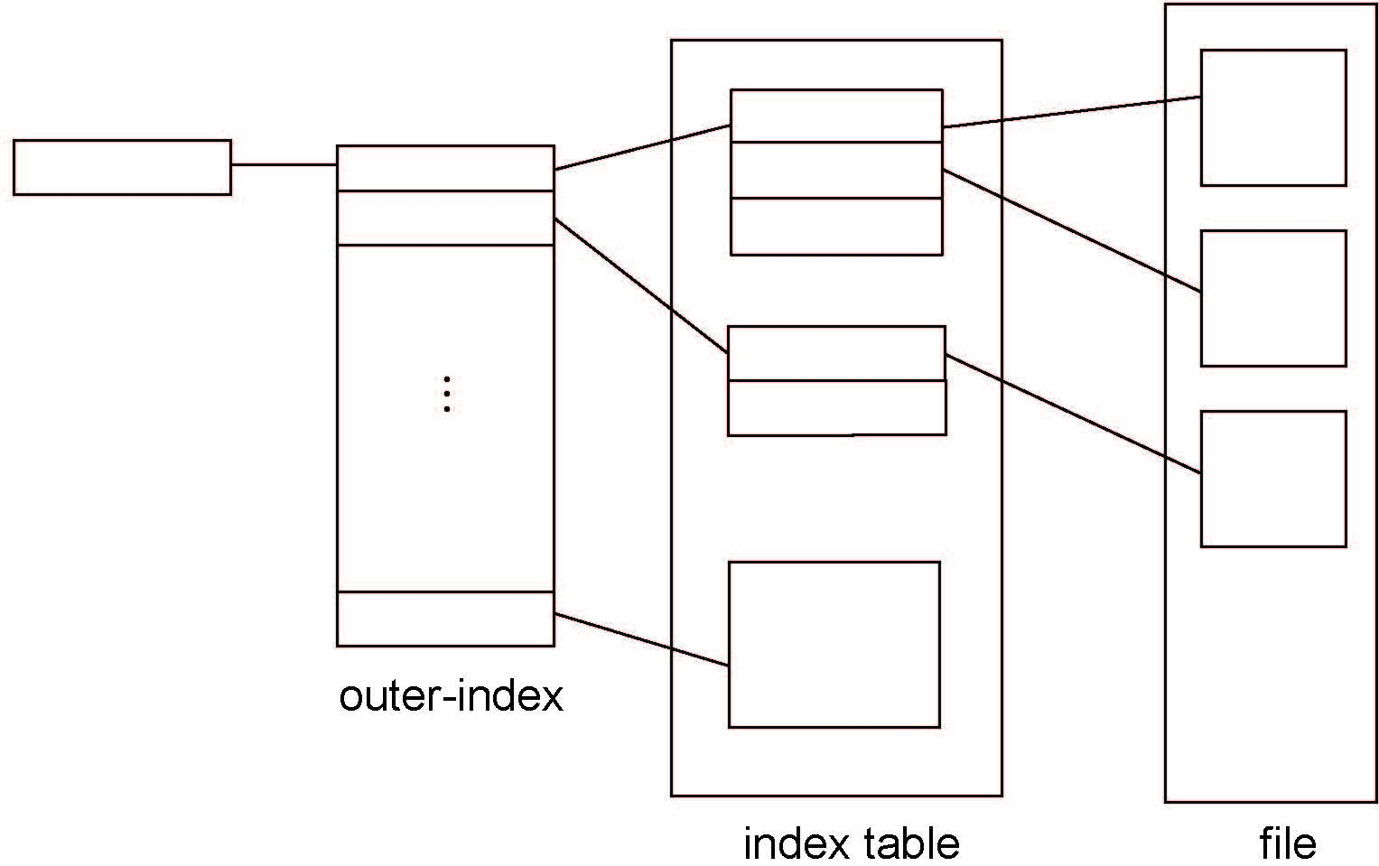
Indexed Allocation – Mapping (Cont.)

Slide 30
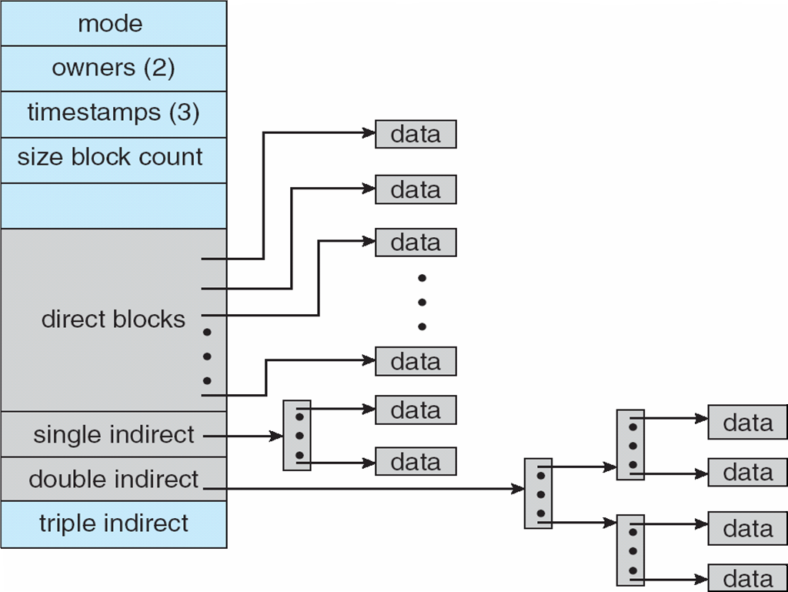
Combined Scheme: UNIX UFS
4K bytes per block, 32-bit addresses
More index blocks than can be addressed with 32-bit file pointer

Slide 31
Performance
Best method depends on file access type
Which scheme is best for sequential access?
Which scheme is best for random access?
Contiguous great for sequential and random
Linked good for sequential, not random
Declare access type at creation -> select either contiguous or linked
Indexed more complex
Single block access could require 2 index block reads then data block read
Clustering can help improve throughput, reduce CPU overhead

Slide 32
Free-Space Management
File system maintains free-space list to track available blocks/clusters
(Using term “block” for simplicity)
Bit vector or bit map (n blocks)
0
1
2
n-1
…
1 ⇒ block[i] free
0 ⇒ block[i] occupied
bit[i] =

Block number calculation
(number of bits per word) *
(number of 0-value words) +
offset of first 1 bit
CPUs have instructions to return offset within word of first “1” bit

Slide 33
Free-Space Management (Cont.)
Bit map requires extra space
Example:
block size = 4KB = 2¹² bytes
disk size = 2⁴⁰ bytes (1 terabyte)
n = 2⁴⁰/2¹² = 2²⁸ bits (or 32MB)
if clusters of 4 blocks -> 8MB of memory
Easy to get contiguous files

Slide 34
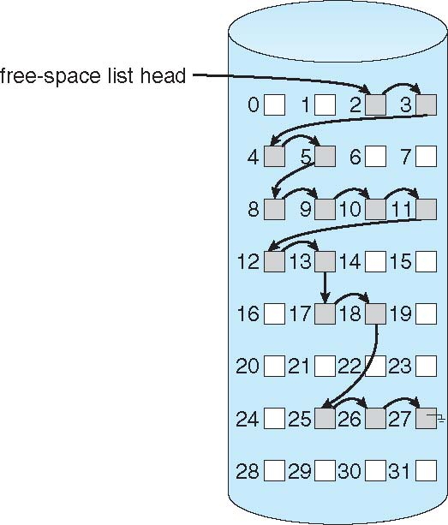
Linked Free Space List on Disk
Linked list (free list)
Cannot get contiguous space easily
No waste of space
No need to traverse the entire list (if # free blocks recorded)

Slide 35
Free-Space Management (Cont.)
Grouping
Modify linked list to store address of next n-1 free blocks in first free block, plus a pointer to next block that contains free-block-pointers (like this one)
Counting
Because space is frequently contiguously used and freed, with contiguous-allocation allocation, extents, or clustering
Keep address of first free block and count of following free blocks
Free space list then has entries containing addresses and counts

Slide 36
Free-Space Management (Cont.)
Space Maps
Used in ZFS
Consider meta-data I/O on very large file systems
Full data structures like bit maps couldn’t fit in memory -> thousands of I/Os
Divides device space into metaslab units and manages metaslabs
Given volume can contain hundreds of metaslabs
Each metaslab has associated space map
Uses counting algorithm
But records to log file rather than file system
Log of all block activity, in time order, in counting format
Metaslab activity -> load space map into memory in balanced-tree structure, indexed by offset
Replay log into that structure
Combine contiguous free blocks into single entry

Slide 37
Final notes
Next time: more on file system implementation
Announcements/reminders
Final Exam time scheduled by registrar: Saturday, 5/6, 8-11 AM

Slide 38
Acknowledgements
These slides are adapted from the following sources:
Silberschatz, Galvin, & Gagne, Operating Systems Concepts, 9th edition
Anderson & Dahlin, Operating Systems: Principles and Practice, 2nd edition
Chen & Madhyastha, EECS 482 lecture notes, University of Michigan, Fall 2016

