Slide 1
EECE.4810/EECE.5730 Operating Systems
Instructor:
Dr. Michael Geiger
Spring 2017
Lecture 17:
File systems: examples; reliability

Slide 2
Lecture outline
Announcements/reminders
Final Exam time scheduled by registrar: Saturday, 5/6, 8-11 AM
Today’s lecture
Review
File system implementation
File system examples
I/O systems

Slide 3
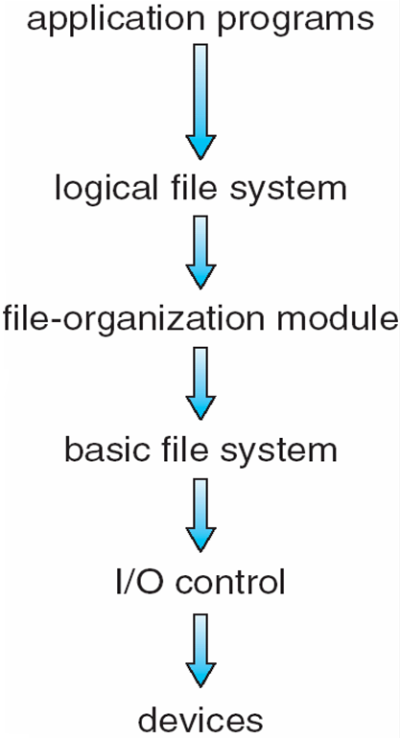
Review: file system layers
Device drivers manage I/O at I/O control layer
Basic file system translates higher-level commands to device driver
File organization module handles files, logical addresses, physical block
Logical file system handles metadata

Slide 4
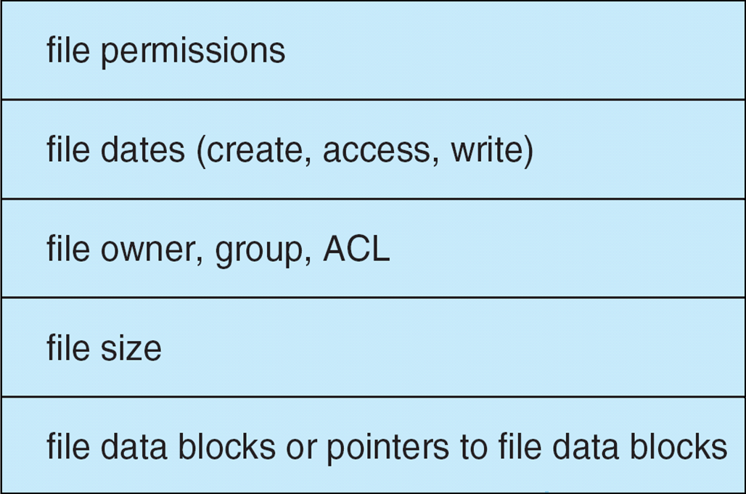
Review: file control blocks
Per-file File Control Block (FCB) contains many details about the file
inode number, permissions, size, dates
NTFS stores into in master file table using relational DB structures

Slide 5
FINISH REVIEW SLIDES—EVERYTHING AFTER THIS UP TO FS EXAMPLES NEEDS TO TURN INTO A REVIEW SLIDE!!!

Slide 6
Review: Allocation Methods
Contiguous allocation – each file occupies set of contiguous blocks
+ Simple, best performance in many cases
- Finding space (first fit/best fit/worst fit), knowing file size, external fragmentation, need compaction
Extent-based systems: modified contiguous alloc.
Extent = contiguous set of disk blocks
File = 1+ extents
Linked allocation – each file a linked list of blocks
+ No external fragmentation, compaction
- Slow block access; can improve by clustering blocks, but that increases internal fragmentation
File allocation table: modified linked allocation
Indexed allocation
Each file has its own index block(s) of pointers to its data blocks
Can have multi-level indexes to save space
Cluster blocks to improve performance

Slide 7
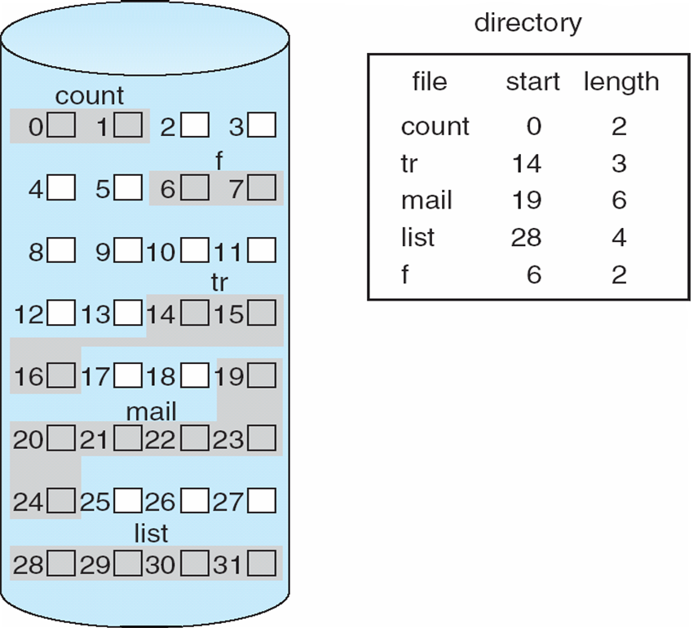
Review: Contiguous Allocation
Mapping from logical to physical
Q
LA/512
R
Block to be accessed = Q + starting address
Displacement into block = R

Slide 8
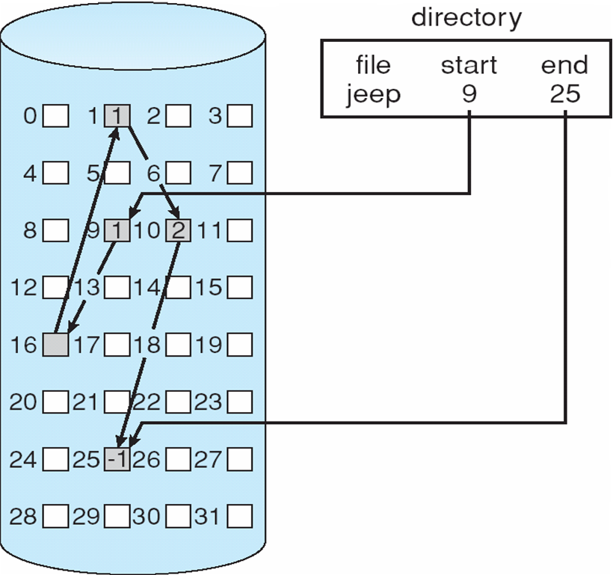
Review: Linked Allocation

Slide 9
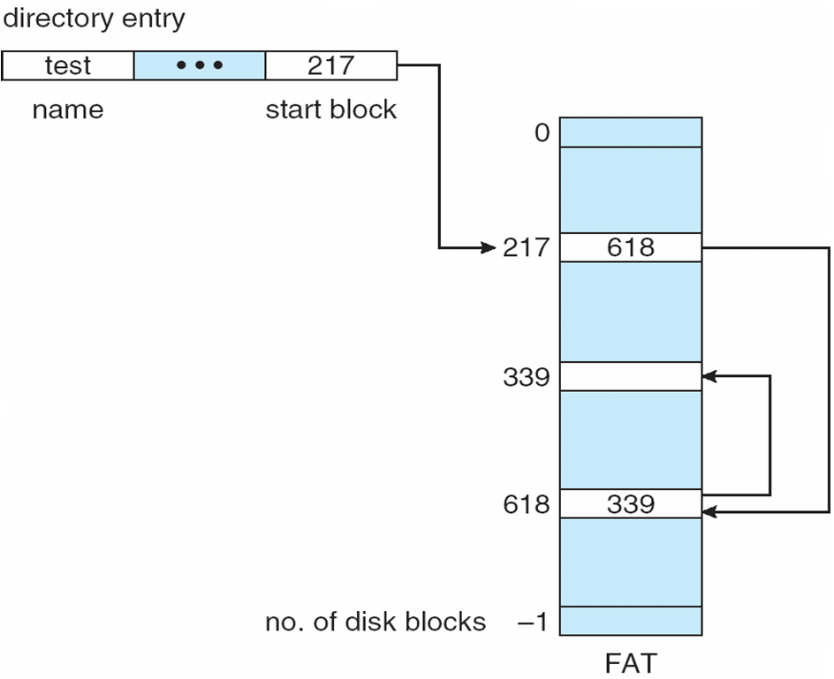
Review: File-Allocation Table

Slide 10
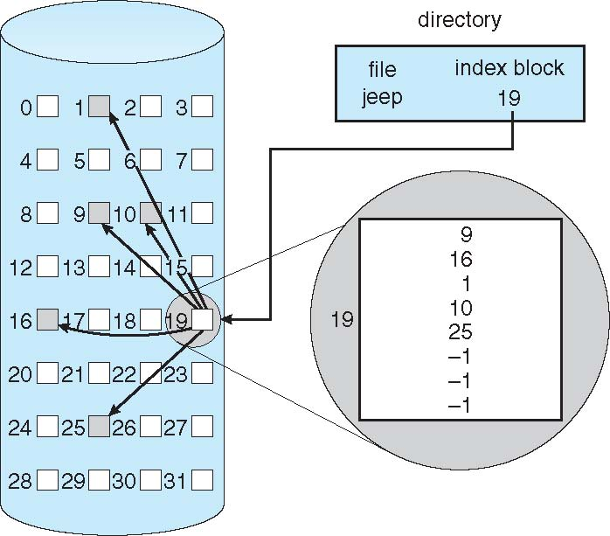
Review: Indexed allocation

Slide 11
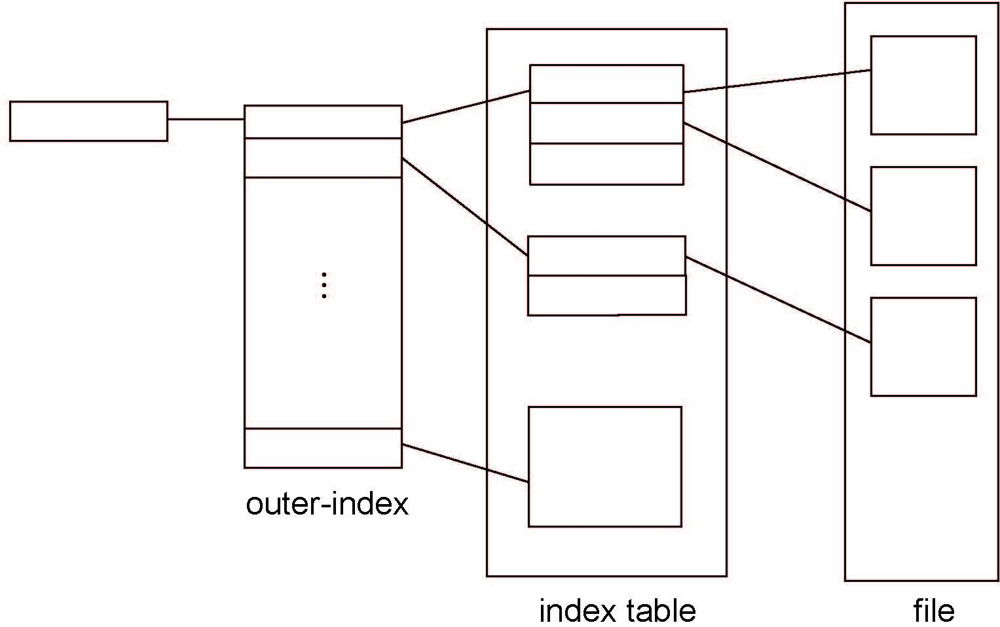
Review: multi-level indexed allocation

Slide 12
Review: Free-space management
File system maintains free-space list to track available blocks/clusters
Bit vector or bit map (n blocks)
0
1
2
n-1
…
1 ⇒ block[i] free
0 ⇒ block[i] occupied
bit[i] =

Block number calculation
(number of bits per word) *
(number of 0-value words) +
offset of first 1 bit
CPUs have instructions to return offset within word of first “1” bit

Slide 13
Free-Space Management (Cont.)
File system maintains free-space list to track available blocks/clusters
Bit vector or bit map (n blocks)
Bit i = 1 if block i free; 0 if occupided
+ Easy to get contiguous files
- Bit map requires extra space

Slide 14
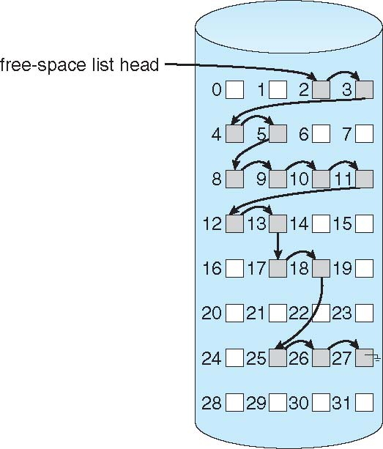
Linked Free Space List on Disk
Linked list (free list)
Cannot get contiguous space easily
No waste of space
No need to traverse the entire list (if # free blocks recorded)

Slide 15
Free-Space Management (Cont.)
Grouping
Modify linked list to store address of next n-1 free blocks in first free block, plus a pointer to next block that contains free-block-pointers (like this one)
Counting
Because space is frequently contiguously used and freed, with contiguous-allocation allocation, extents, or clustering
Keep address of first free block and count of following free blocks
Free space list then has entries containing addresses and counts

Slide 16
Free-Space Management (Cont.)
Space Maps
Used in ZFS
Consider meta-data I/O on very large file systems
Full data structures like bit maps couldn’t fit in memory -> thousands of I/Os
Divides device space into metaslab units and manages metaslabs
Given volume can contain hundreds of metaslabs
Each metaslab has associated space map
Uses counting algorithm
But records to log file rather than file system
Log of all block activity, in time order, in counting format
Metaslab activity -> load space map into memory in balanced-tree structure, indexed by offset
Replay log into that structure
Combine contiguous free blocks into single entry

Slide 17
File system examples
Microsoft File Allocation Table
Berkeley Unix Fast File System
Microsoft NTFS

Slide 18
Microsoft File Allocation Table (FAT)
Linked list index structure
Simple, easy to implement
Still widely used (e.g., thumb drives)
File table:
Linear map of all blocks on disk
Each file a linked list of blocks

Slide 19
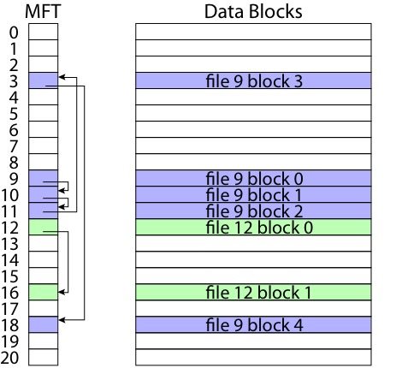
FAT

Slide 20
FAT
Pros:
Easy to find free block
Easy to append to a file
Easy to delete a file
Cons:
Small file access is slow
Random access is very slow
Fragmentation
File blocks for a given file may be scattered
Files in the same directory may be scattered
Problem becomes worse as disk fills

Slide 21
Berkeley UNIX FFS (Fast File System)
inode table
Analogous to FAT table
inode
Metadata
File owner, access permissions, access times, …
Set of 12 data pointers
With 4KB blocks => max size of 48KB files

Slide 22
FFS inode
Metadata
File owner, access permissions, access times, …
Set of 12 data pointers
With 4KB blocks => max size of 48KB files
Indirect block pointer
pointer to disk block of data pointers
Indirect block: 1K data blocks => 4MB (+48KB)

Slide 23
FFS inode
Metadata
File owner, access permissions, access times, …
Set of 12 data pointers
With 4KB blocks => max size of 48KB
Indirect block pointer
pointer to disk block of data pointers
4KB block size => 1K data blocks => 4MB
Doubly indirect block pointer
Doubly indirect block => 1K indirect blocks
4GB (+ 4MB + 48KB)

Slide 24
FFS inode
Metadata
File owner, access permissions, access times, …
Set of 12 data pointers
With 4KB blocks => max size of 48KB
Indirect block pointer
pointer to disk block of data pointers
4KB block size => 1K data blocks => 4MB
Doubly indirect block pointer
Doubly indirect block => 1K indirect blocks
4GB (+ 4MB + 48KB)
Triply indirect block pointer
Triply indirect block => 1K doubly indirect blocks
4TB (+ 4GB + 4MB + 48KB)

Slide 26
FFS Asymmetric Tree
Small files: shallow tree
Efficient storage for small files
Large files: deep tree
Efficient lookup for random access in large files
Sparse files: only fill pointers if needed

Slide 27
FFS Locality
Block group allocation
Block group is a set of nearby cylinders
Files in same directory located in same group
Subdirectories located in different block groups
inode table spread throughout disk
inodes, bitmap near file blocks
First fit allocation
Small files fragmented, large files contiguous

Slide 29
FFS First Fit Block Allocation

Slide 30
FFS First Fit Block Allocation

Slide 31
FFS First Fit Block Allocation

Slide 32
FFS
Pros
Efficient storage for both small and large files
Locality for both small and large files
Locality for metadata and data
Cons
Inefficient for tiny files (a 1 byte file requires both an inode and a data block)
Inefficient encoding when file is mostly contiguous on disk (no equivalent to superpages)
Need to reserve 10-20% of free space to prevent fragmentation

Slide 33
NTFS
Master File Table
Flexible 1KB storage for metadata and data
Extents
Block pointers cover runs of blocks
Similar approach in linux (ext4)
File create can provide hint as to size of file
Journalling for reliability
Will cover later

Slide 34
NTFS Small File

Slide 35
NTFS Medium-Sized File

Slide 36
NTFS Indirect Block

Slide 38
Named Data in a File System

Slide 39
Directories Are Files

Slide 40
Recursive Filename Lookup

Slide 41
Directory Layout
Directory stored as a file
Linear search to find filename (small directories)

Slide 42
Large Directories: B Trees

Slide 43
File caching
File systems store many data structures on disk
Data blocks
Directories
File headers (inodes)
Indirect blocks
Free lists
Improving storage performance
Layout data to reduce seek overhead
File caching
Memory throughput higher than sequential I/O
Significantly faster response time

Slide 44
File caching vs. virtual memory
Both use physical memory as “cache” for disk
VM: disk provides additional capacity for memory
File systems: memory provides faster access for disk
Both compete for physical memory

Slide 45
Memory-mapped files
Map file into virtual address space, then point backing store for that part of address space at file’s data blocks
Can improve performance of file I/O
Basic memory accesses vs. system calls
Demand paging supports only bringing necessary part of file into memory
Common uses
Process loader: use memory-mapped file to bring executable into memory for execution
IPC: memory-mapped file mechanism allows easy creation of shared memory region

Slide 46
Multiple updates and reliability
Reliability major factor for file systems
Losing data (due to system crash, power outage, etc.) in process’s address space is not a problem
Losing data in file system is
Multi-step update is problem if crash in middle
Examples: what happens if crash between 1 & 2?
Transferring money
Deduct $100 from Alice
Add $100 to Bob
Moving file from one directory to another
Delete file from old directory
Add file to new directory
Create new file
Update directory to point to new file header
Write new file header to disk

Slide 47
Transactions
Commonly used in databases, file systems
Key points for file systems: atomicity and durability (all or nothing)
Example:
begin transaction
write disk
write disk
write disk
end (“commit” transaction)
HW: atomic operation is single sector write
Need method for making sequence of sector updates atomic

Slide 48
Transactions with shadowing
Keep 2 copies of file system (old/new)
Store persistent pointer to current version
Write updates to new version
Switch pointer to commit changes
Writing single sector (the one holding pointer) makes series of changes permanent
Optimizations
Don’t copy entire file system—copy only what you need to update (i.e., individual inode)

Slide 49
Transactions with logging
Write-ahead logging
Write new data to append-only log
Write commit sector to end of log to commit changes
Single-sector write makes changes permanent
Eventually, new data copied from log to in-place version of file system
Journalling: use logging for atomic updates to file metadata, not actual file data

Slide 50
Final notes
Next time: TBD
Announcements/reminders
Final Exam time scheduled by registrar: Saturday, 5/6, 8-11 AM

Slide 51
Acknowledgements
These slides are adapted from the following sources:
Silberschatz, Galvin, & Gagne, Operating Systems Concepts, 9th edition
Anderson & Dahlin, Operating Systems: Principles and Practice, 2nd edition
Chen & Madhyastha, EECS 482 lecture notes, University of Michigan, Fall 2016

