Slide 1
EECE.4810/EECE.5730 Operating Systems
Instructor:
Dr. Michael Geiger
Spring 2017
Lecture 19:
OS, networks, and distributed communication

Slide 2
Lecture outline
Announcements/reminders
HW 4 to be posted
Today’s lecture
Review
Reliability
OS & network

Slide 3
Review: File caching
Store currently active file blocks in memory
Memory throughput higher than sequential I/O
Significantly faster response time
Commonly done through memory-mapped files
Map file into virtual address space
Point backing store at disk blocks for file
Allows file accesses to be done using simple memory operations, not through overhead of system calls

Slide 4
Review: Reliability
Reliability major factor for file systems
Losing data (due to system crash, power outage, etc.) in process’s address space is not a problem
Losing data in file system is
Transactions: mechanism for making multi-step operation atomic
Atomic HW operation: single-sector write
2 common methods
Shadowing: maintain two copies of data to update (inode, file block) with pointer to “current” version, update “shadow” version, then change pointer
Logging: write data to append-only log + commit sector, replay log later to write changes into file system

Slide 5
OS network abstractions
Multiple computers connected via network → seen as single computer
Machine-to-machine communication → process-to-process communication
Unreliable, unordered delivery of finite messages → reliable, ordered delivery of byte stream

Slide 6
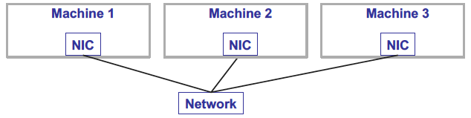
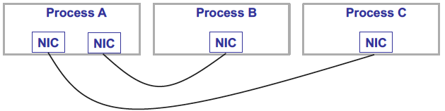
Networks: hardware vs. OS
Hardware reality
Abstracted OS view

Slide 7
Sockets
Process abstraction: each process behaves as if it has its own
Multiprocessor (threads)
Memory (address space)
Network interface cards (sockets)
Socket
Virtual network interface card
Named communication endpoint
NIC has MAC address; socket has port number
Programming interface (in Unix): BSD sockets

Slide 8
Sockets (continued)
Sockets implement client-server IPC model
Characteristics:
Accommodates multiple communication protocols (TCP/IP (Internet comm.) commonly used)
Server code waits for connections; client code initiates them
Support both connection-oriented and connectionless communications
While address typically bound to socket using open(), program can specify destination address instead

Slide 9
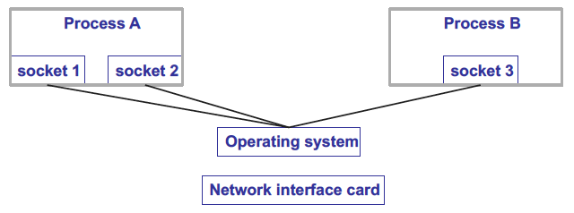
Sockets (continued)
OS multiplexes multiple sockets to single NIC
Common transport layer (process-to-process) protocols
UDP (user datagram protocol): IP + sockets, connectionless, “unreliable” transfers
TCP (transmission control protocol): IP + sockets + reliable, ordered streams

Slide 10
Ordered messages
HW interface: messages can be reordered by IP
Sender transmits A, B
Receiver gets B, A
Application interface: messages seen in order they’re sent
How?
Need notion of network “connection” (logical, not physical)
Messages sent over one connection related
Per-connection sequence number part of each message
TCP: process uses connect method to open connection, sends messages, then closes connection

Slide 11
Reliable messages
Network hardware can drop, duplicate, or corrupt messages
Application interface: each message delivered exactly once, without corruption
How are dropped messages fixed?
Retransmitted by sender once drop detected
How does sender know message was dropped?
Lack of acknowledgement from receiver

Slide 12
Reliable messages (cont.)
How are duplicates detected/dealt with?
Detect: matching sequence numbers
Deal with: drop duplicate message
How are corrupt messages detected/dealt with?
Detect: messages include redundant info (checksum)
Deal with: drop corrupt message
Messages are transformed
Corrupted messages → dropped messages
Potential drops → potential duplicates

Slide 13
Byte streams
Hardware interface: send/receive messages
Application interface: abstraction of data stream
TCP: Sender sends messages of arbitrary size, which are combined into single stream
Implementation
Break stream into fragments
Send fragments as separate messages
Reassemble fragments at destination

Slide 14
Client-server
Common distributed application structure
Server provides centralized service
Client makes request, then waits for response
Example: web server
Server stores, returns web pages
Clients run web browsers
Example: producer-consumer
Server manages state of coke machine
Clients call client_produce() or client_consume(), which send request to server and return when done
Client requests block at server until satisfied

Slide 15
Producer-consumer as client-server
client_produce() {
send produce request to server
wait for response
}
server() {
receive request
if (produce request)
add coke to machine
else
remove coke from machine
}
Problems?
What if machine is full/empty?

Slide 16
Producer-consumer as client-server
server() {
receive request
if (produce request)
create thread that calls server_produce()
else
create thread that calls server_consume()
}
server_produce() {
lock
while (machine is full) {
wait
}
put coke in machine
send response to client
unlock
}

Slide 17
Final notes
Next time: continue with network & OS discussion
Announcements/reminders
Final Exam time scheduled by registrar: Saturday, 5/6, 8-11 AM

Slide 18
Acknowledgements
These slides are adapted from the following sources:
Silberschatz, Galvin, & Gagne, Operating Systems Concepts, 9th edition
Anderson & Dahlin, Operating Systems: Principles and Practice, 2nd edition
Chen & Madhyastha, EECS 482 lecture notes, University of Michigan, Fall 2016

